Slide 1


ON THE ORIGIN
OF RELIGION
RESEARCH ARTICLE PRESENTATION
CHARLES L. HENNING · 1898
American Anthropologist, Vol. 11, No. 12, pp. 373–382
Notes:
Hello everyone. Today I'm going to present an article called "On the Origin of Religion". It was written by Charles L. Henning and published in the journal American Anthropologist in December 1898. So this article is more than 125 years old!
It tries to answer a very big question: where does religion come from? I will tell you who the author was, what question he asked, what evidence he used and what he concluded. Then I'll connect it to our course, share my own thoughts, and at the end we will discuss it together.

Slide 2
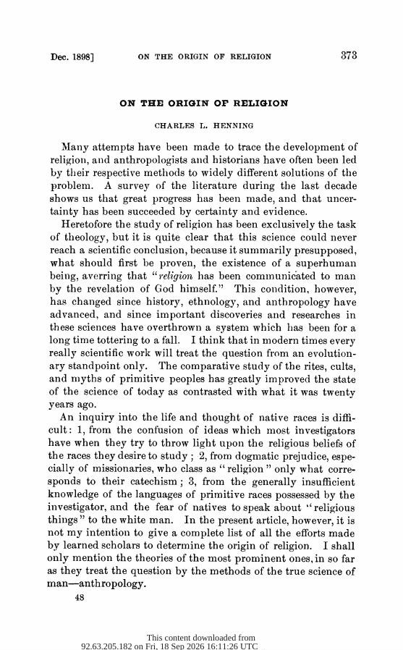



CONTEXT
The anthropologist
Charles L. Henning published this in American Anthropologist (1898), then the journal of the Anthropological Society of Washington. Little is known about his life.
The “field”: no fieldwork
An armchair study. Henning compared reports by missionaries, travellers and scholars on peoples in Africa, India and North America, and on ancient Egypt and Syria.
Why I chose this article
It asks one of the biggest questions of our topic, where religion comes from, and shows how anthropology worked at its very beginning.
Notes:
First, some context.
Charles L. Henning is not a famous name today, and I could not find much information about his life. Most of what we know comes from the article itself. He published it in American Anthropologist, which at that time was the journal of the Anthropological Society of Washington. His footnotes show that he read a lot of German scholarship.
Now, the important thing: Henning did not do fieldwork. He did not travel and live with the people he writes about. Instead, he compared reports written by missionaries, travellers and other scholars. We call this "armchair anthropology". So his "field" was really the library.
Why did I choose this article? Because it asks one of the biggest questions of our topic: why do humans have religion at all? And because it shows us what anthropology looked like at the very beginning, before fieldwork became the normal method.

Slide 3
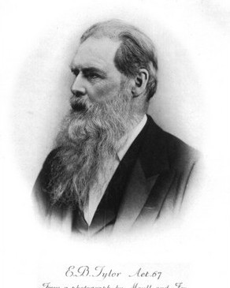
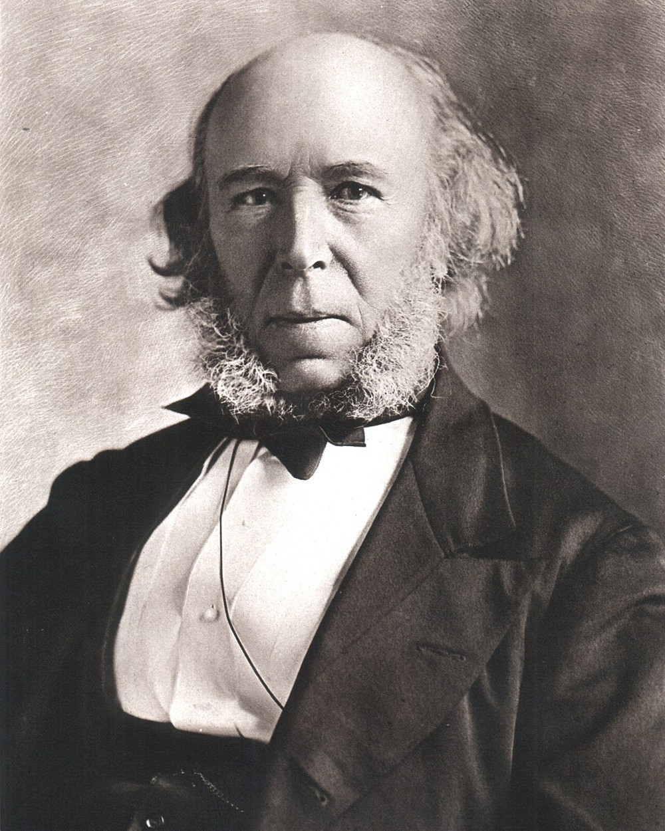
RESEARCH QUESTION
“How did primitive man obtain conceptions that we call ‘religious’?”
Henning, 1898, p. 376
THEORIES HE CHALLENGES
E. B. Tylor: animism, “the belief in spiritual beings”
J. Lippert: religion began as soul worship
H. Spencer: ancestor worship is the root of every religion
A. Lefèvre: “anthropism”: giving human qualities to nature
E. B. Tylor
Primitive Culture (1871)
Herbert Spencer
Principles of Sociology
His critique: a “soul” or “spirit” needs advanced thinking, so it cannot be the first step. And all these theories ignore one factor: economic conditions.
Notes:
So, what was his research question? In his own words: "How did primitive man obtain conceptions that we call religious?" By the way, "primitive" was a normal word in 1898. Today anthropologists avoid it.
Henning starts by reviewing the most important theories of his time. Edward Tylor said that the minimum definition of religion is "the belief in spiritual beings". This is the theory of animism. Julius Lippert said religion began with the worship of souls. Herbert Spencer said ancestor worship is the root of every religion. And the French scholar André Lefèvre talked about "anthropism": people giving human qualities to animals, objects and nature.
Henning respects these scholars, but he says they all share the same problem. Ideas like a "soul" or a "spirit" need a very developed way of thinking, so they cannot be the very first step. And, he says, all of them forgot one important factor: economic conditions. In other words, how people actually got their food and survived.

Slide 4
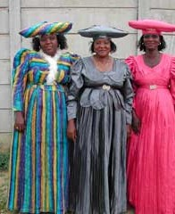

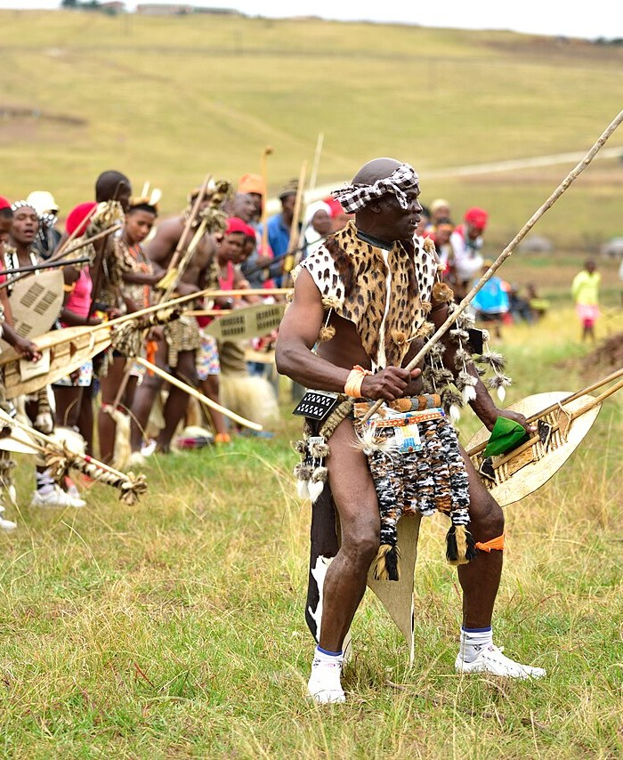
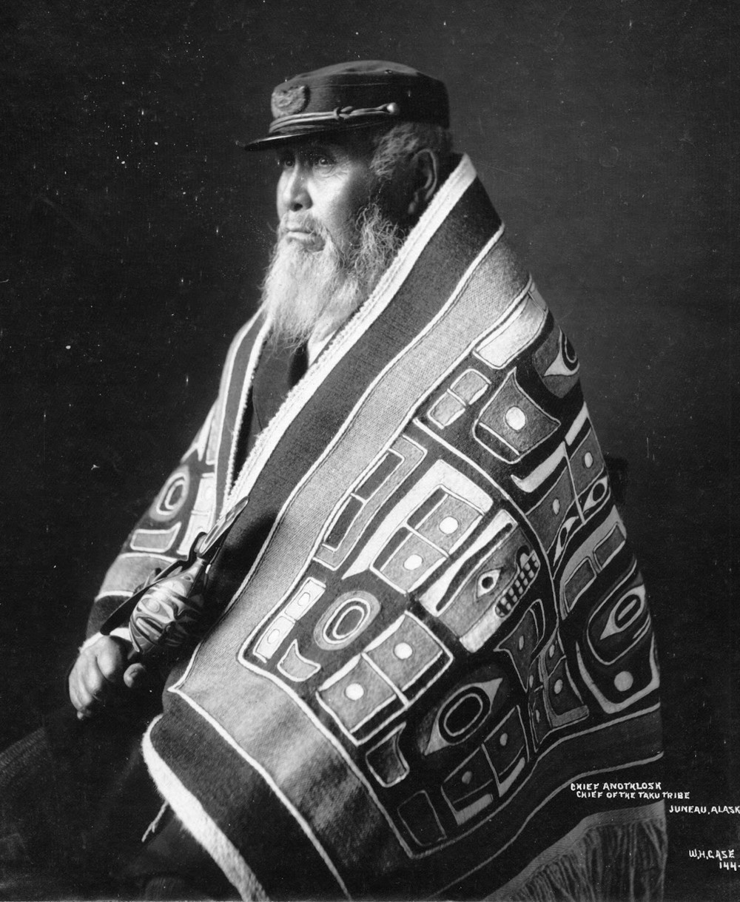
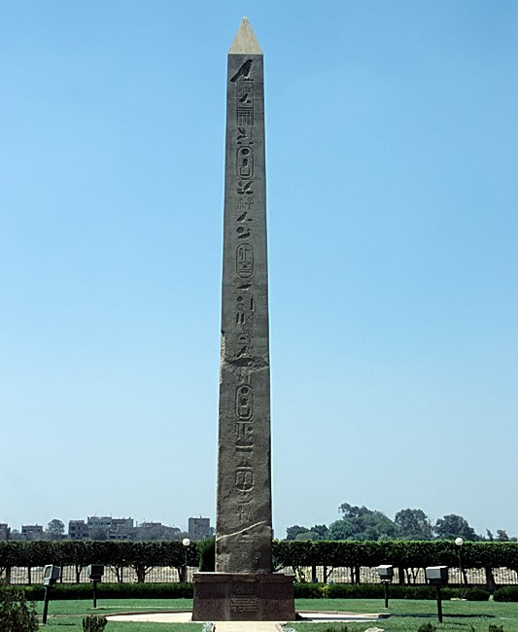
THE FIELD: PLACES IN HIS SOURCES
Herero · Namibia
San · Kalahari
Zulu · South Africa
Tlingit · NW Coast
Ancient Egypt
The chief’s grave is the most sacred place; people ask his soul for advice.
Prayer to Cagn: “Don’t you see our hunger? Give us to eat!”
Ancestors are worshipped; Unkulunkulu, “the Old, Old One”, was the first man.
The hero Yehl first taught them how to improve their life.
Osiris and Isis taught farming, bread-making and weaving.
Also used: the Khonds of Orissa (India), the Zuñi (New Mexico) and Baal in ancient Syria. Henning never visited these places; he read about them.
Notes:
These are the peoples and places that appear in Henning's evidence. Remember, he never visited them. He read about them.
Among the Herero of Namibia, the grave of a great chief was the most sacred place. People went there to ask the chief's soul for advice.
Among the San, also called "Bushmen", a prayer to Cagn says: "Are we not your children? Don't you see our hunger? Give us to eat!"
Among the Zulu of South Africa, people worshipped their ancestors, and Unkulunkulu, "the Old, Old One", was remembered as the first man.
The Tlingit of the north-west coast of North America remembered Yehl, a hero who first taught them how to improve their life.
And in ancient Egypt, Osiris and Isis were remembered as the ones who taught people farming, bread-making and weaving. This obelisk stands at Heliopolis, where the temple of the sun god Ra was.
He also uses examples from the Khonds in India, the Zuni in New Mexico and the god Baal in ancient Syria. His point is that all these prayers and stories are very practical. They are about food, safety and a better life.

Slide 5




FINDINGS I: ECONOMY COMES FIRST
“Primitive man had no religion.” Henning, 1898, p. 377
1 Survival
2 Solidarity
3 Settled life
4 Religion
All energy went into meeting daily needs.
Groups helped each other: a social morality, still without religion.
Language, a fixed home and property widened people’s world.
Only now could the “bud” of religion grow into a flower.
Key claim: religion is not an inborn “religious sentiment”. It developed later, out of economic and social life.
Notes:
So what did Henning conclude? His most surprising sentence is: "Primitive man had no religion." He means that humans were not born with religion. It developed later.
He tells the story in four steps. First, survival: early humans used all their energy just to stay alive. Second, solidarity: they lived in groups and helped each other, because alone they were weak. From this cooperation came a social morality, rules for living together. But, he says, this morality had nothing to do with religion yet. Third, settled life: with language, a settled home and property, people's world became bigger. And only then, in step four, could religion begin to grow. He uses the picture of a bud that slowly becomes a flower.
So, for Henning, economic and social life come first, and religion comes after.

Slide 6
FINDINGS II: FROM BENEFACTORS TO GODS
A few people improve the group’s life
Evidence in the prayers
Prayers ask for food, safety and good harvests. A Khond prayer (India) names “the connection between our wealth and your honor”.
After death: remembered as “heroes” or “benefactors”
His definition of religion
Ancestor worship
“The conception man forms of his relations to the superhuman and mysterious powers on which he believes himself to depend.” (p. 382)
Soul worship and later religion
Limits he admits
Not yet proven for all peoples; ethnographers usually stay only a short time with one group.
Root of it all: economic conditions
Notes:
But how exactly did religion appear? Henning says every person wants to improve their condition, but only a few people actually found a way to do it, for example, people who introduced farming or new tools. After they died, the group did not forget them. They were remembered as heroes or "benefactors". This respect turned into ancestor worship, and later into soul worship.
So he agrees with Lippert and Spencer that these are the first historical forms of religion. But he says the deeper root is economic.
The evidence is in the prayers. A Khond prayer from India even says it directly: "the connection between our wealth and your honor".
At the end he gives his own definition: religion is "the conception man forms of his relations to the superhuman and mysterious powers on which he believes himself to depend."
To be fair to him, Henning also admits the limits. He says he cannot yet prove this for all peoples, partly because ethnographers usually stay with a group only for a short time.

Slide 7




CONNECTION WITH OUR COURSE
Cultural evolutionism
Armchair vs. fieldwork
Like Tylor and Spencer, Henning imagines one ladder from “primitive” to “civilized”. Boas and later anthropologists rejected this model.
He used second-hand reports. Today we expect long-term fieldwork and participant observation: religion seen from the inside.
Ethnocentrism
Religion, economy & society
Words like “savage” and “primitive” judge others by Western standards. This shows why cultural relativism matters.
Ancestor veneration, morality and making a living are linked: religion can help a group survive and stay together.
Notes:
How does this connect to our course? I see four links.
First, cultural evolutionism. Like Tylor and Spencer, Henning imagines all humanity climbing one ladder from "primitive" to "civilized". Later anthropologists, especially Franz Boas and his students, rejected this one-line model.
Second, armchair anthropology versus fieldwork. Henning used second-hand reports. Today we expect long-term fieldwork and participant observation, so we can understand religion from the inside, from the people's own point of view.
Third, ethnocentrism. Words like "savage" and "primitive" judge other cultures by Western standards. Reading this article shows clearly why cultural relativism became so important.
And fourth, the link between religion, economy and society. Even if his history is too simple, his idea that religion is connected to how people make a living, to morality and to remembering ancestors is still useful. It is close to the functional view that religion helps a group survive and stay together.

Slide 8

MY REFLECTIONS & LET’S DISCUSS
MY REFLECTIONS
LET’S DISCUSS
Surprising: his confident claim that the first humans had no religion, with almost no direct evidence.
1. Think of a prayer, holiday or ritual in your culture. Is it linked to food, work or wealth? Is religion only about material needs?
2. Henning never met the people he wrote about. How might his ideas change after a year living with the Herero or the Zulu?
Pair activity (2 min): name someone honoured because they improved others’ lives. How is their memory kept? Is it “religious”?
Interesting: the prayers are so practical (“Give us to eat!”). Belief and everyday life are still linked today.
Learned: how far anthropology has come, from desk theories and “savages” to fieldwork and respect.
Notes:
Now my own reflections.
What surprised me most was how confident Henning is. He says "primitive man had no religion", but he has almost no direct evidence about the earliest humans.
What I found most interesting is how practical the prayers are: "Give us to eat!" Even today, many people pray before exams, for a good job or for a good harvest. And we still honour people who helped our community, at their graves, with monuments or with holidays. So the link between belief and everyday life still feels real to me.
What I learned is how much anthropology has changed: from theories written at a desk to fieldwork and respect for the people we study.
Now I would like to hear from you. Question one: think of a prayer, holiday or ritual from your own culture. Is it connected to food, work or wealth? And is religion only about material needs, or is it something more?
Question two: Henning never met the people he wrote about. How might his conclusions change if he had lived with the Herero or the Zulu for a year?
And if we have time, a short activity: with your partner, take two minutes and name a person who is remembered and honoured because they improved other people's lives. How is their memory kept? Is that "religious"?

Slide 9
REFERENCE
Henning, C. L. (1898). On the origin of religion. American Anthropologist, 11(12), 373–382. https://www.jstor.org/stable/658576
IMAGE CREDITS (WIKIMEDIA COMMONS)
Herero women, Windhoek: Bries, CC BY-SA 3.0
Namibian Bushmen girls: Velatrix, CC0
Zulu culture, KwaZulu-Natal: South African Tourism, CC BY 2.0
Chief Anotklosh, Taku Tlingit (c. 1913): W. H. Case, public domain
Obelisk of Senusret I, Heliopolis: Roland Unger, CC BY-SA 3.0
E. B. Tylor: CC BY-SA 3.0 · Herbert Spencer: Smithsonian Institution, no known restrictions
THANK YOU
Notes:
Here is the full reference for the article in APA format, together with the credits for the photographs I used. Thank you very much for listening!

