Slide 1
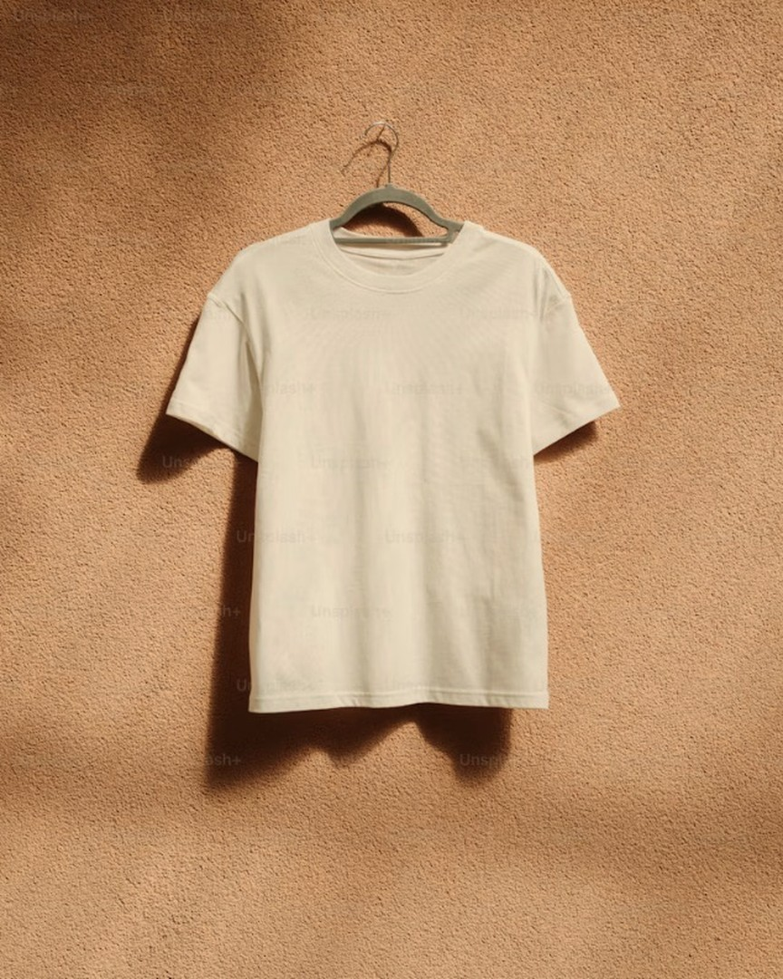

THE STORY OF YOUR OWN STUFF
The Story
of a T-Shirt
FROM FIELD TO LANDFILL
BEKZODJON KIRGIZBAYEV
SUST 1000 7T
03.11.2026
01 / 06
Notes:
Object: one plain cotton T-shirt
Angle: Uzbekistan, cotton country
Route: grow → make → wear → throw
Brief: EPA Ireland, The Story of Your Stuff

Slide 2
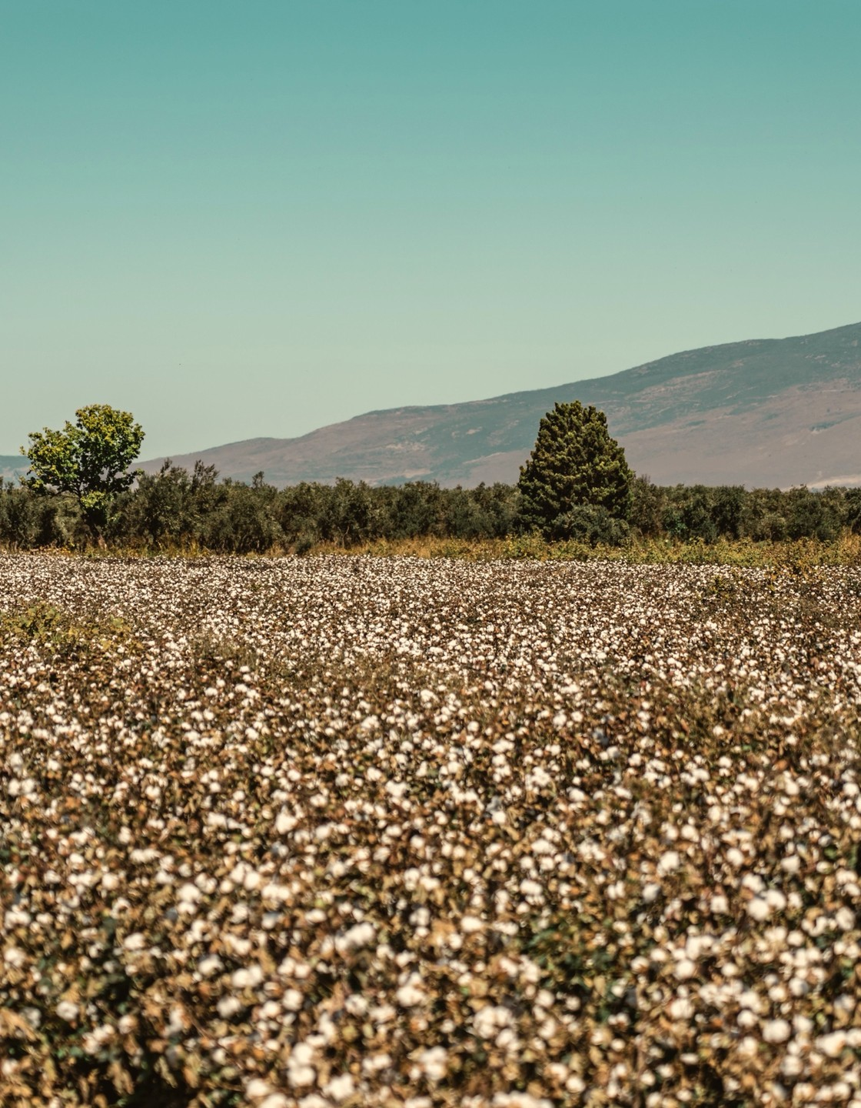
GROW
·
MAKE
·
WEAR
·
THROW
2,700
1
1
LITRES OF WATER FOR ONE COTTON T-SHIRT
1
One person's drinking water for 2.5 years
5
Uzbekistan: world's 7th-largest cotton producer
BEKZODJON KIRGIZBAYEV · SUST 1000 7T
02 / 06
Notes:
2,700 L water → 1 cotton T-shirt [1]
≈ one person's drinking water, ~900 days ≈ 2.5 yrs [1]
Uzbekistan: 7th-largest cotton producer, 2025/26 [5]
≈ 2.8% of world cotton, ≈ 3.45 M bales [5]
Cotton on irrigated desert land, fed by 2 rivers [2]

Slide 3
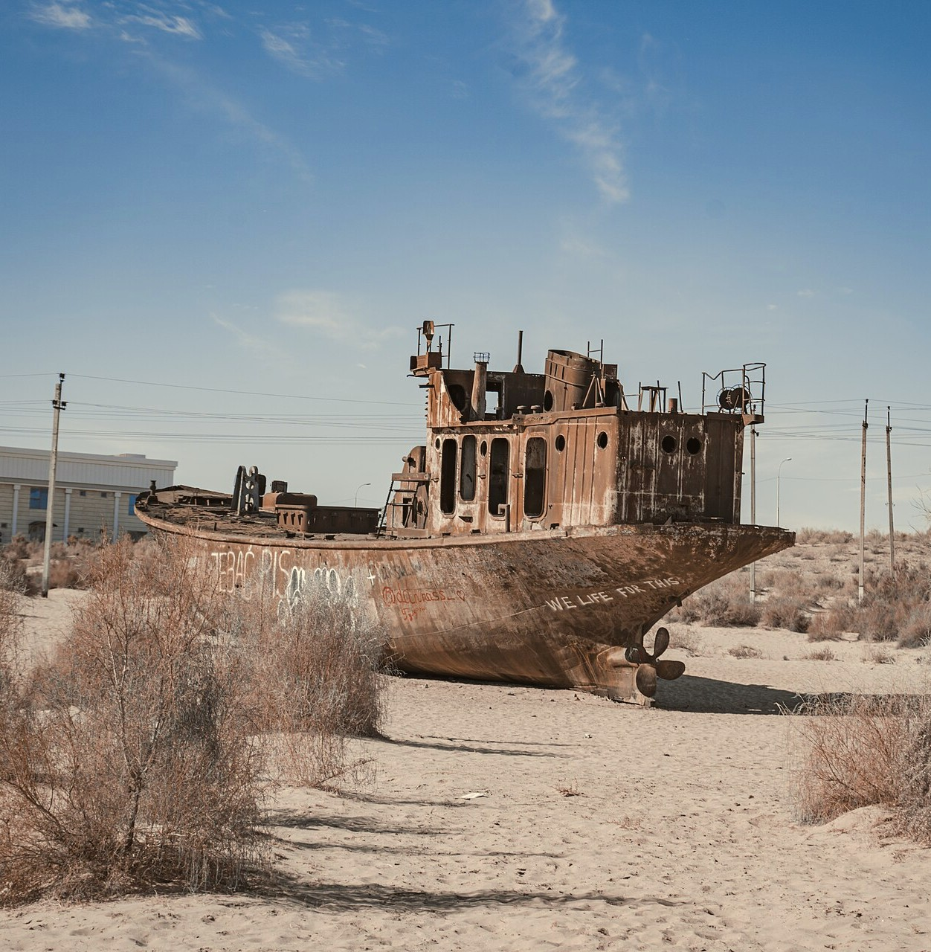

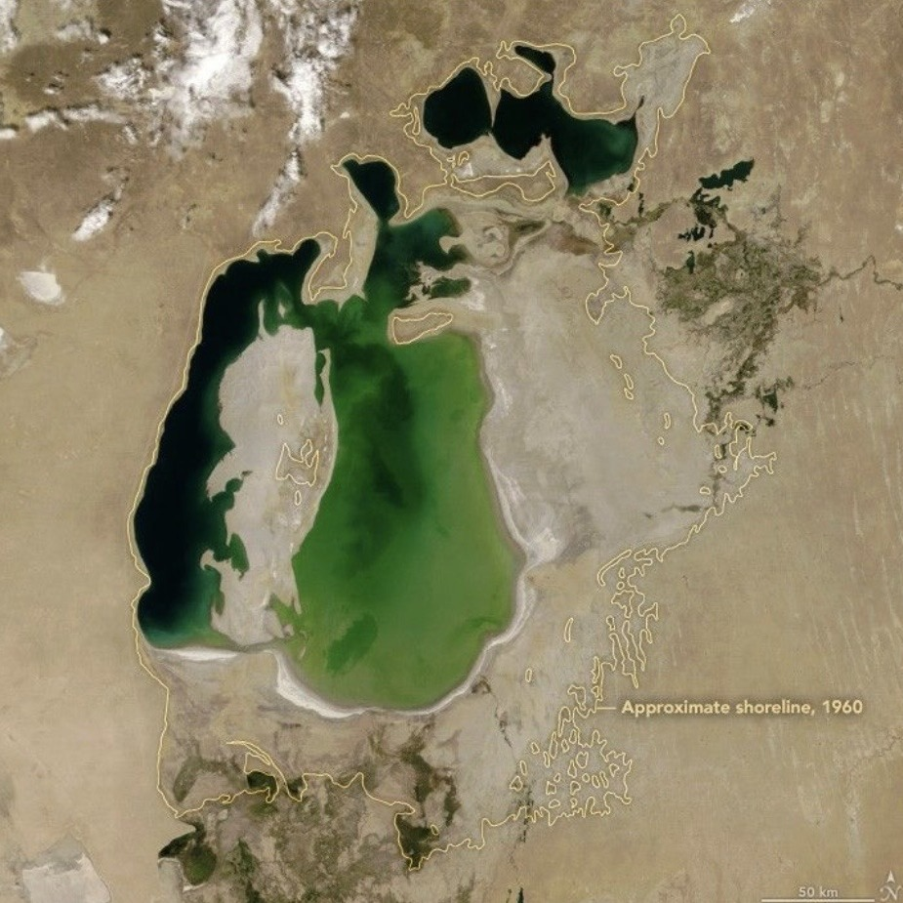
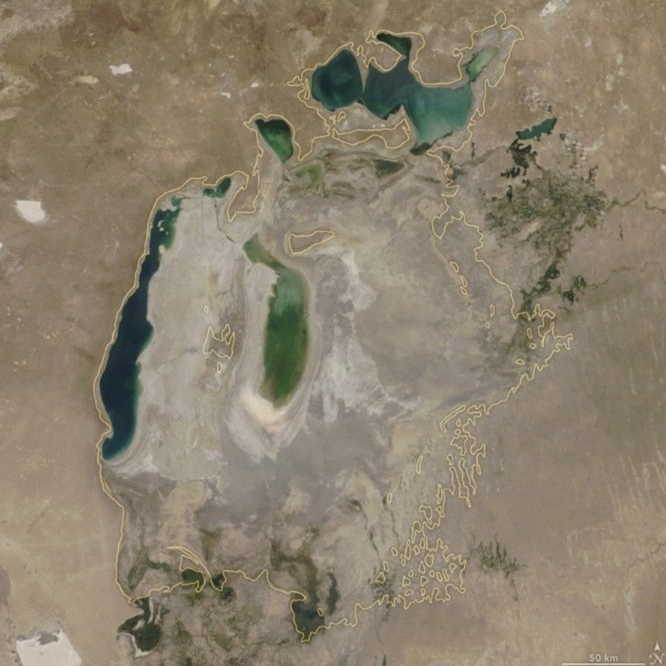
GROW
·
MAKE
·
WEAR
·
THROW
SAME PLACE. SAME FRAME.
THE SEA THAT
WENT DRY
2000
Eastern basin
still holds water
2
2018
Eastern basin first
ran dry in 2014
2
2
Rivers diverted to irrigate cotton
IMAGES: NASA EARTH OBSERVATORY
BEKZODJON KIRGIZBAYEV · SUST 1000 7T
03 / 06
Notes:
Aral Sea: once one of the world's 4 largest lakes [2]
1960s: Soviet canals take Amu Darya + Syr Darya water → cotton [2]
2014: eastern basin of South Aral completely dry [2]
Satellite pair: same frame, 2000 vs latest image [2]
Photo: stranded ship, Moynaq, Uzbekistan

Slide 4
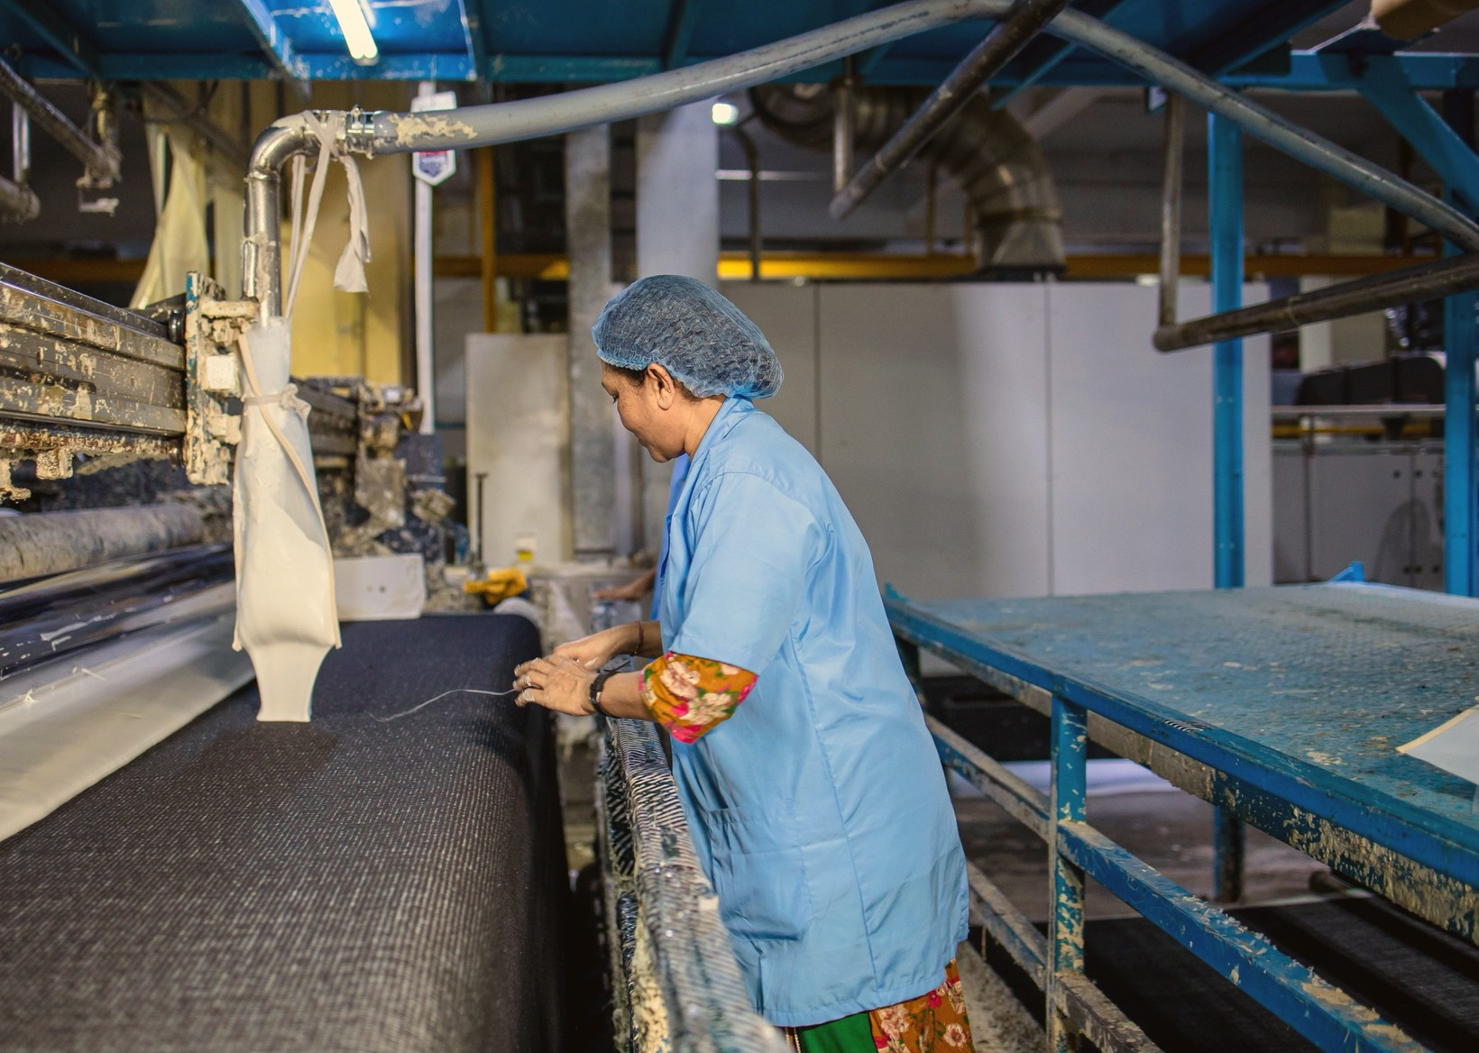
GROW
·
MAKE
·
WEAR
·
THROW
Made Fast, Worn Little
MAKE
WEAR
20%
of industrial water pollution:
textile dyeing & treatment
3
4
Twice the clothes, worn 36% less
BEKZODJON KIRGIZBAYEV · SUST 1000 7T
04 / 06
Notes:
Dyeing + treating textiles ≈ 20% of industrial water pollution [3]
Clothing production ≈ doubled, 2000 → 2015 [4]
Times a garment is worn: −36% in 15 yrs [4]
Chart = index, 2000 = 100: made ≈200, worn 64 [4]
Fast fashion: more clothes, shorter lives

Slide 5
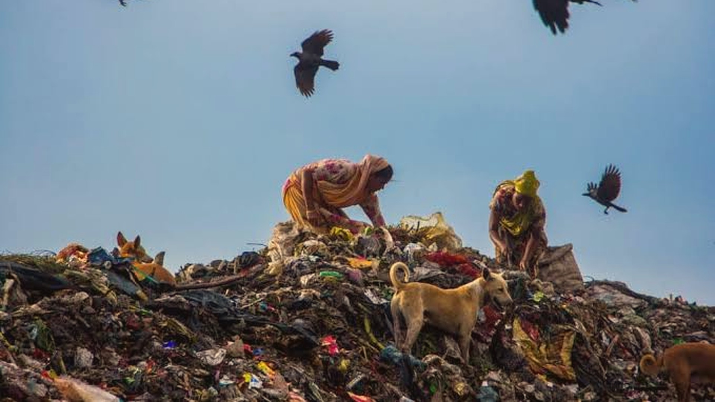

GROW
·
MAKE
·
WEAR
·
THROW
ONE TRUCK.
EVERY SECOND.
4
of textiles landfilled or burned, worldwide
<1% RECYCLED INTO NEW CLOTHES
4
BEKZODJON KIRGIZBAYEV · SUST 1000 7T
05 / 06
Notes:
1 garbage truck of textiles, every second → landfill or burned [4]
< 1% of clothing material recycled into new clothes [4]
Worldwide figure, not one country [4]
Water + dye from slides 2–4 → ends here

Slide 6
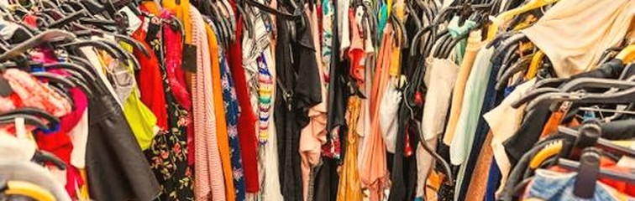
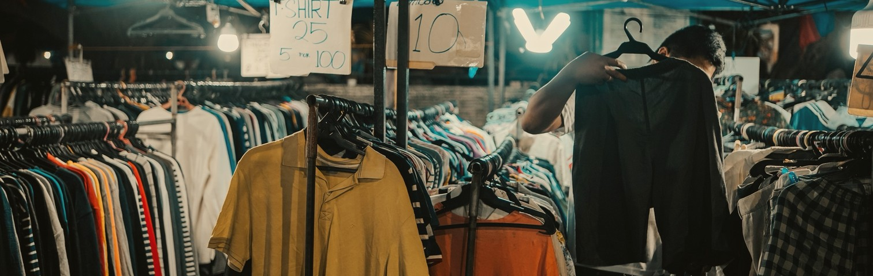
FAST FASHION
BETTER CHOICES
Buy cheap
Wear a few times
Throw away
Buy less, buy better
Second-hand & repair
Donate or recycle
Every T-shirt has a story.
Let's make it a longer one.
Thank you
BEKZODJON KIRGIZBAYEV · SUST 1000 7T
06 / 06
Notes:
Buy less, buy better → more wears, reverse the −36% [4]
Second-hand + repair → same shirt, longer story
Donate or recycle → today < 1% becomes new clothes [4]
Each extra wear spreads the 2,700 L further [1]
Close: every T-shirt has a story

Slide 7
References
[1] World Wildlife Fund. (2014, Spring). Handle with care. World Wildlife Magazine. https://www.worldwildlife.org/magazine/issues/spring-2014/articles/handle-with-care
[2] NASA Earth Observatory. (n.d.). World of change: Shrinking Aral Sea. National Aeronautics and Space Administration. Retrieved October 31, 2026, from https://science.nasa.gov/earth/earth-observatory/world-of-change/aral-sea/
[3] World Bank Group. (n.d.). Cleaner production case study: Right first time (RFT) improvement through process optimization – Evince Textiles Limited. Partnership for Cleaner Textile (PaCT). https://documents1.worldbank.org/curated/en/720341627042851108/pdf/Cleaner-Production-Case-Study-Right-First-Time-RFT-Improvement-Through-Process-Optimization-Evince-Textiles-Limited.pdf
[4] Ellen MacArthur Foundation. (2017). A new textiles economy: Redesigning fashion’s future. https://www.ellenmacarthurfoundation.org/a-new-textiles-economy
[5] U.S. Department of Agriculture, Foreign Agricultural Service. (2026). Cotton [Production by country, 2025/26]. Retrieved October 31, 2026, from https://www.fas.usda.gov/data/production/2631000
BEKZODJON KIRGIZBAYEV · SUST 1000 7T
REFERENCES

