Slide 1

Understanding What Shapes Graduation Success: A National Analysis for USDE Decision-Making
University of Arizona | BNAN 277, Group 13
December 18, 2025
Presented by: Bekzod Bakhtiyorov, Nicholas Chavez, Nicky Khamvongsa, Jiselle Perez, Braeden Taylor

Slide 2

Agenda
Project Purpose & Objective
Data Overview & Cleaning Process
Tableau Exploration Insights
Regression Models Tested
Final Selected Model
Key Predictors & Interpretation
Policy Recommendations for USDE
Conclusion & Next Steps

Slide 3

Purpose
Identify which institutional, geographic, and socioeconomic factors most strongly predict undergraduate graduation rates, and to provide data-driven recommendations

Slide 4
Data Summary
Dataset Overview:
Source: U.S. Department of Education, College Scorecard
Final dataset used for modeling: 1,347 institutions
Includes national coverage across all sectors and locations
Key variable categories:
Graduation rate
Institution type
Geographic setting
Enrollment metrics
Financial indicators
Admissions metrics
Data Cleaning & Preparation:
Removed institutions with missing graduation rate values
Filtered out incomplete or unusable rows
Created dummy variables for categorical fields
Standardized numeric variables
Addressed missing values in financial aid and admissions fields
Selected 6-year graduation rate as the dependent variable

Slide 5
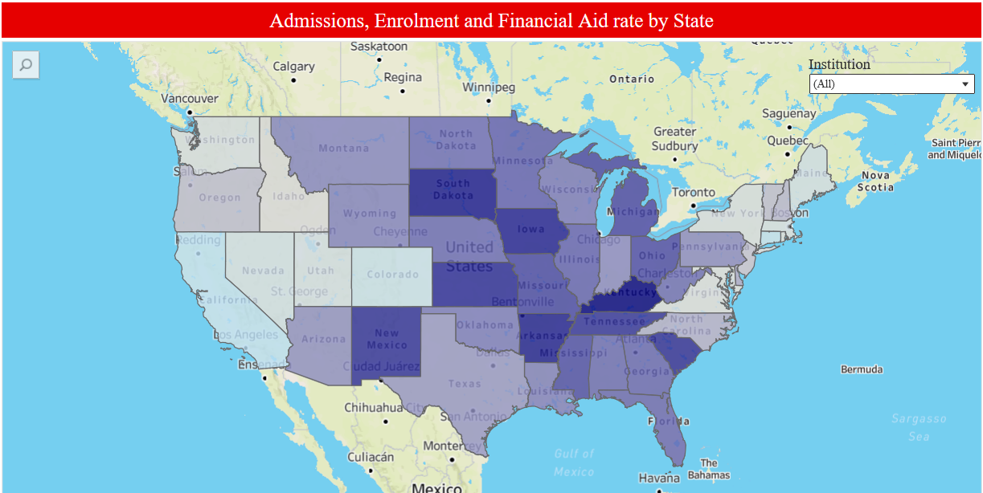
Tableau Findings ( United States Map)
Midwestern and Southern states show the highest percentages of freshmen receiving financial aid (darker colors).
East and West Coast states generally have lower financial aid rates (lighter colors).
Financial aid percentages range from 80% to 97% across states.
Hover tooltips reveal each state's average financial aid, total admissions, and total enrollment.
The institution-type filter allows comparison, but overall patterns remain consistent across types.

Slide 6
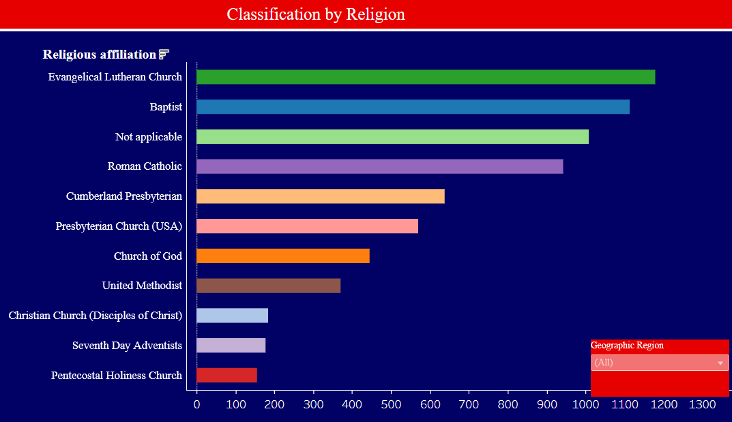
Tableau Findings ( Bar Chart)
Religious Affiliation Analysis:
The most common religious affiliations among institutions are: 1. Evangelical Lutheran 2. Baptist 3. Non-religious students
A region filter allows you to compare how religious affiliation varies across different areas of the U.S.

Slide 7
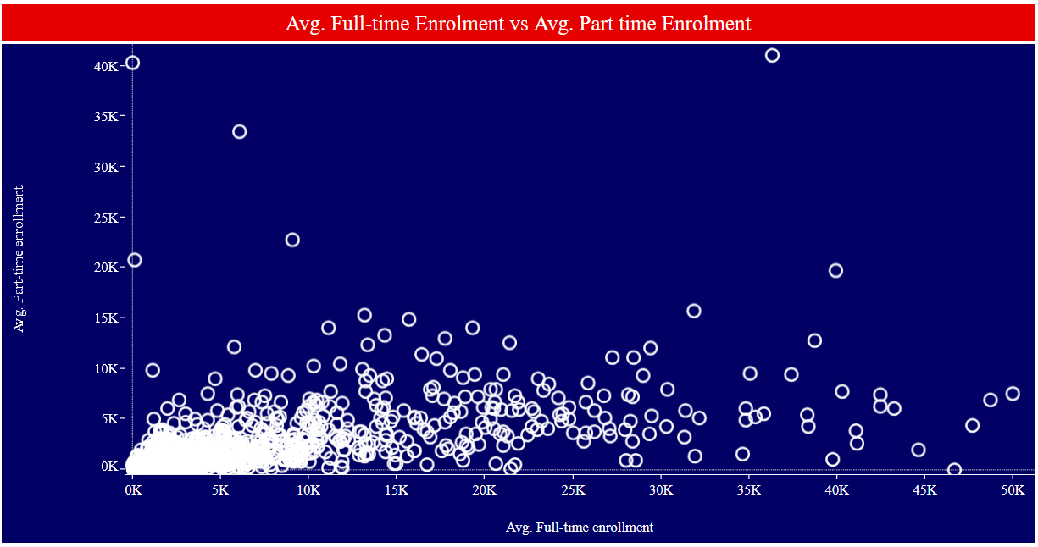
Tableau Findings ( Scatterplot)
The scatterplot compares average full-time vs. part-time enrollment across institutions.
Most schools cluster closely together, showing similar enrollment patterns nationwide.
Full-time enrollment is consistently higher than part-time enrollment at the majority of institutions.
Only a small number of schools show higher part-time enrollment, which may indicate limited full-time capacity or different program structures.
Hovering over each point reveals specific school details, including average full-time and part-time numbers.

Slide 8
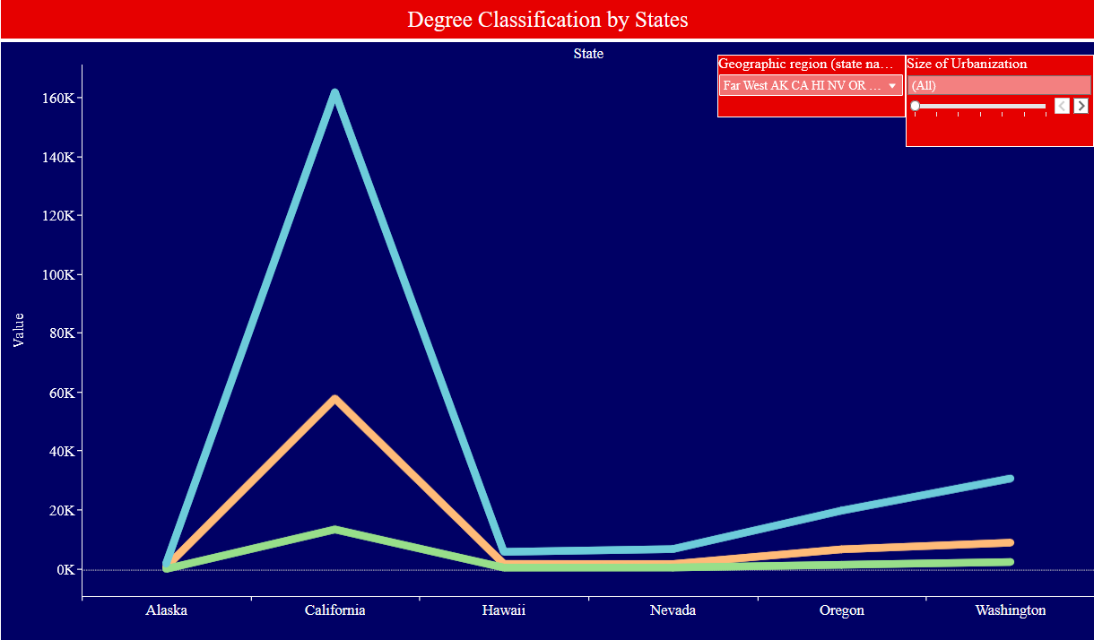
Tableau Findings ( Line Graph)
Bachelor’s vs. Master’s vs. Doctorate’s:
The line graph compares the number of students pursuing Bachelor’s, Master’s, and Doctoral degrees across all U.S. states.
Bachelor’s degree enrollment is significantly higher in every state, making it the dominant academic path.
Master’s degree enrollment is lower but shows moderate variation across states.
Doctoral enrollment is the smallest and remains consistently low nationwide.
Clicking a point reveals the state, degree type, and number of students.
Filters allow users to explore differences by geographic region and urbanization level.

Slide 9
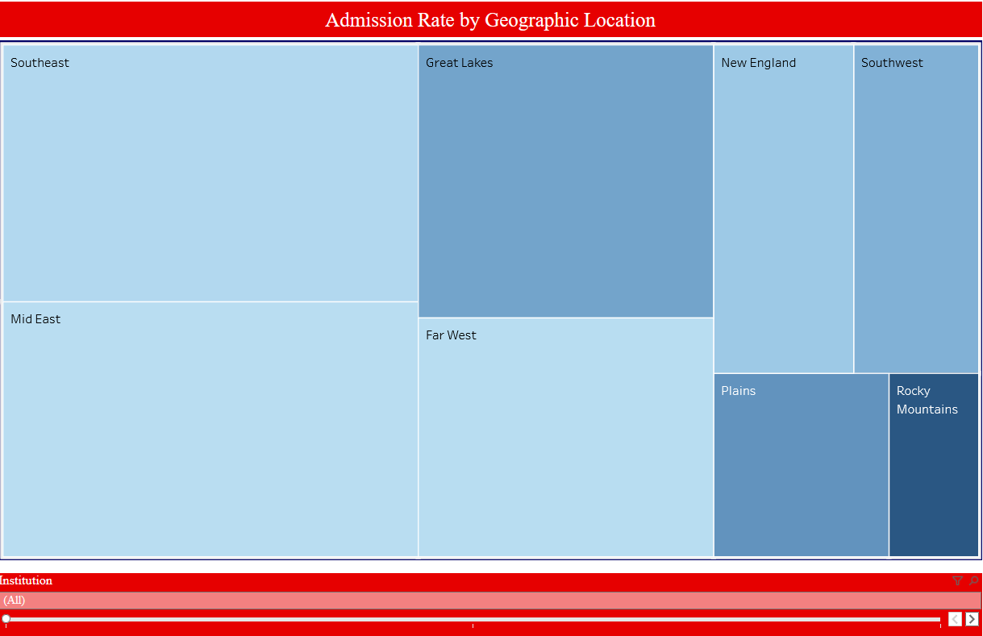
Tableau Findings ( Tree Map)
Admissions by Region:
The tree map shows total admissions and percent admitted across eight U.S. regions.
Larger regions on the map represent higher total admissions, typically associated with bigger institutions.
Smaller regions tend to have higher admission percentages, indicating less selective schools.
A filter allows comparison between public vs. private institutions.

Slide 10
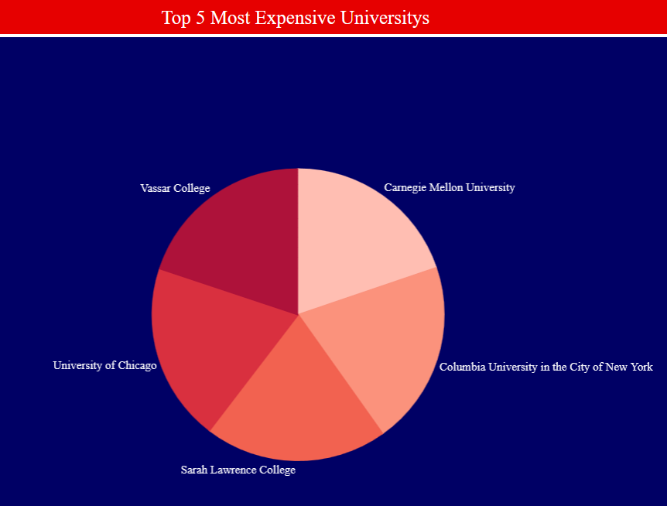
Tableau Findings ( Pie Chart)
Highest Tuition Institutions:
The pie chart highlights the five most expensive institutions based on tuition and fees.
All five schools have similarly high tuition costs, significantly above the national average.
These high costs may influence student access and graduation outcomes due to increased financial burden.
Full Tableau Dashboards: https://public.tableau.com/shared/GJY3B6QT8?:display_count=n&:origin=viz_share_link

Slide 11
Regression Process Overview
Model 1 – Baseline Predictors
Included: Public/Private, Applicants, Admissions, Basic Location
R² ≈ 0.31
Purpose: Establish a foundational model with essential structural variables.
Result: Many predictors were significant but explanatory power was limited.
Outcome (Models 2 & 4)
Only full-time enrollment and rural/city indicators consistently mattered.
R² improved slightly (0.29 → 0.35), but many added variables were insignificant, and complexity increased.
Model 2–4 Adding Institutional Characteristics
We added variables step-by-step to test:
School type
Urbanization sub-categories
Enrollment variables
Model 5 – Adding Financial Aid Variables
Added: Pell Grants, Institutional Aid, Federal Grants
Improvement: R² jumped to 0.68
Pell Grants emerged as the strongest predictor across all models.
Aid-related variables significantly increased explanatory power.

Slide 12
Final and Best Regression Model + Why?
Strong model fit: R² = 0.69
Public institutions graduate fewer students (negative coefficient)
More applicants → higher graduation rate
City and rural locations both show lower graduation rates
Higher total enrollment → lower graduation rate
Higher full-time enrollment → higher graduation rate
Higher % of Pell Grant freshmen → strongly lower graduation rates
Institutional grant aid % has a small negative effect
Higher acceptance rate & yield rate → lower graduation rates
Graduation success is shaped by institution type, financial need, selectivity, and student enrollment structure.

Slide 13

Recommendation
Increase selectivity: Schools with more applicants and lower admission rates have higher graduation outcomes.
Control enrollment size: Admitting fewer students is associated with higher graduation rates.
Promote full-time enrollment: Higher full-time enrollment strongly improves graduation success.
Address financial need barriers: A higher share of Pell Grant recipients is linked to lower graduation rates, indicating a need for stronger support systems.
Institutional context matters: Private institutions, particularly in rural areas, tend to achieve better graduation outcomes.

Slide 14

Graduation outcomes are driven primarily by financial need, selectivity, and enrollment structure.
Institutions with strong applicant demand and higher full-time enrollment perform best.
Supporting Pell-eligible students is critical for improving national graduation rates.
Final Thoughts

Slide 15
Thank You!

