Slide 1
Cell fate Boehm’s paper
250811

Slide 2
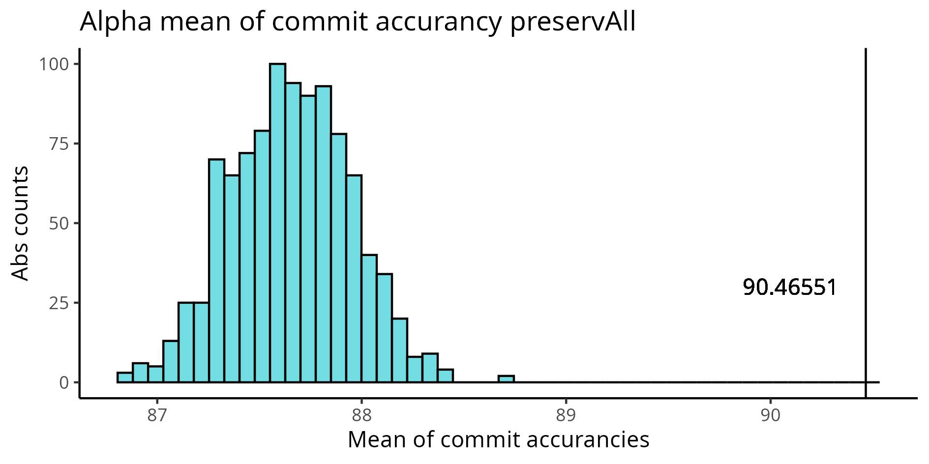
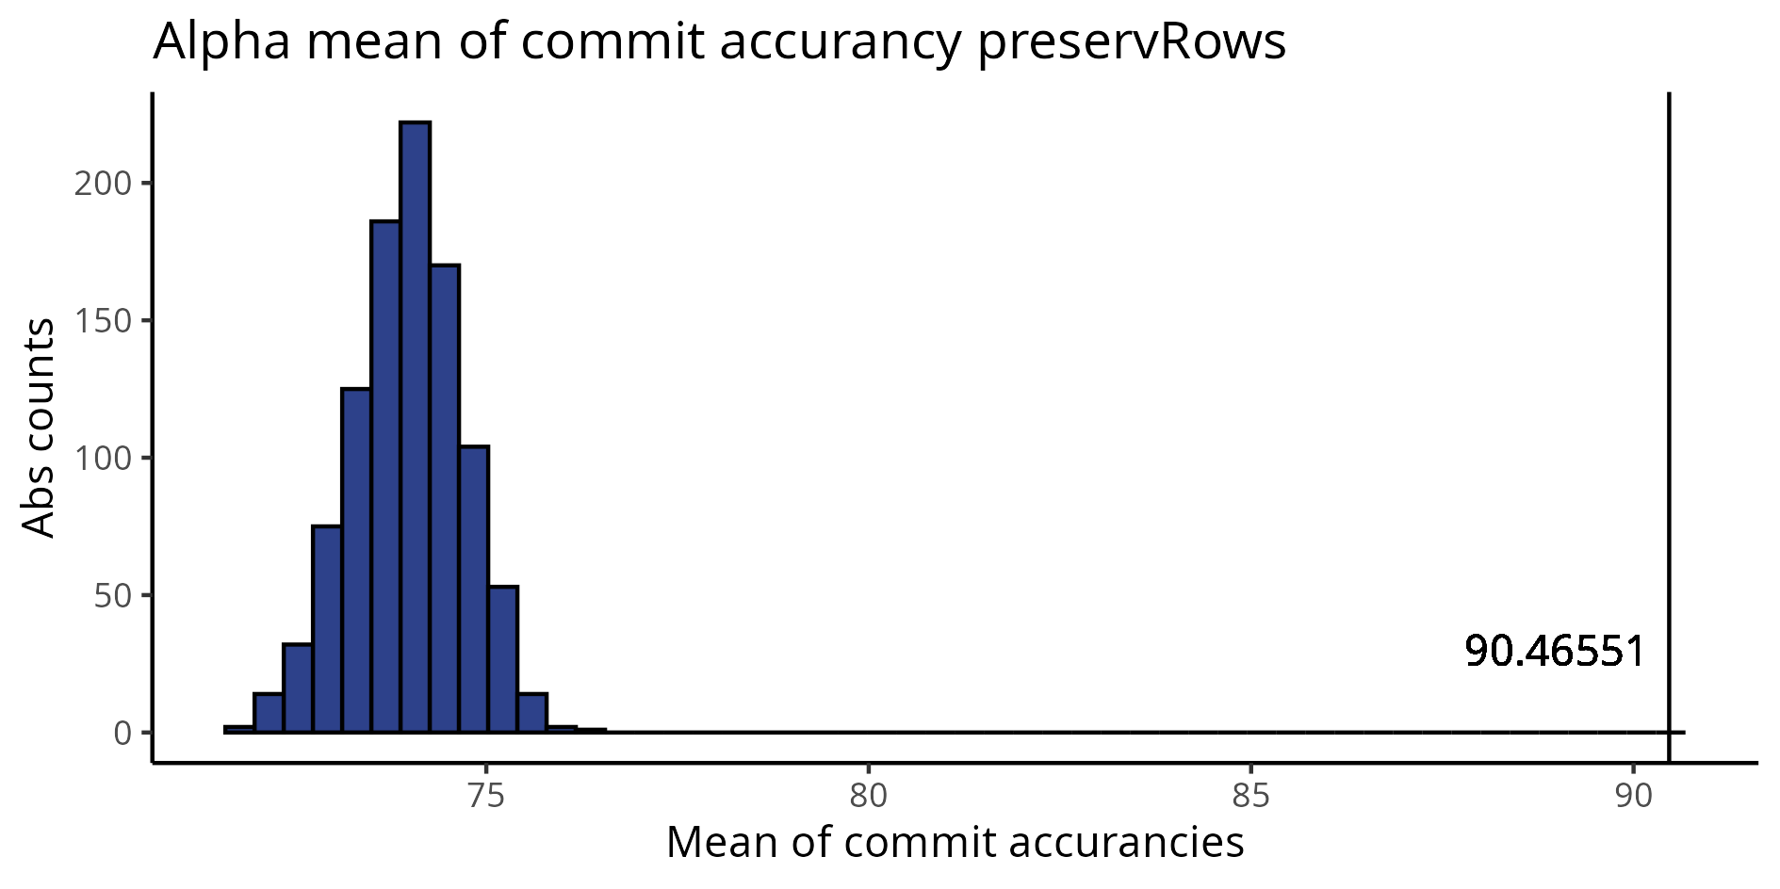
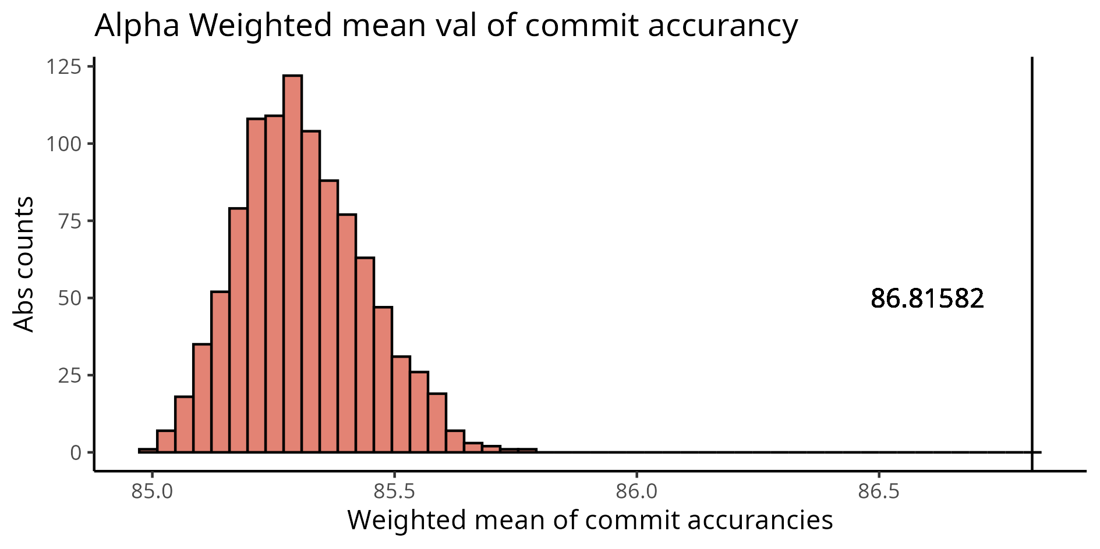
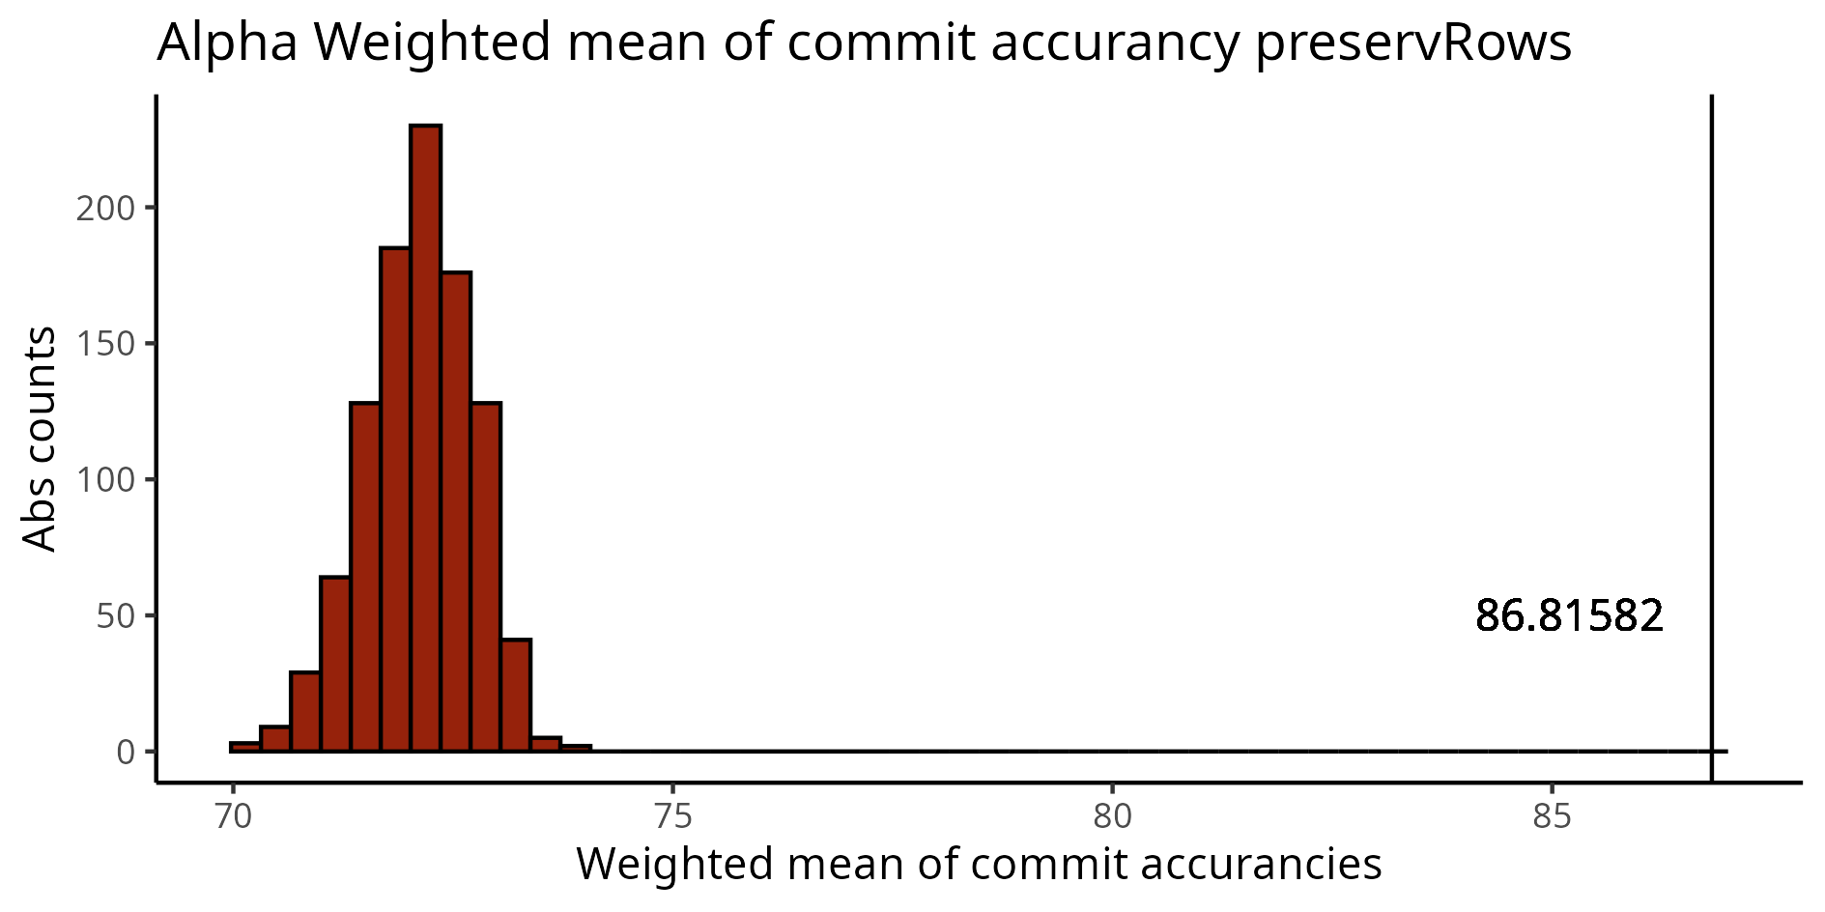
Comparison of commit accuracy - alpha
Preserving counts of rows and cols in each simulation
Preserving only rows in each simulation
Mean accuracy of simulations 87,65488
Mean accuracy of our data 90,46551
Mean accuracy of simulations 74,01443
Mean accuracy of our data 90,46551
Mean accuracy
Weighted mean accuracy of simulations 85,30911
Weighted mean accuracy of our data 86,81582
Weighted mean accuracy of simulations 72,13059
Weighted mean accuracy of our data 86,81582
Weighted mean accuracy

Slide 3
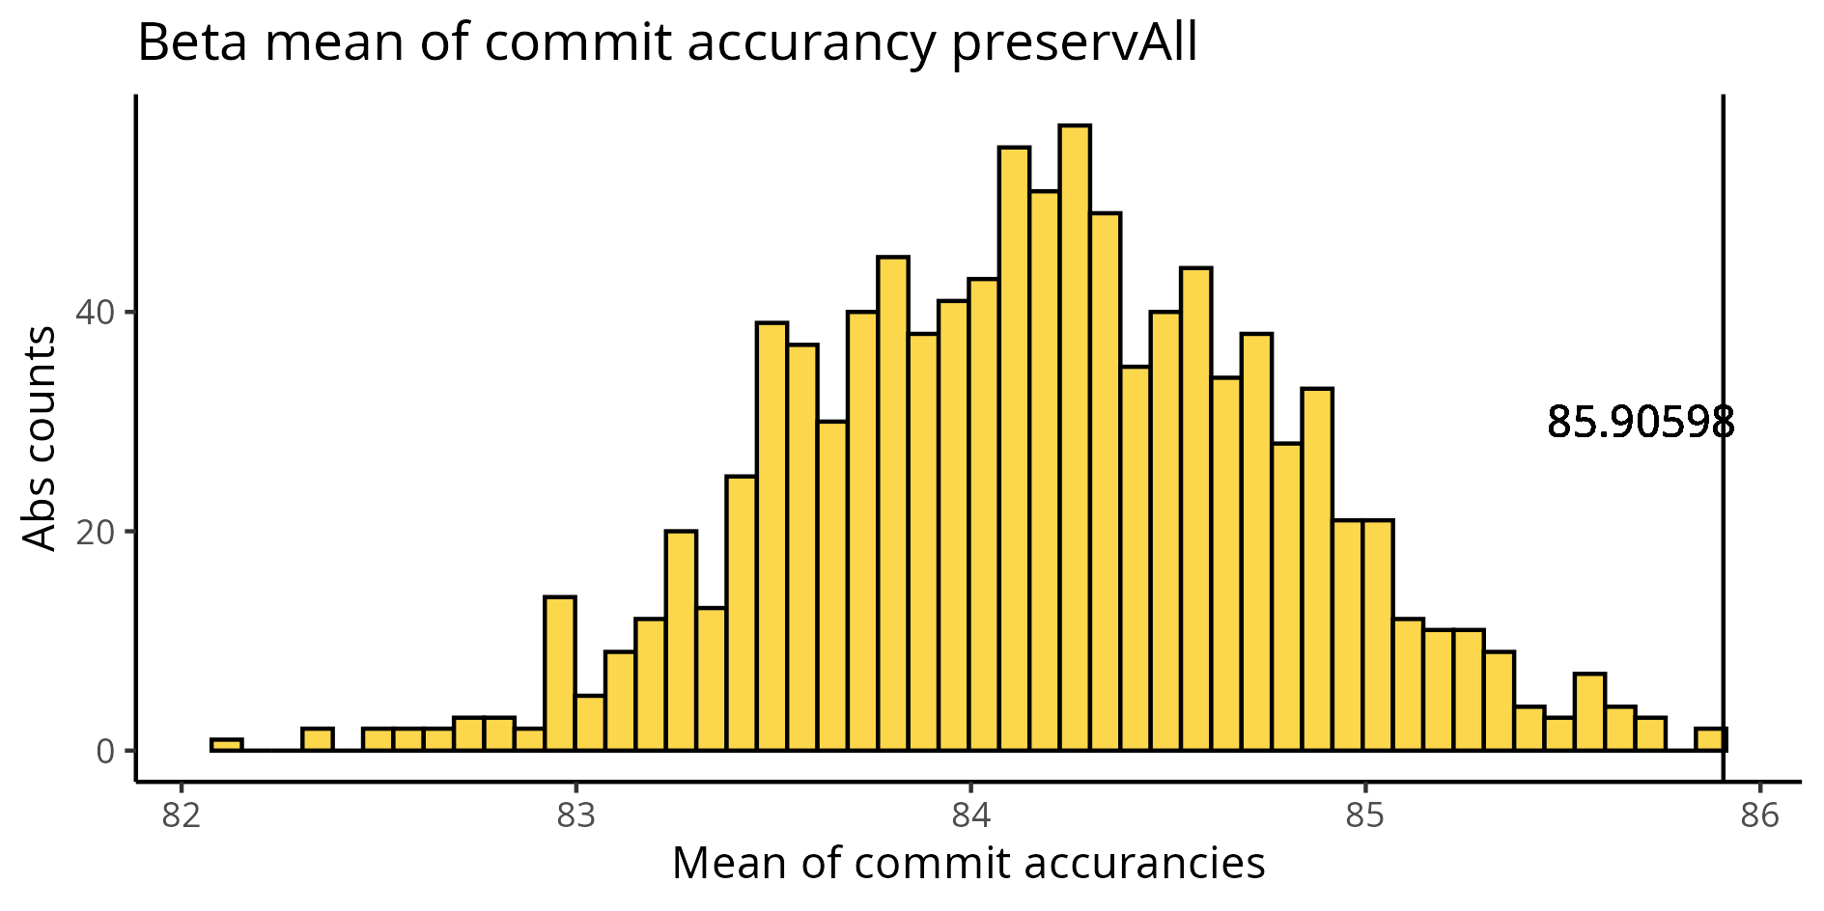
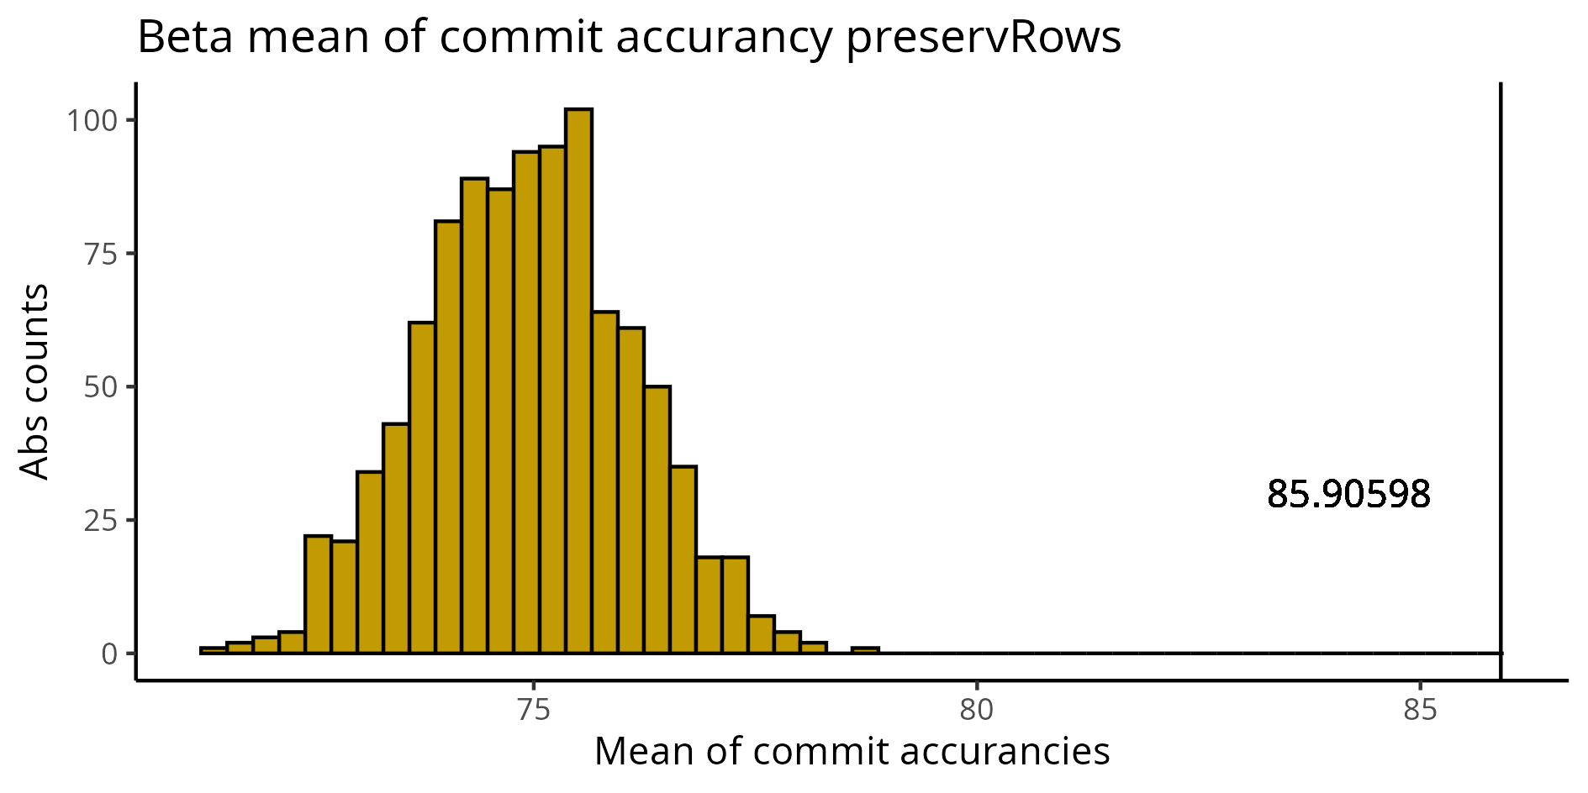
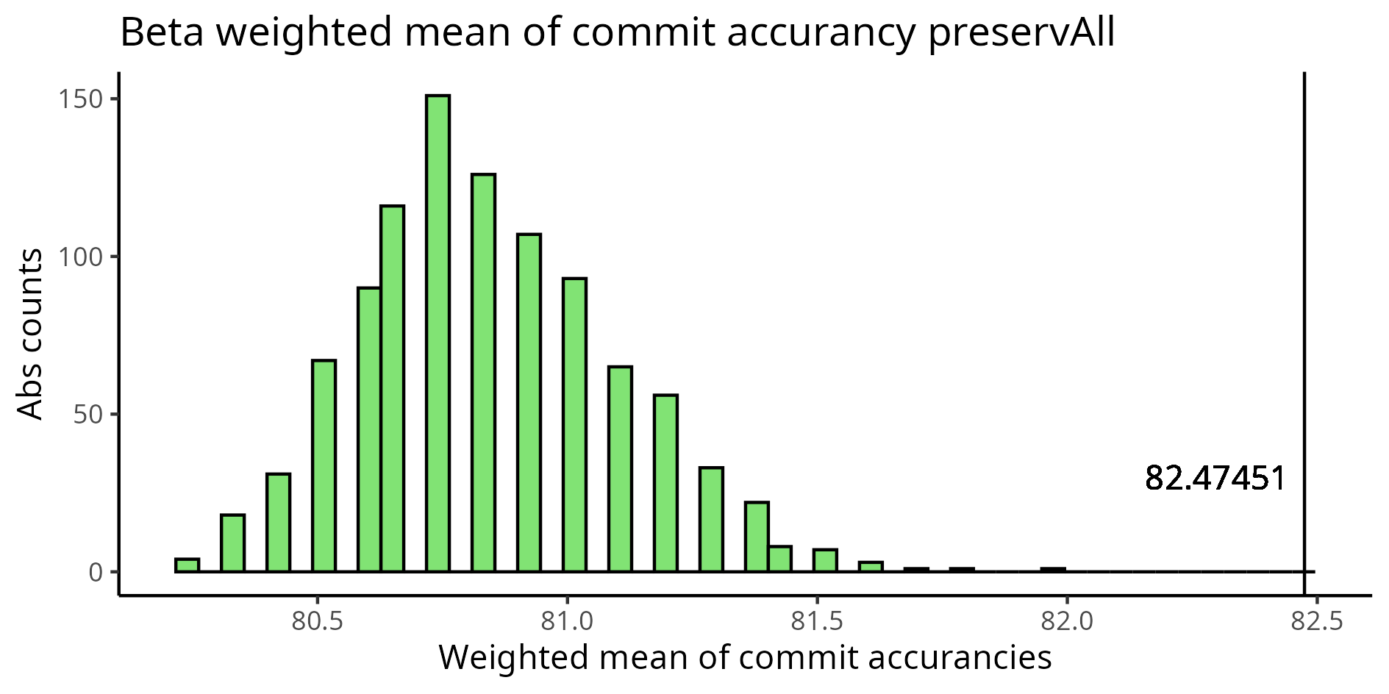
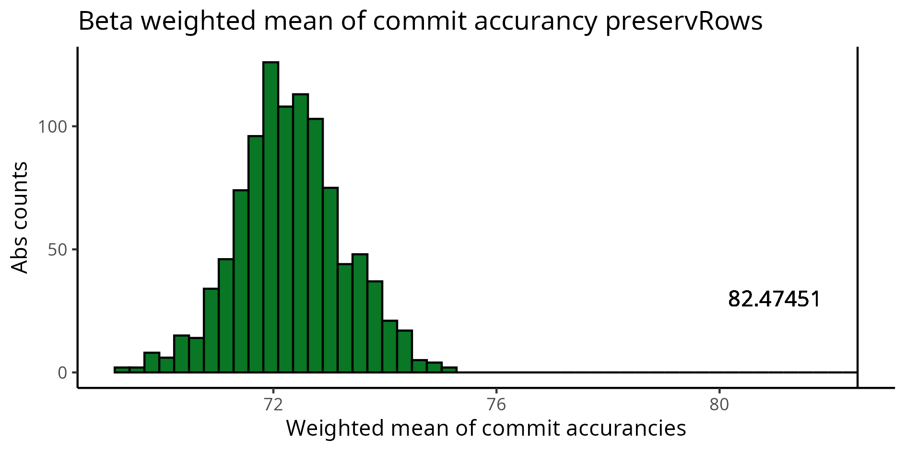
Comparison of commit accuracy - beta
Preserving counts of rows and cols in each simulation
Preserving only rows in each simulation
Mean accuracy of simulations
84,16906
Mean accuracy of our data 85,90598
Mean accuracy of simulations 74,80132
Mean accuracy of our data 85,90598
Mean accuracy
Weighted mean accuracy of simulations 80,83941
Weighted mean accuracy of our data 86,81582
Weighted mean accuracy of simulations 72,23469
Weighted mean accuracy of our data 82,47451
Weighted mean accuracy

Slide 4
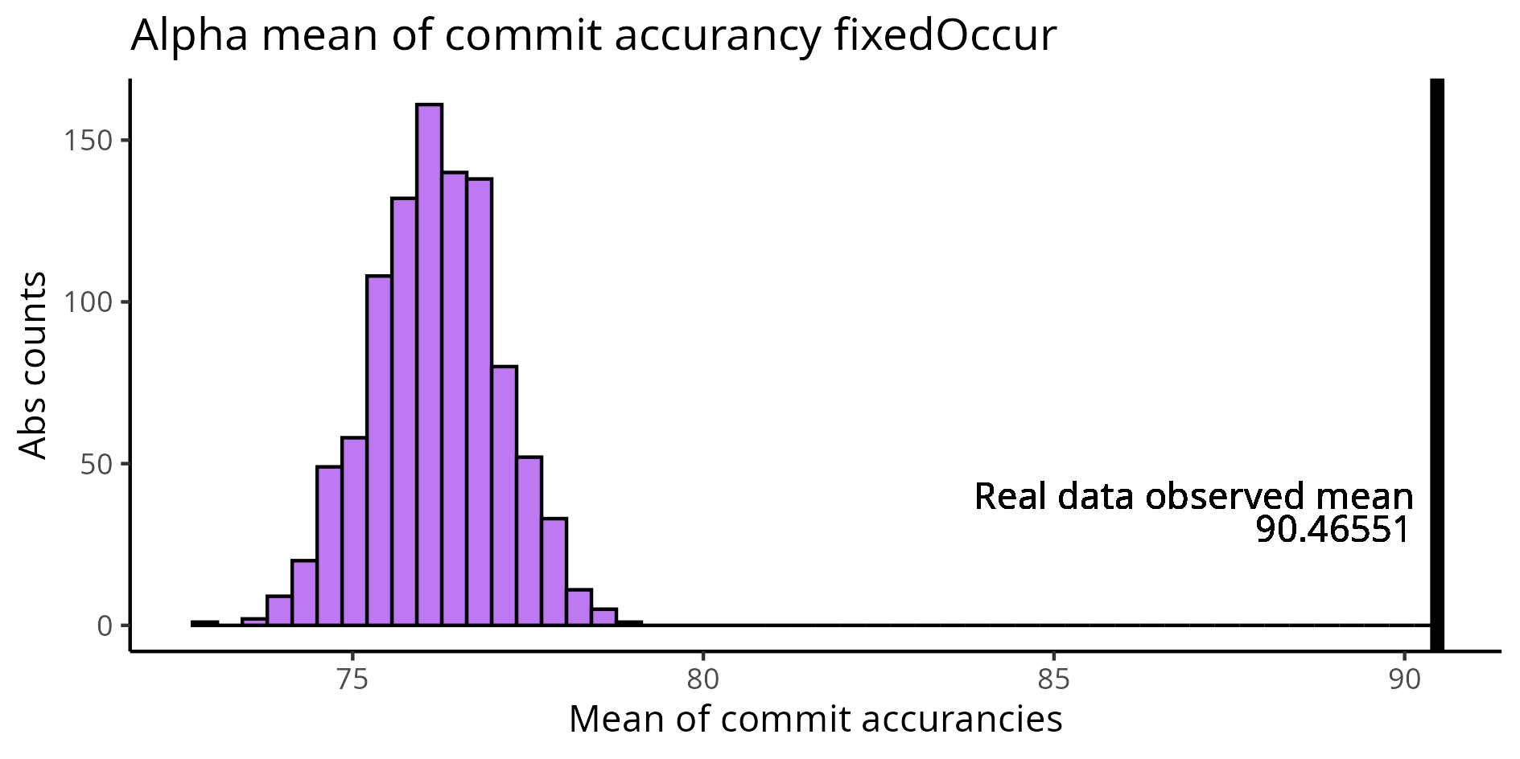
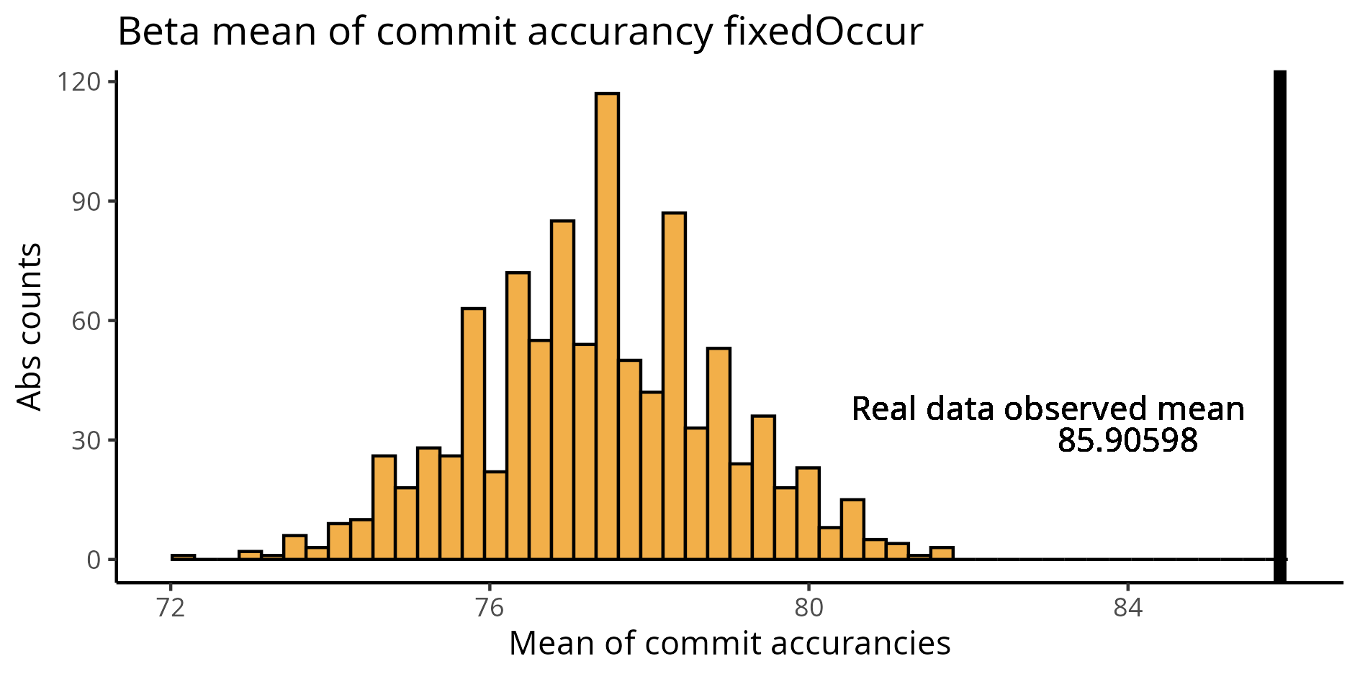
Fixed Occurrence = 2 for all the sequences
Mean accuracy of simulations 76,18299
Mean accuracy of our data 90,46551
Mean accuracy of simulations 77,39366
Mean accuracy of our data 85,90598

Slide 5
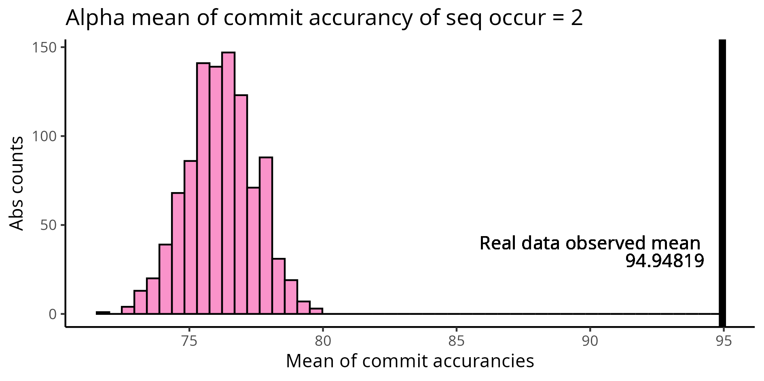
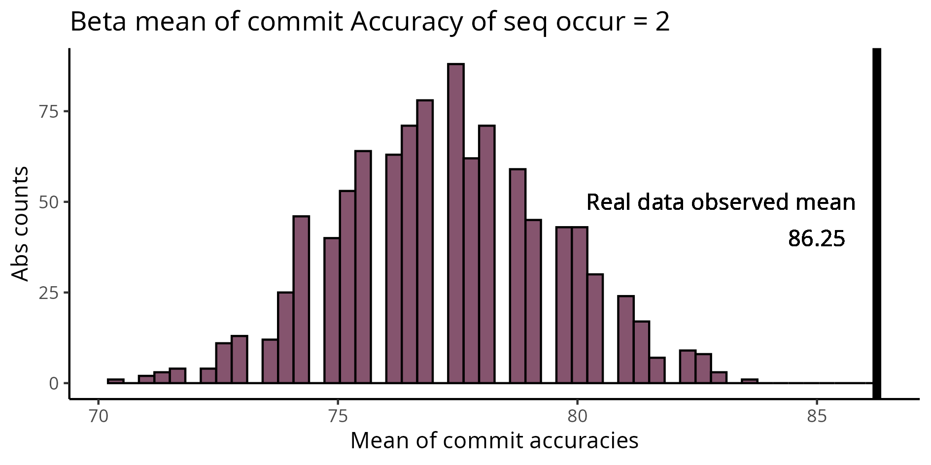
Filtered sequences only with occurrence = 2 in real data
Mean accuracy of simulations 76,18333
Mean accuracy of our data 94,94819
Mean accuracy of simulations 77,24696
Mean accuracy of our data 86,25

Slide 6
References
https://www.nature.com/articles/s41586-023-06218-x
https://www.jstor.org/stable/2346669?seq=2
https://www.rdocumentation.org/packages/vegan/versions/2.7-1/topics/permat

