Slide 1
250912 Cell Fate Meeting
Běla Charvátová
Methods and results

Slide 2
Estimating Pc
Steps done so far
0. Obtained sequencing data from two experiments – alpha and beta editing
Merging reads from the same sample with the same aa seq but different nucleo seq
Creating count table with non-unique sequences accross samples
Commit accurracy
Simulations of random distribution vs. the original data
The goal is to estimate the commitment number

Slide 3
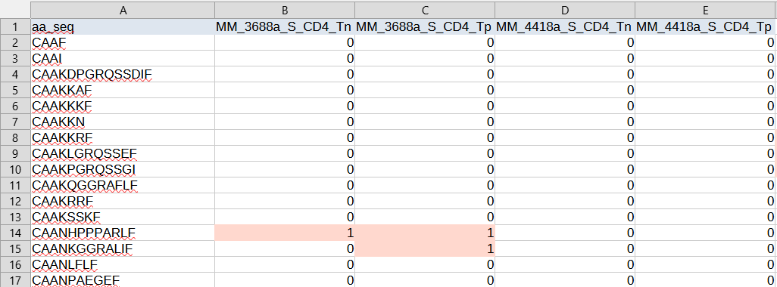
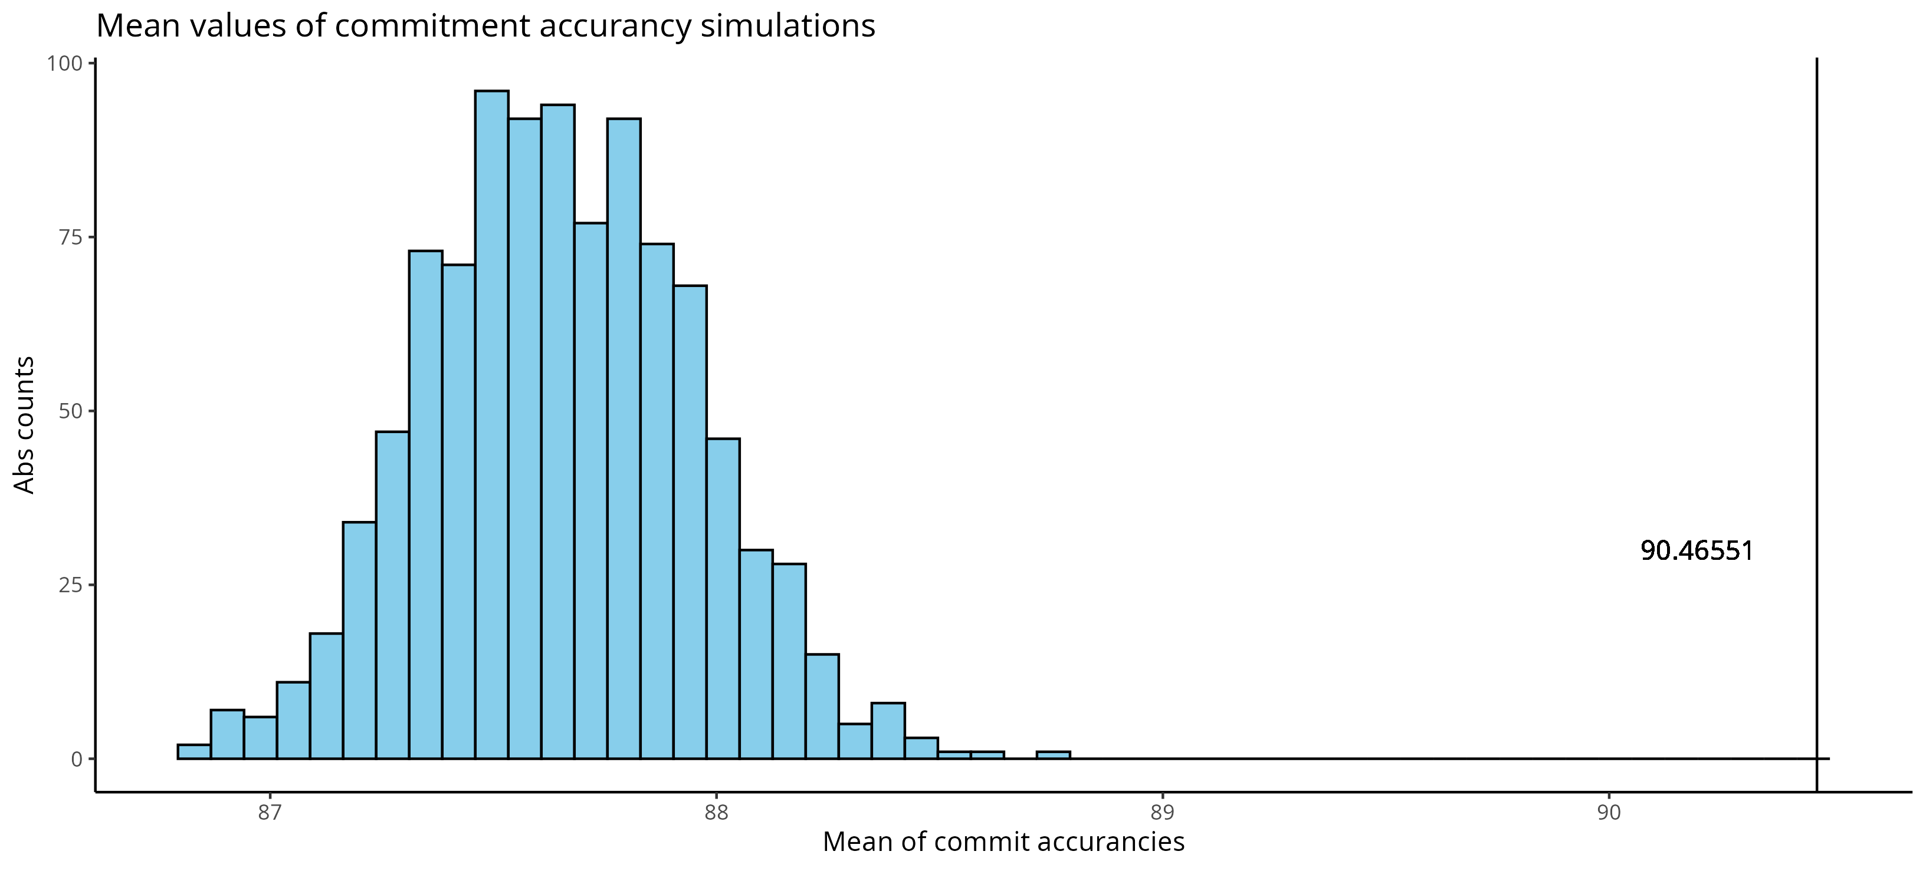
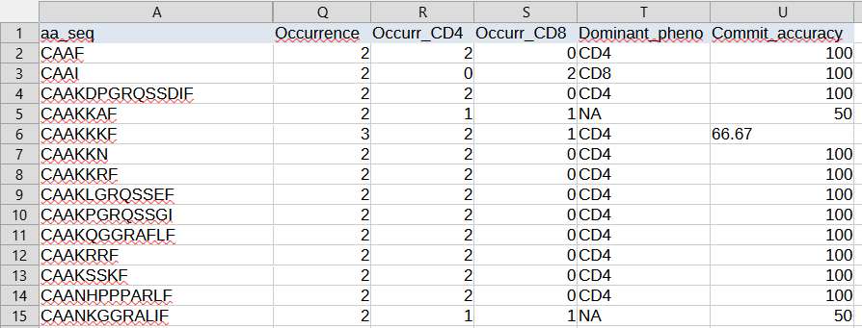
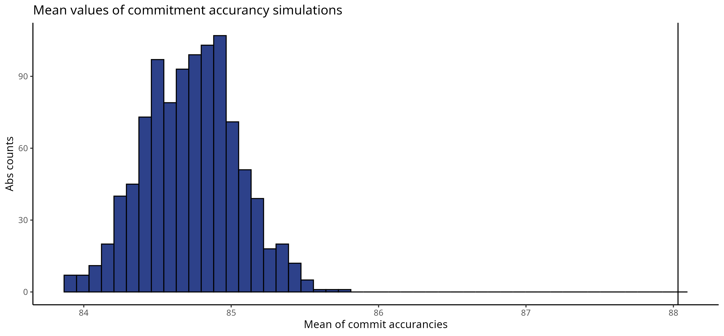
B.CH.
Brief summary of what has been done
1. Count table for each sequence its presence in samples
3. Mean commit accuracy and simulations
2. Commit accuracy of each seq
4. Fixing inconsistency in ratio of CD4/CD8 samples
In the end, we left this idea of excluding samples with low seq count
SSC-A

Slide 4
Estimating Pc
To take an easier approach, we filtered the sequences present in only 2 samples exactly (occurrance 2)
Then each sequence can be either
CD4-CD4 (present in two CD4 samples)
CD4-CD8 (present in one CD4 sample and in one CD8 sample)
CD8-CD8 (present in two CD8 samples)
Next steps
Assuming all the sequences are CD4 biased
Assuming all the sequences are either CD4 or CD8 biased

Slide 5
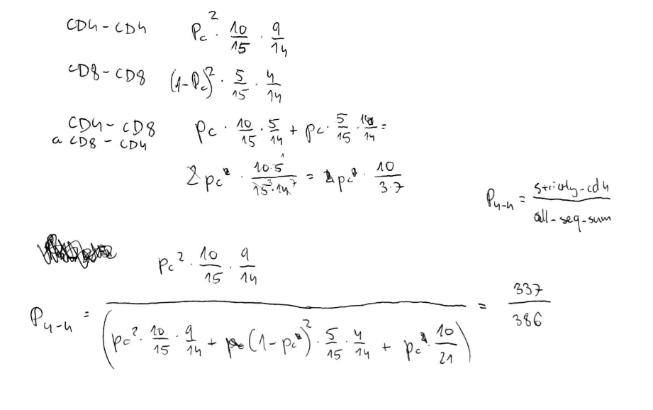
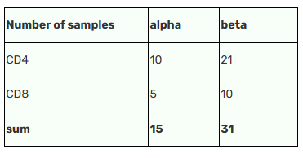
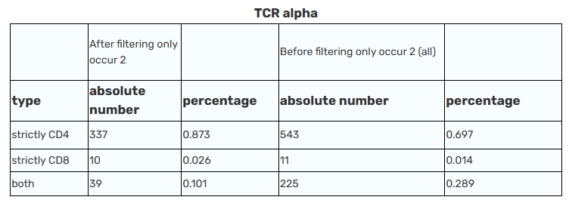
Estimating Pc (occurrence 2) 1. All the sequences are CD4-biased

Slide 6
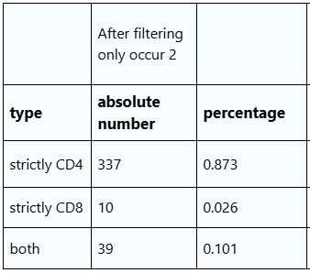
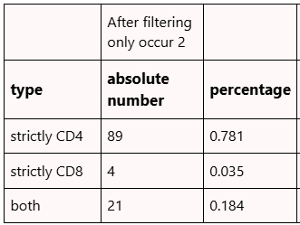
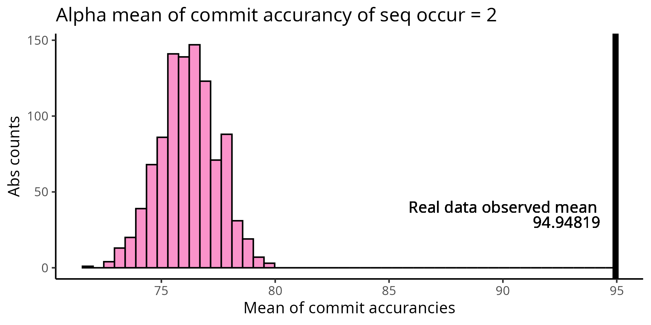
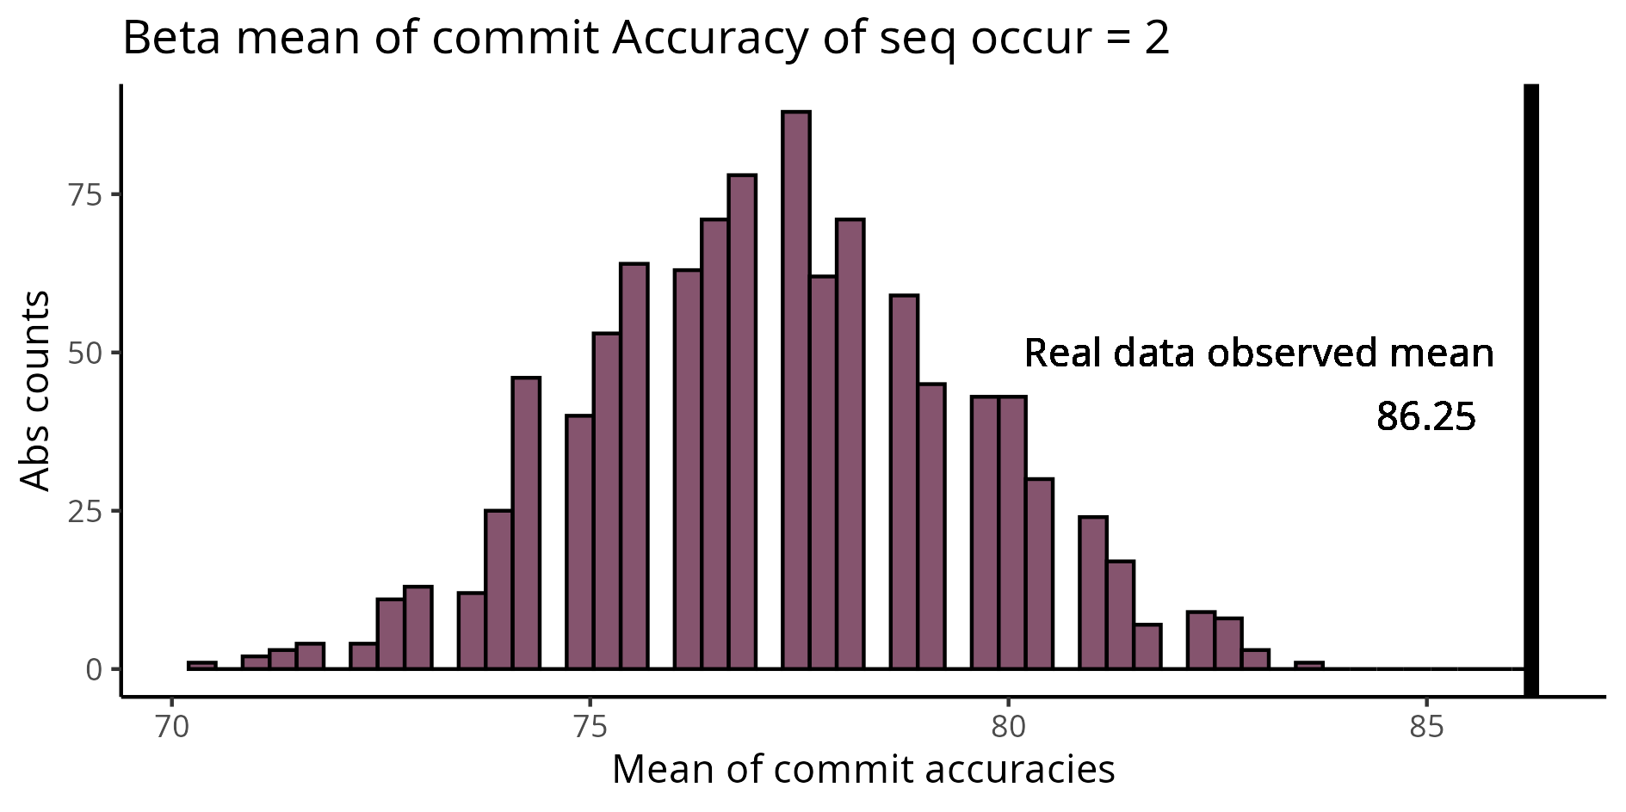
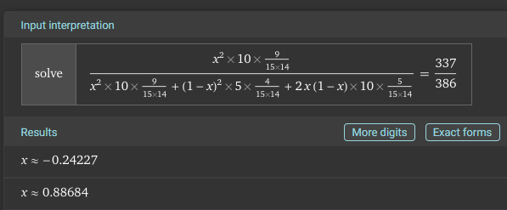
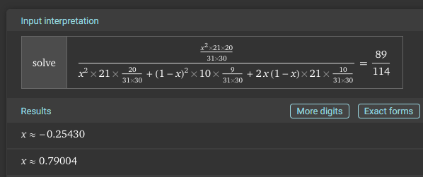
Estimating Pc (occurrence 2) 1. All the sequences are CD4-biased
TCR alpha
TCR beta
10 CD4+ samples
5 CD8+ samples
21 CD4+ samples
10 CD8+ samples

Slide 7
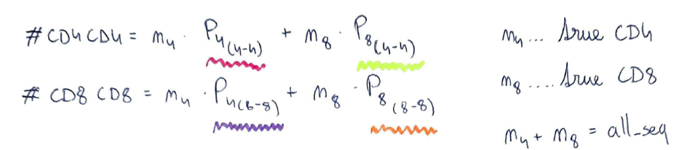
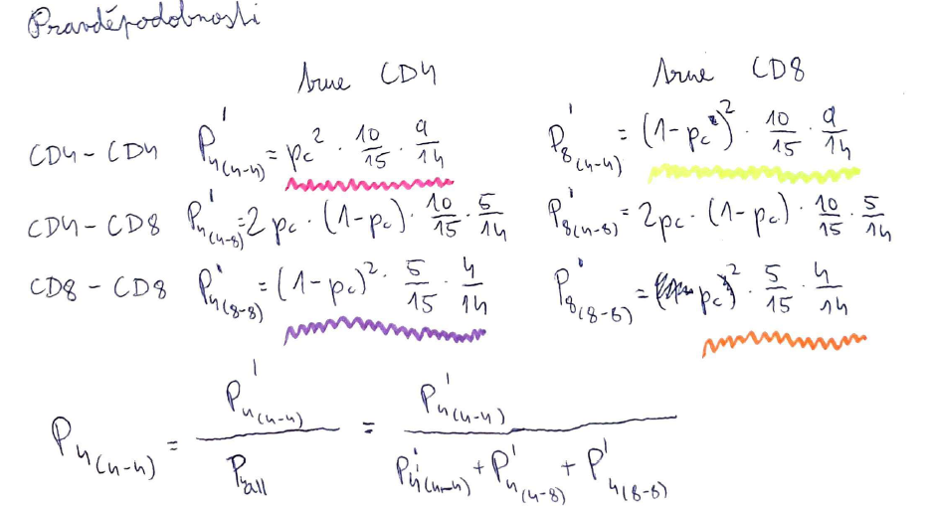
Estimating Pc (occurrence 2) 2. All the sequences are either CD4- or CD8-biased

Slide 8
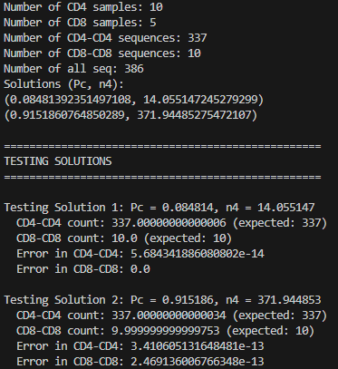
Estimating Pc (occurrence 2) 2. All the sequences are either CD4- or CD8-biased
TCR alpha

Slide 9
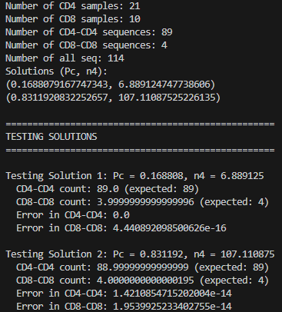
Estimating Pc (occurrence 2) 2. All the sequences are either CD4- or CD8-biased
TCR beta

Slide 10
Validating the model
Using this dataset
80% training, 20% testing
Parameter recovery
Simulating larger datasets?
Using other datasets
Vb5 experiment

Slide 11
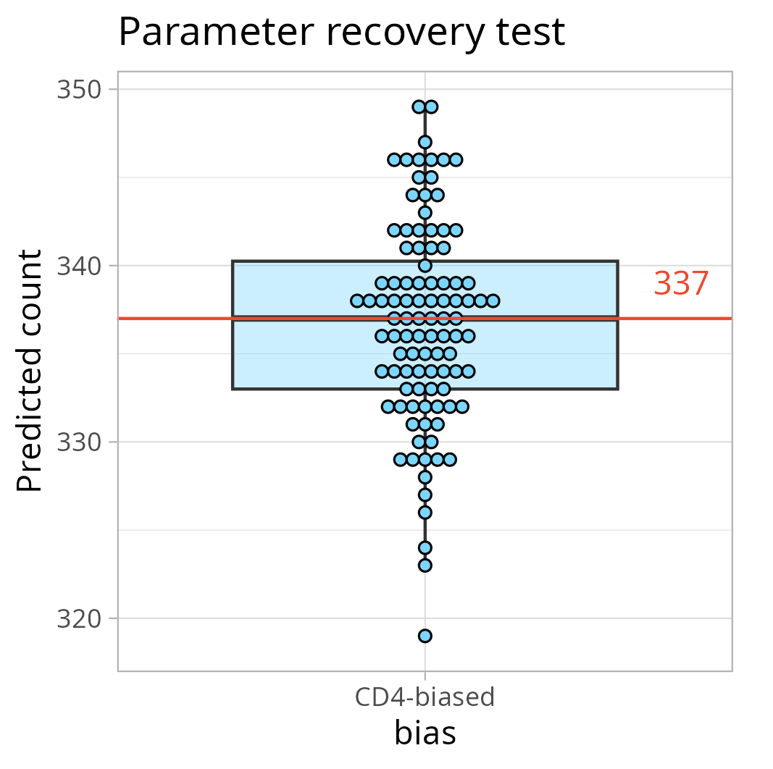
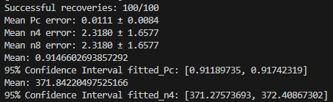
Parameter recovery
TCR alfa
Input
true_Pc = 0.9151860764850289
true_n4 = 372
true_n8 = 14

Slide 12
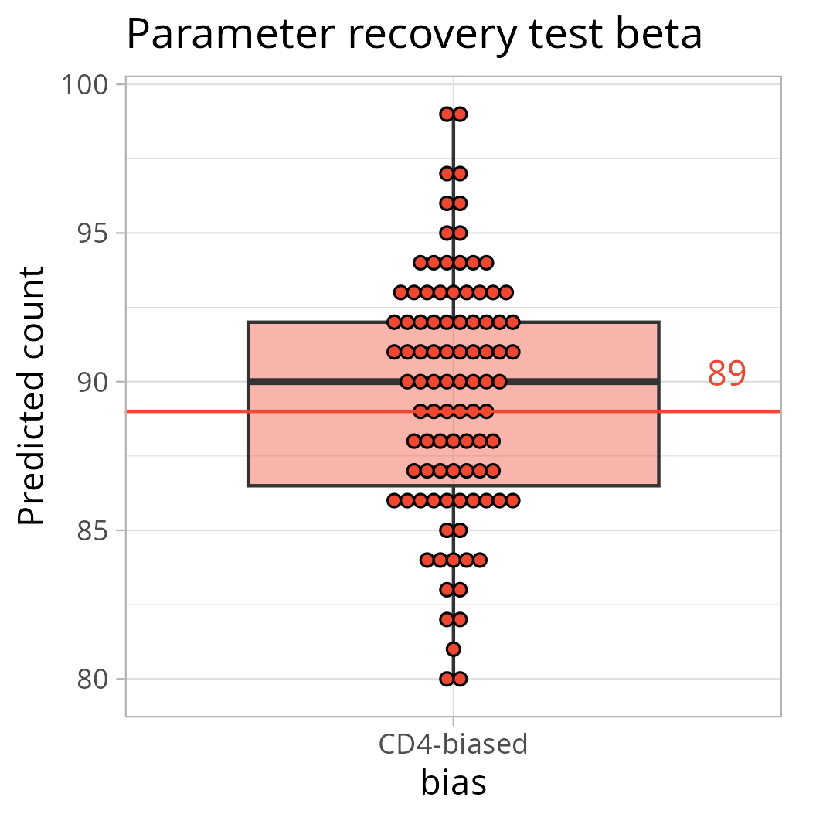
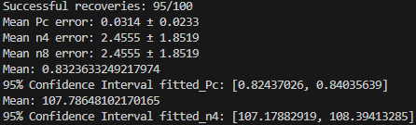
Parameter recovery
TCR beta
Input
true_Pc = 0.8311920832252657
true_n4 = 107
true_n8 = 7
5 simulations constantly failing
91 22 1 2x
89 24 1
86 27 1
88 25 1

Slide 13
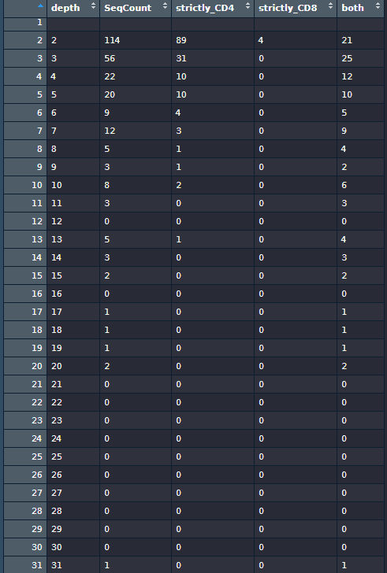
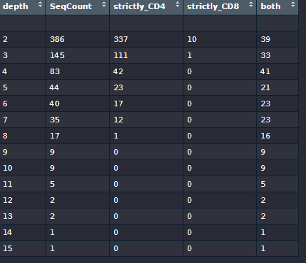
Depth division
TCR beta
TCR alfa

Slide 14
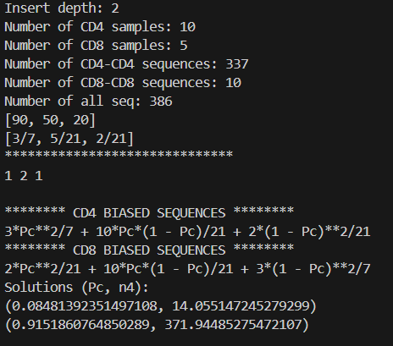
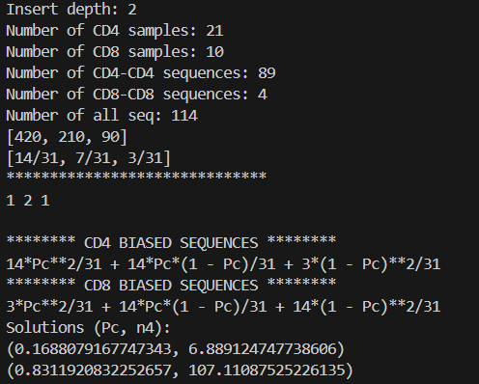
Other depths – testing script
TCR alfa
TCR beta

Slide 15
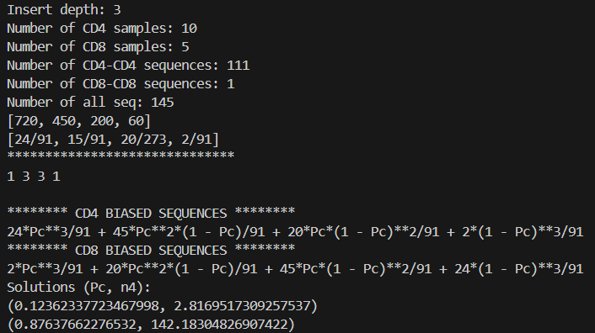
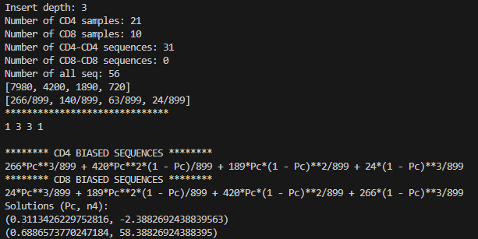
Other depths – 3rd
TCR alfa
TCR beta

Slide 16
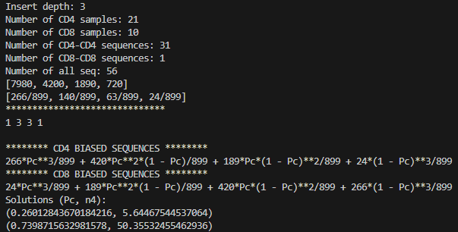
Other depths – 3rd
TCR beta
Increased number of CD8 sequences to 1

