Slide 1
251002 Cell fate meeting
Boehms paper

Slide 2
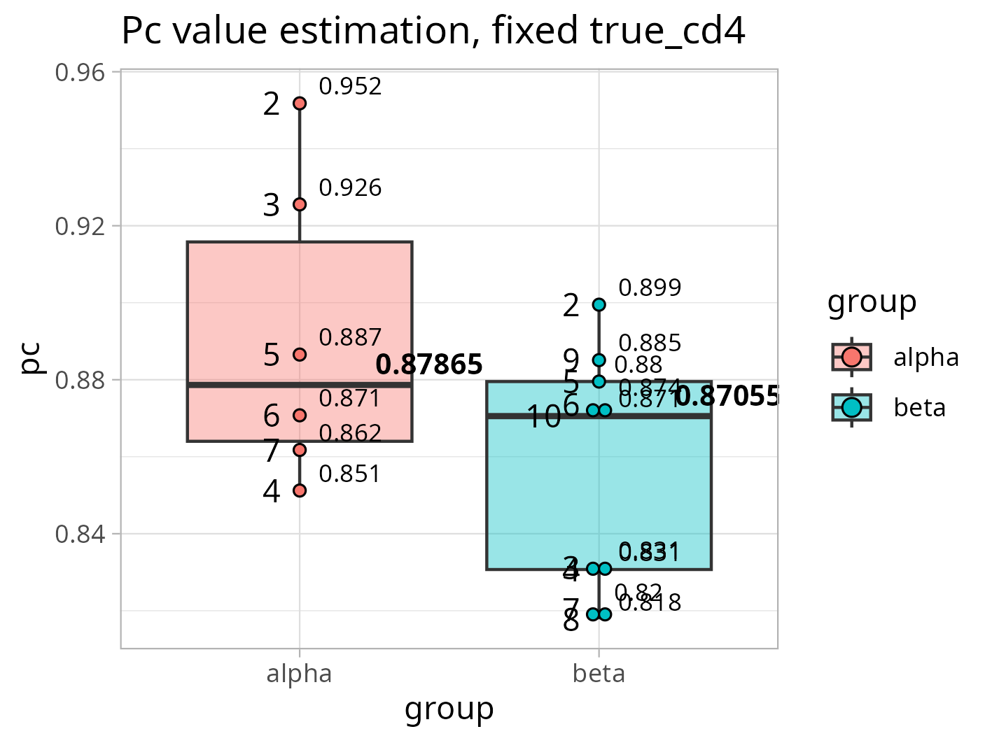
All depths with fixed true_cd4
%true_cd4 = 372/382 where
372 is true_cd4 for depth 2
382 is all_seq_count for depth 2
This parameter was then used to calculate expected value of true_cd4 in each of the depths
For each depth, the Pc was then calculated from equation
CD4-only = Pc^X*C where
Pc is commitment
X is depth
C is true_cd4 for that depth
CD4-only is number of seq that are present only in cd4 samples
Pc value displayed
depth

Slide 3
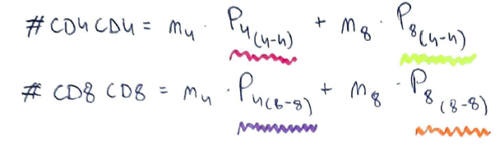
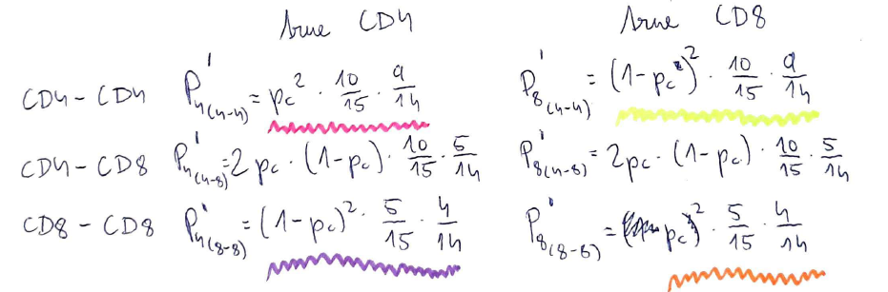
Pc estimation and true_cd4 fixed

Slide 4
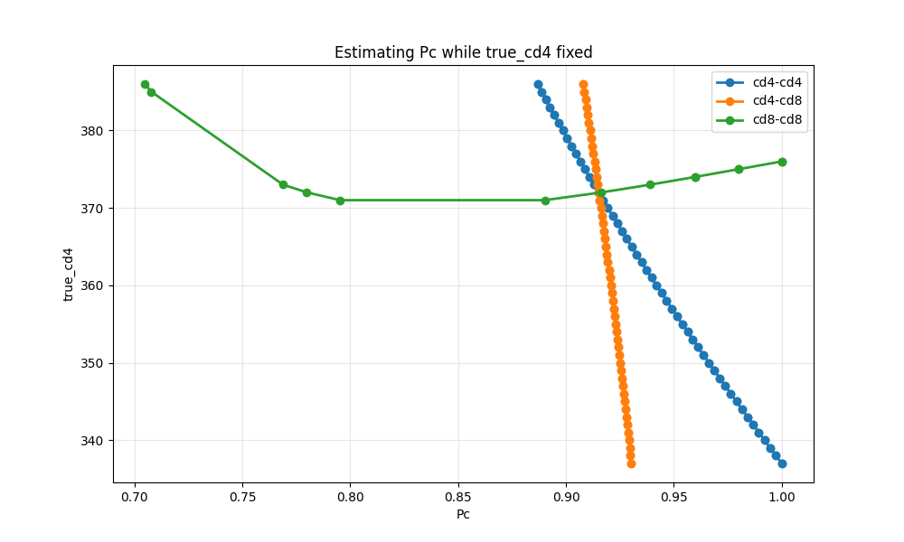
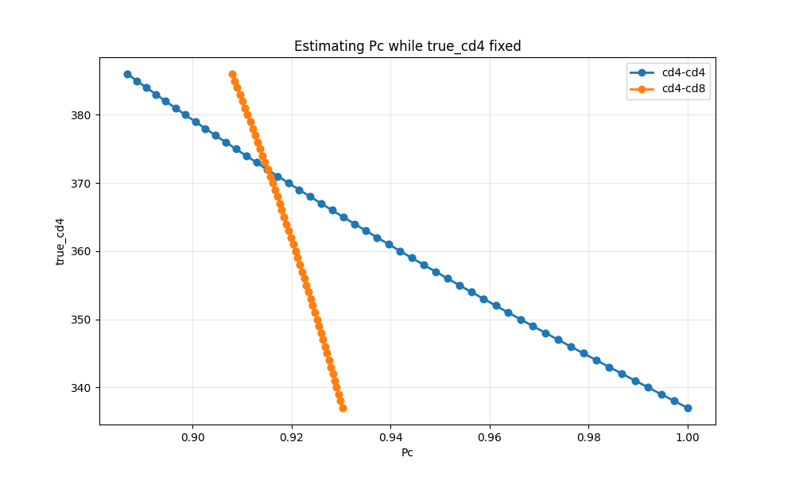
Pc estimation and true_cd4 fixed
alpha
For true_cd4 = 386, the Pc=0.886836

Slide 5
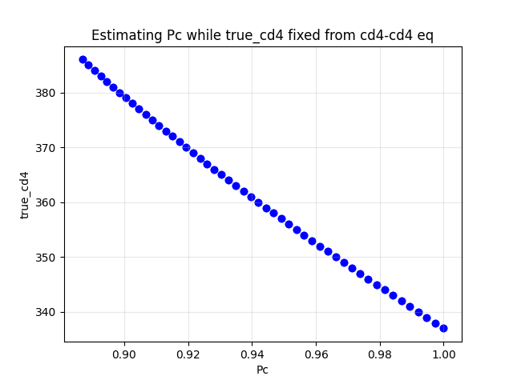
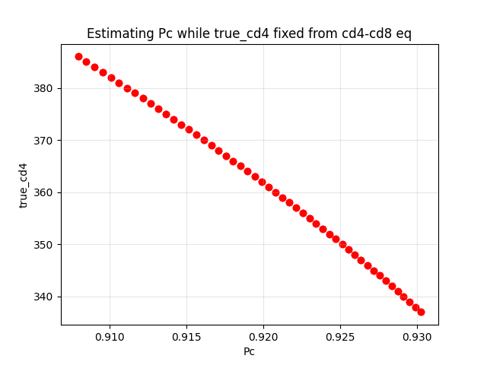
Pc estimation and true_cd4 fixed

Slide 6
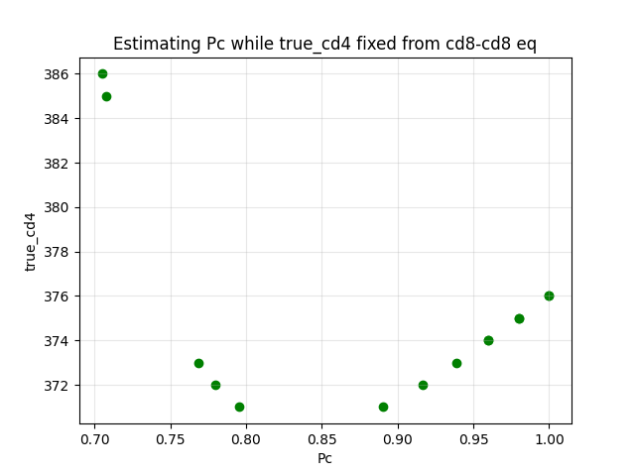
Pc estimation and true_cd4 fixed

