Slide 1
251002 Cell fate meeting
Boehm’s paper

Slide 2
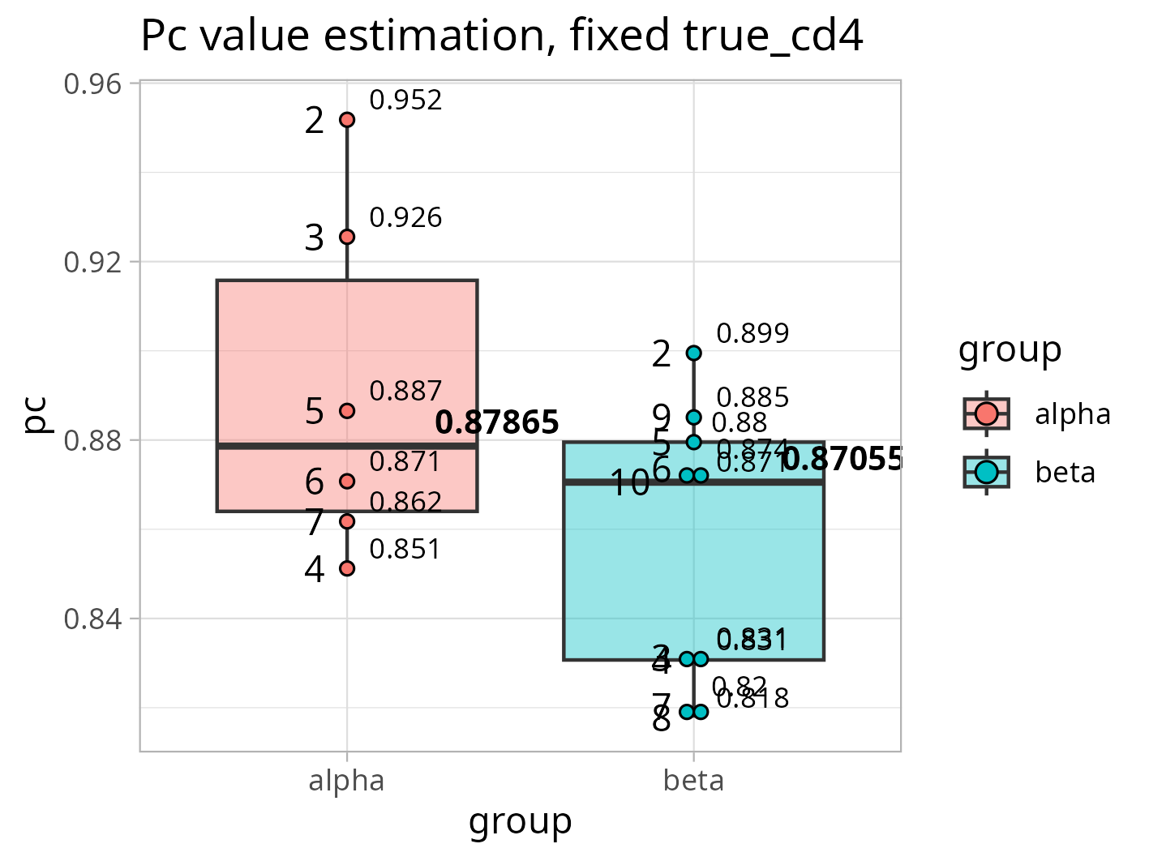
All depths with fixed true_cd4
%true_cd4 = 372/382 where
372 is true_cd4 for depth 2
382 is all_seq_count for depth 2
This parameter was then used to calculate expected value of true_cd4 in each of the depths
For each depth, the Pc was then calculated from equation
CD4_only = Pc^X*C where
Pc is commitment
X is depth
C is true_cd4 for that depth
CD4-only is number of seq that are present only in cd4 samples
Pc value displayed
depth

Slide 3
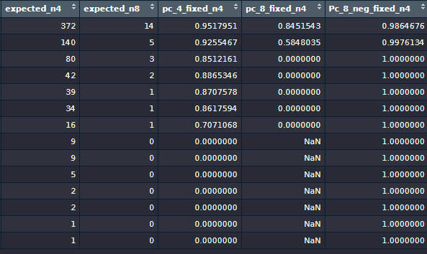
All depths with fixed true_cd4
n4 = true_cd4
n8 = true_cd8
Adding the equation for Pc based on true_cd8
The code:
pc_8_fixed_n4 = (CD8_only/(expected_n8))^(1/depth))
Pc_8_neg_fixed_n4 = (1-(strictly_CD8/(expected_n4)))^(1/depth))

Slide 4
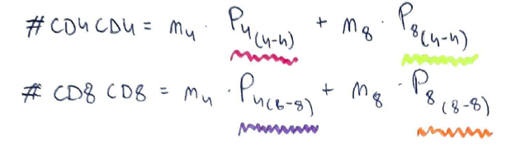
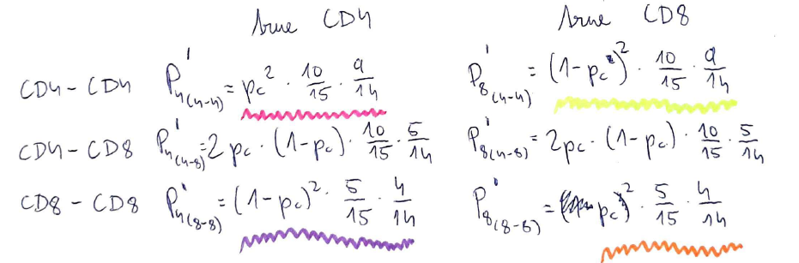
Pc estimation and true_cd4 fixed

Slide 5
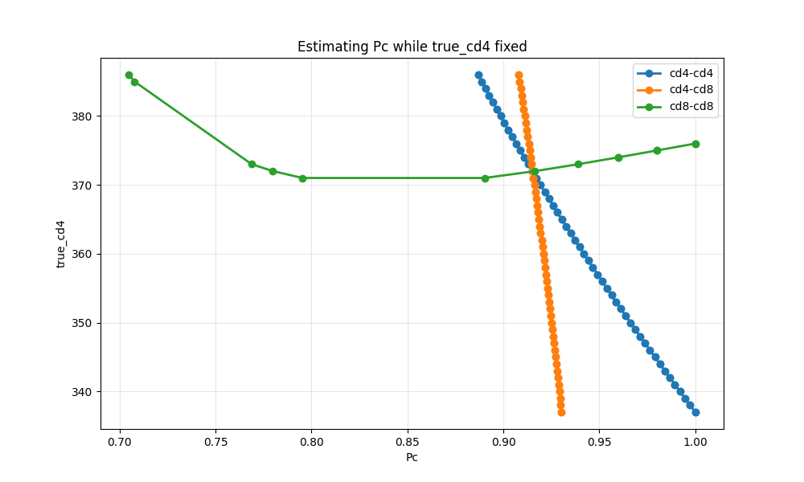
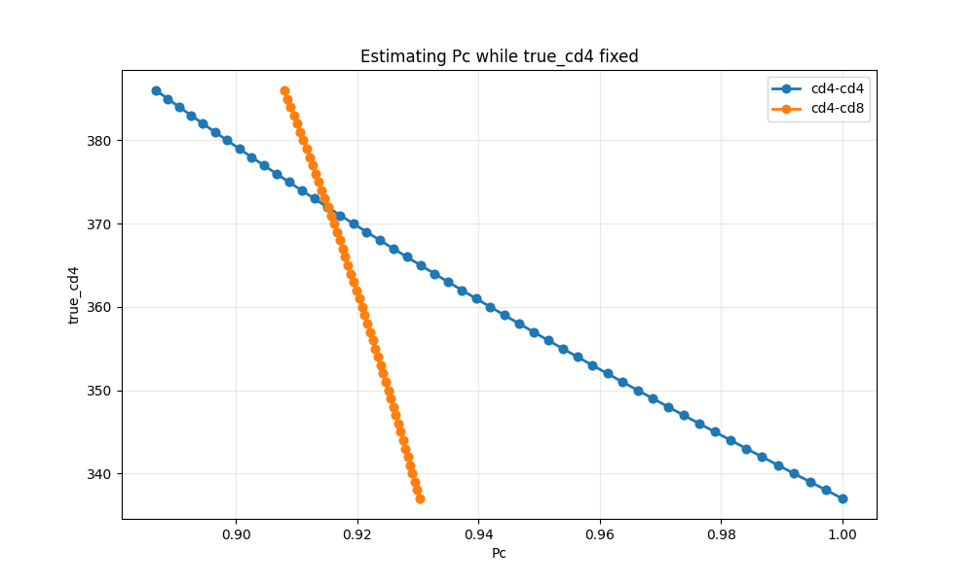
Pc estimation and true_cd4 fixed
Alpha, true_cd4 = 372
For true_cd4 = 386, the Pc=0.886836

Slide 6
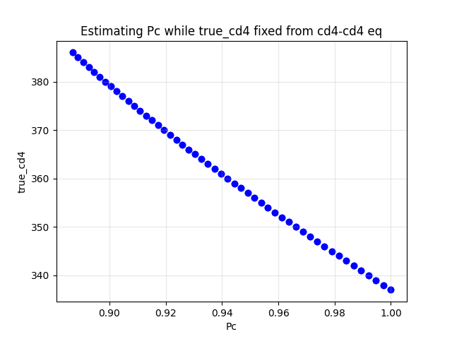
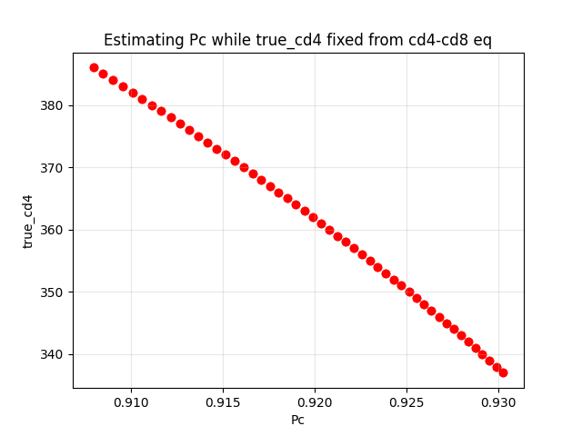
Pc estimation and true_cd4 fixed
Alpha, true_cd4 = 372

Slide 7
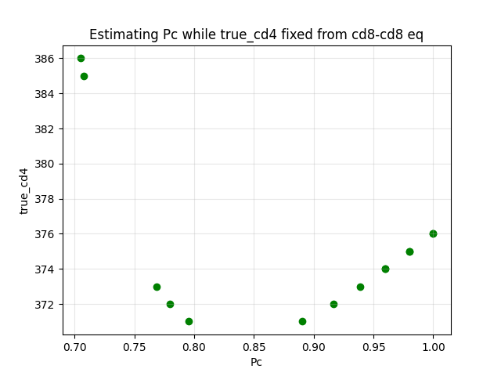
Pc estimation and true_cd4 fixed
Alpha, true_cd4 = 372

Slide 8
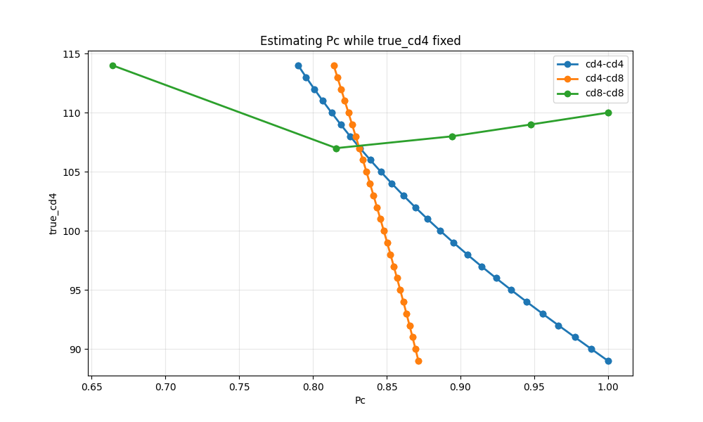
Pc estimation and true_cd4 fixed
Beta, true_cd4 = 89

Slide 9
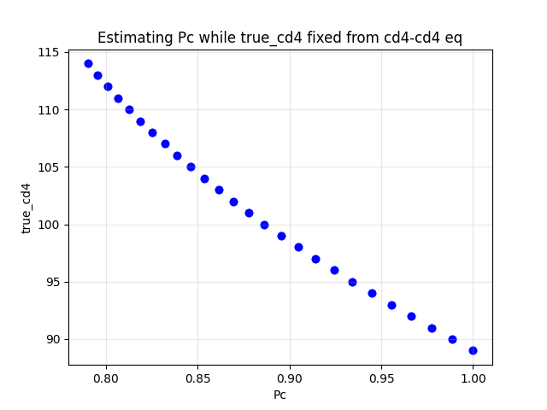
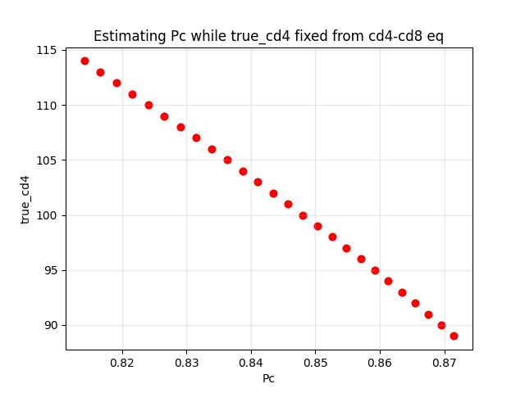
Pc estimation and true_cd4 fixed
Beta, true_cd4 = 89

Slide 10
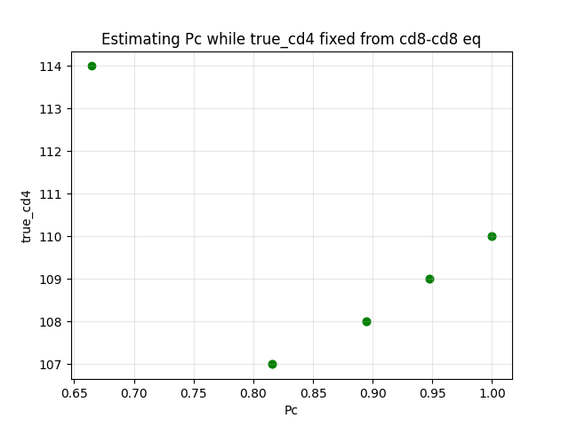
Pc estimation and true_cd4 fixed
Beta, true_cd4 = 89

