Slide 1





Project: Home Irrigation Control System (HICS) Team: SmartGrass
Team Status Report
March 26th, 2015
Belachew
Haile-Mariam
Gautam
Adhikari
Jeremiah
O’Connor
Tung
Vo
Notes:
This presentation demonstrates the new capabilities of PowerPoint and it is best viewed in Slide Show. These slides are designed to give you great ideas for the presentations you’ll create in PowerPoint 2010!
For more sample templates, click the File tab, and then on the New tab, click Sample Templates.

Slide 2
Testing and Document Progress
DDS Changes
Implemented changes in DDS to reflect review suggestions
Testing and STP
Team meetings to discuss testing approaches and timing of those methods
Started hardware, integration, and component testing for soil sensors, Arduinos, and Raspberry Pi
Divided sections of STP to begin creating

Slide 3
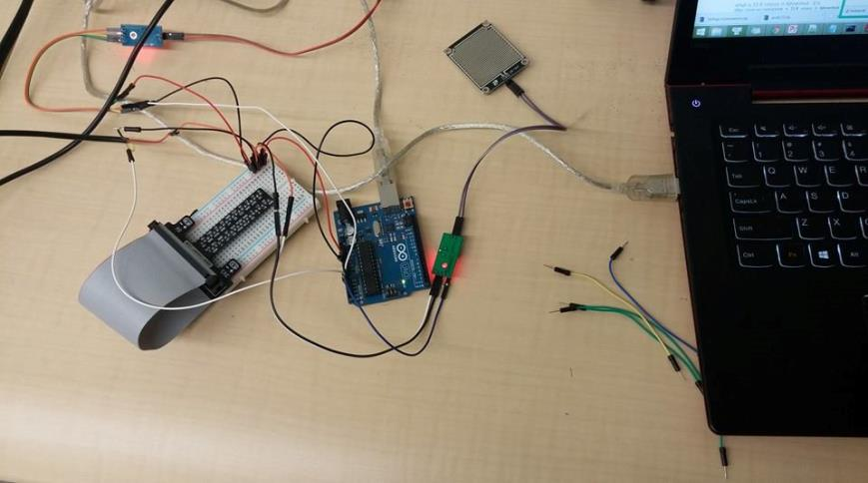
Prototype Development
Soil Moisture Sensor

Slide 4
Prototype Development
Soil Sensor Communication & Functionality
Wired and connected soil moisture sensor to Arduino
Verified functionality by dipping the sensor in and out of a cup of water and viewing the data stream to the Arduino

Slide 5
Prototype Development
Controller and Web Communication
Implemented API caller from the Raspberry Pi that connects to a URI and can receive data back from the call
Verified that the caller can send a JSON object to the API

Slide 6
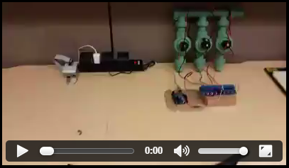
Prototype Development
Irrigation Valve Communication

Slide 7
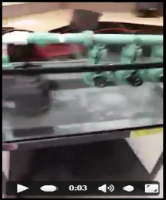
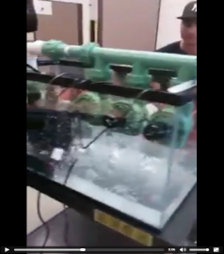
Prototype Development
Irrigation Valves and Demo Construction
Established communication between the Arduino and valves to control power
Able to control power for all valves and power for each individual valve

Slide 8
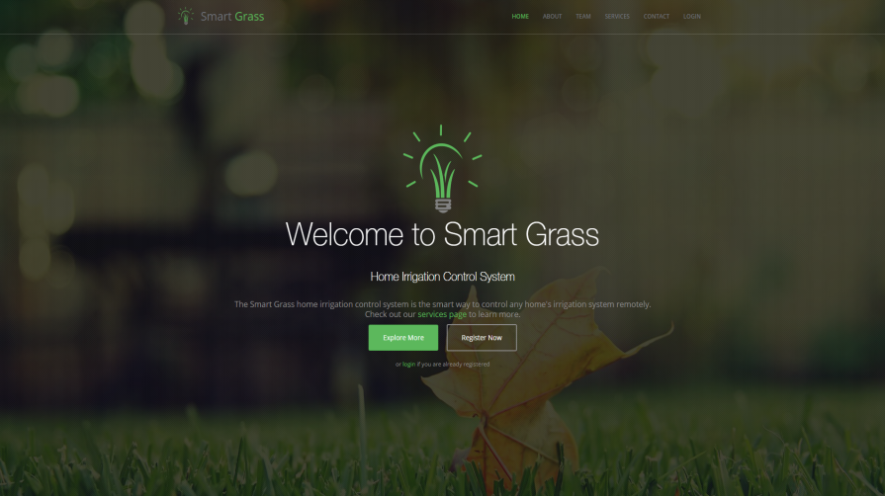
Prototype Development
Web Application UI

Slide 9
Prototype Development
Web Application UI
Started stylizing the web application pages
Added validation to login and registration
Made changes to logo to support scaling quality and color matching

Slide 10
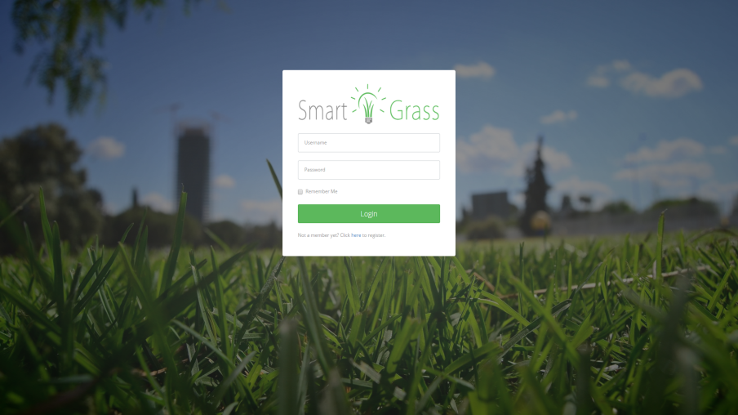
Prototype Development
Web Application UI

Slide 11

Any Questions?
?

