Slide 1
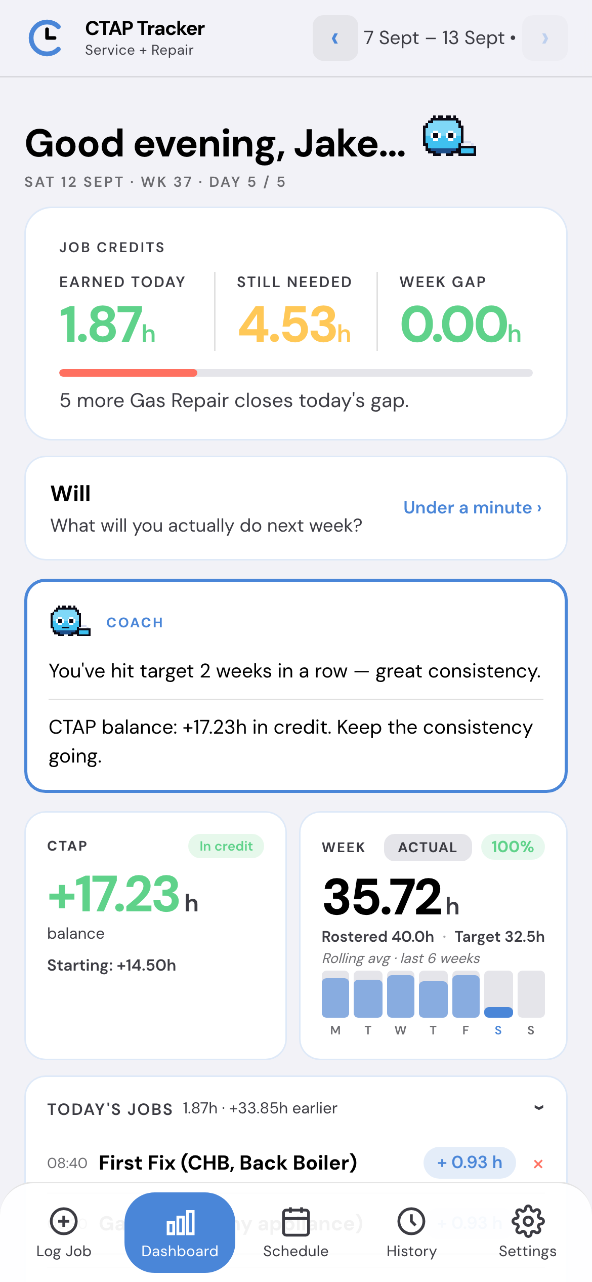
CTAP
Tracker
Know where your CTAP stands today, not next month.
TRIAL BUILD · v0.8.0 · SERVICE + REPAIR
Notes:
CTAP Tracker — a personal tool for Service & Repair engineers to track their CTAP bonus in real time. Built by an engineer, and looking for a handful of engineers, five to ten, to trial it: anyone a manager thinks would get something out of it. Everything you see is on-device; I will come back to that.

Slide 2
THE PROBLEM
You find out a week was short
when it’s already gone.
10–14
0
?
DAYS
IN-WEEK VIEW
AFTER TAX
Before MI lands
Nothing to act on
A balance in hours
By the time the figures come back, the week they’re about is long gone.
Nothing tells you mid-week that you’re behind while there’s still time to do something about it.
The bonus is a number of hours. Nobody tells you what that is in your pocket.
Notes:
The scheme is real money, but the feedback loop is broken. MI is ten to fourteen days behind, so you learn about a bad week when there is nothing left to do about it. This app closes that loop — it does not replace MI, it just tells you where you are now.

Slide 3
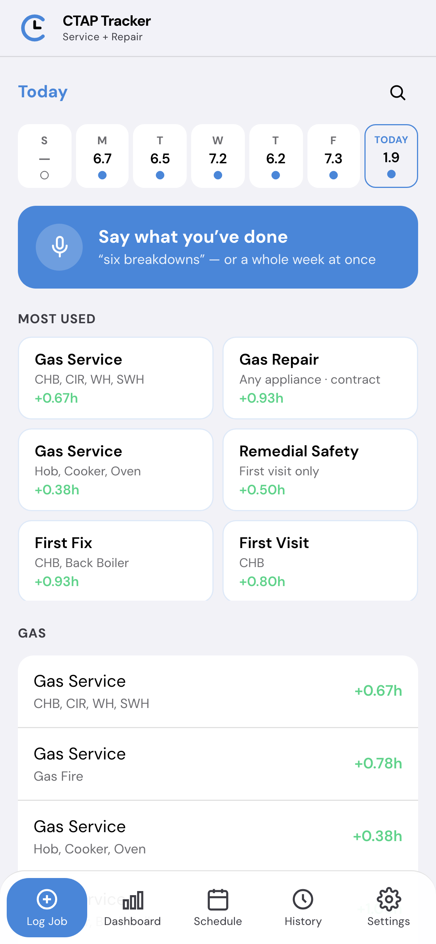
LOG IT
Say the day. It writes nothing
until you confirm.
“Six breakdowns and two services.”
A day, said once.
“Monday six breakdowns, Tuesday three services
and an inhibitor, Wednesday a long duration.”
A whole week, caught up on a Friday. Each day is read on its own and lands on the day you said.
It handles what voice does to trade numbers. “too high installs” becomes 2 × Hive install, not a job called “too high”.
Notes:
This is the bit engineers actually care about. You can talk a day in, or catch a whole week up on a Friday by naming the days. Critically it produces a draft, not a write — you see the proposed entries and anything it could not match, and nothing lands until you confirm. The worst outcome would be wrong figures you did not know about.

Slide 4
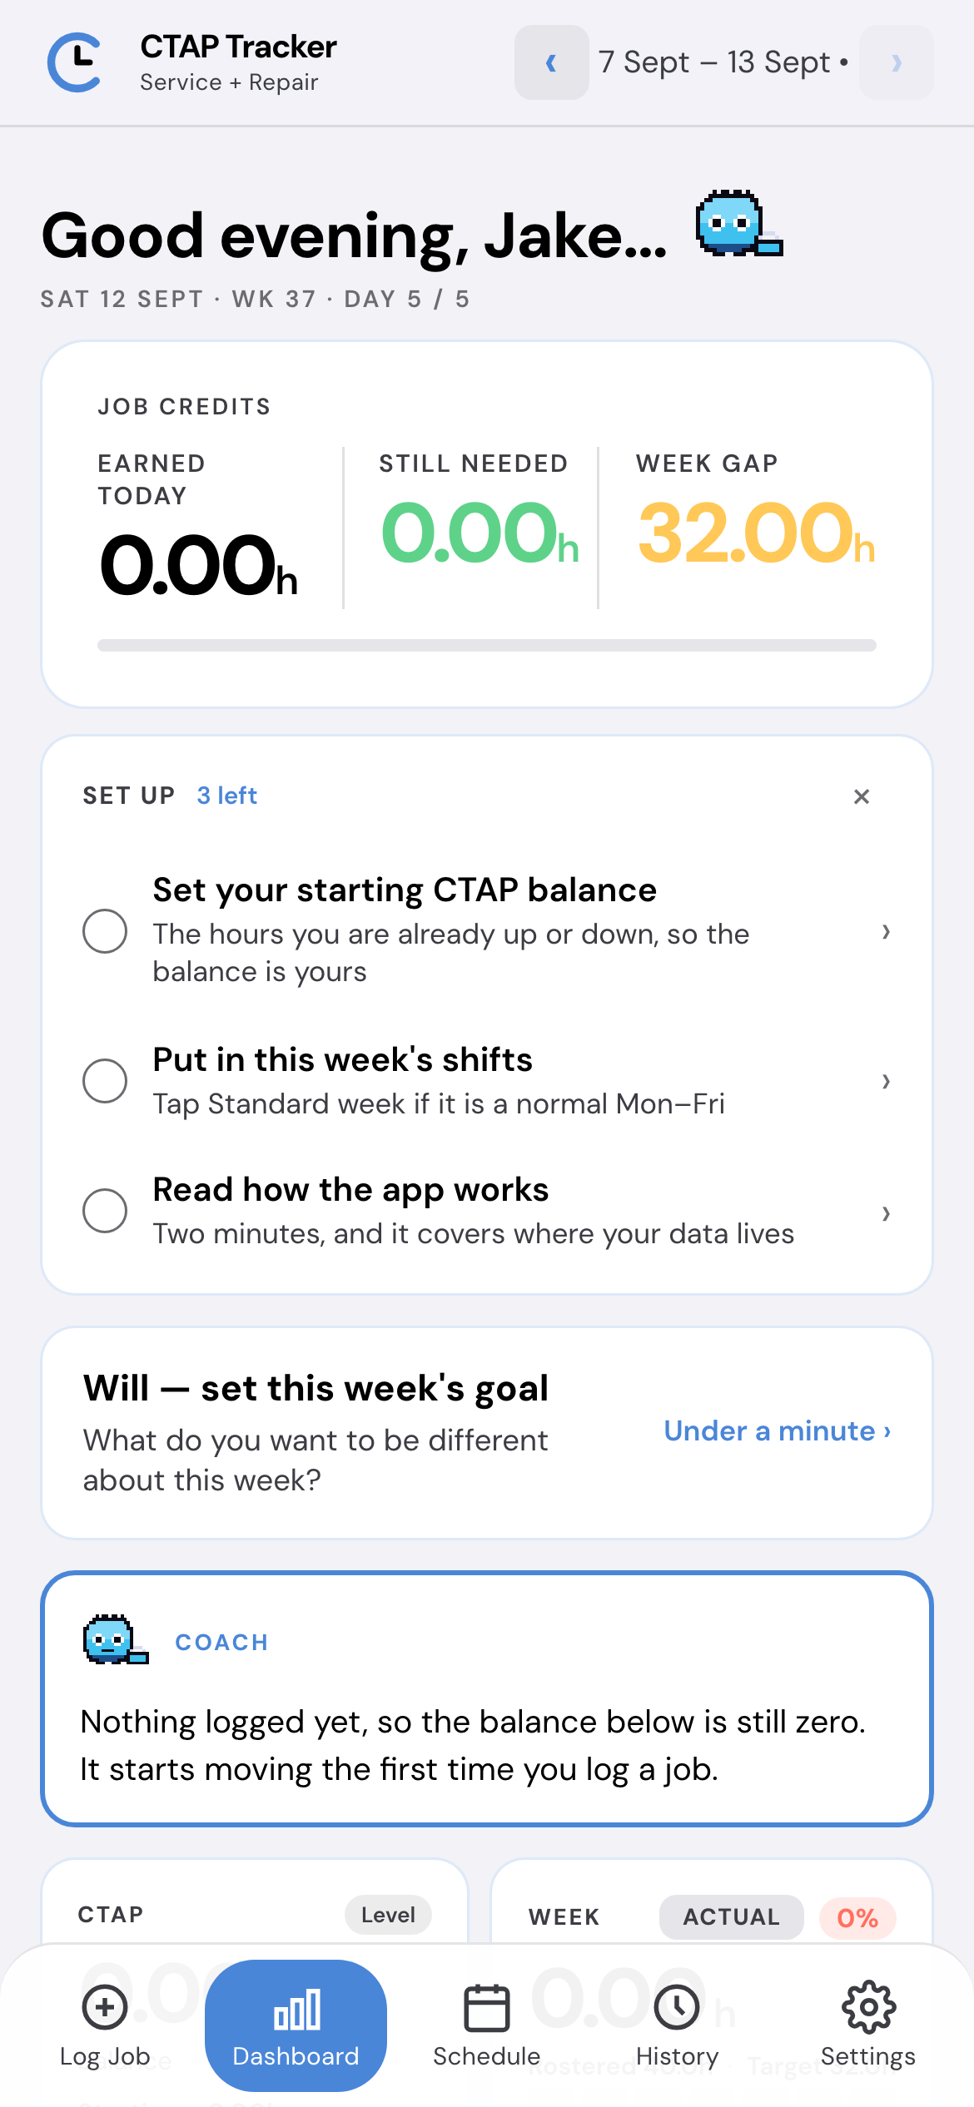
SET UP
Three taps, then it gets
out of the way.
1
Your starting balance
The hours you’re already up or down. Without it every figure starts from zero, which is almost certainly not where you are.
2
This week’s shifts
One tap if you’re a normal Mon–Fri.
3
How it works
Two minutes, covering where the data lives.
The card ticks each step off and disappears for good once they are done.
Notes:
First open. The app deliberately does not look finished until it is — the starting balance is the one setting that makes the headline number theirs rather than fictional, so the card names it rather than leaving it at zero.

Slide 5
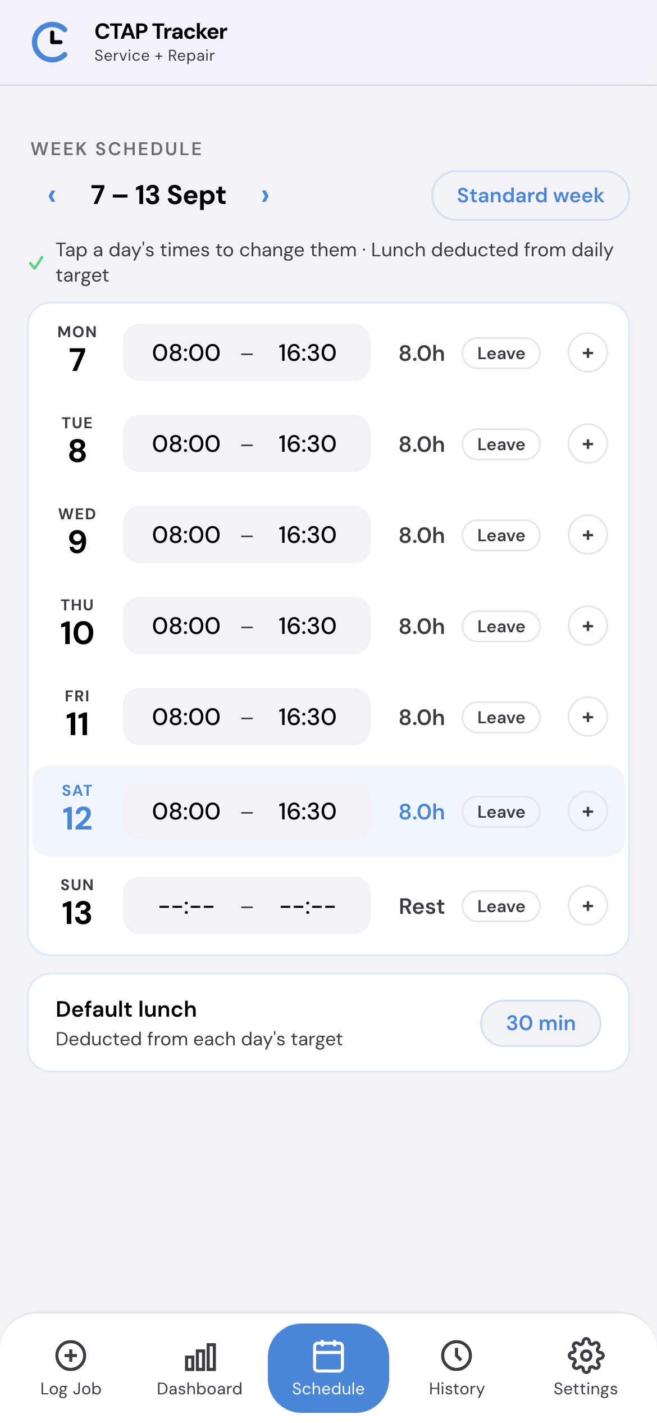
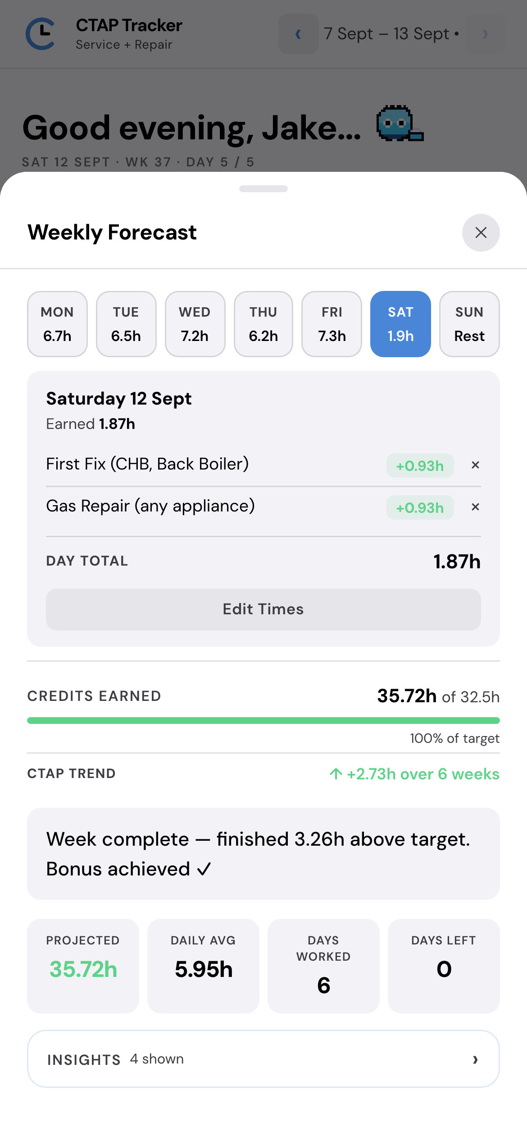
YOUR WEEK
Set the week you work,
then see all of it.
Tap a day's times, set them, Confirm
Copy a shift to any days you choose
No times means a rest day, not leave
The Weekly Forecast runs Monday to Sunday and opens on today. Days left counts only the days you're working, so a Friday off doesn't spread the target over an extra day.
A rest day keeps your 40 hours. It just isn't a day you're expected to earn on, unlike leave, which takes that day's hours off the week.
Notes:
New since the first version of this deck. Shift times are set in a picker with a Confirm, because the iPhone time wheel used to close after the first scroll. An engineer on a rota can copy a shift to exactly the days they work. A day with no times is a rest day: it isn't leave, so the week keeps its 40 hours, and nobody has to mark it, because it's read from the Schedule.

Slide 6
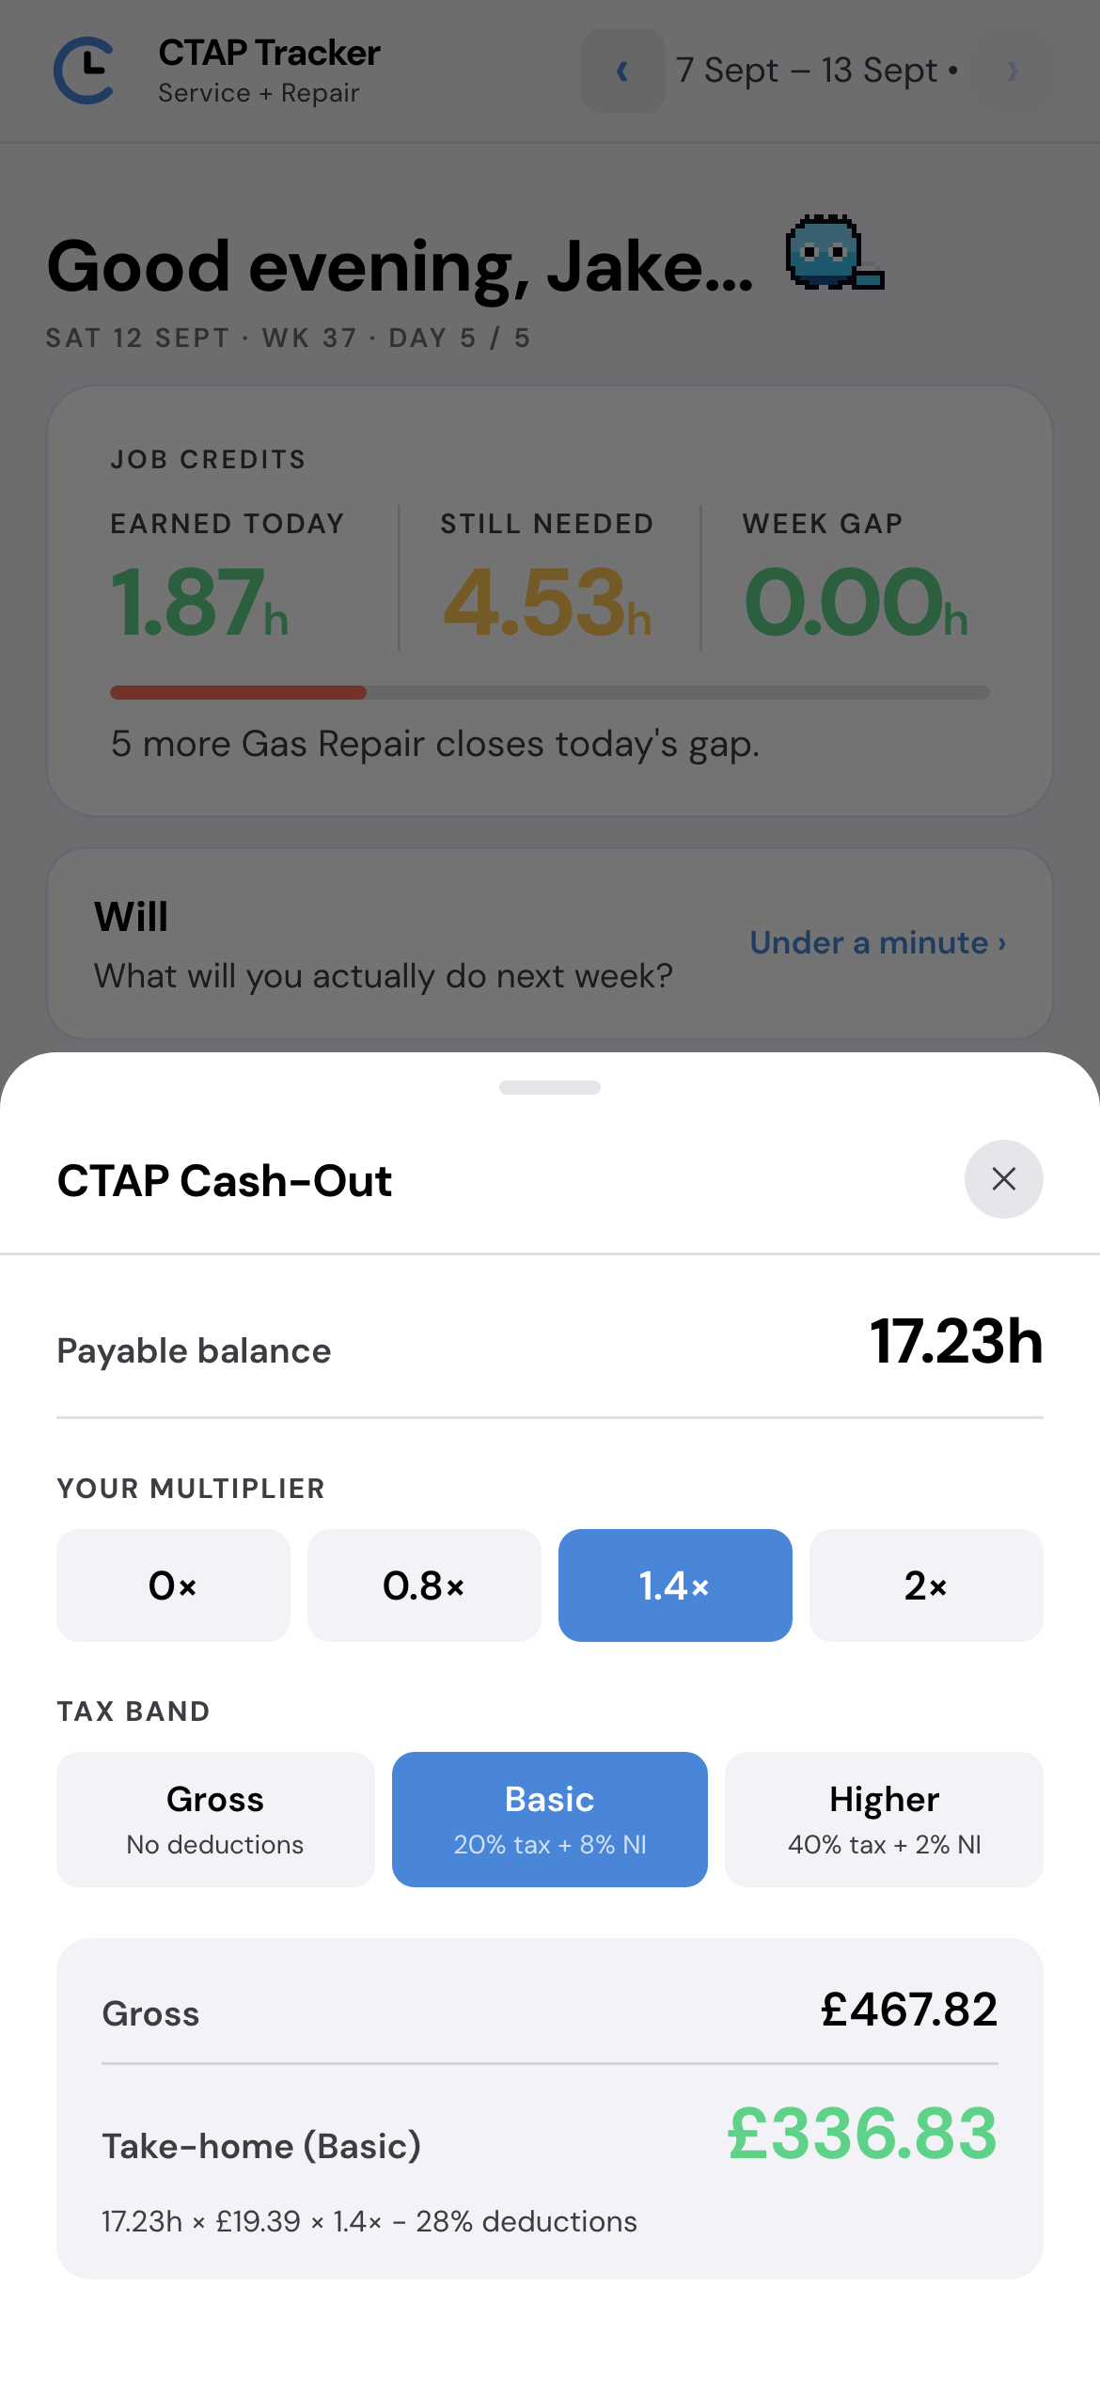
WHAT IT IS WORTH
Hours, converted into
what reaches your bank.
WEEKLY TARGET
40.0h rostered × 80% = 32.0h
The 80% is a buffer for travel and performance factor. After four logged weeks it uses your own rolling average instead.
CASH-OUT
17.23h × £19.39 × 1.4× − 28%
£336.83 take-home
The arithmetic is printed under the figure in the app, so it can be checked rather than trusted.
Notes:
Set your multiplier and tax band and it shows gross and take-home. Example figures on screen. This is the thing that turns the bonus from an abstraction into a decision.

Slide 7
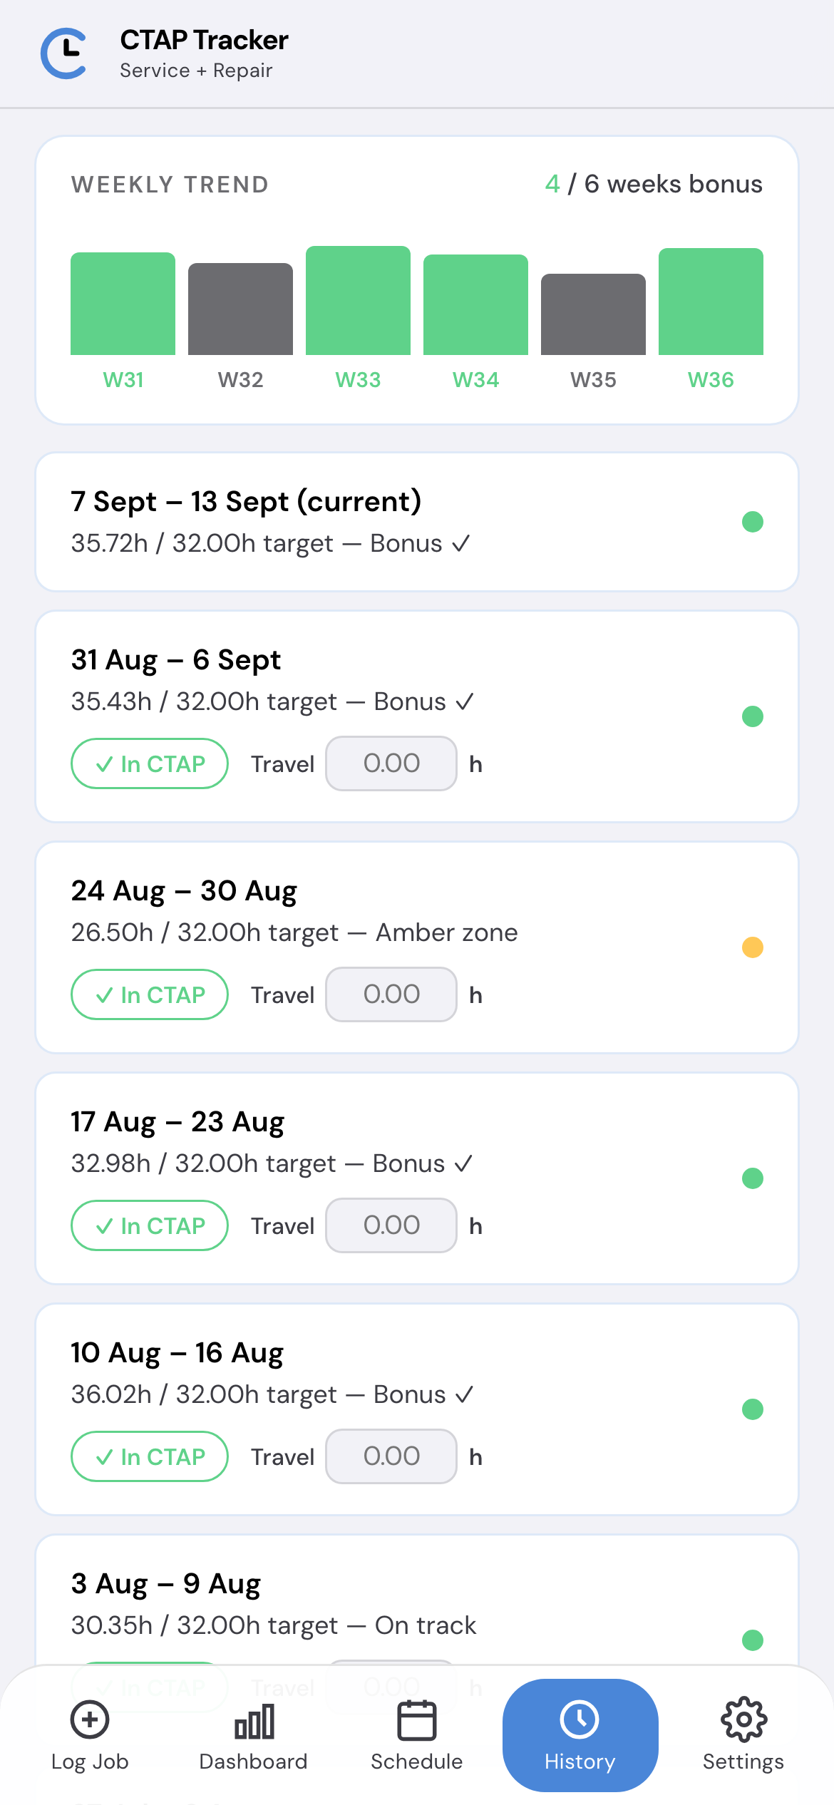
WHERE YOU STAND
Every week you’ve logged,
and the balance that carries.
Green — bonus hit
Amber — on track
Red — below target
Had a week that wasn’t a fair test? Sickness, a phased return, a week you were still getting the hang of the app. Untick it and it stays out of your balance without being deleted.
Your balance never resets. It carries on from wherever you were already up or down, week after week.
Notes:
History gives the pattern rather than a single week. The exclude toggle matters for fairness — a week of certified sickness should not drag a balance down, and deleting the data to achieve that would be worse.

Slide 8
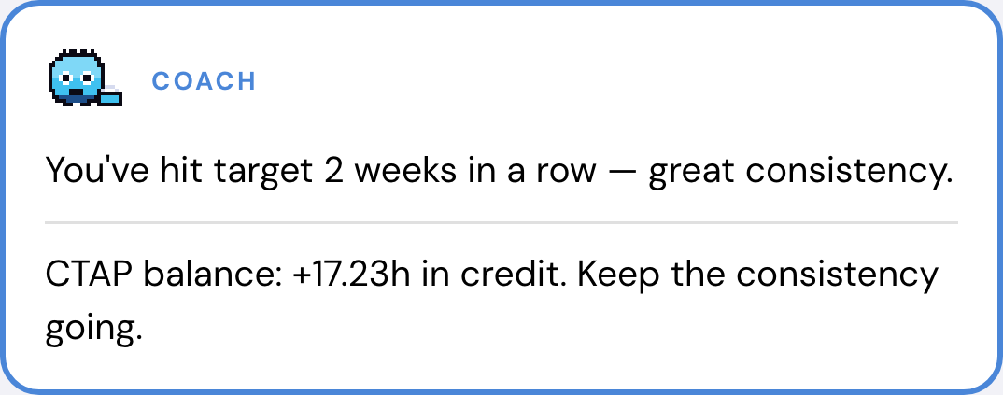
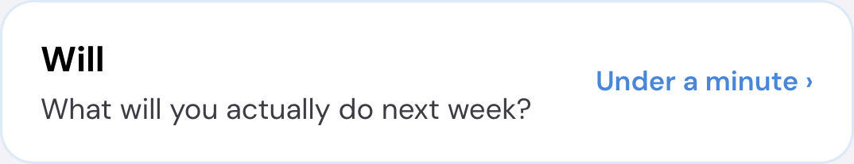
COACH MODE AND THE DAILY CHECK-IN · BOTH OPTIONAL
Coach works out the way back.
The check-in is your own diary.
Coach Mode
The daily check-in
Built on GROW. Goal, Reality, Options, Will. One question a day, and it takes under a minute.
An honest diary. Where the gaps in the day were, what you’re struggling with, what you’d do differently. It’s there for the engineers who genuinely want to use it.
Only you can read it. No team view, no export, no comparing engineers. That’s how it’s built, not a setting.
Your run rate. How many jobs, or how many hours, get a deficit down, and by when. Keep going as you are today and it tells you where you’ll be in ten days.
What lifts the balance most. On the visit you’re already on: a Hive, an inhibitor, a CO alarm, a boiler lead. It shows what each one is worth against today’s gap.
Never dispatched work. It won’t suggest a service or a repair you weren’t given, so it can’t nudge anyone into raising work that wasn’t done.
Notes:
Both optional, both off in one tap in Settings. Coach is the bit I would show a new engineer first: it turns the figures into a run rate and tells you what the extras on a visit are worth. The check-in is a private diary built on GROW. There is no management view of it, and that is a property of the build rather than a promise.

Slide 9
YOUR DATA
Everything stays
on your phone.
It’s completely secure, because there’s nothing to secure: every figure you log lives on your own phone and nowhere else. No account, no upload, no server. Nobody can see your CTAP figures but you.
!
The one catch
ACCOUNT
None. Nothing to sign into, nothing to sign out of.
There’s no backup. Delete the app, erase the data or lose the phone and it’s gone. Nobody can get it back, because nobody else ever had it.
Engineers are told this before they start.
UPLOAD
None. Once it’s installed it makes no network requests at all.
SHARED WITH
Nobody. Not your manager, not me, no analytics.
OFFLINE
Works fully, which matters in plant rooms and cellars.
DELETING
Settings → Erase all data, and it’s gone straight away.
Notes:
The data question, answered the simple way: nothing leaves the phone, so there is nothing to protect on a server and nobody to share it with. The catch is real and we say it up front: no backup, no recovery.

Slide 10
TRIAL
Where it’s up to, and who I’m after.
v0.8.0
5–10
0
429
SHIPPED VERSION
ENGINEERS WANTED
THIRD-PARTY REQUESTS
AUTOMATED TESTS PASSING
Who I’m looking for
Engineers in a slight deficit who want to get it back.
New recruits who aren’t on CTAP yet, or are just starting.
Anyone a manager thinks would get something out of seeing their figures day to day.
Jake Rainford · Service & Repair Engineer · any questions, get me on email or Teams
Personal estimates only — verify against your payslip and company tools. Not affiliated with, endorsed by, or representative of Centrica plc, British Gas or any employer.
Notes:
What is shipped, and the ask: a handful of engineers, five to ten, who a manager thinks would get something out of it. Engineers a little behind on CTAP and new starters get the most from seeing the figures day to day. Nobody can install it without the link, so it goes out to whoever comes forward.

