Slide 1
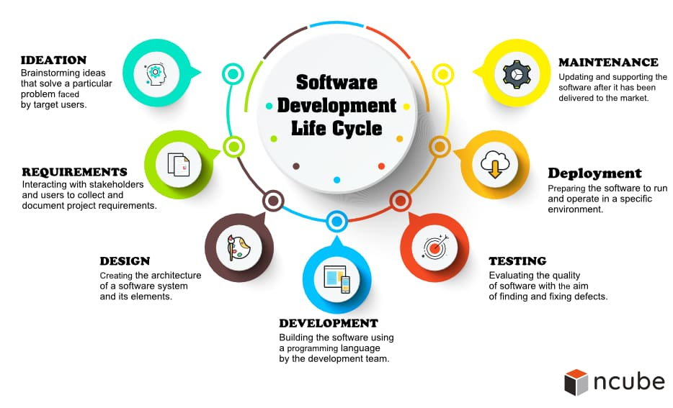

Slide 2
Car Auction
1-Project Idea:-
1-Idea
2-Goals
3-Auction’s Features
4-Auction’s problems
5-Problesms we encountered
2-Project Analysis:-
3-Database:-
4-Coding (with python django (MVT)):-
1-model
2-view:
1-URLs
2-API’s
3-Template
5-Mobile Application:-
6-Why this project..

Slide 3
1.1-Idea:
-Online Auction for sell & buy cars online, that the car’s owner can show his car in details and uploades it to the site to be auctioned, and the buyer can search for any car he wants by it’s (name,model,transmission type,mileage… etc), and can bid on it.
1.2-Goals:
-The user can find any car easily.
-The user can pay his money in a safe way.
-The owner upload his car to appear publicly.
-The owner upload his car to get the best price to his car.
-Preventing the separation between the seller and the buyer.
-Encourage people to buying from online stores.
-There’re no geographical or time obstacles for user.

Slide 4
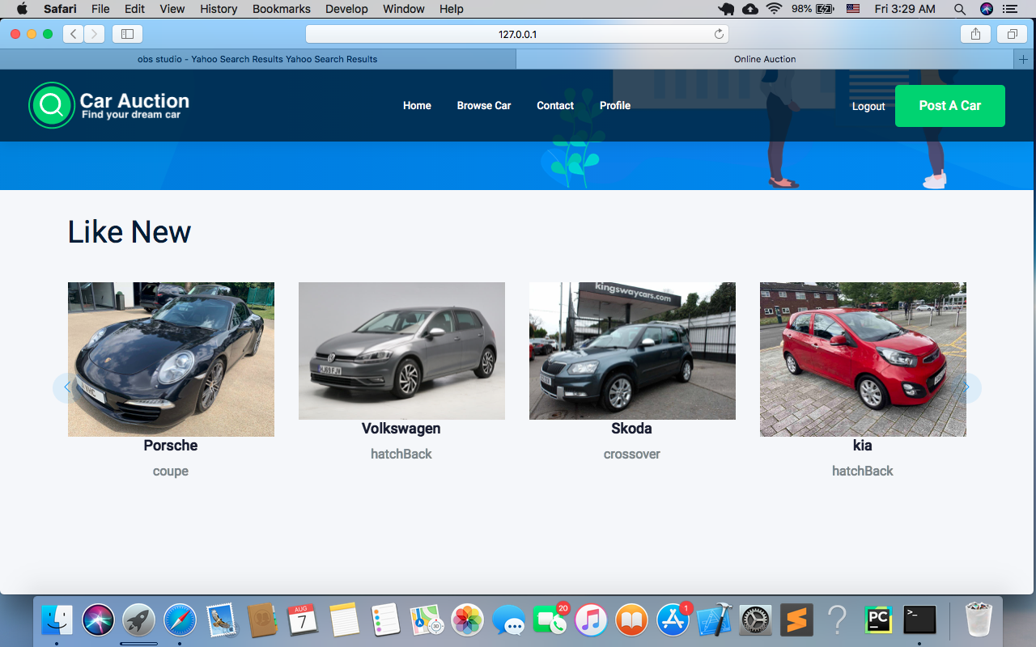
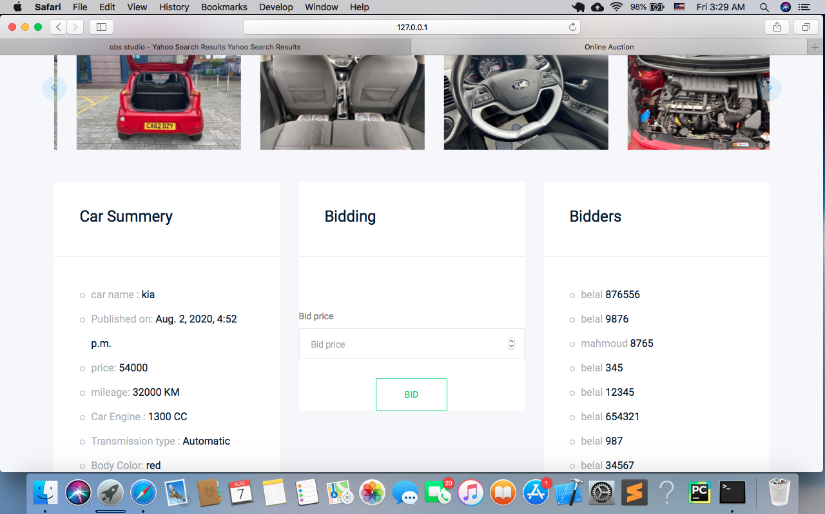

Slide 5
1.3-Auction’s Features:
- For buyer:-
- Search for cars and filter them based on your
specifications.
- Pay in easy way.
- Bid in real time.
- Dashboard to post requirements and view bid results.
- For Seller:-
- Provide the sellers with dashboard to post his car.
- Set the base price.
- The seller can track the bidding process.
- When the auction ends, he can accept or reject the price.
- He can manage his profile.
- He sells his car and get his money easily.

Slide 6
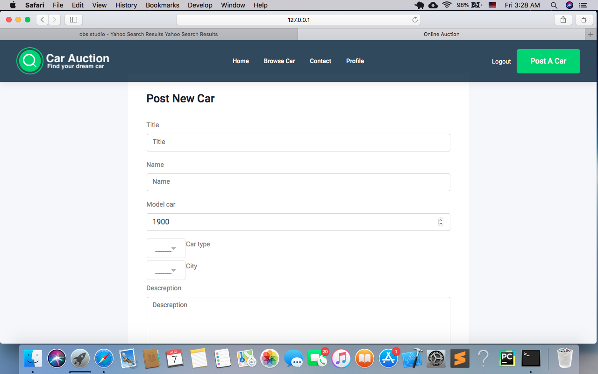
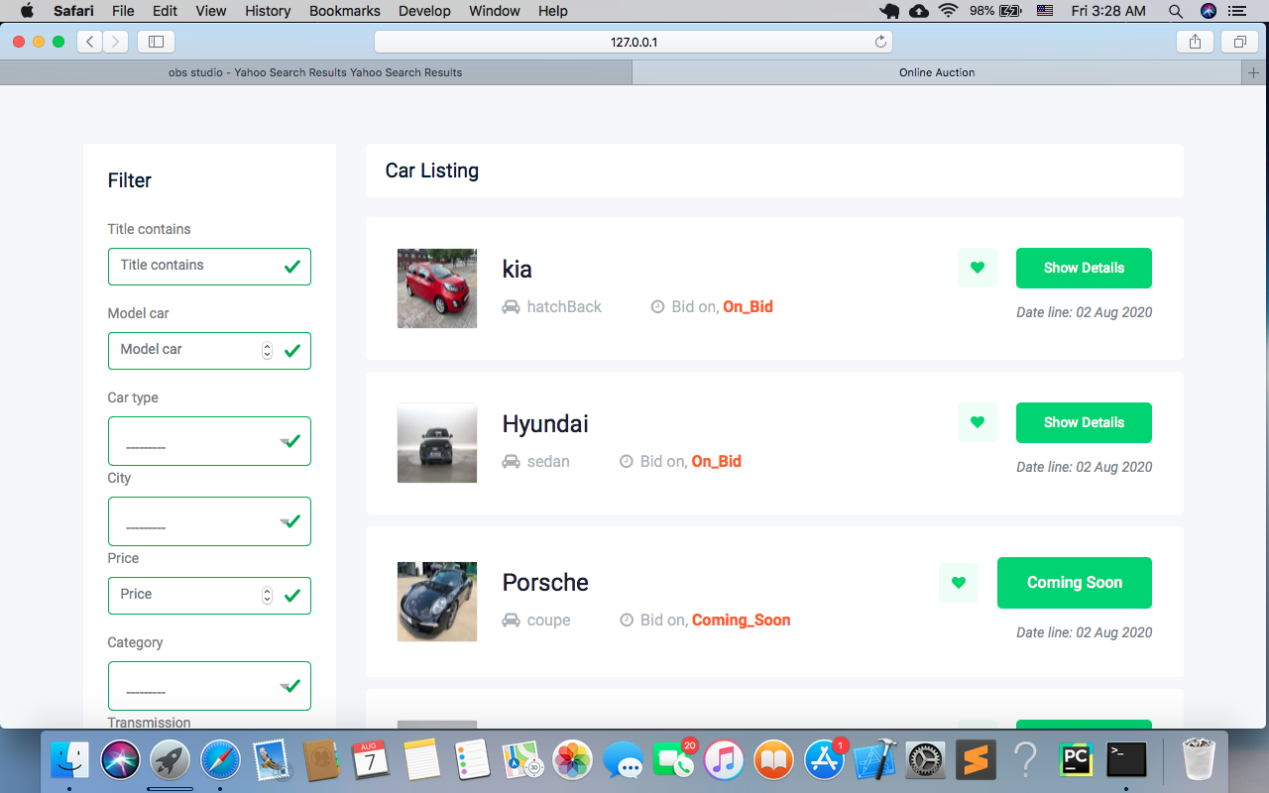

Slide 7
1.4-Auction’s Problems:
-Having a bank account and internet subscription.
-Slow sales process, auction may last for several days.
-There is a problem with buyers' confidence, as auction
sites may occasionally contain vendors who do sittings.
-The bidder have to wait until the bidding process ends.
Previous Similar Projects:
- eBay Motors:-
*Advantages:
- eBay Motors works the same way as traditional eBay.
- The many filtering options help you find the exact vehicle you're
looking for.
*Disadvantages:
- You'll need to figure out your own transportation and shipping after
the auction is won if you didn't purchase the vehicle locally. eBay
doesn't do that for you.

Slide 8
- Salvage bid:-
*Advantages:
- There are many vehicles in great condition on Salvage Bid that just
need some TLC to get up and running again.
- Cars on this site are extremely affordable.
*Disadvantages:
- The premium membership will cost you $200 a year, regardless of
how often you use it.
- For live auction bidding, a premium membership is required.
- Auto Auction Mall:-
*Advantages:
-You get access to dealer-only auctions, saving you thousands off the
retail price of your vehicle.
*Disadvantages:
-After spending cash on a vehicle, you'll be required to pay Auto
Auction Mall a $299 fee for allowing you entry into the auctions on
its website.

Slide 9
1.5-Problems we encountered:
-User authentications.
-User validations.
-Contact between the user and Admin.
-Sqlite with image.
-Deploying the site.

Slide 10
2-Project Analysis :-
Browse
SignUp
Login
Post Car
Home
User Authenticate
Bidding
Profile
contact
Car detail
Logout

Slide 11
3-Database :-
cars
PK : car_id
FK : owner
title
name
Model_car
Car_type (ch)
FK : city
description
Published_at
mileage
price
engine
Bid on
color
category
City_car
name
Bid_price
FK : Owner_bid
Bid_price
User
username
First_name
Last_name
email
Profile
1_to _1 : user
phonenumber
city
image

Slide 12
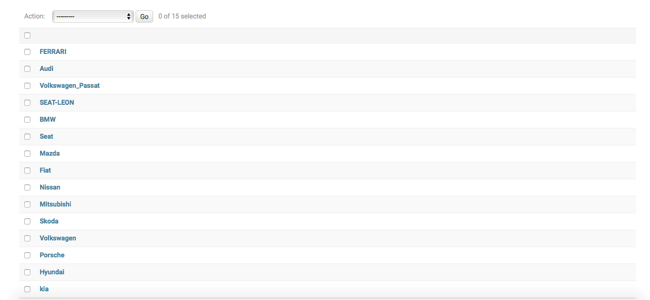

Slide 13
(M V T)
4.1-Model:
- Any python (django) application have model, because
the model express the database.
- We need the model to store the whole information for
the object.
- Place model for object to make the access to the
information easy.
- Put the keys to the tables to link them and navigate
information easily.

Slide 14
4.2-View:
- A view function is a python function, that takes a web request and
return response, this response can be an HTML, redirect or error.
-With view, we can handle method to show what we want in any
page.
-We can put a context to View, because the context gets some or all
the information from database, and after that we return render
with request, HTML page and context.
EX:- Return render(Request, Example.HTML, Context)

Slide 15
4.2.1-URLs:
- It’s a path for the view function to show information on a page.
EX:- Path(‘Example/’, View.function_name, name=‘Example’).
- Django provides to us libraries to make registration pages.
EX:- Path(‘Example/’, Include(‘Django.contrib.outh.URLs’)).
- We may need URLs pattern to store media and static file.

Slide 16
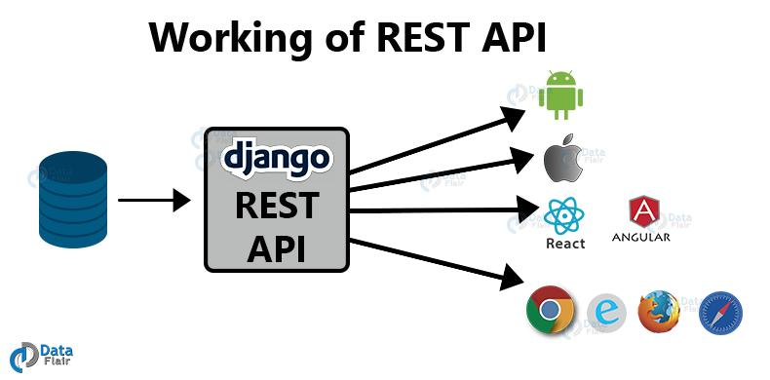
4.2.2-API’s:

Slide 17

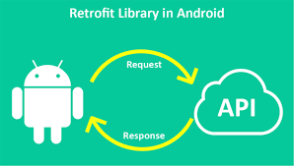
5-Mobile Application:
XML is used for layout designing.
All the UI and layout of our app was designed using XML.
Xml helps you to design the app (how it will look, how components like buttons, text view, icons… etc, will be placed and their styling).
Apart from these, XML is also used for parsing data either from database or server into your android app. (XML, parsing).
Retrofit Library in Android..
Retrofit is REST API Client for Java.
It is devoloped by Square Inc.
It uses OKHTTP library for HTTP Request.
It is a simple library that is used for network transaction.
It is very easy and fast library to retrieve and upload the data viaa REST based web service.

Slide 18

Whats is Java?
Java is a programming language
expressly designed for use in the distributed environment of the Internet.
It was designed to have the “look and feel”
Of the C++ Programming language, but it is simpler to use that C++ and enforces an object-oriented Programming model.
Features of web Application?
- Cloud-hosted and scalable.
- Cross platform.
- Modular and loosely coupled.
- Easily tested with automated tests.
- Simple development and deployment.

Slide 19
Why API’s..?
We make mobile application to make it easier for people to access the site via mobile

Slide 20
6-Why this project..?
Thanks to technonlgy, managing a project has never been easier, with computerized project management tools a-plenty and project management apps available for almost any device, just about anyone can have access to intuitive and sophisticated software.
It provides a visualization of the all process.
This project provides to the clients to find any car easily and fast with
the price he want, the web project makes you pay safely.
We made this project to make traffic on the internet in Egypt.
This project is the first online auction in Egypt & Middle East.
In this project, the seller can post his car and makes more and more people see it, and it’ll be sold quickly.

