Slide 1
Datawarehouse analysis

Slide 2
DataBase & Dimention Exploration
Data Exploration
Measure Exploration
Magnitude analysis
Ranking Analysis

Slide 3
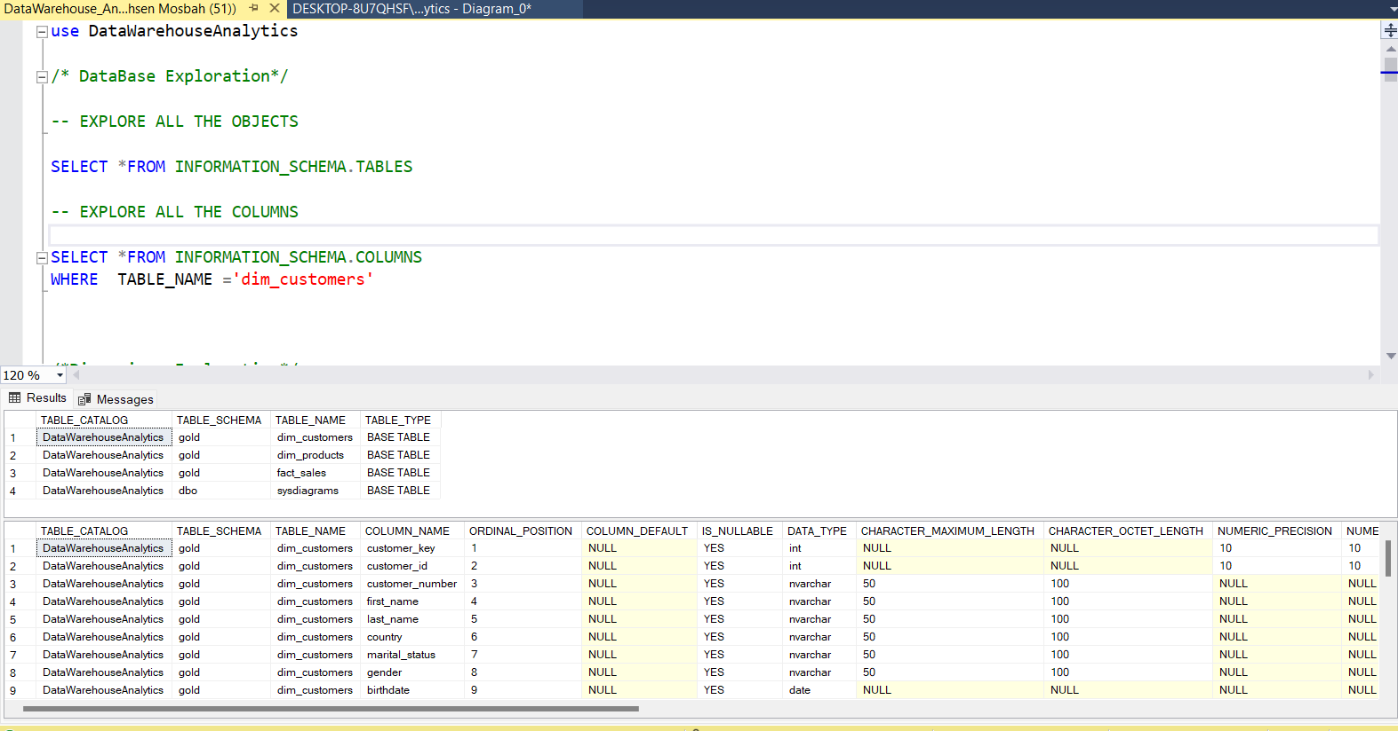
Database & Dimention Exploration

Slide 4
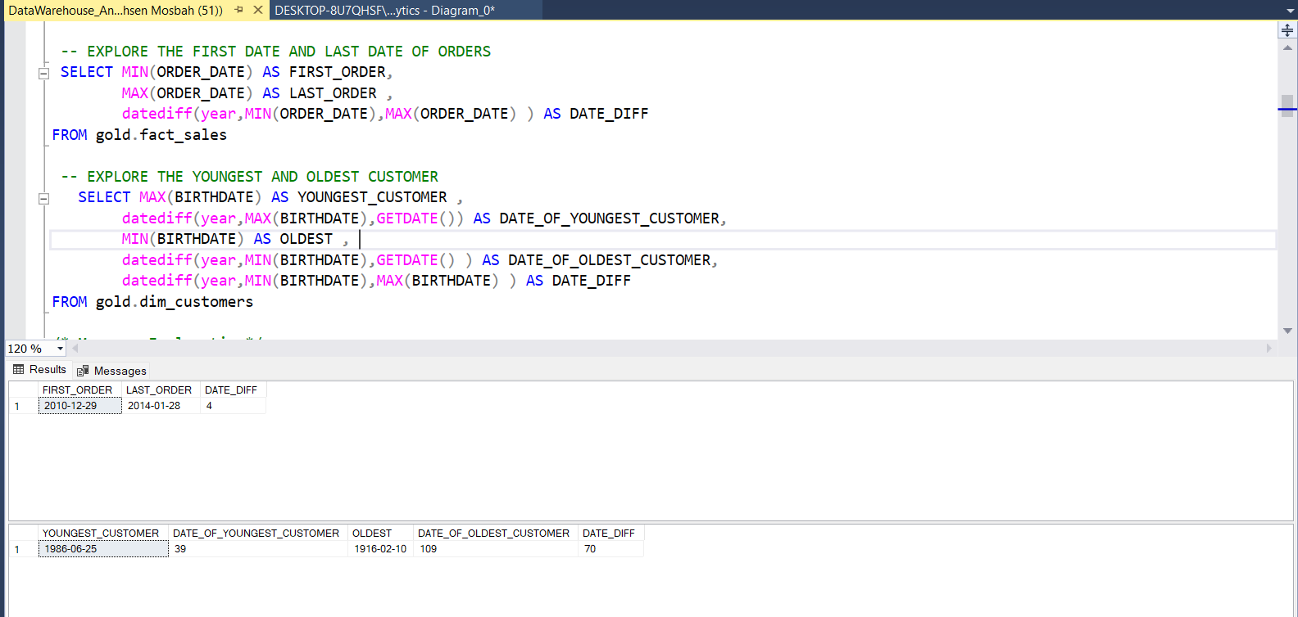
Data Exploration

Slide 5
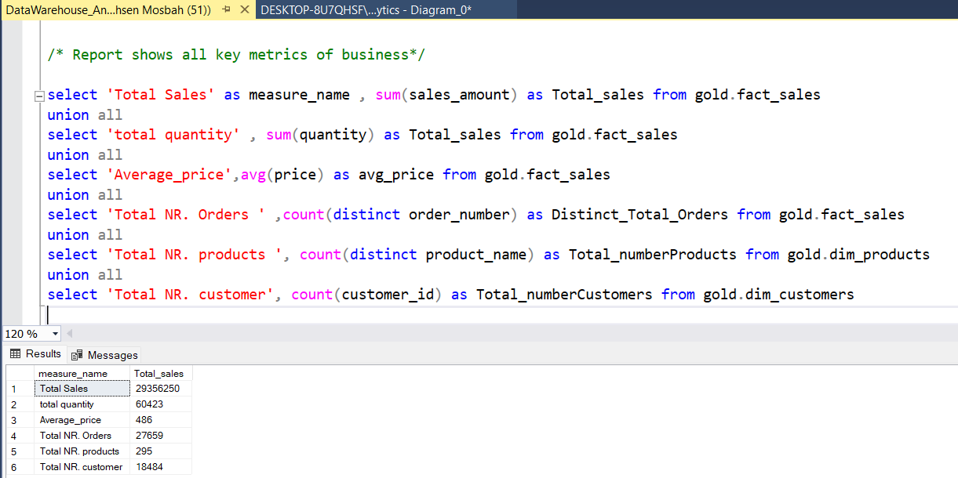
Measure Exploration

Slide 6
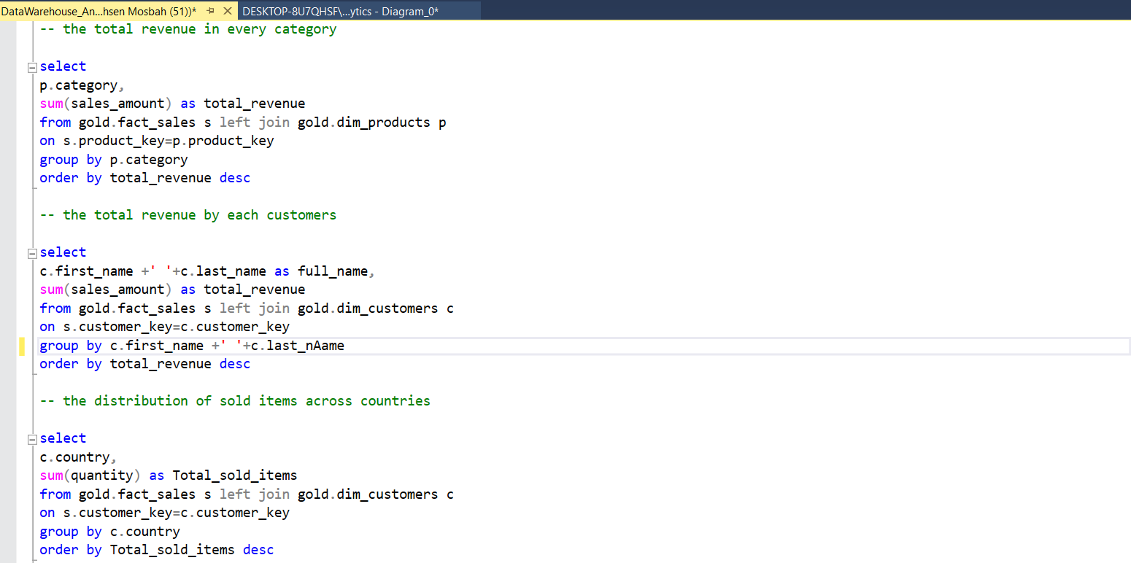
Magnitude analysis

Slide 7
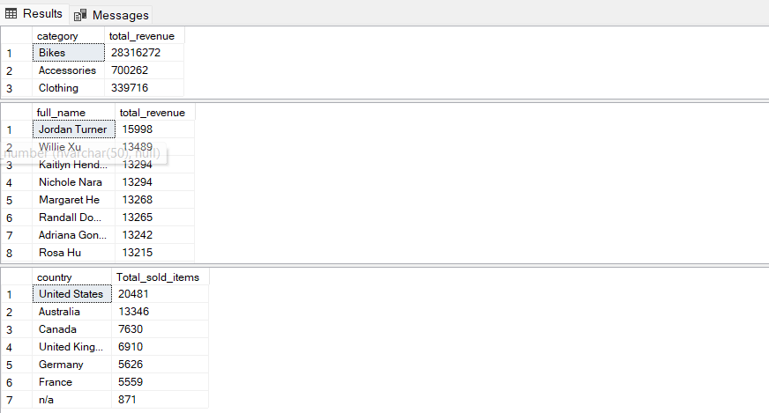

Slide 8
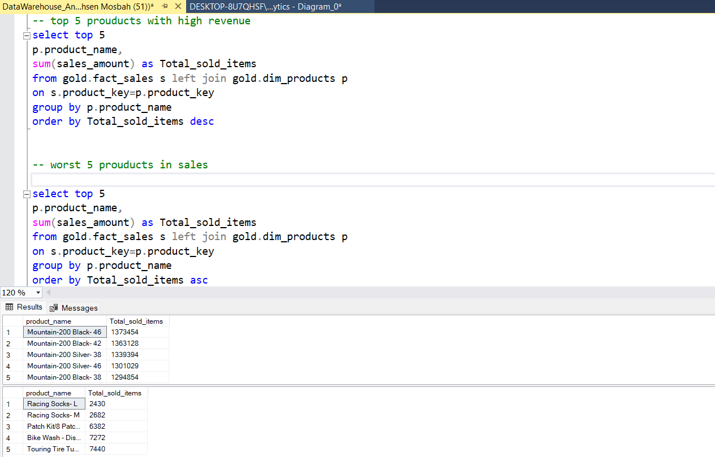
Ranking Analysis

