Slide 1
LispASR
3/22/10

Slide 2
Implementation details
Lisp:
Gargbage collected language (like Java and Python?)
Dynamic typing (i.e. type declaration are not required) (like Python?)
e.g. (defun plus (x y) (+ x y))
No types for the parameter or return value
But, memory allocation and garbage collection are very expensive
All trellis nodes and links are pre-allocated and recycled
Just keep a list of available nodes; “reset” them when recycled
And, use extreme caution not to cons unnecessarily (currently my code conses ~25KB to construct and search trellis, butcould be even less); audio I/O and feature computation necessarily cons more…
Dynamic typing
Due to type uncertainty simple arithmetic may “cons” (i.e. call malloc)
(+ single-float single-float) > maximum-single-float !!!
So Lisp allocates a double-float for the result…
Can be avoided by using type declaration very carefully in critical section of the code:
(defun plus (x y)
(declare (single-float 0.0 1.0) x y)
…)
May be similar issues/techniques in Python?

Slide 3
Recognition accuracy
Test set: 5 per digit
Single-template:
Same speaker: 100%
Different speaker: 40%
About 7x realtime on this laptop; <1x on server
Without pruning
~80% of this is trellis construction
~20% is trellis search
With pruning
~99% is trellis construction
Analysis on following slides
Multiple-template:
100%
slowww, analysis excluded
Segmental K-means:
10%

Slide 4
Accuracy vs. pruning parameter
Notes:
Can prune veryyy aggressively without losing performance

Slide 5
Total avg. time
Notes:
How much time does this save us??? Not much, since most of the time is trellis construction

Slide 6
Total avg. search time
Notes:
However,

Slide 7
% of nodes visited

Slide 8
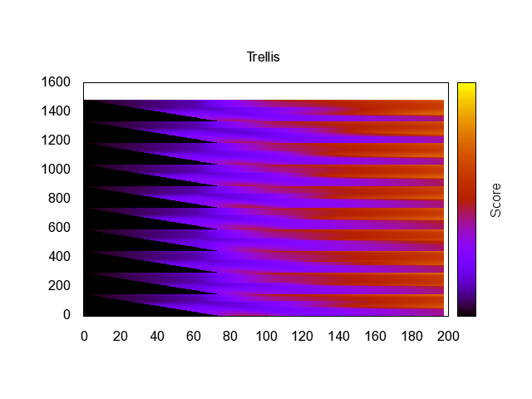
Example lattice – no pruning

Slide 9
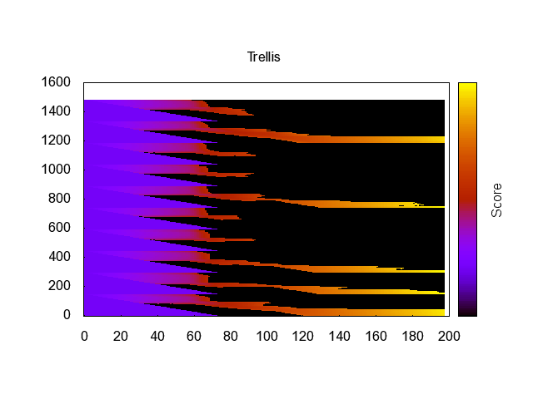
Example lattice pruned @ 200 relative (“one”)

Slide 10
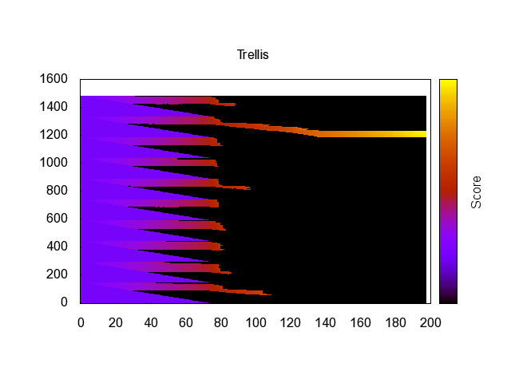
Example lattice pruned @ 100 relative (“one”)

Slide 11
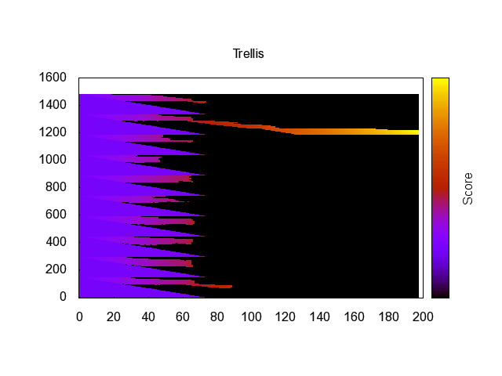
Example lattice pruned @ 50 relative (“one”)

Slide 12
Demo
Show:
Digit recognition
N-best list
Plot of features
Trellis visualization

Slide 13
“HMM” recognition
Segmental k-means
Euclidean distance (no covariance)
No state transition probabilities
Doesn’t work.
Trellis:

Slide 14
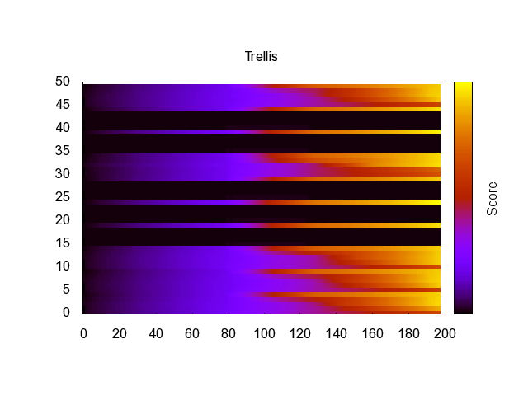
“HMM” trellis

Slide 15
The end.

Slide 16
Avg. shortest path length

Slide 17
Avg. shortest path length (2)

