Slide 1
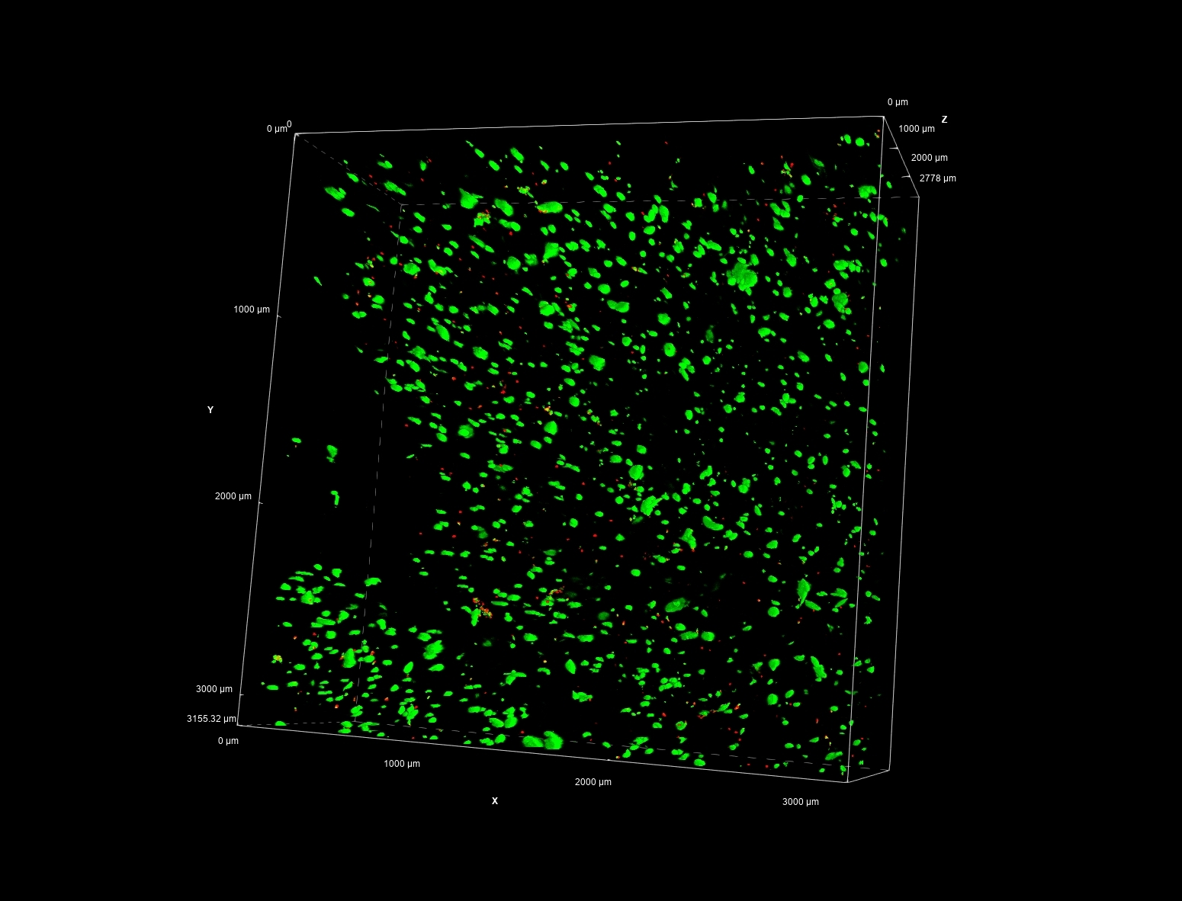
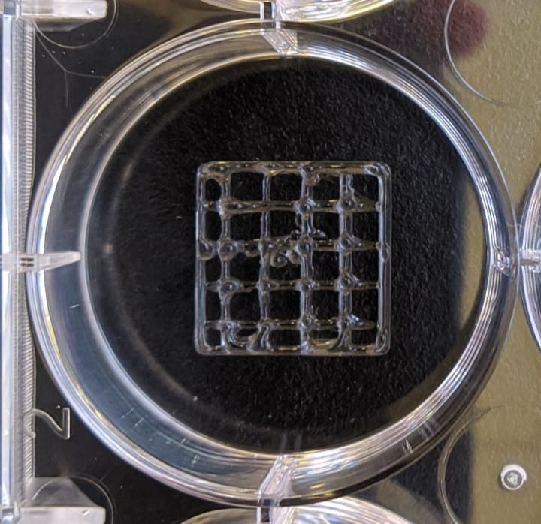
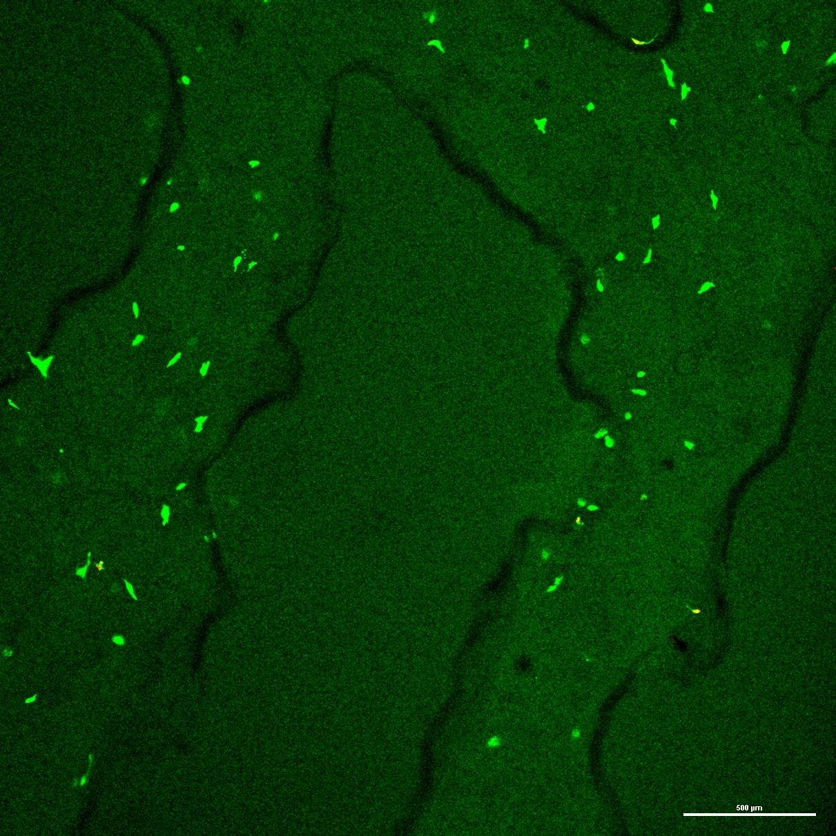
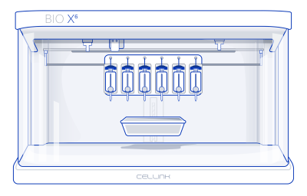
Characterization of Extrusion Based Bioprinted Tissue Constructs
Mercy Golda Sam Raj, Roshan Vijayakumar, Bela Perdomo, Caleb Philips, Kunal Mitra
Biomedical Engineering, Florida Tech
Introduction
Results
Methodology
3D bioprinting has become a vital technology for studying tissue regeneration, modeling diseases, and aiding pharmaceutical development for disease prevention. Compared to traditional 2D cultures, 3D bioprinted tissues provide more accurate representations of cell morphology, proliferation gradients, drug responses, gene expression, and cell health. However, manually producing 3D models is often difficult and expensive, resulting in high sample variability. This research proposes a novel approach to evaluating the capabilities of modern 3D bioprinting.
• GelMa-based tissue constructs were bioprinted using an extrusion-based bioprinter.
• Confocal microscopy imaging offered detailed insights into the cellular integrity and architecture of the bioprinted samples.
• Cellular viability was notably high, with 96.21% on Day 7, gradually decreasing to 82.56% on Day 10 and 77.19% on Day 14.
PhotoGel® with 50% degree of methacrylation (DOM) was prepared at 10% (w/v), using a 10% LAP photoinitiator in Reconstitution Agent P. Cells were seeded at 9 million per 1 mL of GelMA. Bioprinting occurred at 23.5°C and 45-55kPa pressure in a sterile environment. The constructs had eight layers of rectilinear grids with 40% infill.
The LIVE/DEAD® Viability/Cytotoxicity Kit for mammalian cells protocol (Molecular Probes™) was used. 200 µL of the live/dead staining solution was applied to each construct and incubated for 30 minutes at 37°C, protected from light. Confocal microscopy was used to image the spatial distribution of live (green) and dead (red) cells throughout the 3D bioprinted structure. Z-stack images at multiple depths assessed cell viability across the full construct. The live/dead assay provided qualitative and quantitative data on biocompatibility, evaluating cell survival and distribution in the constructs over 14 days.
Objectives
Develop a bioink with high biodegradability, biocompatibility, and ability to maintain cellular viability.
Bioprint constructs for disease modeling and treatment using a CELLINK BIOX6 extrusion-based bioprinter.
Use fluorescence microscopy to assess cell attachment and distribution within bioprinted constructs.
Evaluate cellular viability using a live-dead assay to measure the effectiveness of the bioprinting process.
Figure 2 depicts the volume view of the construct, highlighting the successful integration of living cells into the printed framework.
Conclusion
The bioprinted tissue constructs showed strong cellular adhesion, distribution, and viability, confirmed by fluorescence microscopy and live-dead assays. Cellular viability remained high, from 96.21% on Day 7 to 77.19% by Day 14, demonstrating the constructs' structural integrity and functionality. These results suggest bioprinted constructs have the potential to replace animal testing, with further optimization of bioink and bioprinting parameters to improve long-term viability.
Acknowledgements
Figure 1 : (left) The BIOX6 Bioprinter used in the study. (right) Architecture of the bioprinted construct with design that enables the creation of tissue structures with precise control over cellular organization and spatial distribution.
The authors would like to acknowledge funding support from National Science Foundation – Grant Number CBET 2317757.
Figure 3 : The 4X magnification view offers a perspective on the construct's cellular organization and spatial distribution.

