Slide 1

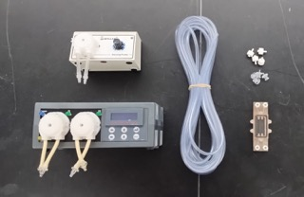
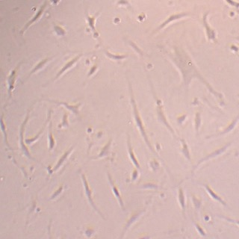
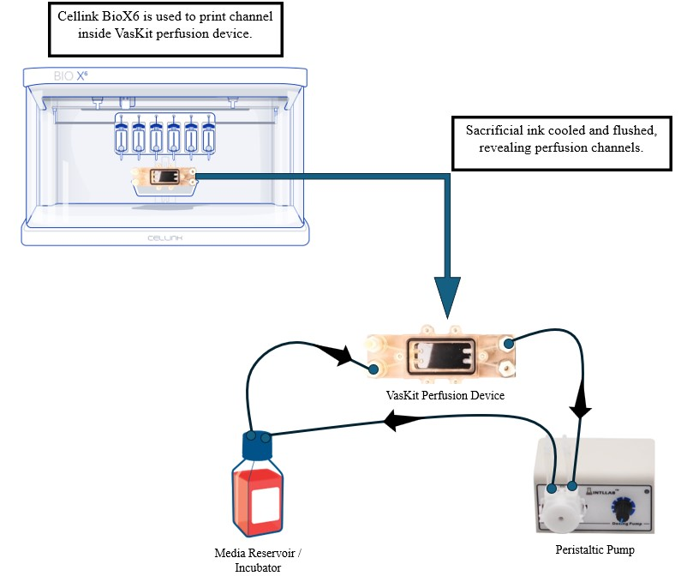
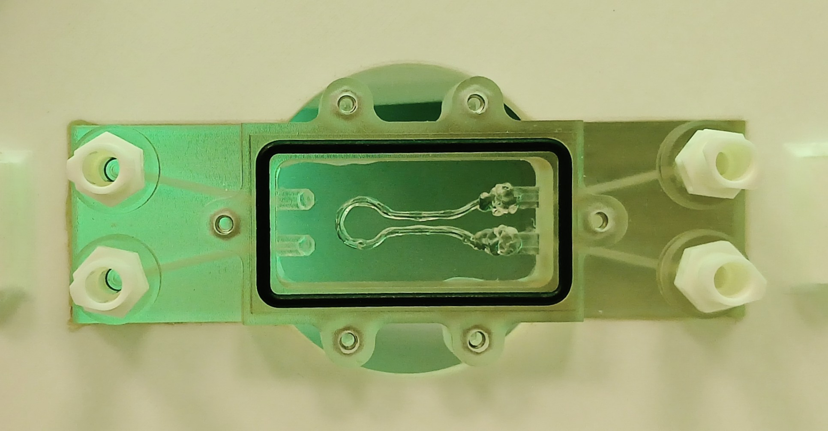
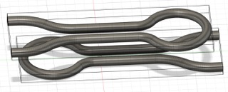
Perfusion Based System Incorporating Bioprinted Vascularized Tissue for Drug Delivery Applications
Bela Perdomo, Isscca Hall-Burns, Roshan Vijayakumar, Kunal Mitra
Biomedical Engineering, Florida Tech
Introduction
Experimental Setup
Methodology
Recent studies show that 3D cell culture models offer significant advantages over 2D models, including improved cell morphology, proliferation gradients, drug response, gene expression, and overall behavior. 3D bioprinting provides increased efficiency and reproducibility, allowing for the creation of human tissues in microfluidic chips as alternatives to animal trials. These microfluidic 3D culture devices promote structural complexity and incorporate dynamic fluid flow and mechanical stimulation. Traditional animal models have led to over 90% of candidate drugs failing in human trials due to physiological differences. The use of 3D bioprinting offers benefits such as customization of medical products and advancements in pharmaceutical research, including drug development, dosage, delivery, and toxicology testing.
Perfusable channels were created by printing sacrificial ink (Pluronic F127) onto the VasKit device bed under pressures of 40-90 kPa to achieve 400 µm diameter vessels. To remove the ink and form channels, the temperature was lowered to 4°C, causing the ink to liquefy for easy flushing with sterile deionized water via a syringe. Before seeding with endothelial cells like HUVECs, the inner surfaces were coated with fibrinogen to enhance cell attachment. The perfusion system was setup inside a sterile hood and consisted of the VasKit device, a media reservoir, a peristaltic dosing pump, and other materials needed to close the loop. Continuous media perfusion supports the long-term culture and functioning of the vascular bed. This integrated bioprinting and perfusion approach provides structural and microfluidic control over engineered vascularized tissue models. Cell viability within the channels was assessed using the LIVE/DEAD® Viability assay kit.
Figure 2: (left) Materials for sustained perfusion system including perfusion pumps, tubing, VasKit, and connectors. (right) HUVEC cells flushed through the printed channels.
Objectives
Results
• Establish a protocol for printing perfusable channels with sacrificial ink (Pluronic F127) and cellularizing the printed construct with endothelial cells.
• Investigate how interstitial flow affects cell viability and maturation in bioprinted vascular structures using the LIVE/DEAD® Viability assay.
• Assess the advantages of 3D cell culture models over 2D models in cell morphology, proliferation, drug response, and gene expression.
Perfusable 400 µm diameter channels were successfully created using sacrificial ink extruded at 23.5 ̊C and a pressure of 55kPa (figure 4). Cell viability is to be confirmed by the LIVE/DEAD® Viability assay.
Figure 3: Diagram showing the printing process and sustained culture system.
Conclusion
Printing of vascular channels using sacrificial ink was optimized on an extrusion 3D bioprinter, and the cellular viability with continuous media perfusion is being assessed. This approach has significant applications in biomedical engineering, enabling the development of engineered tissue models for drug testing, disease modeling, and personalized medicine.
Acknowledgments
Figure 4: Photo showing a VasKit device with flushed bioprinted channel.
The authors would like to acknowledge funding support from National Science Foundation – Grant Number CBET 2317757.
Figure 1: CAD model to be printed in a VasKit device

