Slide 1
Basics (and musts) of web design: integration of plain language, usability, and information architecture
www.plainlanguage.gov
Lisbon | October 13, 2010

Slide 2
The three requirements for a useful website
Logically organized (information architecture)
Easy to use (usability)
Understandable (plain language)
Notes:
Users require three things when using a website – a logical structure so they know where to look for information, an easy-to-use interface to get them to that information, and easily-understandable information (information architecture, usability, and plain language). A website needs all these elements to be successful.
This is just a brief overview of these three aspects to web, starting with information architecture. But, I want to stress that you need all three prongs for a good, useful site. Think of a three-legged stool, depending on how the legs are balanced, it might be able to stand if it were missing one leg, but you probably wouldn’t want to sit on it. If it were missing two legs, forget about it.
Finally, you’ll notice that the distinction among these three legs is not always clear. They all have the same goal – to make sure people can find what they need and use what they find – and they use many of the same principles. Some of the requirements for usability and plain language, for example, good navigation and good headings, can be met fairly easily if you already have a logical structure in place for your content. Also, all three aspects of good design need you to identify your audience.

Slide 3

Why do people come to your site?
They DON’T come to read
Notes:
We’ll get into how people expect to use your site in a minute – for now, let’s concentrate on what they don’t do.

Slide 4
We know people don’t read on the web
They scan.
Nielsen and Morkes, in a famous 1997 study, found that 79 percent of their test users always scanned any new page they came across; only 16 percent read word-by-word.
A recent study of people reading long-form text on tablets finds higher reading speeds than in the past, but they're still slower than reading print.
http://www.useit.com/alertbox/ipad-kindle-reading.html

Slide 5
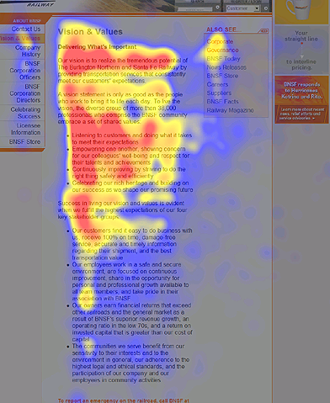
Notes:
Here’s the ubiquitous “F”

Slide 6
Some horrifying facts*
Based on analysis of 45,237 page views, Nielsen found that people read an average of 18% of what’s on a page.
However, as the number of words on a page goes up, the percentage read goes down.
To get people to read half your words, you have to limit your page to 110 words or fewer.
*http://www.useit.com/alertbox/percent-text-read.html

Slide 7
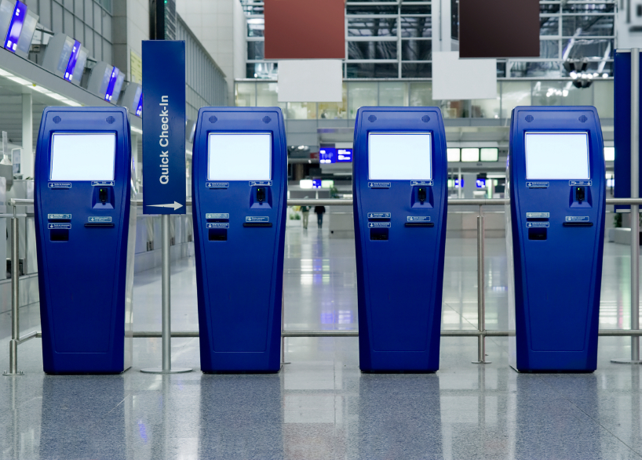
Why do people come to your site?
Customers come to your site to perform a task.
They come because they expect to get self-service.
Notes:
Since people come to you site to DO something, usually by finding information they can use, you need to have a logical way to organize your information.

Slide 8
Organizing your content
Your customers need to be able to find what they need, but the way you organize your information isn’t necessarily the way they look for it.
Notes:
Your customers need to be able to find what they need quickly and easily. If your site is well-organized, that should be easy. But how do you create a well-organized site?

Slide 9
Who are your customers?
On-site survey
If you deal with customers by mail, include a paper survey in a regular mailing.
Visit offices where users interact with your organization directly. Talk to users, and the people who serve them.
Do one-on-one interviews
Do a focus group
You can read about these and other techniques at www.usability.gov

Slide 10
What are their needs?
What do they need to know?
What is their level of knowledge?
Are they experienced web users?
What technology do they have?
And, most importantly,
What do they want to do?

Slide 11

Identify customers’ top tasks
People come to your website with a specific task in mind. If your website doesn’t help them complete that task, they’ll leave.
Identify the mission—the purpose—of your website, to help you clarify the #1 top task your website should help people accomplish.

Slide 12
Logical organization
You’ve identified your customers’ top tasks, but you still have a lot of material that some customers want.
How do you figure out how to organize your site?
If you thought even for a second that the answer might be “by office” –WRONG!
The easiest method is an old-fashioned card sort.

Slide 13
Remember -
DON’T
Write for your supervisor or co-workers
DO
Write for your customers
Make a list of who reads your content
Decide why they read it and what information they need
Address your customers’ top tasks

Slide 14
Writing your content
Identify your audience
Write to meet the needs of your audience
Choose simple, everyday words
Keep your sentences and paragraphs short
Use active voice, headings and pronouns
Use bulleted lists and tables
Notes:
Again, make sure you know who you are writing for – remember, it’s much easier to write from scratch than to re-write! And, remember, there is a difference between print writing and web writing.

Slide 15

Print Writing
Tells a story
Is linear — has a beginning, middle, and end
Is often consumed in a relaxed setting
Written in complete sentences

Slide 16

Web Writing
Easy to scan
Quick, accessible source of info
Minimal text
User-friendly — Users may be stressed, impatient, skeptical, or disoriented
Interactive

Slide 17
Writing content
When you start thinking about content pages, keep these points in mind:
Think topics, not stories.
Think about having a conversation with your customer. Eliminate anything that’s not part of the conversation.
A very few content pages might contain more extensive information.
Notes:
Remember what I talked about earlier? That people don’t read on-line? And that they don’t read web pages with a lot of text? To get people to read half your words, you have to limit your page to 110 words or fewer. Here’s where you eliminate words, but not just words – check to see if what you put up is really necessary. For example, how many people really care about the “about us” page almost every website has? Is that something you really want to highlight and take up space on your site?

Slide 18
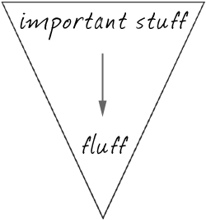
Remember
On average, visitors read about 18% of what’s on the page, and the more words you have, the lower the percent they read.
So, use the inverted pyramid. Begin with the shortest and clearest statement you can make about your topic.
Conclusions/Key Info
Background

Slide 19

Eliminate words
Some common sources of wordiness—
Passive voice
Redundancies
Prepositional phrases
Hidden verbs
Unnecessary modifiers
Failure to use pronouns

Slide 20
Omit Information
Remember, your web content is a conversation with your customer. If material doesn’t belong in the conversation, it doesn’t belong on the web.
Hopefully, you can research what customers really want.
You aren’t Santa Claus. You can’t serve all customers. If you serve your top 3 or 4 customer groups, you’re doing good.

Slide 21
What your customers don’t care about
When your office was formed
Who is the head
What the head said the day he was sworn in
What the head looks like
What your annual report from 3 years ago looked like
How the Bureau is organized
What you did for customers 5 years ago
The text of a law that authorizes your office

Slide 22
Displaying your content
Be consistent!
Consistent design and color scheme (remember to take into consideration low-vision readers and screen reader users)
Consistent style for headings
Consistent navigation
Use lots of white-space
Use lots of informative headings
Take care with links
Notes:
People use design cues to help them navigate. If you use a different heading style on each page, your customers will be confused and get distracted from their mission – finding what they need. Keep your navigation in the same location on each page and in the same order. You don’t want people thinking about your design or thinking about why you did something, you want them to be able to use your site without thinking about it at all.

Slide 23
Links: Eye Track study results
The best links in the study: | The worst links in the study:
☺ Used plain language | ☹ Used bland, generic words
☺ Were specific and clear | ☹ Used made-up words or terms
☺ Used common words | ☹ Started with speech- introduction language
☺ Started with the essence of the message
☺ Were action-oriented
* http://www.useit.com/alertbox/nanocontent.html
Notes:
Remember – use plain language when preparing links, just like when writing text.

Slide 24
USE
Logical organization
Informative headings
Pronouns
Active voice
Lists and tables
Common words (no jargon)

Slide 25
Avoid
Hidden verbs
Abbreviations
Long sentences
Unnecessary words
Information the user doesn’t want

Slide 26
The requirements (recap)
Know and write for your audience
Make sure your audience can quickly and easily find and use the information they want
Make sure your stool has three legs:
Logical organization
Easy to use
Easy to understand

Slide 27
www.plainlanguage.gov

