Slide 1
Principles of Plain Language
Presented by:
Plain Language Action and Information Network

Slide 2
Overview
Definition of plain language
Plain language techniques
Examples
Next steps

Slide 3
What is plain language?
Communication that your audience or readers can understand the first time they hear or read it.

Slide 4
What are the main elements of plain language?
Logical organization
The active voice
Common, everyday words
Short sentences
“You” and other pronouns
Lists and tables
Easy-to-read design features
4

Slide 5
Plain Writing Act of 2010
Requires executive agencies to use plain language in documents by October 13, 2011
In all communications with general public – except regulations.

Slide 6
Plain Language Mandates
Presidential Memo of June 1, 1998, requires plain language in all documents (including regulations) that we write for the public.
E.O. 12866 requires that regulations must be “simple and easy to understand, with the goal of minimizing uncertainty and litigation...” (Sec. 1, Par. (b)(12))
E.O. 12988 requires that each regulation specify its effect “in clear language” (Sec. 3 Par. (b)(2))
E.O 13563 requires that regulations be accessible, consistent, written in plain language, and easy to understand

Slide 7
Plain Language Myths
Plain Language is NOT:
1. Baby talk, or an attempt to be folksy, playful, or pc
2. Stripping out necessary technical and legal information
3. Just editorial “polishing” after you finish writing
4. Imprecise

Slide 8
More Plain Language Myths
5. Just using pronouns in a Q and A format
6. Something the lawyers will never go for
7. Something the Federal Register and OMB will never go for
8. Easy
8

Slide 9
Why use Plain Language?
We’re all busy people.
We don’t want to waste a lot of time trying to translate difficult, wordy documents.
And when we go to the web, we want to scan, not read.

Slide 10
Why use plain language?
To make your message stand out

Slide 11
Why use plain language?
Plain Language:
Shows customer focus
Communicates effectively
Eliminates barriers
Reduces time spent explaining
Improves compliance

Slide 12
Plain language means fewer calls from customers

Slide 13
What Happens When Readers Don’t Understand?
You may have to:
Answer phone calls
Write interpretative letters
Write explanatory documents
Litigate

Slide 14
Pop Quiz
Is Springfield the capital of Illinois? Is Chicago's N.F.L. team named the Packers?
Yes
No

Slide 15
Actual State Department question
Have you ever been refused admission to the U.S., or been the subject of a deportation hearing or sought to obtain or assist others to obtain a visa, entry into the U.S., or any other U.S. immigration benefit by fraud or willful misrepresentation or other unlawful means? Have you attended a U.S. public elementary school on student (F) status or a public secondary school after November 30, 1996 without reimbursing the school?
Yes □ No□

Slide 16
Goals of Plain Language
Help the reader find the information
Help the reader understand the information
Remember: If your document doesn’t do both, it’s not plain language.

Slide 17
Identify your audience
Think of why the user needs to read your document
Keep in mind the average user's level of technical expertise
Write to everyone who is interested, not just to experts (focus on the 90 percent of readers in the middle of the spectrum)
Even an expert will prefer a clearly written document

Slide 18
Focus outward--on the reader
☹ NOT… ☺ BUT…
What do I want to say? What does the audience need to know?
How can I protect my interests? How can I serve the audience’s interests?
What can I do to impress you? What can I clearly express to the audience?

Slide 19
Coast Guard Boating Information
CO Detector Update:
The Coast Guard has conducted an investigation to determine what carbon monoxide (CO) detection devices are available to recreational boaters, such that, when installed and activated could reduce the risk of being exposed to high levels of CO -THAT SILENT KILLER. A variety of technologies is available for detecting the presence of CO on boats and should be considered by recreational boaters to reduce their risk of injury or death while boating.
(72 words)

Slide 20
Coast Guard Boating Information
Carbon monoxide is a silent killer. The Coast Guard recommends that you use a carbon monoxide detection device on your boat to reduce the risk of being exposed to high levels of CO. You may choose from a variety of devices. (39 words)

Slide 21
Organize to serve the reader
Anticipate questions an informed reader is likely to ask
Organize writing to answer questions in the order the reader will ask them

Slide 22
Use headings
Allow the reader to quickly find relevant information
Break up the information
Increase blank space on the page
Informative headings help the reader navigate the document

Slide 23
Try question headings
Readers have questions in mind
Questions help readers relate to the information
Questions help you organize the information

Slide 24
You may apply for an extension of stay in the United States if:
• You were lawfully admitted into the United States as a
nonimmigrant;
• You have not committed any act that makes you ineligible to
receive an immigration benefit;
• There is no other factor that requires you to depart the United States prior to extending status (for example, a USCIS officer may determine that you should obtain a new visa prior extending your status); and
• You submit an application for an extension of stay before the expiration date on your Form I-94. (There are certain very limited circumstances under which USCIS will excuse a late submission.)
How do I know if I am eligible to extend my stay in the
United States?

Slide 25
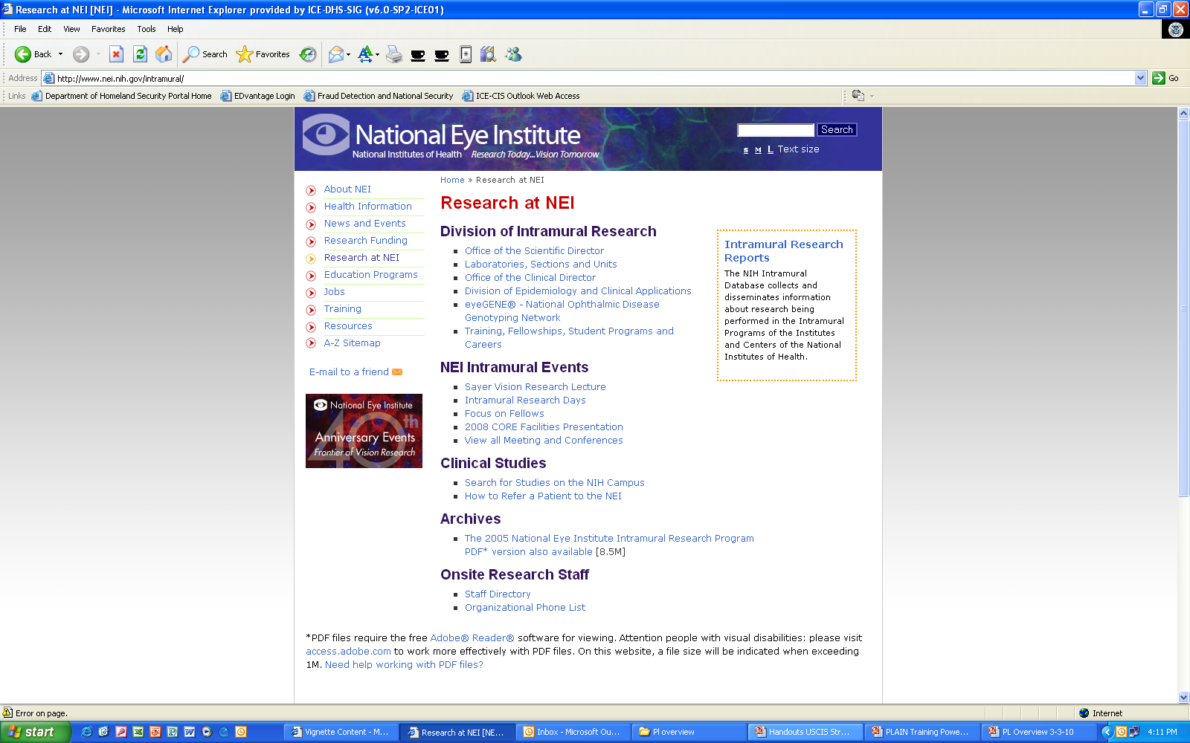

Slide 26
Plain Language and the Web
Web users scan – they don’t read. Many web pages are too dense.
Plain language helps keep web content as short and as readable as possible.
Avoid bloat! Less is more!

Slide 27
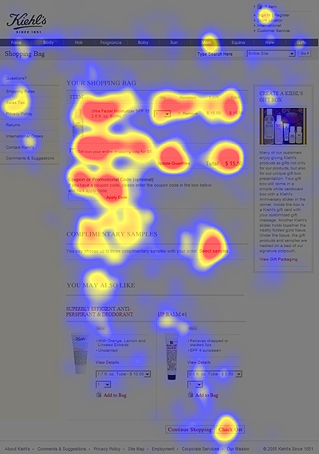
Web Writing
People read 25% slower on the Web
Cut out 50% of your text
Online readers focus on headings and bulleted list information
Image from Nielson Norman Group usability eye tracking test (2006)
27

Slide 28
Keep things short
No one wants to read material like the next slide.

Slide 29
Executive Order 12988
With respect to the review of existing regulations and the promulgation of new regulations, section 3(a) of Executive Order 12988, “Civil Justice Reform,” 61 FR 4729 (February 7, 1996), imposes on Executive agencies the general duty to adhere to the following requirements: (1) Eliminate drafting errors and ambiguity; (2) write regulations to minimize litigation; and (3) provide a clear legal standard for affected conduct rather than a general standard and promote simplification and burden reduction. With regard to the review required by section 3(a), section 3(b) of Executive Order 12988 specifically requires that Executive agencies make every reasonable effort to ensure that the regulation: (1) Clearly specifies the preemptive effect, if any; (2) clearly specifies any effect on existing Federal law or regulation; (3) provides a clear legal standard for affected conduct while promoting simplification and burden reduction; (4) specifies the retroactive effect, if any; (5) adequately defines key terms; and (6) addresses other important issues affecting clarity and general draftsmanship under any guidelines issued by the Attorney General. Section 3(c) of Executive Order 12988 requires Executive agencies to review regulations in light of applicable standards in section 3(a) and section 3(b) to determine whether they are met or it is unreasonable to meet one or more of them. DHS has completed the required review and determined that, to the extent permitted by law, this final rule meets the relevant standards of Executive Order 12988.

Slide 30
Revised Version
This rule meets the applicable standards in sections 3(a) and 3(b)(2) of Executive Order 12988.
“The most valuable of all talents is never using two words when one will do.”
~Thomas Jefferson

Slide 31
Use short paragraphs
Limit a paragraph to one subject or step
Smaller “bites” of info are easier to digest
Aim for no more than 7 lines

Slide 32
Use short sentences
Treat only one subject in each sentence
Avoid complexity and confusion
Aim for 20 words per sentence or fewer

Slide 33
Using pronouns
Pronouns:
Speak directly to readers
Make your writing relevant to readers
Require less translation from your readers
Eliminate words

Slide 34
Using pronouns
Use “we” to refer to your agency
Use “you” for the reader
If you are using Q&A format, use “I” in the questions and “you” in the text

Slide 35
Let’s do an exercise
Once the candidate’s goals are established, one or more potential employers are identified. A preliminary proposal for presentation to the employer is developed. The proposal is presented to an employer who agrees to negotiate an individualized job that meets the employment needs of the applicant and real business needs of the employer.

Slide 36

Eliminate
Excess words
Some common sources of wordiness (we’ll review only some of these today)
Passive voice
Redundancies
Prepositional phrases
Hidden verbs
Unnecessary modifiers
Failure to use pronouns
Excess content
Think about your purpose, your topic, and your audience. If content doesn’t further your goals, don’t include it!
36

Slide 37
With Pronouns…
Once we establish your goals, we identify one or more potential employers. We prepare a preliminary proposal to present to an employer who agrees to negotiate a job that meets both his and your employment needs.

Slide 38
Saving You Words
Once the candidate’s goals are established, one or more potential employers are identified. A preliminary proposal for presentation to the employer is developed. The proposal is presented to an employer who agrees to negotiate an individualized job that meets the employment needs of the applicant and real business needs of the employer.
52 words
Once we establish your goals, we identify one or more potential employers. We prepare a preliminary proposal to present to an employer who agrees to negotiate a job that meets both his and your employment needs.
37 words

Slide 39
When Pronouns Don’t Work
If you’re addressing more than one audience
If you refer readers to more than one office within your organization

Slide 40
Use active, not passive voice
Active voice is more clear, concise and direct
Passive is a characteristic of bureaucratese
“Mistakes were made.”

Slide 41
Identifying passive voice
The person doing the action usually follows the verb.
Example: Arlene was promoted by her boss.
The verb has two parts: The verb “to be” plus the past participle of another verb.
Example: The house will be leased by Fred.

Slide 42
Why Avoid Passive Voice
Passive voice
Can disguise who does what:
The memo was written yesterday.
Active voice
Makes it clear who does what:
The Director wrote the memo yesterday.

Slide 43
Why Avoid Passive Voice
Passive Voice
Is wordy:
The application must be completed by the applicant and received by the financial office at the time designated by that office.
Active Voice
Is concise:
We must receive your completed application by the deadline that we establish.

Slide 44
Why Avoid Passive Voice
Passive Voice
Is awkward:
Consultation from respondents was obtained to determine the estimated burden.
Active Voice
Is natural:
We consulted with respondents to determine the estimated burden.

Slide 45
Passive to Active Voice Exercise
Excess and/or unauthorized expenses, delays, or luxury accommodations and services will not be reimbursed by the company, but will be borne by the employee.
Your application has been denied by the Department of State.
3. The submission you filed will be reviewed by the judges.
Notes:
Have audience suggest rewrites.

Slide 46
Possible Answers
The company will not reimburse you for
unauthorized expenses,
delays, or
luxury accommodations and services.
2. The Department of State has denied your application.
3. The judges will review your submission.
Notes:
Click to have each answer fly up on the screen.

Slide 47
Avoid hidden verbs
Hidden verbs are verbs disguised as nouns. They are generally longer than their true verb forms.

Slide 48
Hidden Verbs
Conduct an analysis
Present a report
Do an assessment
Provide assistance
Came to the conclusion of
Analyze
Report
Assess
Help
Concluded

Slide 49
Use consistent terms
Avoid “Shall.” It is ambiguous and is not used in everyday speech
Use “must” for an obligation
Use “must not” for a prohibition
Use “may” for a discretionary action
Use “should” for a recommendation

Slide 50
Bryan A. Garner on “Shall”
In just about every jurisdiction, courts have held that “shall” can mean not just “must” and “may,” but also “will” and “is.” The [U.S. Supreme] Court has [in various decisions]:
Held that a legislative amendment from “shall” to “may” had no substantive effect
Held that “shall” means “must” for existing rights, but that it need not be construed as mandatory when a new right is created
Acknowledged that, “legal writers sometimes misuse ‘shall’ to mean ‘should,’ ‘will,’ or even ‘may.’ ”

Slide 51
Don’t sound so bureaucratic
Limit jargon and acronyms
Contractions aren’t bad
Use everyday words

Slide 52
Two kinds of jargon
Necessary technical terms
Example: Habeas corpus, plaintiff
Obscure and often pretentious language marked by circumlocutions and long words
Example: Hereby, Wherefore, ab initio

Slide 53
TWIP
TDWR
ARTS
TAEP
ASOS
ACD
DEDS
FIAT
CTAS
ACE-IDS
TDLS
SATDS
IPDS
RACD
ASR
ITWS
TDW
ATB
TRACON
DBRITE
FDIO
ICAO
IWG
ETVS
FDAD
pb-ICE
STARS
TVSR
IPT
DVRS
FAA
53

Slide 54

Limiting acronyms/abbreviations
Use “we” for the agency
Don’t use acronyms/abbreviations for infrequent phrases
Try another style (the Council)
Make them pronounceable
(STARS, TRACON, FSDO)

Slide 55

What is this?
Notes:
This is a special oil machine referred as a Christmas Tree in the industry. a petroleum engineer asked for a Christmas Tree on the cover of an oil and gas drilling handbook. He got an evergreen. Beware of jargon.

Slide 56
Use everyday words
anticipate
attempt
commence
demonstrate
implement
in the event that
submit
terminate
expect
try
begin, start
show, prove
start
if
send, give
end, cancel

Slide 57
Simpler is Better
Lithodial fragments ought not to be projected by the inhabitants of vitreous abodes.
People who live in glass houses shouldn’t throw stones.

Slide 58
Simpler is Better
A perissodactyl ungulate may be propelled toward a body of aqueous fluid, but such ungulate cannot be compelled or forcibly induced to imbibe such fluid.
You can lead a horse to water, but you can’t make him drink.

Slide 59
Place words carefully
- Keep subjects and objects close to their verbs.
- Put conditionals such as "only" or "always" next to words they modify.
- Don’t misplace modifiers.
- Put exceptions and long conditions after the main clause, not before or in the middle.

Slide 60
Does word placement make a difference?
Yesterday a mad dog bit five men and women in the south end.
This section applies to appeals of orders involving the reporting and payment of royalties or other payments due under Federal oil and gas leases pending on the date this rule becomes effective.
This rule proposes the Spring/Summer subsistence harvest regulations in Alaska for migratory birds that expire on August 31, 2003.

Slide 61
Use lists
Lists--
Make it easy for the reader to identify all items or steps in a process,
Add blank space for easy reading, and
Help the reader see the structure of your document.

Slide 62
But don’t make lists too long
Research suggests that seven items are the maximum that work well in a list.
Longer lists are hard to navigate.

Slide 63
How Does This Read?
U.S. Citizenship and Immigration Services (USCIS) is expanding its Direct Mail Program to provide that filings of Form I-800A, Application for Determination of Suitability to Adopt a Child from a Convention Country, Form I-800A Supplement 1, Listing of Adult Member of the Household, Supplement 2, Consent to Disclose Information, Supplement 3, Request for Action on Approved Form I-800A, Form I-800, Petition to Classify Convention Adoptee as an Immediate Relative, Supplement 1, Consent to Disclose Information, for the Hague Adoption Convention be filed at a designated Chicago, Illinois lockbox facility for initial processing.

Slide 64
Now in List Format
U.S. Citizenship and Immigration Services (USCIS) is expanding its Direct Mail Program to include the following forms:
Form I-800A, Application for Determination of Suitability to Adopt a Child from a Convention Country
Form I-800A Supplement 1, Listing of Adult Member of the Household
Form I-800A Supplement 2, Consent to Disclose Information
Form I-800A Supplement 3, Request for Action on Approved Form I-800A
Form I-800, Petition to Classify Convention Adoptee as an Immediate Relative
The Form I-800 Supplement 1, Consent to Disclose Information.
Mail these forms to the Chicago Lockbox facility.

Slide 65
Why use tables?
Tables--
Save words
Make it easy to locate specific provisions
Make it easy to take in complex material at a glance
Make your logic and structure clear

Slide 66
Sending expense forms
We must receive your completed expense form on or before the 15th day of the second month following the month you are reporting if you do not submit your form electronically, or the 25th day of the second month following the month you are reporting if you submit your form electronically.

Slide 67
When must I send my completed expense form?
If you send your form--
Electronically,
Paper or fax,
Then we must receive it by--
The 25th day of the second…
The 15th day of the second...

Slide 68
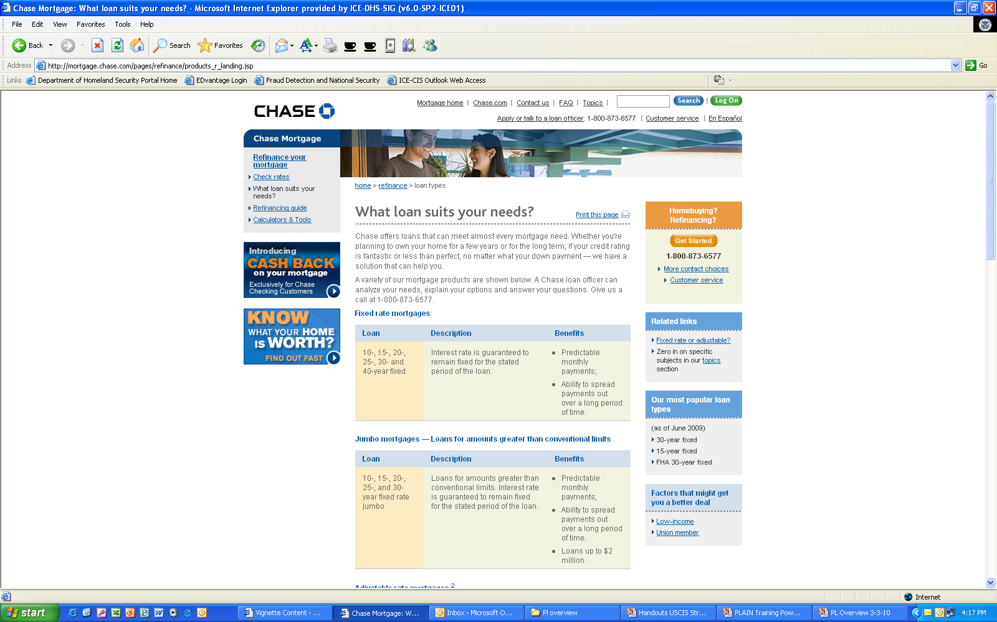

Slide 69
Resources for writing
NIH plain language training on the web
Plainlanguage.gov
Federal plain language guidelines
Center for Plain Language
Writing Web Content that Works, by Janice (Ginny) Redish
69

Slide 70
What should I do next?
Practice
Come to PLAIN monthly meetings—2nd Wednesday of each month, 2 to 3:30 p.m. (locations announced in advance)
Visit our Web site (www.plainlanguage.gov)

