Slide 1

What am I trying to do?
Am trying to do a non-commercial project in data analysis and visualization.
Why am I trying to do this?
To learn and understand data analysis and visualization technologies.

Slide 2
How am I trying to do this?
Using subject data collated from different source systems, transformed and stored for analysis on a relational database and visualised on a dashboard.
Using Python 3.7 , MS SQL, Power BI / Tableau , GitHub.

Slide 3
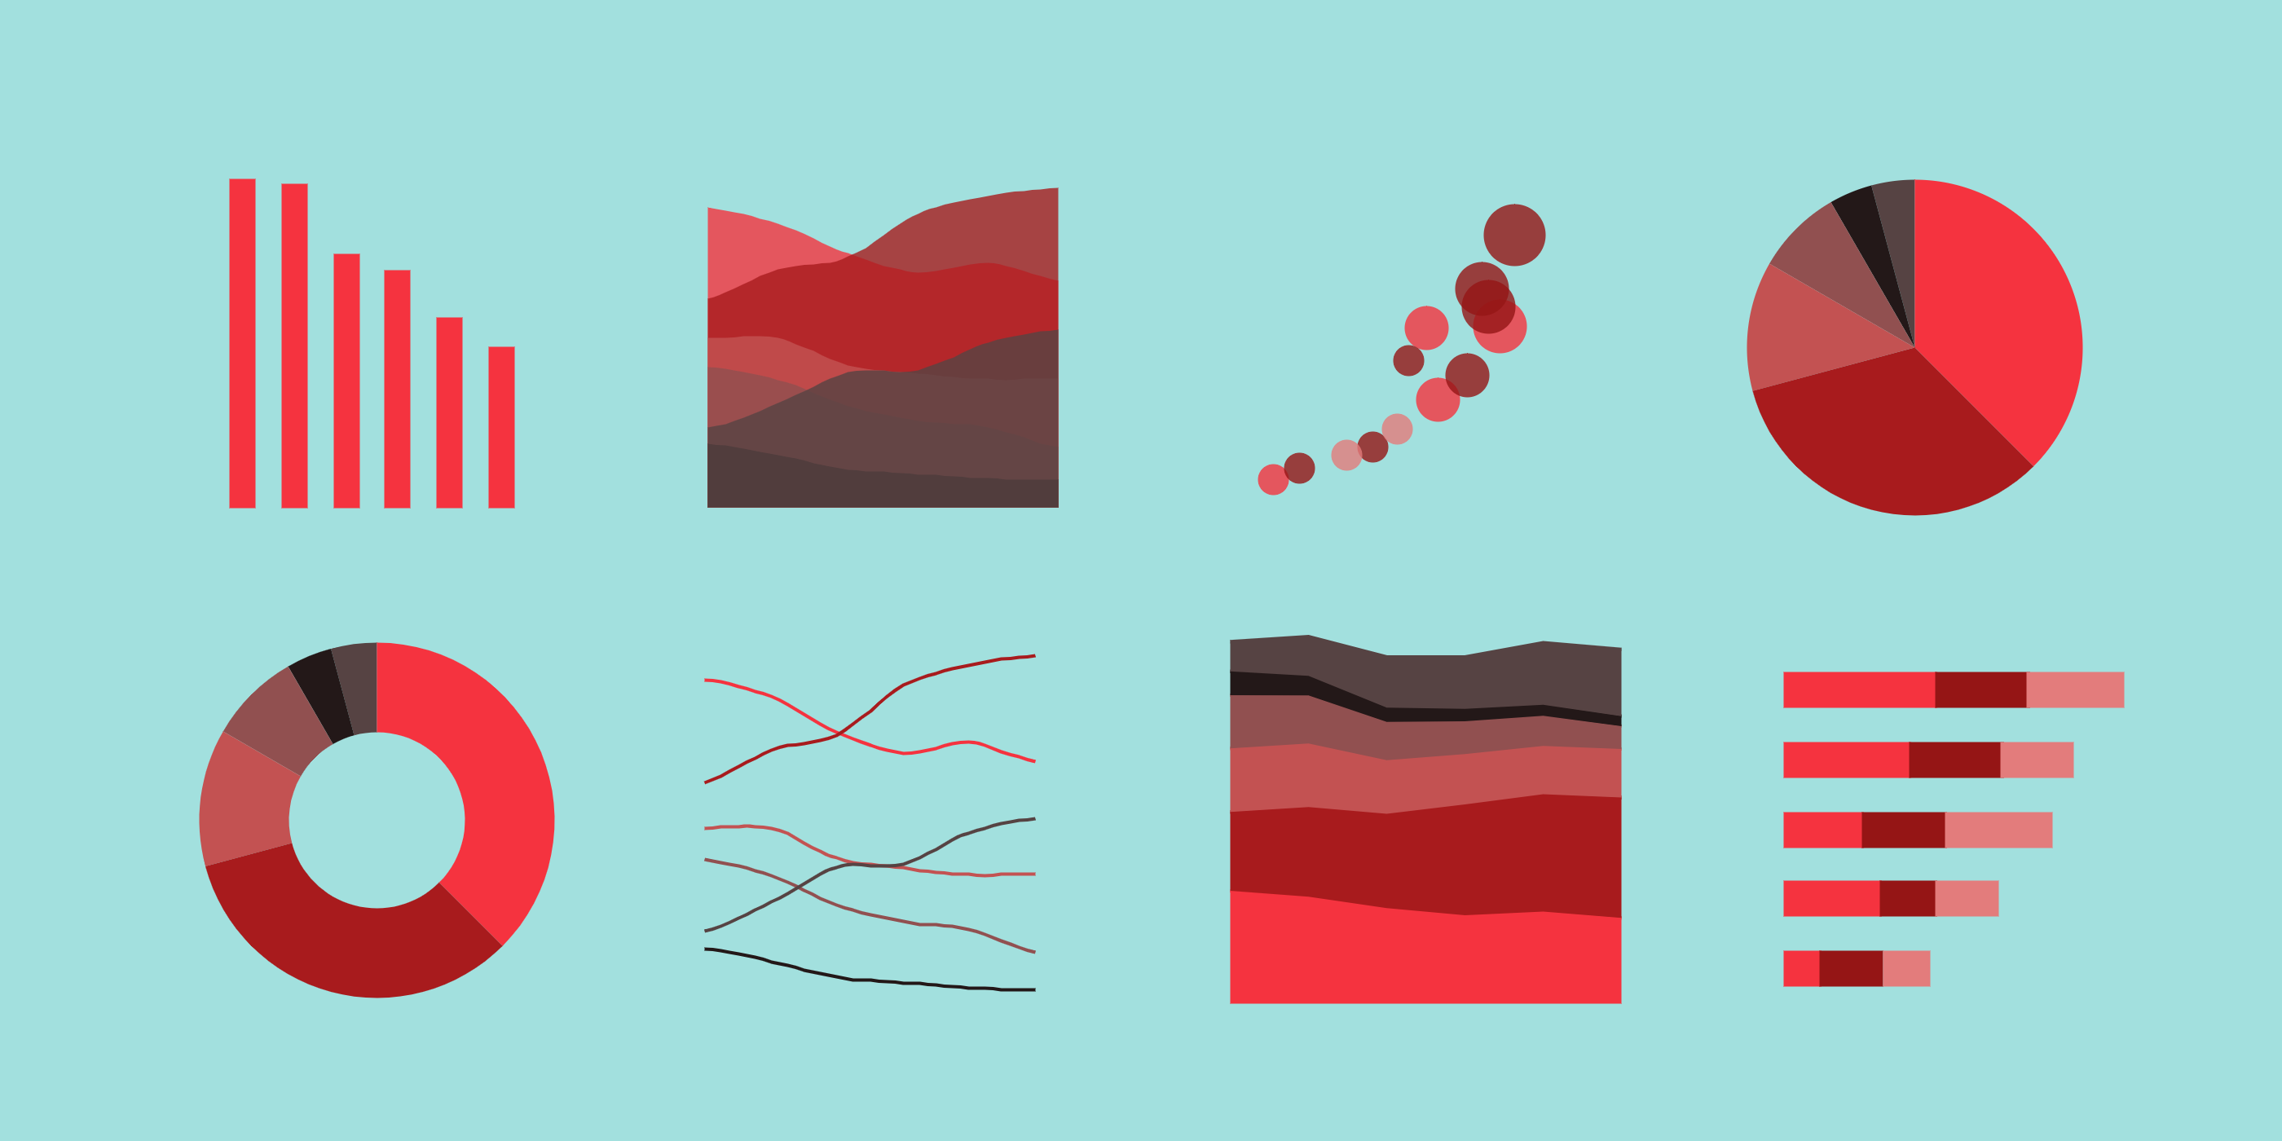
Process Flow
MS SQL
Power BI / Tableau
Python

Slide 4
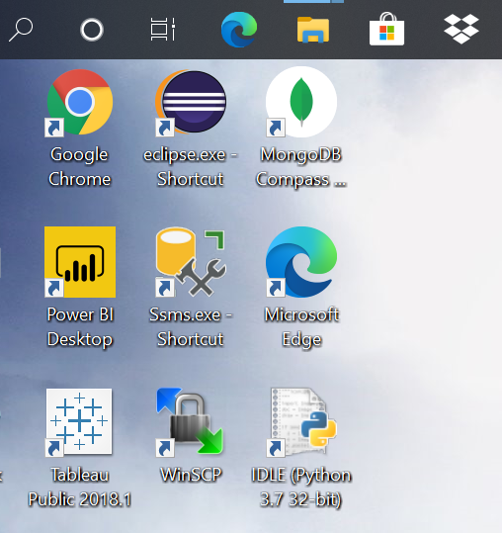
Step 0 – Install necessary software.
.

Slide 5
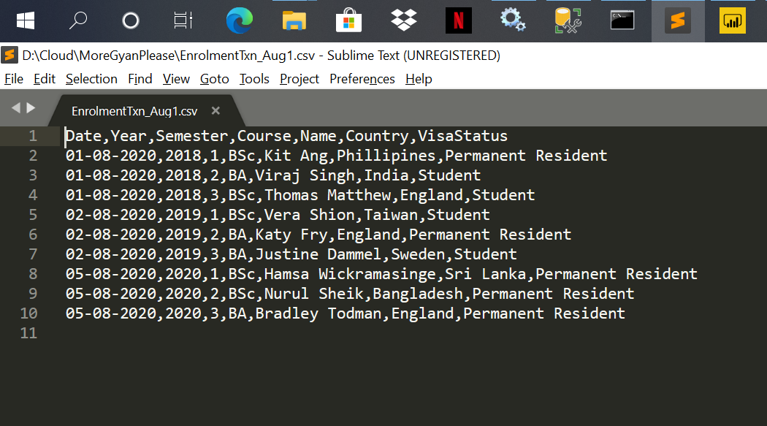
Step 1 – Create a data set.
.

Slide 6
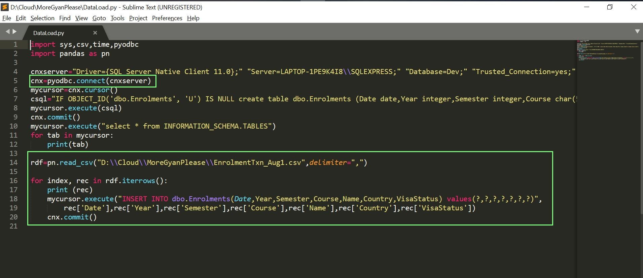
Step 2 – Ingest the data.
.

Slide 7
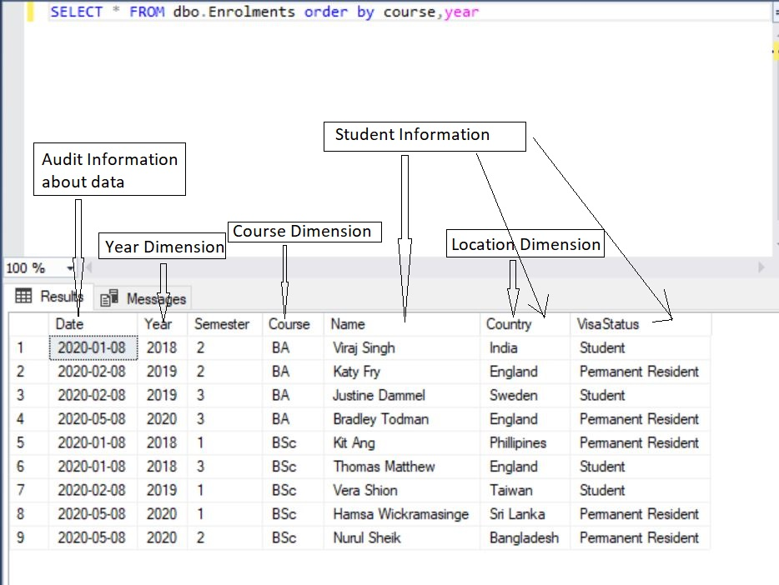
Step 3 – Understand the data.
.

Slide 8
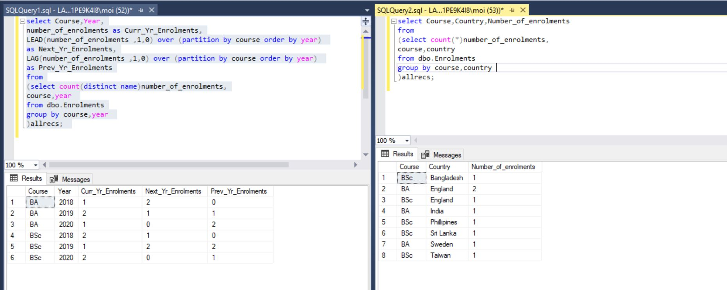
Step 4 – Analyse the data.
In this case, we have tried to analyse Enrolments Data a. by Course and Year. b. by Country

Slide 9
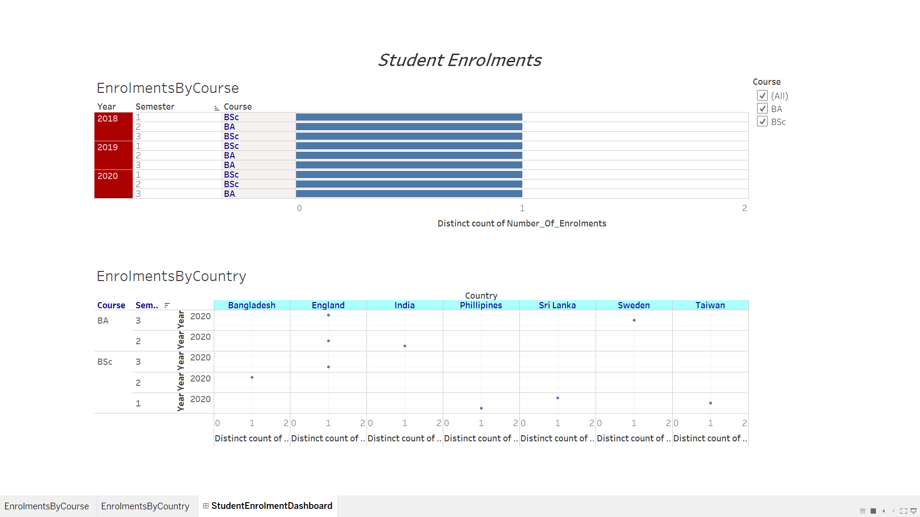
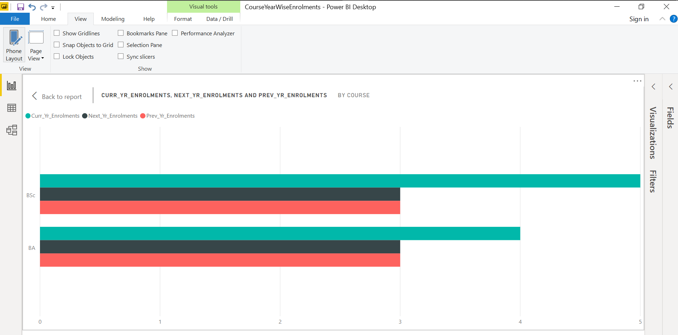
Step 5 – Visualise the analysis.

Slide 10
Conclusion
☺ …this is just a tiny peek into the wonderful world of data analysis and visualisation. Happy Visualising and Analysing Data!

