Slide 1
Dijkstra’s Algorithm
Konstantin Nenashev, Olga Belavina, Stevenson George

Slide 2
History of Dijkstra’s Algorithm
In 1956, Dijkstra accomplished two important things: got his degree and his opening of a new computer called the ARMAC.
Dijkstra needed a demonstration of the computer that non-computing people would understand so he used a simple problem statement of finding the shortest route between two cities in the Netherlands. He used a reduced roadmap which only had 64 cities.
64 Cities so that 6 bits would be enough to identify a city.
Dijkstra designed the algorithm in just 20 minutes at a café terrace. One morning while shopping in Amsterdam with his fiancée, he sat down for a cup of coffee and thought about the shortest way to travel from Rotterdam to Groningen. There he designed the algorithm and published it three years later, in 1959.
(Misa 42)

Slide 3
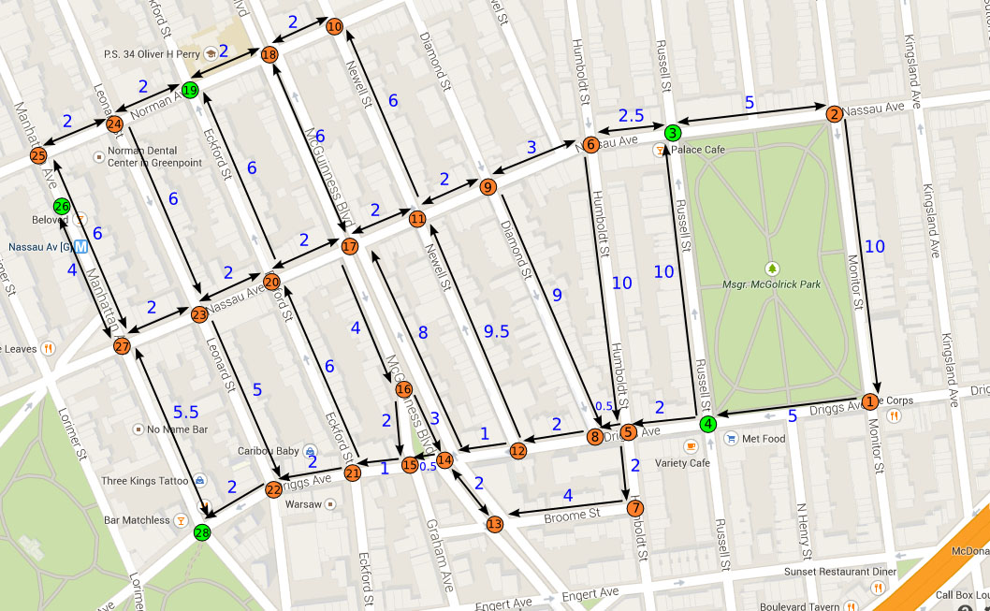
Problem Statements
Real-life examples of this algorithm:
Map routing
Networking
Currency Exchange
Flight Plans

Slide 4
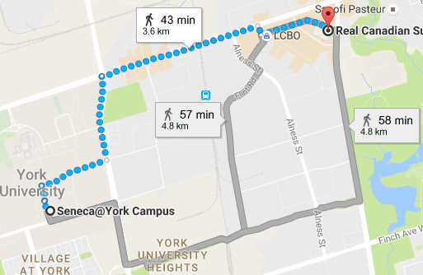
The shortest distance between locations
Vertex – Location
Edge’s weight – Distance / Time between locations
maps.google.ca

Slide 5
Networking
Vertex – Device
Edge’s weight – Number of hops / Access time

Slide 6
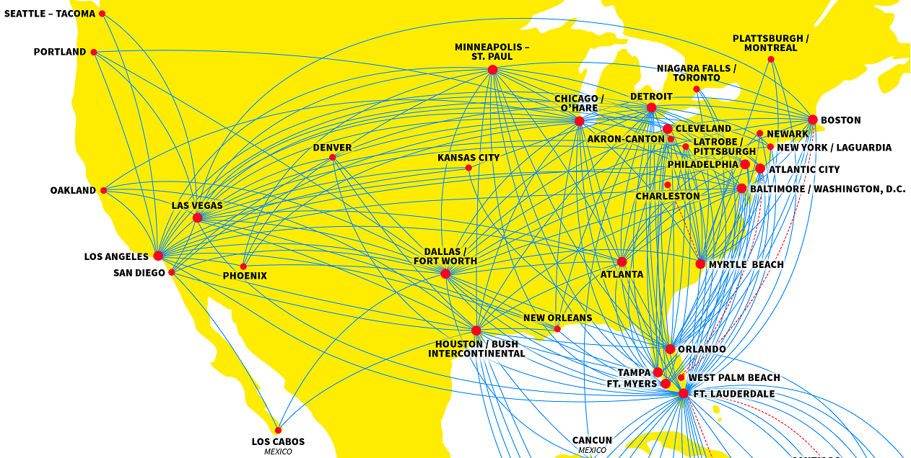
Flight Plans
Vertex – Airport
Edge’s weight – Cost of flight between airports
www.spirit.com/RouteMaps.aspx

Slide 7
Currency Exchange
Vertex – Currency
Edge’s weight – Exchange rate between currencies
 | $ | € | ¥ | £
$ | 1 | 0.9 | 101.23 | 0.76
€ | 1.11 | 1 | 112.55 | 0.85
¥ | 0.0099 | 0.0089 | 1 | 0.0075
£ | 1.31 | 1.18 | 132.94 | 1
¥
$
€
£

Slide 8
Algorithm Explanation
Determines the distance and the shortest path from the source node to every other node in the digraph.
Initially, the source nodes’ distance value is 0 and all other nodes’ distance value is set to infinite.
As we calculate the distance value of each node, we update the distance value with the calculated tentative distance value ONLY if the value is smaller than the current distance value.
After all neighboring nodes have been calculated, the next node with the smallest distance value that is not the currently processing node is processed. Then we mark the processed node as visited. We do not calculate distance values for nodes that have been visited.

Slide 9
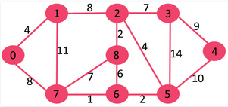
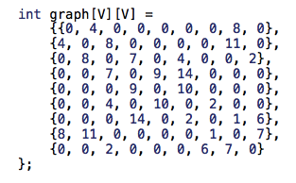
C++ Code Sample – Problem Statement
Find the shortest path from source node to every other node in this graph.
Source
or

Slide 10
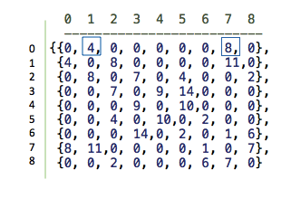
C++ Code Sample – Problem Statement
Node “0” is connected to node “1” and “7”, but not to any other node (2,8,7 etc..)
Adjacency Matrix
Source
or

Slide 11
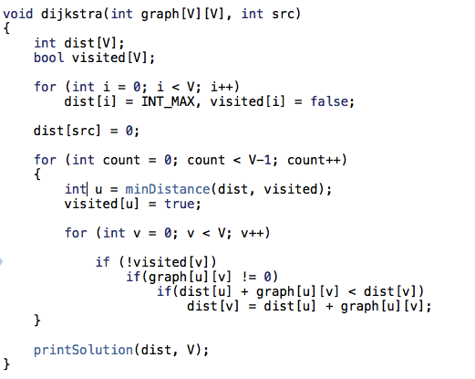
C++ Code Sample – Step 1
Stores the shortest distance from source node to
destination
Holds true if a node is already visited

Slide 12
C++ Code Sample – Step 1
Initialize all distances as infinity
Initialize source node with 0

Slide 13
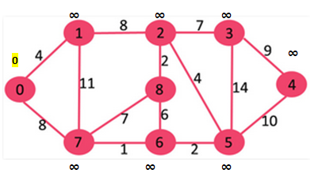
C++ Code Sample – Step 1
Initialize all distances as infinity
Initialize source node with 0

Slide 14
C++ Code Sample – Step 2
- Pick the node with the minimum distance
That is not yet processed
- Mark it as visited vertex

Slide 15
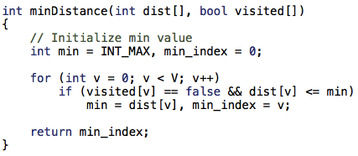
C++ Code Sample – Step 2
- Pick the node with the minimum distance
That is not yet processed
- Mark it as visited vertex

Slide 16
C++ Code Sample – Step 2
- Pick the node with the minimum distance
That is not yet processed
- Mark it as visited vertex

Slide 17
C++ Code Sample – Step 3
In this loop, we need to update dist ( array of shortest paths )
if
- node is not yet visited
- node is connected to another node (there is an edge from u to v )
- the total weight of path from src to v through u is smaller that
current value of dist[v]

Slide 18
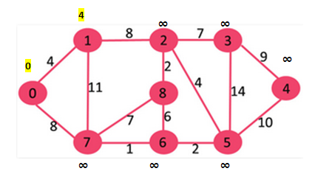
C++ Code Sample – Step 3
In this loop, we need to update dist ( array of shortest paths )
if
- node is not yet visited
- node is connected to another node (there is an edge from u to v )
- the total weight of path from src to v through u is smaller that
current value of dist[v]

Slide 19
C++ Code Sample – Step 3
In this loop, we need to update dist ( array of shortest paths )
if
- node is not yet visited
- node is connected to another node (there is an edge from u to v )
- the total weight of path from src to v through u is smaller that
current value of dist[v]

Slide 20
C++ Code Sample – Step 3
No direct connection to node 2
In this loop, we need to update dist ( array of shortest paths )
if
- node is not yet visited
- node is connected to another node (there is an edge from u to v )
- the total weight of path from src to v through u is smaller that
current value of dist[v]

Slide 21
C++ Code Sample – Step 3
No direct connection to node 3
In this loop, we need to update dist ( array of shortest paths )
if
- node is not yet visited
- node is connected to another node (there is an edge from u to v )
- the total weight of path from src to v through u is smaller that
current value of dist[v]

Slide 22
C++ Code Sample – Step 3
No direct connection to node 4
In this loop, we need to update dist ( array of shortest paths )
if
- node is not yet visited
- node is connected to another node (there is an edge from u to v )
- the total weight of path from src to v through u is smaller that
current value of dist[v]

Slide 23
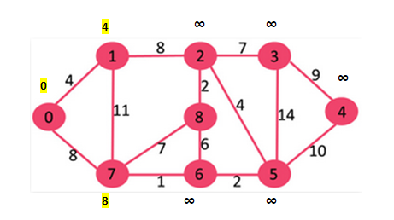
C++ Code Sample – Step 3
In this loop, we need to update dist ( array of shortest paths )
if
- node is not yet visited
- node is connected to another node (there is an edge from u to v )
- the total weight of path from src to v through u is smaller that
current value of dist[v]

Slide 24
C++ Code Sample – Go Back to Step 2

Slide 25
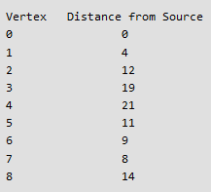
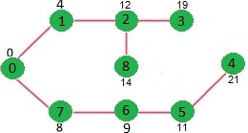
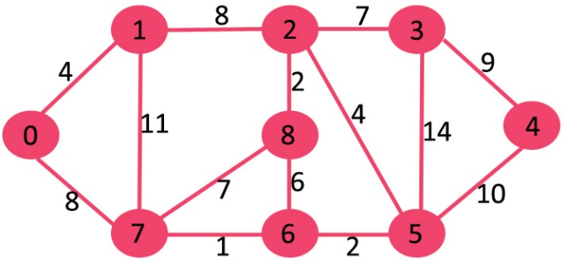
C++ Code Sample – Step 4 Print Solution
1) The code calculates shortest distance, but doesn’t calculate the path information. We can create a parent array, update the parent array when distance is updated.
2) The code is for undirected graph, same dijekstra function can be used for directed graphs also.
3) The code finds shortest distances from source to all vertices. If we are interested only in shortest distance from source to a single target, we can break the for loop when the picked minimum distance vertex is equal to target
Initial Graph
Shortest Distances

Slide 26
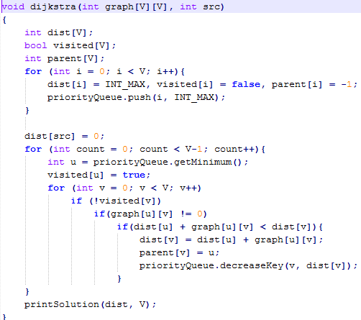
Improvements
Priority queue
Using the priority queue to get the minimum
Decrease the priority of the node

Slide 27
Heaps
Operation | Simple list | Binary heap | Fibonacci heap
Find-min | O(N) | O(1) | O(1)
Delete-min | O(N) | O(log N) | O(log N)
Insert | O(1) | O(log N) | O(1)
Decrease-key | - | O(log N) | O(1)

Slide 28
Run-time comparison
Algorithm |  | Time complexity
Bellman–Ford algorithm |  | O(VE)
 |  | O(V² log V)
Dijkstra's algorithm | with simple list | O(V²)
 | with binary heap | O(Elog V + Vlog V)
 | with Fibonacci heap | O(E + V log V)
Thorup |  | O(E + V log log V)
V – number of vertices
E – number of edges

Slide 29
Path tracking
This array is used to track the paths
Save the number of the node we came from

Slide 30
Path tree
1
8
2
7
3
1
8
2
7
3
4
2
9
4
2
11
4
0
8
14
4
0
8
4
7
6
8
10
8
7
6
5
7
6
5
10
1
2
1
2
Vertex:
0 | 1 | 2 | 3 | 4 | 5 | 6 | 7 | 8
Parent:
-1 | 0 | 1 | 2 | 5 | 6 | 7 | 0 | 2

