Slide 1
Test::Cookbook
Belden Lyman, Shutterstock Images YAPC::NA 2012
All images from Shutterstock Images

Slide 2
Who am I anyway
git clone git://github.com/belden/test-cookbook.git
Perl for 12 years; full-time Perl developer for 10.
At AirWave.com for 6.5 years. Now at Shutterstock.
twitter.com/belden
github.com/belden
belden.com :(

Slide 3
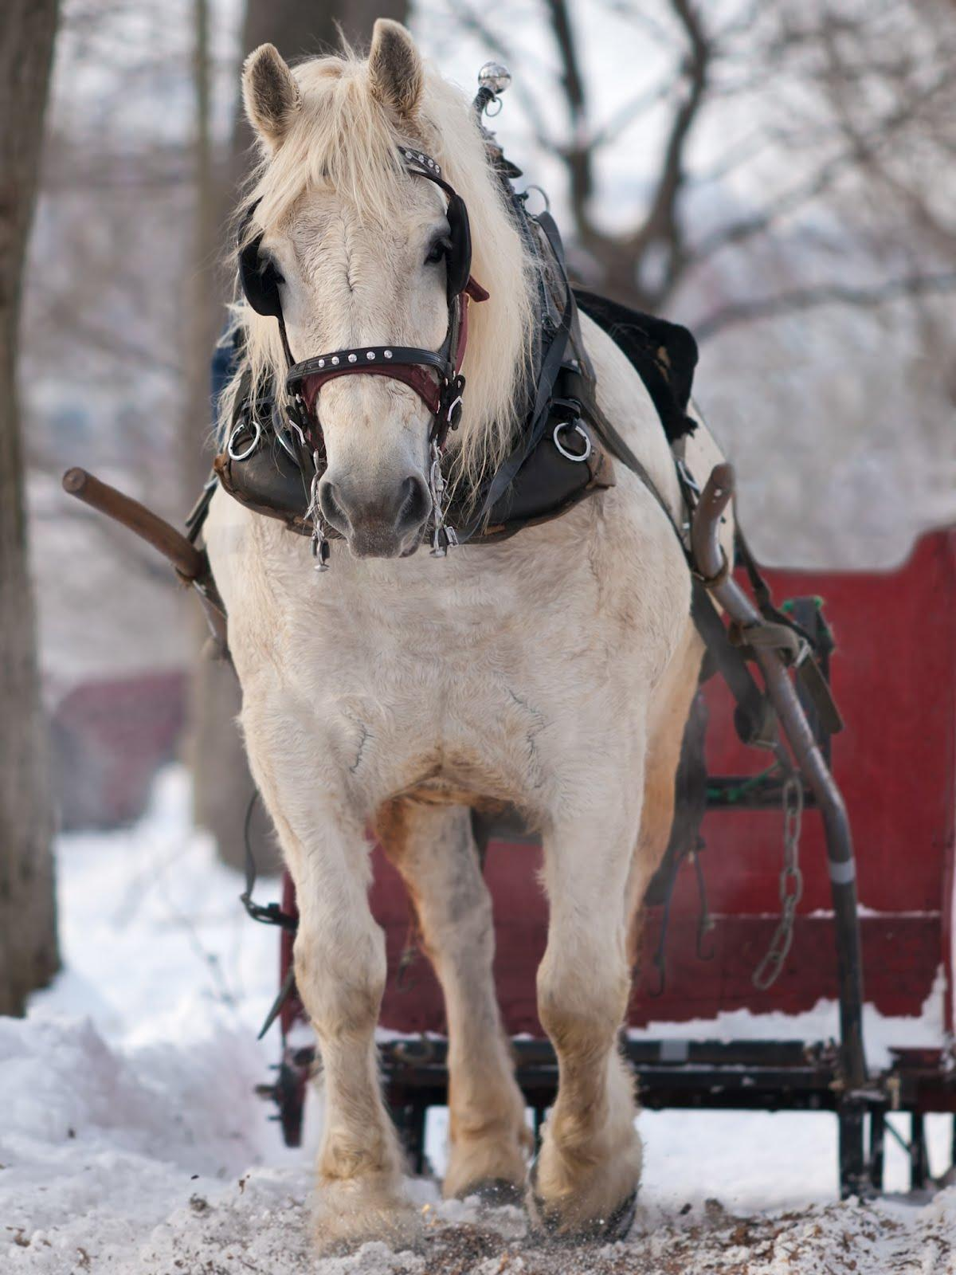
Test Driven Development
I think we generally think about it like this

Slide 4

I think about Test Driven Development like this
i.e. we're taking your code for a test drive

Slide 5
Test-driving a car is pretty fun
How does this compare to other cars?
Do I like the dashboard?
Would I want to own this?
What's it look like under the hood?
Data collection:
acceleration
mileage
crash test ratings

Slide 6
Your tests should give you info too
Right, you get to measure correctness; we get it
Your test harness can have meta-tests
this test has failed if it's slower than 2 standard deviations from the norm

Slide 7
Above all, Test Driven Development needs failures to be meaningful
Consider:
my @got = (1, [2..5, {hello => 'world'}, [8..10]]);
my @exp = (0, [1..4, {goodnight => 'moon' }, [7..10]]);
is_deeply( \@got, \@expected);
__END__
# Structures begin differing at:
# $got->[0] = '1'
# $expected->[0] = '0'

Slide 8

More info is better
slides/deeply-shootout.t

Slide 9
A simple toolset
deep_ok()
set_ok()
xml_ok()
system_ok()
memoized_ok()
stdout_of(&), stderr_of(&)
slides/simple-toolset.t
slides/xml.t

Slide 10
Tests should be easy to maintain
Tests in a loop are easy to write...
Tests in a loop are easy to write...
maintaining testcounts gets annoying
understanding failure modes becomes hard
chances are each iteration isn't really a unique test anyway
slides/loop.t

Slide 11
mock objects
It's not that hard to roll your own mock object library.
We're Perl developers; we don't always get to be purely TDD
Help you pin down the behavior of a legacy system
slides/mock_object.t

Slide 12
Monkeypatching
#!/usr/bin/perl
{
package some;
sub where { 'beyond the sea' }
}
is( some->where, 'beyond the sea' );
{
no warnings 'redefine';
local *some::where = sub { 'over the rainbow' };
is( some->where, 'over the rainbow' );
}

Slide 13

resub - monkeypatching delivered
slides/resub.t

Slide 14
dependency injection
This allows users of your code to specify what objects should be created, and how.
work on slides/mock_object.t

Slide 15
overriding CORE functions
Install a resub on any CORE function with a prototype
slides/resub-core.t

