Slide 1
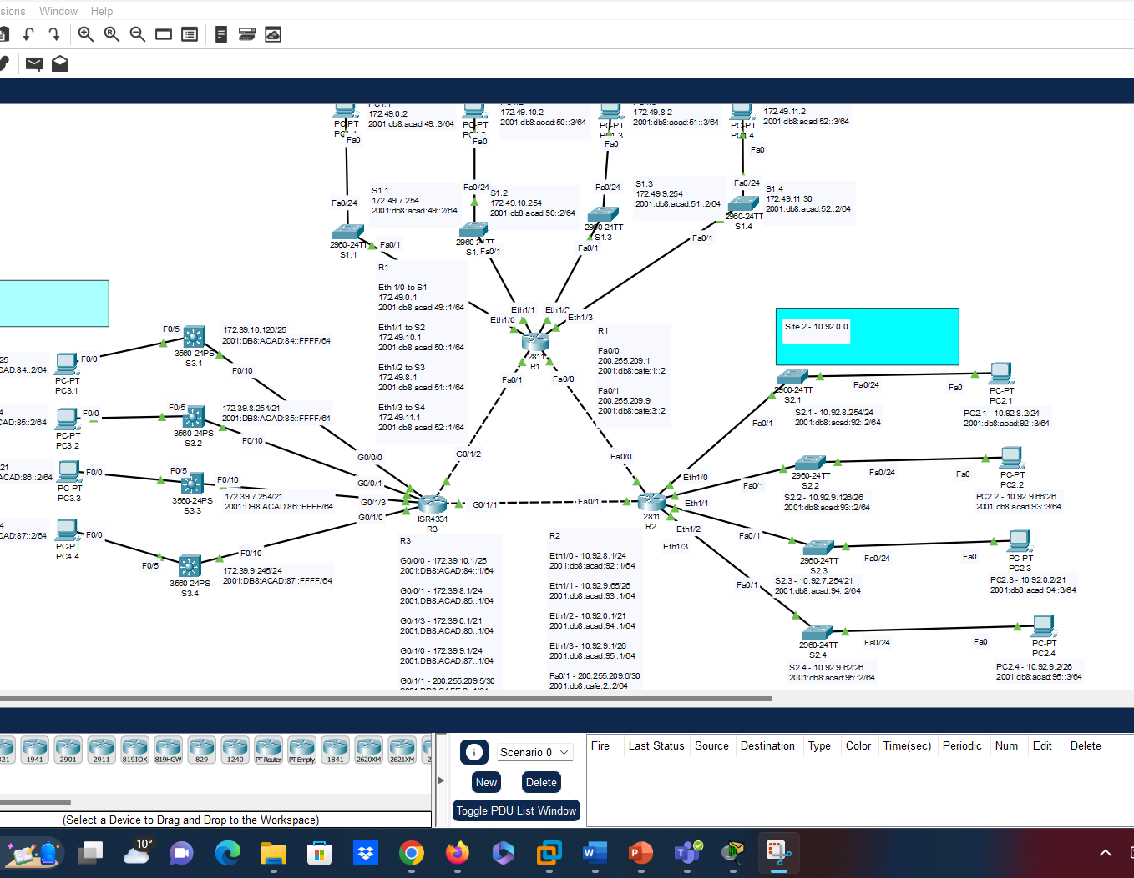
Network Set UP
Here I demonstrated prowess in configuring and establishing communication across multiple network sites and subnets.
A scenario whereby routers and accompanying devices such as PCs, Switches, Printers, etc. are isolated at different locations across a facility and inter-network integration as well as isolation is required is imagined and attained in this demonstration

