Slide 1
Maternal Mortality Risk
By Belen Gutierrez

Slide 2
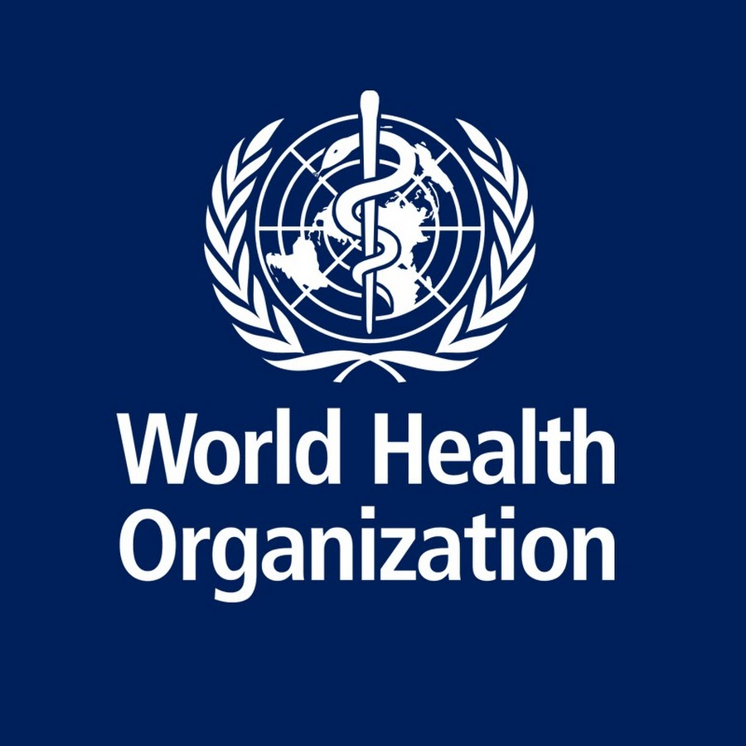
Intro
What: How health factors affect maternal mortality risk during childbirth
Why: Trying to discover what is most likely to correspond with a high mortality risk
Who: Hospitals, World Health Organization, United Nations

Slide 3

Method
Data: CSV dataset of mothers listing their age, blood pressure, blood sugar, body temperature, resting heart rate, and risk level
How: Python, pandas library, matplotlib library, seaborn library

Slide 4
Important Note #1
Blood pressure is expressed with two numbers: systolic blood pressure and diastolic blood pressure
Lower than 90/60: low blood pressure (hypotension)
Higher than 130/80: high blood pressure (hypertension)
Systolic pressure over 180 and/or Diastolic pressure over 120: hypertensive crisis

Slide 5
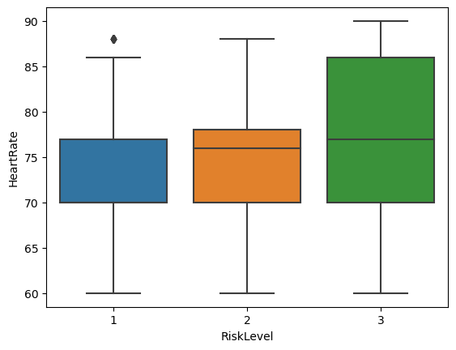
Results
High risk: green
Mid risk: orange
Low risk: blue
Safest: between 70 bpm and ~77 bpm, inclusive

Slide 6
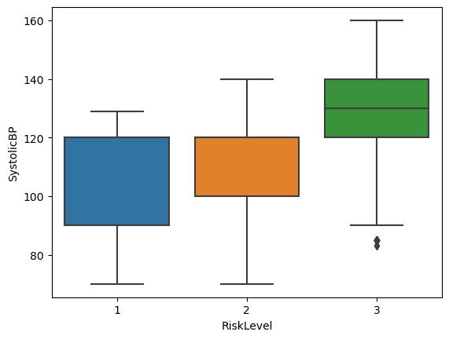
Results
This chart specifically examines the systolic blood pressure

Slide 7
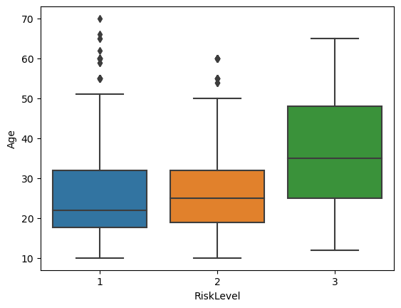
Results
People over the age of ~54 with a mid or low risk were considered outliers

Slide 8
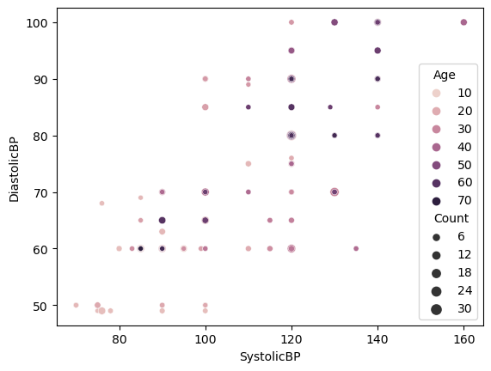
Results
Increased age is associated with higher blood pressure
Darker circles: higher ages

Slide 9
Important Note 2
Older age is associated with higher blood pressure, so it is difficult to separate the two factors when making an assessment

Slide 10
Future Work
Investigate how blood sugar impacts the other factors, including mortality risk
Are heart rate and blood pressure related, and if so, how?

Slide 11
Appendix
https://www.kaggle.com/datasets/joebeachcapital/maternal-health-risk
https://www.heart.org/en/health-topics/high-blood-pressure/understanding-blood-pressure-readings
Systolic: how much pressure exerted against artery walls when heart contracts (pumps)
Diastolic: how much pressure exerted against artery walls when heart relaxes

Slide 12
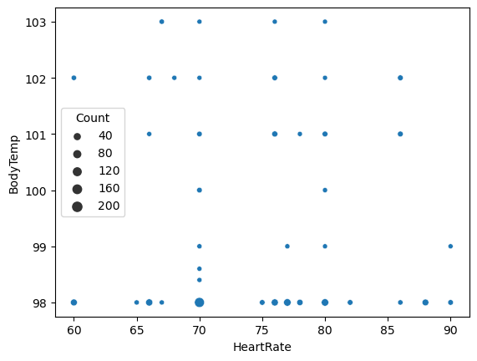
Appendix
No correlation found between resting heart rate and body temperature

