Slide 1
Room Manager

Slide 2
What is it?
It is a mobile application designed to help the meeting’s organizers on the searching and booking conference rooms inside of a company. Room Manager also contains an admin module, which helps the application administrator or IT on managing, organizing, customizing and also with assignments of resources to the conference rooms making them more descriptive for the organizers, when searching for a conference room.

Slide 3
Installation
Requisites
NodeJs
MongoDB
Minimum Supported
Exchange 2010 SP1
OS
Windows x64bits

Slide 4
Installation Configuration
Select the feature to install (currently only the service is available)
Specify the service account (currently specify a domain admin account this is an issue will be fixed soon).
Specify the port where the application will be running
Specify room manager account (this will be used to log in to the application and to connect the “Tablet” to the room manager service)
Specify the room manager certificate (this is used to encrypt the information sent through client and server)
Specify the information that the certificate will have
Specify the mongoDB information… the mongoDB credential is needed when it is configured to use credentials
During the installation the SSL component is requested to be installed when not presented in the server

Slide 5
Checking the installation
Room Manager service is up and running (if not, start it manually)
Open the room manager admin console (the login page should be opened)
https://<hostname>:<port>/admin/#/admin
Open the Tablet Client (the register page will be displayed)
https://<hostname>:<port>/tablet/#/tablet

Slide 6
Admin Console - Features
Email Server
Impersonation (RFID option is not implemented)
Conference Room
Out Of Order
Issues (not implemented)
Resources
Locations
Tablets(not implemented)

Slide 7
Login
Open the following link:
https://<hostname>:<port>/admin/#/admin
In order to get logged specified the account that was specified during the installation.

Slide 8
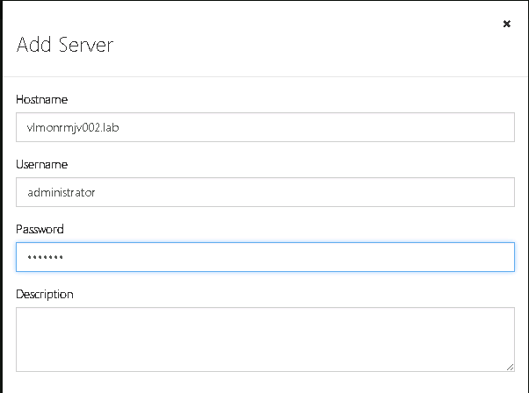
Email Server
Click on Email Servers
Add an email Server
Enter the hostname, account and password.
Note: the account specified has to have permissions over the conference rooms

Slide 9
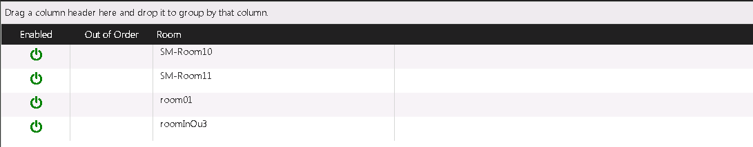
Conference Rooms
Once Saved the credentials in the Email Servers, verify the conference rooms have been retrieved for the Email Server

Slide 10
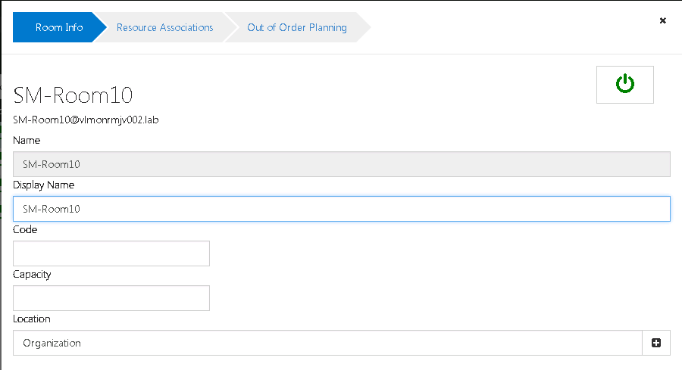
Conference Rooms – Room Info
Double click over a conference and you can see and customize their properties, associate resources and configure the Out of order planning

Slide 11
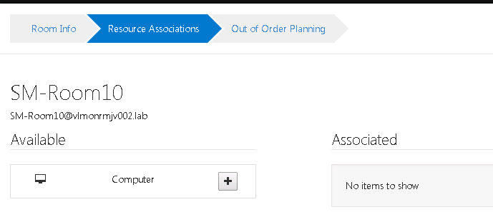
Conference Rooms - Resources
Computers, seats, etc that could be associated to a conference room.
The resources are created in Resources section

Slide 12
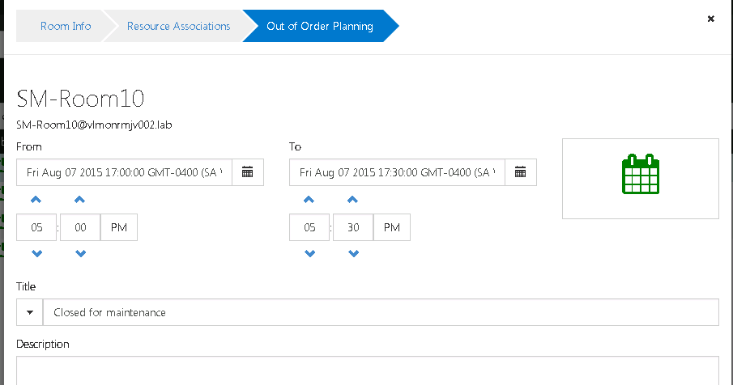
Conference Rooms – Out of Order
Used to schedule the Out of Order, when this is triggered and running no meeting will be possible to be created using room manager

Slide 13
Impersonation
Authentication
Impersonation Checkbox – allows to create, edit and delete meeting in the organizer’s name, for this the account specified in email servers has to have impersonation over the accounts
User and Password
The meeting is created in the organizer’s name, also the edition and deletion can be done only by the organizer
RFID
Not Implemented

Slide 14
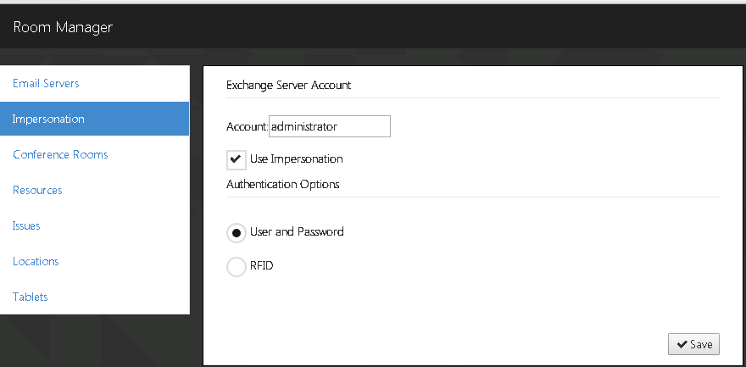
Impersonation

Slide 15
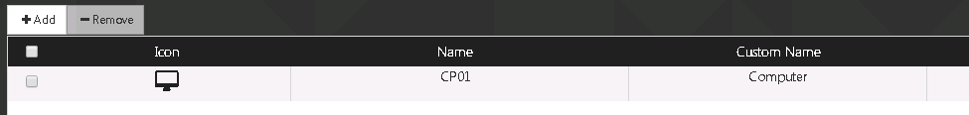
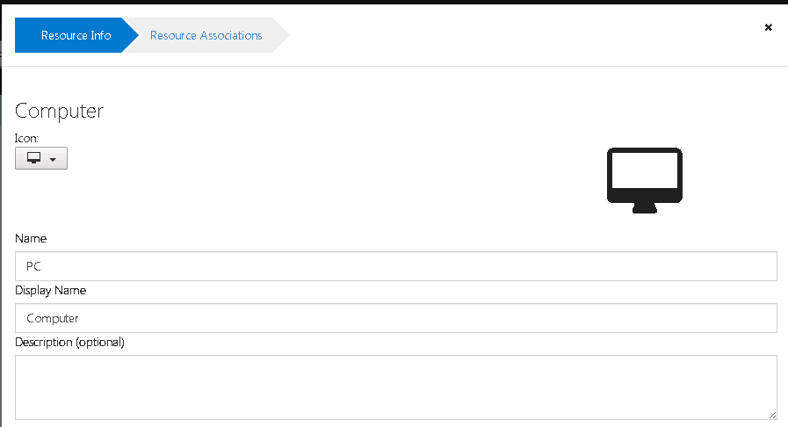
Resources
These are resources that can be assigned to the conference rooms

Slide 16
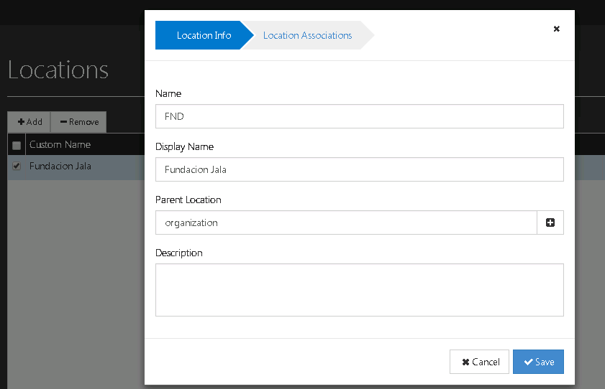
Locations
Helps to organize the conference rooms in a company through the associations of the conference rooms to the locations

Slide 17
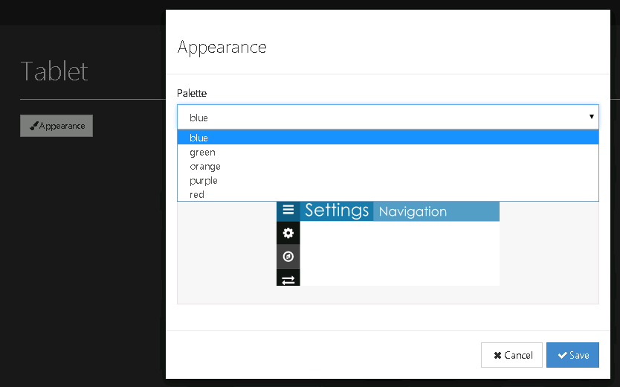
Tablet
This is a section that it is finalized yet, many features still need to be added here, currently the only one that it is working is the appearance, which is reflected on the tablets once saved

Slide 18
Tablet Client
The client was designed to run on tablet with Android, where it is used Cordova to encapsulate the Chrome browser and load the application.
The setting displayed on web was enabled only for testing purposes(it is under planning how this will be done for web browser)
Open the following link in order to load the tablet client
http://<hostname>:<port>/tablet/#/tablet
Note: this will redirect to the register link

Slide 19
Tablet Client - Features
Home
Display the current and next meeting
Schedule Meeting (in the conference room associated to the tablet and any other conference room selected from the Search)
Create
Get
Edit
Delete
Search
Filter
Timeline
Settings
Associating a meeting to the “tablet”

Slide 20
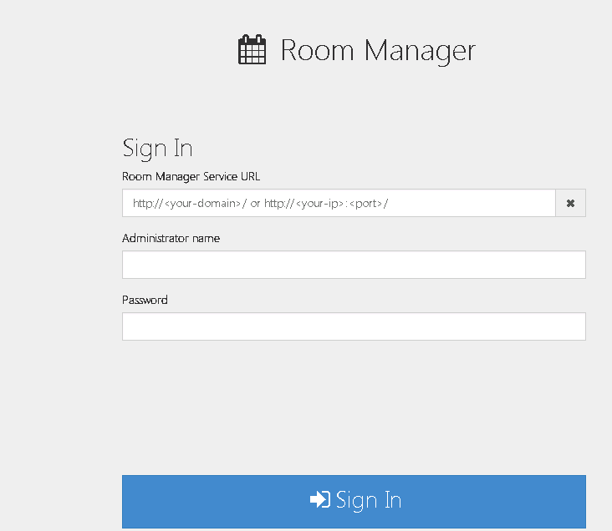
Setting - Register
Enter the room manager service
Enter room manager account, the one that was created during the installation

Slide 21
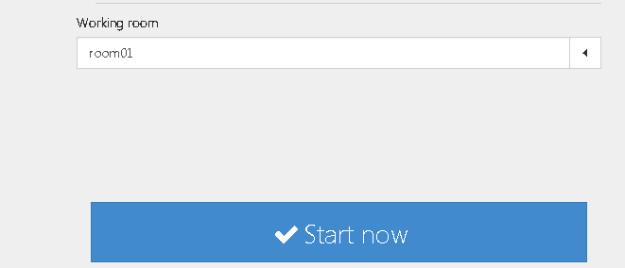
Setting – Associating a conference room
Once the credentials is entered and saved, a combobox with conference rooms will be displayed where the user has to select one conference room that will be associated to the “tablet”
And, then click Start now to start with the application

Slide 22
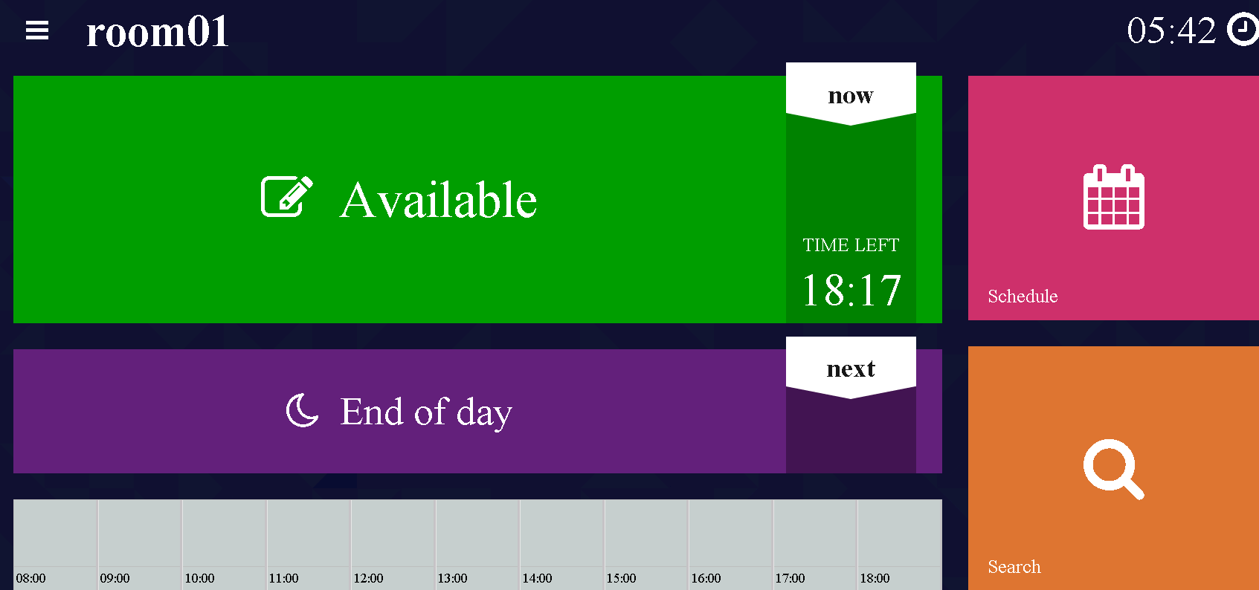
Tablet - Home
Once started this is the screen displayed

Slide 23
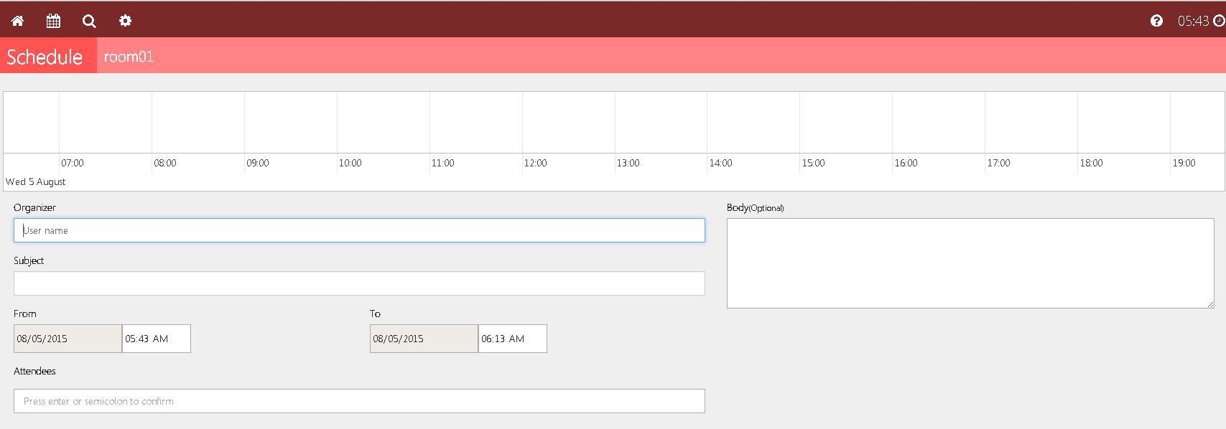
Schedule Meeting
Click on the schedule, the timeline or details meeting (when displaying Available) and below screen will be displayed.

Slide 24
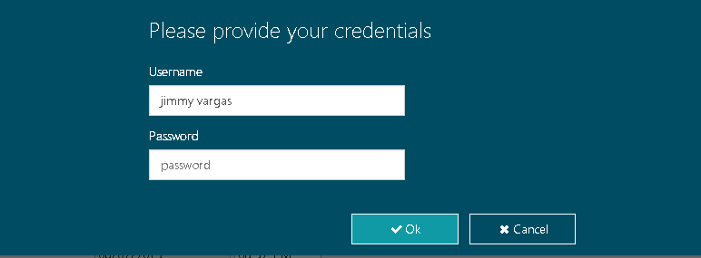
Schedule Meeting – Impersonation Unchecked
After clicking Create, Edit or Delete the following screen is showed requesting the organizer’s credentials

Slide 25
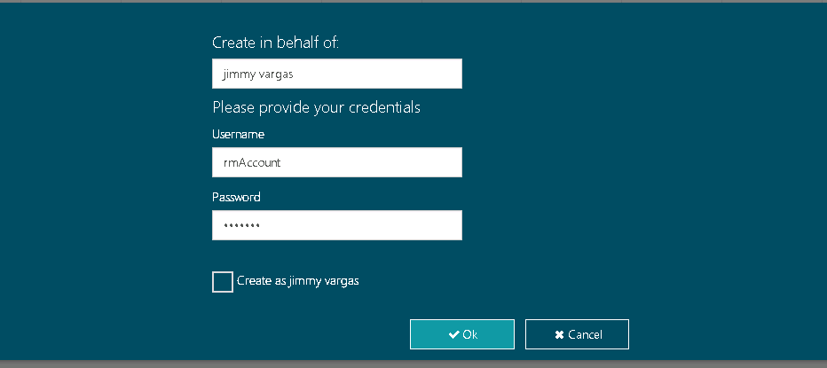
Schedule Meeting – Impersonation Unchecked
After clicking Create, Edit or Delete the following screen is showed requesting the credentials of the person that wants to execute operation, this helps to the organizer and attendees now who did the operation over the meeting

Slide 26
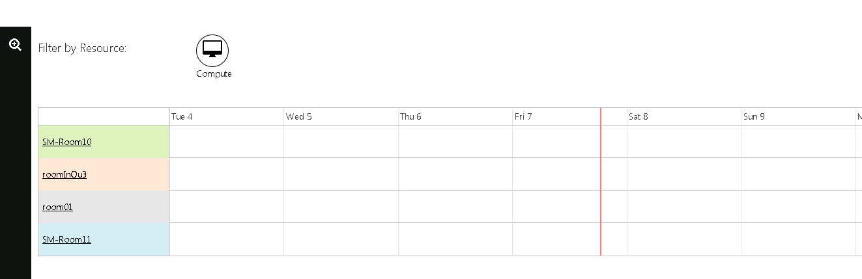
Search
Enables the people to search for conference rooms according to the availability, resources and location. Giving the capability of creating a meeting in a room different from the one associated to “tablet”

