Slide 1
REST (Representational State Transfer) Web Services
Basic Concepts

Slide 2
HTTP (Hypertext Transfer Protocol)
Foundation for World Wide Web
Application-level protocol for distributed, collaborative, hypermedia information systems
Based on TCP/IP which is used to deliver data (HTML files, image files, query results etc)
HTTP specification specifies how clients request data will be constructed and sent to the server, and how servers respond to these requests
Standardizes way for computers to communicate with each other
HTTP is a generic and stateless protocol which can be used for other purposes as well using extension of its request methods, error codes and headers

Slide 3
HTTP – Basic Features
HTTP is connectionless: client initiates a HTTP request and disconnects from the server and waits for a response
HTTP is media independent: any type of data can be handled the as long as the client and server know how to handled, both has to specify it in the MIME-type
HTTP is stateless: The server and client are aware of each other only during a current request

Slide 4
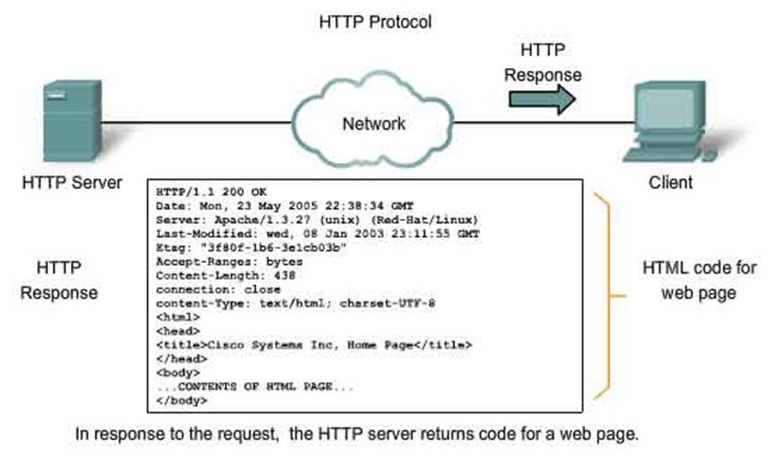
HTTP - Architecture
The HTTP protocol is a request/response protocol based on client/server

Slide 5

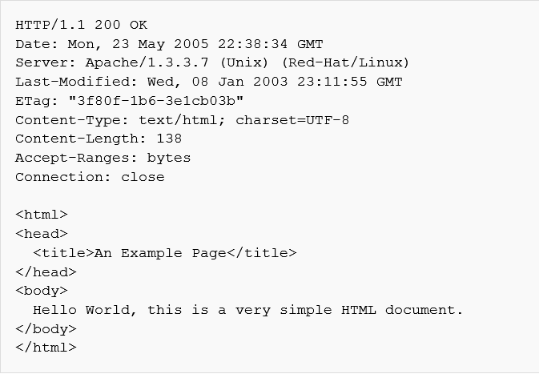
HTTP - Architecture
Client Request
Server Response
Request Line
Response Line
Headers
Empty Line
Body

Slide 6
Request Methods
GET - The GET method is used to retrieve information from the given server using a given URI. Requests using GET should only retrieve data and should have no other effect on the data.
HEAD - Same as GET, but only transfer the status line and header section.
POST - A POST request is used to send data to the server, for example customer information, file upload etc using HTML forms.
PUT - Replace all current representations of the target resource with the uploaded content.
DELETE - Remove all current representations of the target resource given by URI.
CONNECT - Establish a tunnel to the server identified by a given URI.
OPTIONS - Describe the communication options for the target resource.
TRACE - Perform a message loop-back test along the path to the target resource
PATCH - The PATCH method applies partial modifications to a resource

Slide 7
Safe and Idempotent Methods
Method | Safe | Idempotent
GET | YES | YES
HEAD | YES | YES
POST | NO | NO
PUT | NO | YES
DELETE | NO | YES
CONNECT | YES | YES
OPTIONS | YES | YES
TRACE | YES | YES
PATCH | NO | YES
Safe - Intended only for information retrieval and should not change the state of the server.
Idempotent - multiple identical requests should have the same effect as a single request.

Slide 8
Status code
1 | 1xx: Informational This means request received and continuing process.
2 | 2xx: Success This means the action was successfully received, understood, and accepted.
3 | 3xx: Redirection This means further action must be taken in order to complete the request.
4 | 4xx: Client Error This means the request contains bad syntax or cannot be fulfilled
5 | 5xx: Server Error The server failed to fulfill an apparently valid request

Slide 9
Headers
HTTP - Header Fields
HTTP deader fields provide required information about the request or response, or about the object sent in the message body. There are following four types of HTTP message headers:
General-header: These header fields have general applicability for both request and response messages.
Client Request-header: These header fields are applicability only for request messages.
Server Response-header: These header fields are applicability only for response messages.
Entity-header: These header fields define metainformation about the entity-body or, if no body is present

Slide 10
General Header
Cache-control
Connection
Date
Pragma
Trailer
Transfer-Encoding
Upgrade
Via
Warning

Slide 11
Client Request Headers
Accept-Charset
Accept-Encoding
Accept-Language
Authorization
Expect
From
Host
If-Match
If-Modified-Since
If-None-Match
If-Range
If-Unmodified-Since
Max-Forwards
Proxy-Authorization
Range
Referer
TE
User-Agent

Slide 12
Server Response Header
Accept-Ranges
Age
ETag
Location
Proxy-Authenticate
Retry-After
Server
Vary
WWW-Authenticate

Slide 13
Entity Header
Allow
Content-Encoding
Content-Language
Content-Length
Content-Location
Content-MD5
Content-Range
Content-Type
Expires
Last-Modified

Slide 14
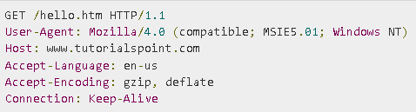
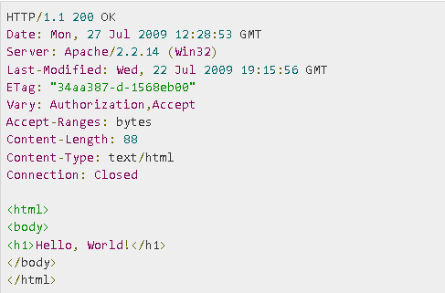
Example
Request
Response

Slide 15
REST (Representational State Transfer) Web Services
Basic Concepts

Slide 16
Web Services
Web Server
A web server can mean two things - a computer on which a web site is hosted and a program that runs on such a computer. So the term web server refers to both hardware and software
Software examples
IIS
APACHE
NODEJS
….

Slide 17
Web Services
Web Services
Are client and server applications that communicate over the World Wide Web’s (WWW) HyperText Transfer Protocol (HTTP).
Provides a standard means of interoperating between software applications running on a variety of platforms and frameworks
Service
On the conceptual level, a service is a software component provided through a network-accessible endpoint
Simplest definition – it is a function that can be accessed by another program over the WEB (HTTP)

Slide 18
REST History
Introduced on 2000 by Roy Fielding in his academic dissertation, "Architectural Styles and the Design of Network-based Software Architectures"

Slide 19
Basic knowledge
REST gives a coordinated set of constraints
Communicates over the Hypertext Transfer Protocol
REST interfaces usually involve collections of resources with identifiers

Slide 20
Architectural Constraints
Client-Server
Stateless
The client–server communication is further constrained by no client context being stored on the server between requests. Each request from any client contains all the information necessary to service the request, and session state is held in the client.
Cacheable
Responses must therefore, implicitly or explicitly, define themselves as cacheable, or not, to prevent clients from reusing stale or inappropriate data in response to further requests

Slide 21
Architectural Constraints
Layered System
A client cannot ordinarily tell whether it is connected directly to the end server, or to an intermediary along the way. Intermediary servers may improve system scalability by enabling load balancing and by providing shared caches
Code On Demand(optional)
Servers can temporarily extend or customize the functionality of a client by the transfer of executable code

Slide 22
Architectural Constraints
Uniform Interface
The uniform interface simplifies and decouples the architecture, which enables each part to evolve independently
Identification of resources
Ex. https://concesionaria/clientes/
Manipulation of resources through these representations
Ex. POST https://concesionaria/clientes/

Slide 23
Uniform Interface
Self-descriptive messages
Each message includes enough information to describe how to process the message

Slide 24

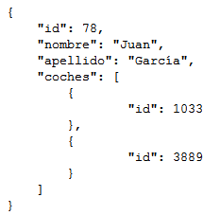
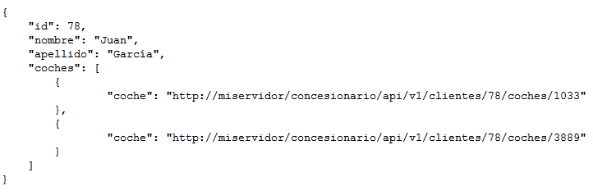
Uniform Interface
Hypermedia as the engine of application state (HATEOAS)
Clients make state transitions only through actions that are dynamically identified within hypermedia by the server (e.g., by hyperlinks within hypertext)
Following the HATEOAS this would be the answer

Slide 25
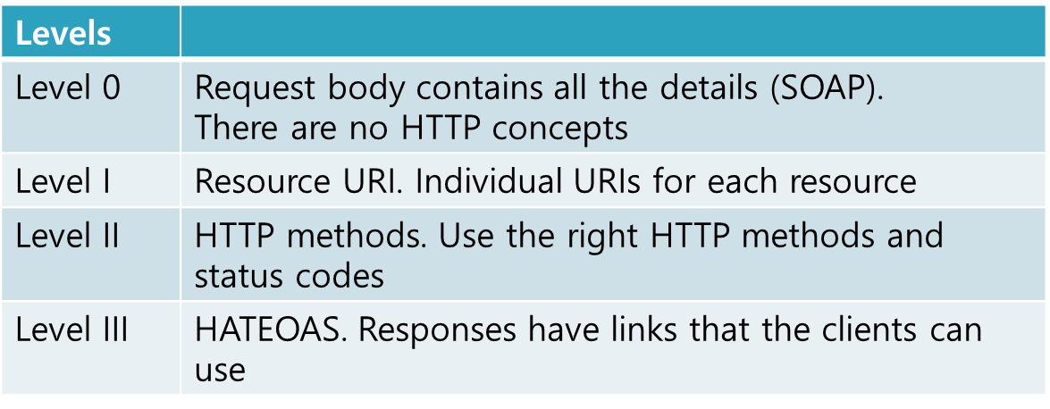
RESTFul
If a REST services violates any of those constraints are not considered as RESTFul
Richardson Maturity Model different level of RESTFul

Slide 26
URI (Uniform Resource Identifier)
Such identification enables interaction with representations of the resource over a network.
Examples:
https://concesionaria/clientes/
https://concesionaria/clientes/1234
https://concesionaria/clientes/1234/coches/1

Slide 27
Methods
Resource | GET | PUT | POST | DELETE
Collection URI, such as http://api.example.com/v1/resources/ | List the URIs and perhaps other details of the collection's members. | Replace the entire collection with another collection. | Create a new entry in the collection. The new entry's URI is assigned automatically and is usually returned by the operation.^{[10]} | Delete the entire collection.
Element URI, such as http://api.example.com/v1/resources/item17 | Retrieve a representation of the addressed member of the collection, expressed in an appropriate Internet media type. | Replace the addressed member of the collection, or if it does not exist, create it. | Not generally used. Treat the addressed member as a collection in its own right and create a new entry in it.^{[10]} | Delete the addressed member of the collection.

Slide 28
More about REST services
Status Code returned usually are the same ones defined for HTTP
The most common of data transferred by the API is:
XML
JSON

Slide 29
References
http://www.tutorialspoint.com/http/http_quick_guide.htm
https://en.wikipedia.org/wiki/Hypertext_Transfer_Protocol
https://en.wikipedia.org/wiki/Web_server
https://en.wikipedia.org/wiki/Representational_state_transfer
http://www.ibm.com/developerworks/webservices/library/ws-restful/

