Slide 1
REST Requests Examples
with TodoLy site

Slide 2

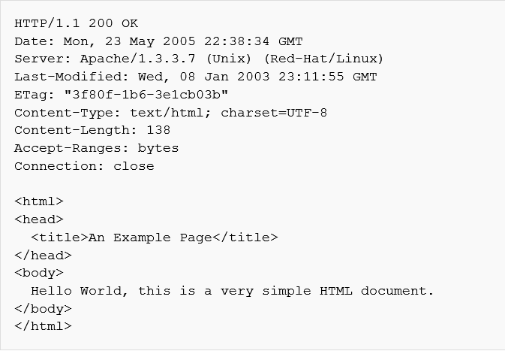
HTTP (Hyper Text Transfer Protocol)
Client Request
Server Response
Request Line
Response Line
Headers
Empty Line
Body

Slide 3
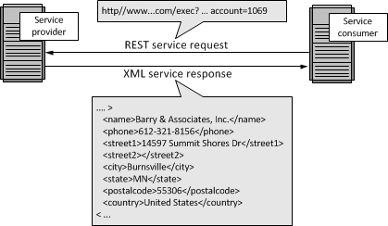
REST Web Services

Slide 4
REST - Web Service
Based HTTP Protocol
Request Methods
GET
POST
PUT
DELETE
Type of Data:
JSON,XML and others
Manage Resources
Example for a blog:
Blog
Users
Posts
Answers
Tags

Slide 5
Identifying the requests
Most common browsers used to identify
Chrome
Developer tools
Firefox
Developer tools
Firebug
Other Tools
Charles Proxy - http://www.charlesproxy.com/download/
Fiddler - http://www.telerik.com/download/fiddler
These tools are not used just to identify they bring much more functionality

Slide 6
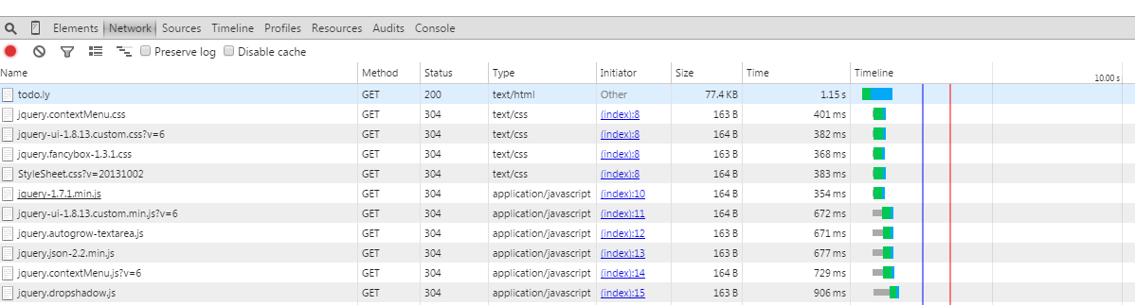
HTTP Requests – Todo.Ly
Login to Todo.ly
Open the developer tools-> Network and refresh the page

Slide 7
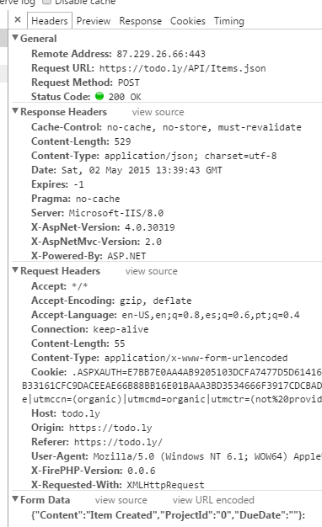
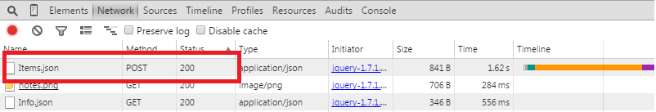
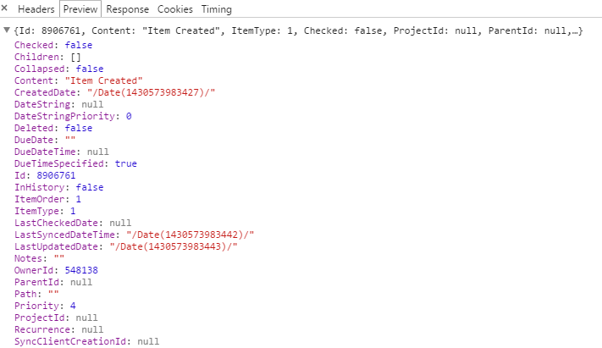
Creating an Item

Slide 8
Cont. Update an Item
Review the API
Update an Item
Identify the request to the method
Review the Response

Slide 9
REST Requests – Using a Rest Client Tool
The most common tools on Chrome are:
PostMan
Advanced REST Client

Slide 10
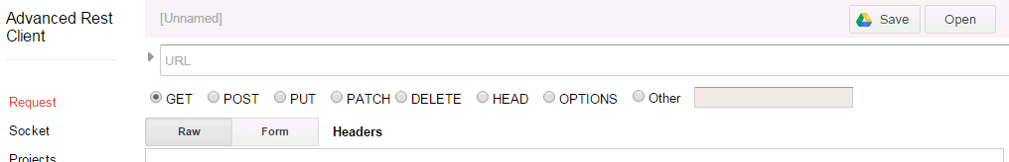
Exercise - Create a Project
Open the Rest Client
What the API says?

Slide 11
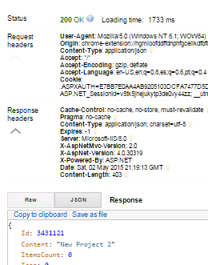
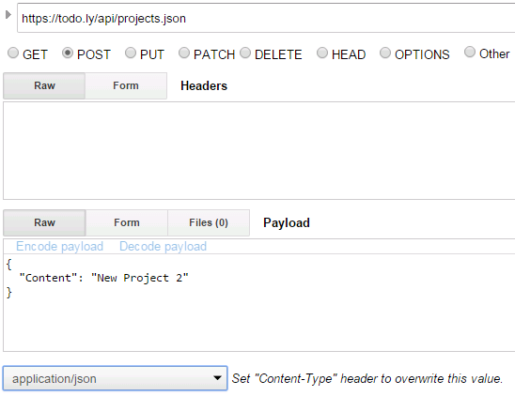
Cont. Create a project

Slide 12
Exercises
Create an Item
Create an Item under a project
Associate an Item to a project
Delete a project with items
what happens with the items?
Empty the Recycle Bin

Slide 13
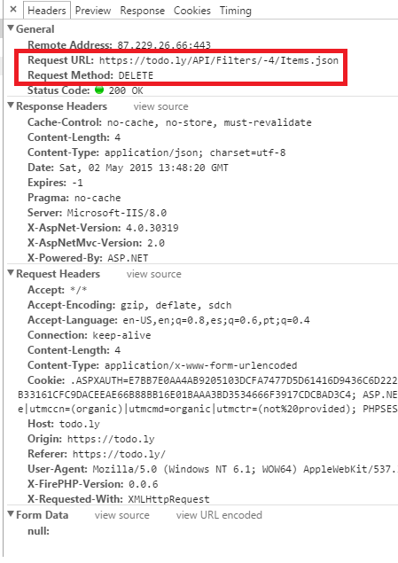
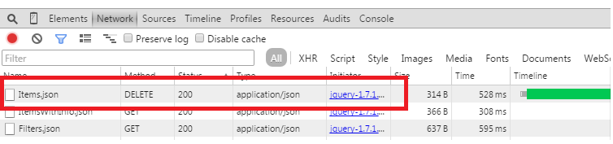
Exercise - Empty the Recycle Bin
Review the API
There is no API!!!
What now? how could you identify the service?

Slide 14
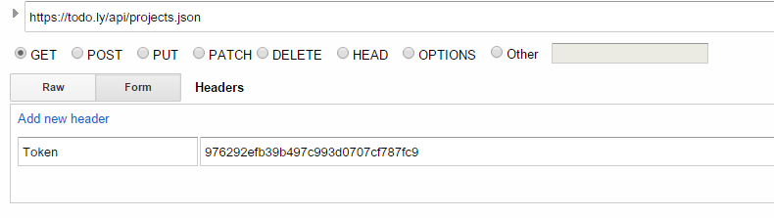
Exercises
Create a project using a token
It is needed to get the token first

