Slide 1
Development/Automation process
Basic

Slide 2
Helps the team to have the control on how and when the features are being developed and delivered, it can contain certain activities that helps on the code quality.
Having a good process reduces the probability on delivering broken code

Slide 3
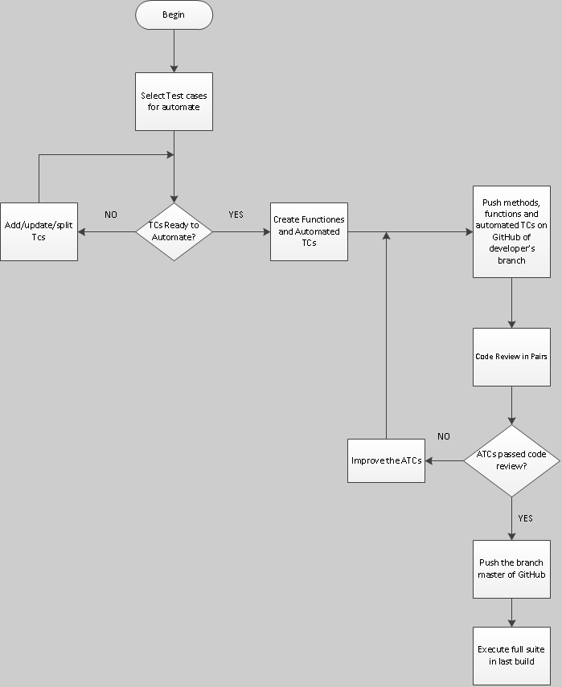
Example

Slide 4
Automate test cases
Define the process from the moment that a test case/feature/user story is selected to be automated until it is merged to master branch for example :
Check the test case is read to be automated
Is it need to add/split/update the test cases?
Check if there are classes/methods already implemented
Once the test case is automated
Test the code locally in order to make sure that no code has been broken
Request for code review
Once the code review is passed, merged the code to the branch
Once the code is in the main branch execute all the tests against the latest version
note: this is a small example of process.

Slide 5
Code Standards
Defining Code Standards helps to the team to talk the same language.
This involves:
Documentation in the code
Variables/functions naming
Indentation
Folder/Files structures
Tests structures (mentioned, because our project it is an automation project)
…
For each programming language there is already proposed code standards
Javascript - https://google.github.io/styleguide/javascriptguide.xml
C# - https://msdn.microsoft.com/en-us/library/ff926074.aspx
……

Slide 6
Versioning Code
Practice that tracks and controls the changes in the source code
It is important because it helps to get the code organized by versions, helps to identify in which version the code got broken
There are numerous tools that helps with this practice, for instance:
Git
Perforce
SVN

Slide 7
GitHub
Powerful collaboration, code review, and code management for open source and private projects.

Slide 8
Git Branching model
There are different models proposed for branching the code:
Centralized Workflow
Feature Branch Workflow
GitFlow Workflow
Forking Workflow
Note: each project defines which model fits better in the project

Slide 9
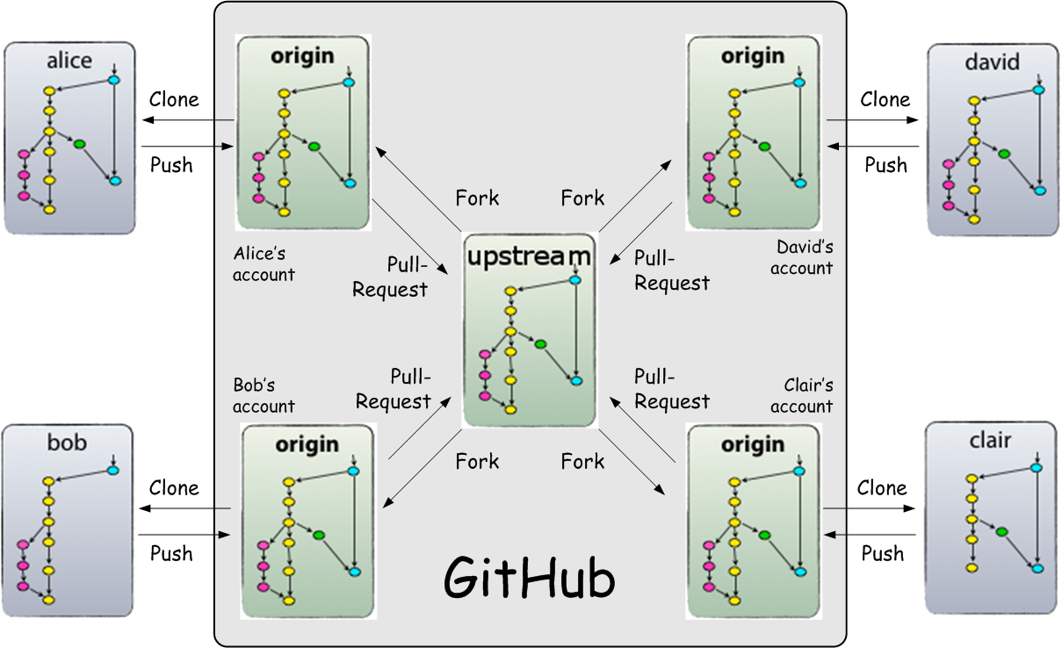
Forking Workflow

Slide 10
Versioning Code – Forking Workflow
The main advantage of the Forking Workflow is that contributions can be integrated without the need for everybody to push to a single central repository. Developers push to their own server-side repositories, and only the project maintainer can push to the official repository. This allows the maintainer to accept commits from any developer without giving them write access to the official codebase.

Slide 11
How we will do
A base repository (upstream) is created
Each Developer forks the base repository (upstream)
Each Developer can start working on their assignments
Once it is done has to push their changes(fixed code, new methods…) into their forks
Request a pull request from their fork to the base repository (upstream)
Anyone can review the code, if approved the code is merged and also the same reviewer can reject it (this depends how this is defined in the project)

Slide 12
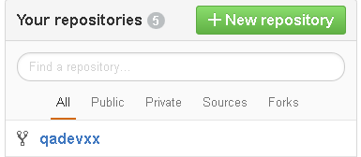
Example - Github
Base repository(upstream) called qadevxx
Fork the repository, and it will be displayed as in the picture below
Clone the fork into your machine

Slide 13
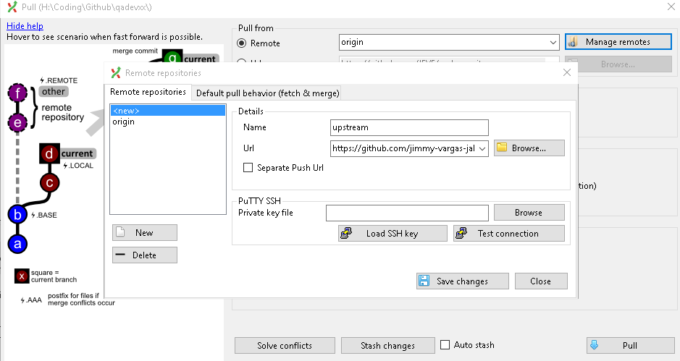
Create a pull command upstream from the repository base (upstream)
this is will help to sync local repo with upstream
Note: this is GitExtension for GUI

Slide 14
(By command line)
Clone your own public repository
git clone https://user@bitbucket.org/user/repo.git
Add the upstream from the original repository
git remote add upstream https://bitbucket.org/maintainer/repo.git
Updating the local repository with the latest changes from original repository
git pull upstream master
Reference: https://www.atlassian.com/git/tutorials/comparing-workflows/forking-workflow

Slide 15
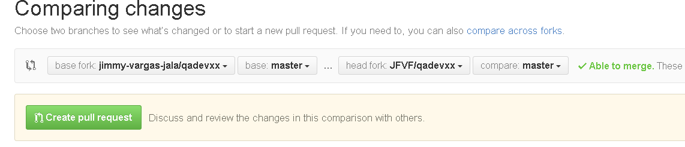
5. Create another file and push it to your fork.
6. Create a pull request to the Base Repository, it can be done using git extensions or through the web. I will do using the web
6.1. Go to your fork in GitHub
Click Pull Requests>New pull request
7. Click Create new pull request

Slide 16
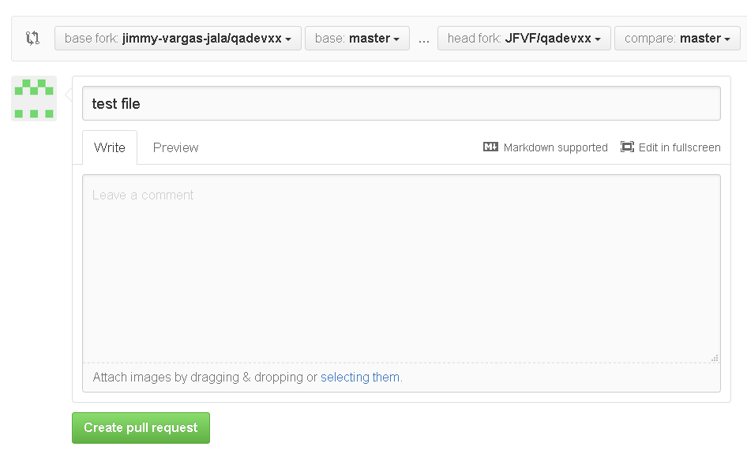
8. After clicking the Create pull request. The window below is displayed where the subject and the comments can be added
9. Click Create pull request

Slide 17
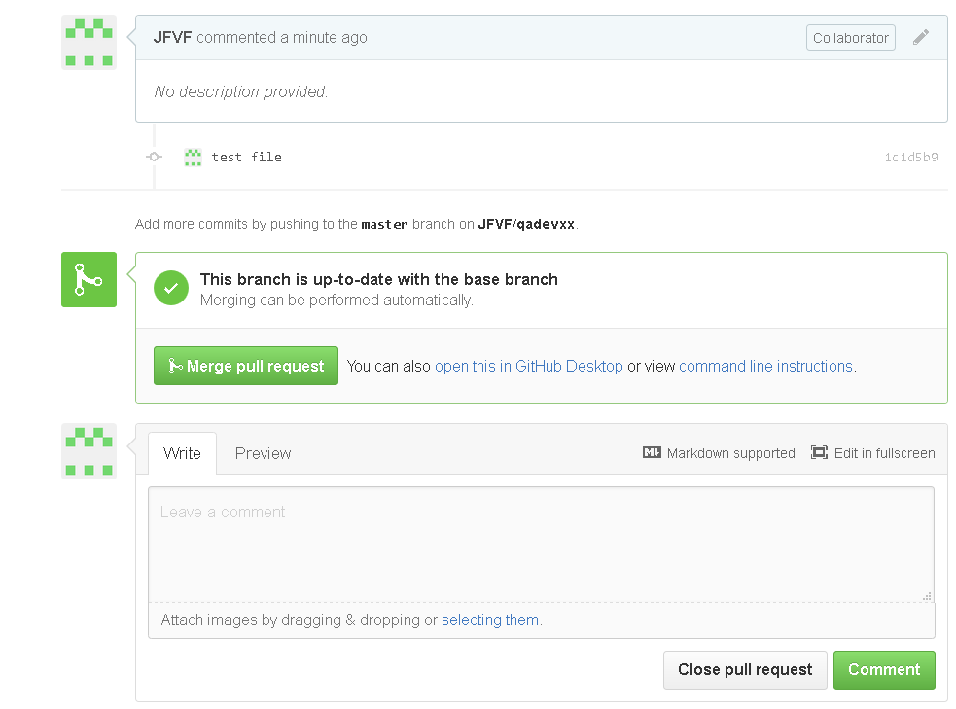
The following is displayed which gives the option to merge the pull request, write comments and close the pull request (rejecting it)

Slide 18
10. When a pull request is done everybody that it is contributing will receive an email, giving the possibility to each to review the code and merge to the base repository (upstream) whenever the enough permissions is given to the people.
Quick Exercise
11. Let’s create a file in the base repository
12. Sync your local repository fork with the base repository
13. Do the corresponding changes
14. Push the code to your fork.
15. Create a pull request from your fork to the base repository

Slide 19
Good practices
Before starting coding the fork has to be synced with the upstream otherwise there is high probability to have conflicts
Pull request from base repository to the local repository
Push the code to the fork (Optional)
Note: this way we are going to have both places updated
When creating a pull request it has to have all the info related to the work done for instance:
Files have been modified/added/deleted
Methods have been added/modified/deleted.
No empty files should be submitted
Only source code, configuration files, dependencies should be merged
Source Code that doesn’t follow the code standard shouldn’t be merged.
No source code should be pushed directly to the upstream

