Slide 1
TDD and BDD
Introduction

Slide 2
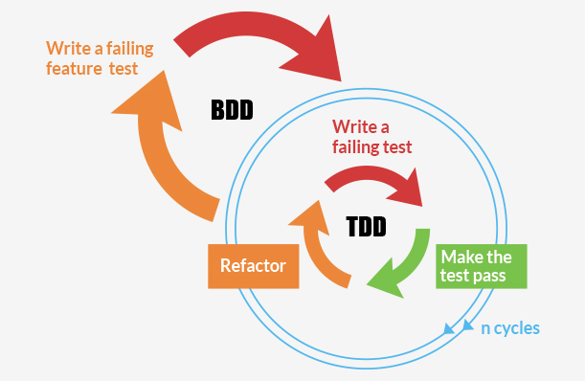
TDD and BDD
TDD (Test Driven Development)
Unity/Method
Test
Assertion
Setup and Teardown
BDD (Behavior Driven Development)
Feature
Specification
Expectation
Before and After each

Slide 3
TDD - Exercise
Example: Create a simple String Calculator
Requirements:
Create a method add that receives a string add(String)
e.g “1,2” return 3
Create a method multiply that receives a string multiply(String)
e.g “1,2,3” return 6
When the String is empty it should return 0
e.g “” return 0
When the String contains a character to be sum an exception should be returned
e.g “1,S” return exception
It is possible to add previous results with current input
It is possible to multiply previous results with current input

Slide 4
TDD Steps
Write a Test
Run the Tests
Review the Results
Refactor the code
Repeat from 1 to 4

Slide 5
BDD
BDD provides a “ubiquitous language” for analysis, that it is shared by developers and users
It starts at the outside by identifying business outcomes, and then drills down into the feature set that will achieve those outcomes. Each feature is captured as a “story”, which defines the scope of the feature along with its acceptance criteria
Dan North

Slide 6
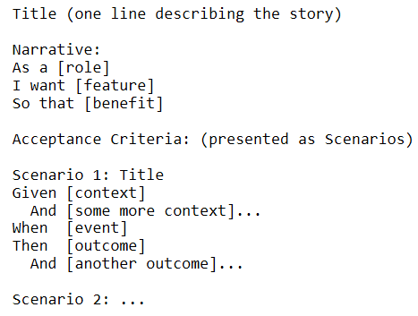
BDD Story Format
Even though there are different variations of the BDD story template, they all have two common elements: narrative and scenario. Each narrative is followed by one or more scenario

Slide 7
Fields
Story Title: The title of the story, describes an activity that the account holder wants to carry out.
Narrative: It should include a role, a feature and a benefit
Scenario: Title should say what’s different
It should be in terms of Givens, Events and Outcomes
(generally defined on a 3 amigos style: PO, DEV,QA)

Slide 8
Cont.
Recommendation when the story has more than six scenarios it could be break down and grouped in similar stories

Slide 9
BDT
We are using BDD approach to design and implement the test scenarios. So, from now on we will call this as BDT (Behavior Driven Testing)

Slide 10
Example – TodoLy Projects
Story: Create a subproject
As employee
I want to create a subproject
So I am able to organize and split my project in subprojects
Scenarios:
Scenario 1: Create a subproject inside an empty project
Scenario 2: Create a subproject inside a project that has subprojects already created
Scenario 3: Create a subproject inside a project that has items already created
….

Slide 11
Scenario 1 – Examples - Create a subproject inside an empty project
Ex.1
Given I have empty project ‘Project A’
When I create a subproject ‘SubA’
Then ensure the project “SubA” is a “Project A”’s child
And ensure the SubA’s ParentId is the same than ‘Project A’
Ex2.
Given I have empty project {Content: “Project A”}
When I create a subproject {Content:”SubA”,ParentId:ProjectA.Id} under “Project A”
Then ensure the project “SubA” is a “Project A”’s child
And ensure the SubA’s ParentId is the same than ‘Project A’

Slide 12
Scenario 1 – Examples - Create a subproject inside an empty project
Ex3.
Given I have an empty project ‘Project A’
When I create a subproject ‘SubProject B’
Then the ‘Project A’ becomes in parent of ‘SubProject B’
And the ‘SubProject B’ is children of ‘Project A’
And the number of children is ‘1’

Slide 13
Scenario 1
Ex.4
Given I have empty project “Project A”
When I send a POST request to /projects.json with the json
{
Content:”SubA”,
ParentId:”ProjectA”.Id
}
Then ensure the status code is 200
And ensure the response contains the following information
{
Content: “SubA”
ParentId:”ProjectA”.Id
}
When I send a GET request to /projects/”ProjectA”.Id.json
Then ensure the response contains the following information
{
Children: [{
Content: “SubA”,
ParentId:”ProjectA”.Id
}]
}

Slide 14
Scenario 2 - Create a subproject inside a project that has subprojects already created
Given I have an empty project “Project A”
And I have two subprojects created under “Project A”
When I create a new subproject ‘NewSubA’
Then the ‘Project A’ becomes in parent of ‘NewSubA’
And the ‘SubProject B’ is children of ‘Project A’
And the number of children is ‘3’

Slide 15
Example – TodoLy Items
Story: Undone items
As employee
I want to undone items.
So, I am able to rework in the item undone
Scenarios:
Scenario 1: Undone item that was in the Inbox filter
Scenario 2: Undone item that was in the Today’s filter
Scenario 3: Undone item to a subproject that it is not empty
….

Slide 16
Scenario 1 – Undone item that was in the filter Inbox filter
Given I have an item ‘Item01’ in the Inbox filter
And the ‘Item01’ is marked as done
When I undone the item ‘Item01’
Then ensure the ‘Item01’ has done enabled
And ensure the ‘Item01’ is no longer part of done list

Slide 17
Scenario 3 – Undone item to a subproject that it is not empty
Given I have the project “ProjectA”
And I have subproject “SubProjectB”
And I have items created inside of the subproject “SubProjectB”
And the item “ItemD” is marked as done
And the item “ItemD” is deleted
When I restore the item “ItemD” from the Recycle Bin to the subproject “SubProjectB”
Then ensure the item “ItemD” is displayed in the subproject “SubProjectB”'s done list
When I unmark the item “ItemD” as done
Then ensure the item “ItemD” is removed from the subproject's done list.
And the item “ItemD” is now active

Slide 18
More Examples

Slide 19
BDD – Example (String Calculator)
Story
In order to add n numbers from a string that it is delimited by a ‘,’
As mathematician
I want to be able to get the results by operations and accumulative ones, and when a invalid value is entered an exception should be displayed
Scenarios
Scenario 1:
Given I have string with just a number
When the string is specified in the calculator
Then the number as int is returned

Slide 20
Scenarios
Scenario 2:
Given I have a string with n numbers
When the string is specified in the calculator
Then the sum of numbers is returned as int
Scenario 3:
Given I have a string with n numbers
And at least one number of string it is not a number
When the string is specified in the calculator
Then a exception should be thrown

Slide 21
Scenarios 4
Given I have two strings with n numbers
When the first string is specified in the calculator
And the second string is specified in the calculator
Then the sum of the first string plus from the second string is returned

Slide 22
References
http://dannorth.net/whats-in-a-story/
http://technologyconversations.com/2013/11/14/behavior-driven-development-bdd-value-through-collaboration-part-1-introduction/
http://www.infoq.com/news/2013/09/care-about-bdd

