Slide 1
Mochajs & Superagent

Slide 2
Agenda
TDD and BDD (quick overview)
NodeJS
npm
mochajs
superagent
mochajs-reports
debugging

Slide 3
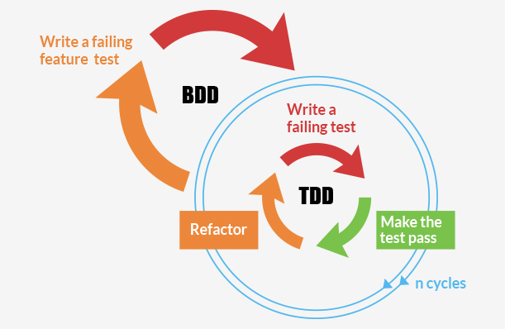
TDD and BDD
TDD (Test Driven Development)
Unity/Method
Test
Assertion
Setup and Teardown
BDD (Behavior Driven Development)
Feature
Specification
Expectation
Before and After

Slide 4
NodeJS
It is a server-side solution for JavaScript
Built on Chrome's JavaScript runtime (Java script engine)
Node.js provides an event-driven architecture and a non-blocking I/O API that optimizes an application's throughput and scalability.

Slide 5
Npm
Package Manager for Javascript
Makes it easy for JavaScript developers to share and reuse code, and it makes it easy to update the code that you're sharing

Slide 6
npm – Command lines
list modules installed
npm list --depth=0
uninstall module
npm uninstall <package>
install module and adding it to the package.json as dependency
install <package> --save
Create package json by command and enter the info for the project
npm init
Behind a proxy
npm config set proxy http://proxy.company.com:8080

Slide 7
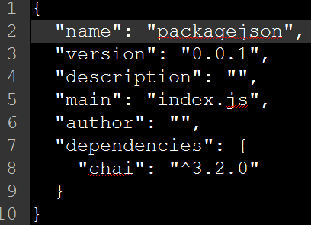
npm - package.json
Holds the metadata for the project
Gives information to npm that allows it to identify the project and its dependencies

Slide 8
Mochajs
Mocha is a feature-rich JavaScript test framework running on Node.js and the browser, making asynchronous testing simple and fun.
Features
Interface (BDD, TDD,Exports, Qunit)
Assertions
Hooks
Timeouts
Reporters
http://mochajs.org/
https://github.com/mochajs/mocha/wiki
note: It is similar to jasmine

Slide 9
Mocha - Installation
Prerequisites
NodeJS installed
Installation
local: npm install mocha
global: npm install mocha –g
Folder with the tests
mkdir test

Slide 10
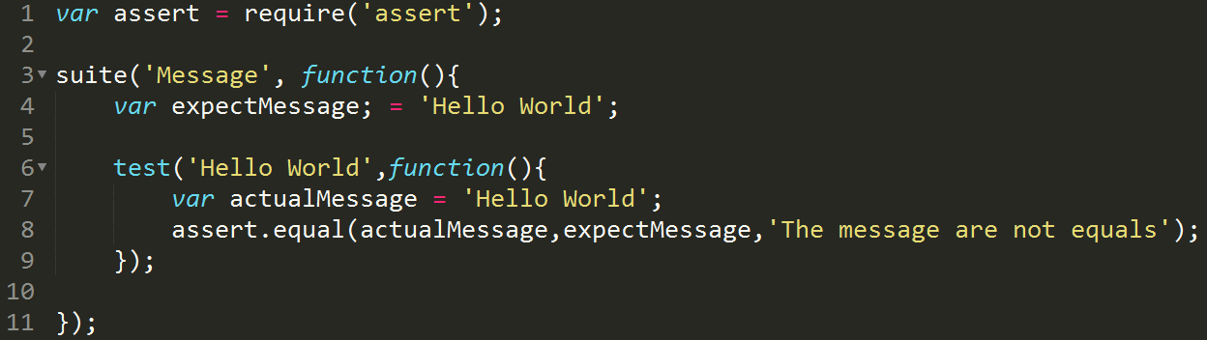
TDD style
suite()
test()
suiteSetup()
suiteTeardown()
setup()
teardown()

Slide 11
Running TDD Tests
Command Line:
(installed globally)
mocha --ui tdd
(installed locally)
node node_modules\mocha\bin\_mocha --ui tdd
(running specific file)
mocha --ui tdd <file>

Slide 12
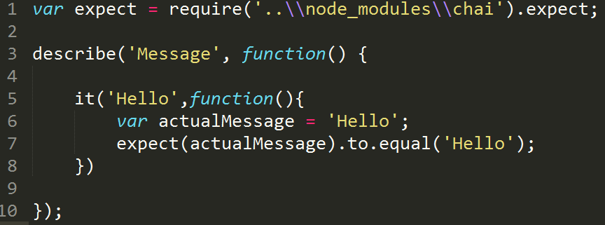
BDD style
describe()
context()
it()
before()
after()
beforeEach()
afterEach()

Slide 13
Running BDD Tests
Command Line:
(installed globally)
mocha
(installed locally)
node node_modules\mocha\bin\_mocha
(running specific file)
mocha <file>
note: this is set by default

Slide 14
Assertions Library
should.js
expect.js expect() style assertions
chai expect(), assert() and should style assertions
better-assert c-style self-documenting assert()
And others…

Slide 15
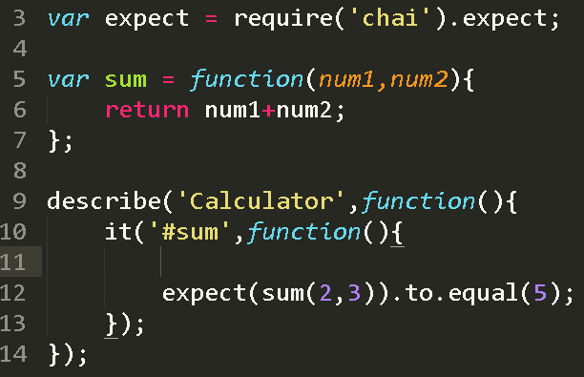
Synchronous tests

Slide 16
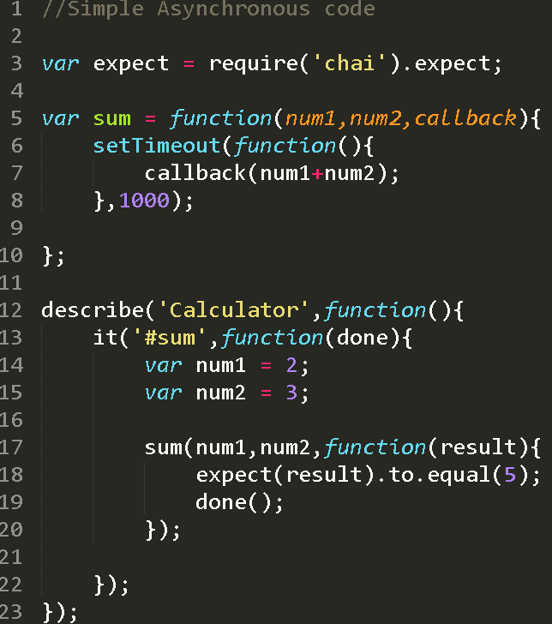
Asynchronous Tests
Callback is a piece of executable code that is passed as an argument to other code, which is expected to call back (execute) the argument at some convenient time. The invocation may be immediate as in a synchronous callback, or it might happen at later time as in an asynchronous callback.
Callbacks are generally useful when the function needs to perform actions before the callback is executed, or when the function does not (or cannot) have meaningful return values to act on, as is the case for Asynchronous JavaScript (based on timers) or XMLHttpRequest requests

Slide 17
More BDD Style
Test and Suites
describe() - generally used to describe the feature to be tested and actions
context() – generally used to describe the scenario to be tested
it() – generally used to the tests and assertions
Hooks
before() – execute before all tests inside a suite
after() – execute after all tests inside a suite
beforeEach()
afterEach()

Slide 18
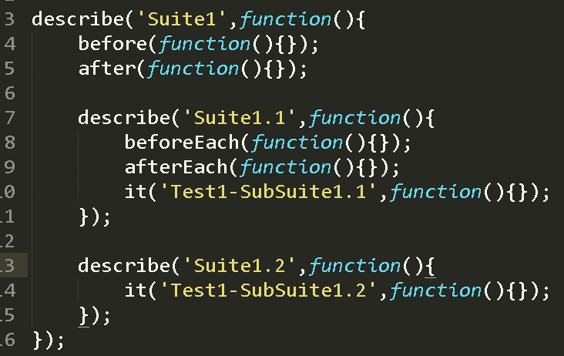
Suites and Hooks - example

Slide 19
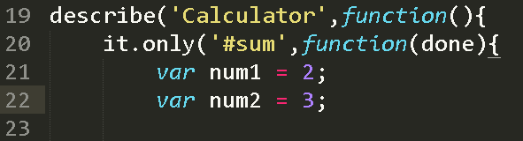
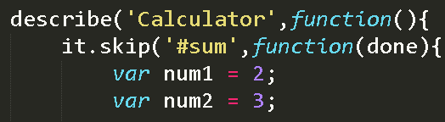
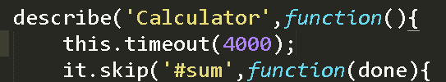
Only, Skip and Timeout
Only()-> used to run only one suite or test
Skip()-> skip the execution of a suite or test
this.timeout() -> sets the timeout for the entire suite or test

Slide 20
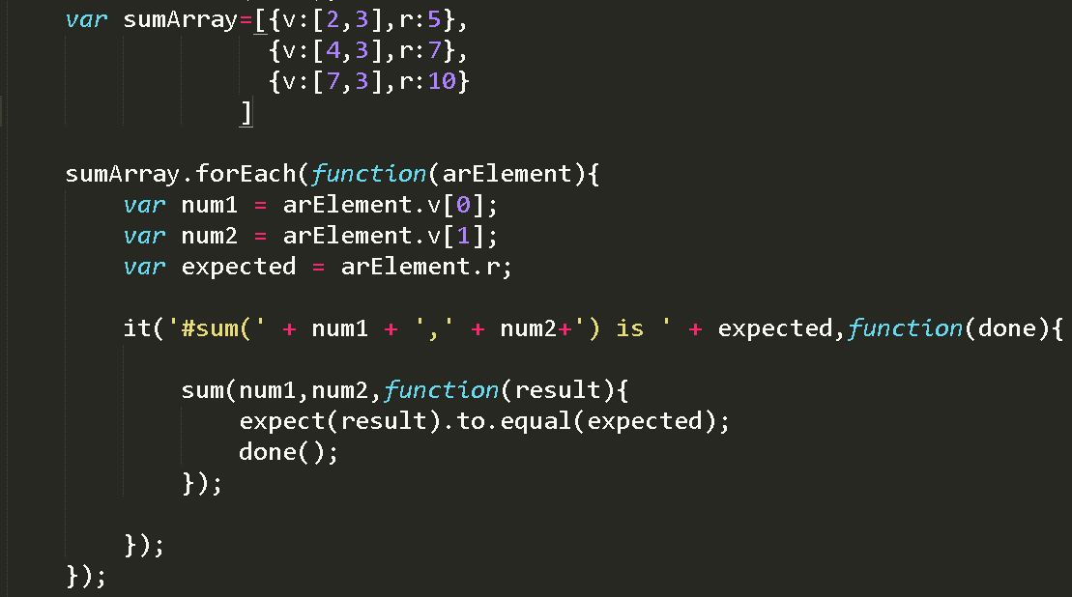
Dynamically Generating Test
This can be done when executing a same with different inputs (also called DataDriven)

Slide 21
Reports - Styles
spec
dot
nyan
tap
landing strip
list
progress
…
XUnit (xunit-file package to create the xml file)
TeamCity
Command line: mocha --reporter <style> <file>
note: by default it is set the spec

Slide 22
Mocha options
Mocha has many options, and these are some of them:
--ui
--reporter
--grep
--debug-brk
--recursive
--watch

Slide 23
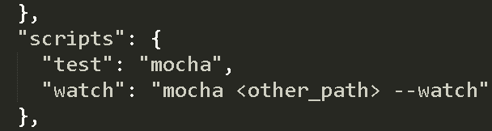
Extra - npm
npm gives the possibility of running scripts
npm test -> executes the tests for the project (the test folder)
npm run-script <otherScript> -> executes other tests
By default the scripts under test folder are executed

Slide 24
superagent
superagent is a small progressive client-side HTTP request library, and Node.js module with the same API, sporting many high-level HTTP client features.
https://github.com/visionmedia/superagent
http://visionmedia.github.io/superagent/

Slide 25
superagent-proxy
This module extends visionmedia/superagent's Request class with a .proxy(uri) function. This allows you to proxy the HTTP request through a proxy of some kind.
https://github.com/TooTallNate/superagent-proxy

Slide 26
Installation
Supergagent
npm install superagent
superagent-proxy
npm install superagent-proxy

Slide 27
API
Response
post(url)
put(url)
get(url)
del(url)
auth(account,password)
set(header,value)
type(type)
accept(type)
end(callback)
res.body
res.files
res.headers
res.header[header]
res.status
res.statusType
res.info
res.ok
…..

Slide 28
API
Error
4xx and 5xx are considered errors by default
err.status
err.response
Otherwise it will be null

Slide 29
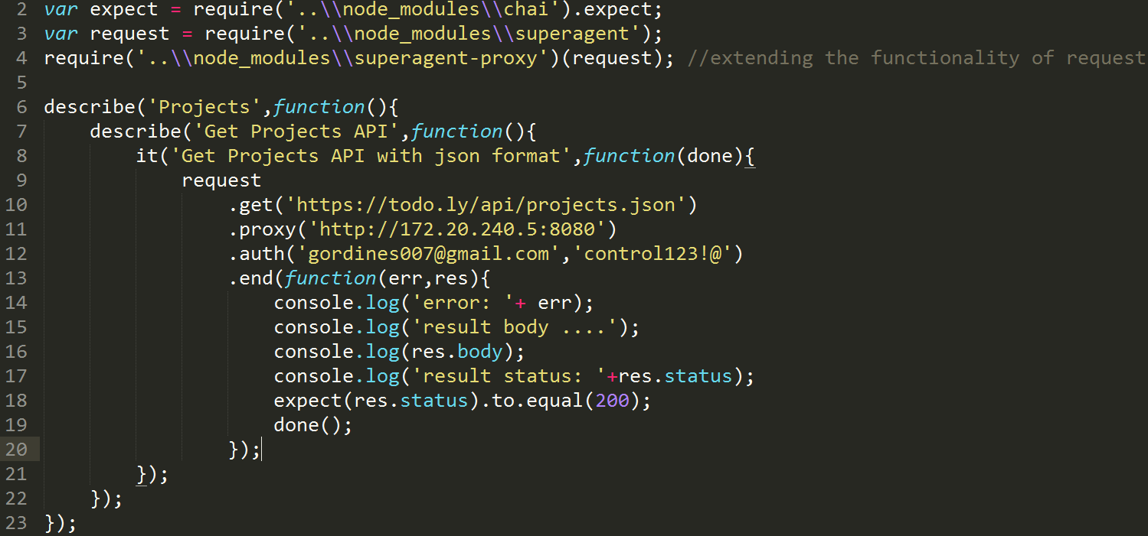
Example - Get Projects

Slide 30
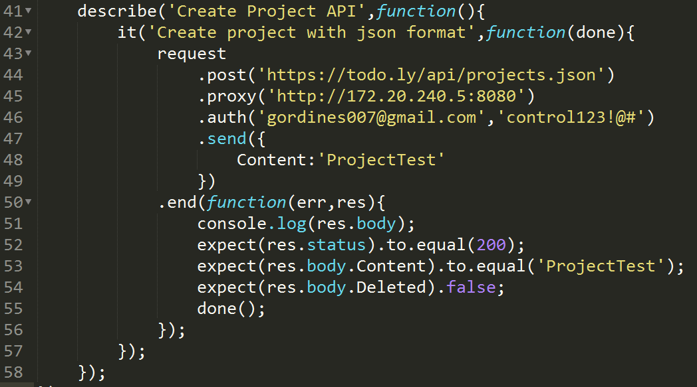
Example – Create Project

Slide 31
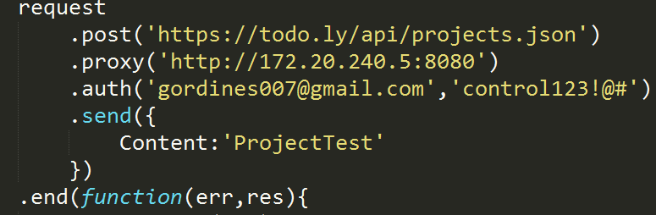
Usage
This is the order that the proxy, authentication, set of headers and sending payload should be done
proxy
authentication (using superagent api)
set of headers (when it is really required to specify it)
payload

Slide 32
Debugging
Install node-inspector.
npm install -g node-inspector
In a separate Terminal window, run node-inspector with no arguments.
node-inspector
Go to http://127.0.0.1:8080/debug?port=5858 in Chrome.
Run your Mocha tests.
node –debug-brk node_modules/mocha/bin/_mocha <file>
Go back to the browser. The --debug-brk tells the debugger to break on the first line of the first script.
In this case it is stopped in Mocha first line.
Press F10
Add the breaking points
Press F8
https://github.com/node-inspector/node-inspector

Slide 33
Tasks– Implement the smoke tests for Project
Get All Projects
Create New Project
Get Project By Id
Update Project By Id
Delete Project By Id
Get Items of a Project
Get Done Items of a Project
note: Remember Smoke Test verifies the API is present in the application

Slide 34
Tasks– Implement the smoke tests for Items
Get All Items
Create new Item
Get Item By Id
Update Item By Id
Delete Item By Id
Get Root Item By child Id
Get Done Root Item By child Id
note: Remember Smoke Test verifies the API is present in the application

Slide 35
Exercises – Acceptance Test
Test Case: Verify that an empty project’s name can be edited
Pre Condition:
Create a project
Test Case:
Edit the project
Verify the edited name was applied to the project
Post Condition:
Delete the project

Slide 36
Exercise – Acceptance Test
Test Case: Verify that an project’s name with subprojects can be edited
Pre Condition:
Test Case:
Post Condition:

Slide 37
Recommendations
Before a test case execution all the prerequisites have to be set.
After a test cases execution finishes it has to do a clean up over the SUT
The Pre (before) and Post(after) conditions can be done by
DB
Creating objects in the product domain using external tools
API
All the methods depends on the accessibility to the resources, or architecture of the SUT

