Slide 1
Continuous Integration
Using Jenkins - Basic

Slide 2
Continuous Integration
Continuous Integration is a software development practice where members of a team integrate their work frequently, usually each person integrates at least daily - leading to multiple integrations per day. Each integration is verified by an automated build (including test) to detect integration errors as quickly as possible. Many teams find that this approach leads to significantly reduced integration problems and allows a team to develop cohesive software more rapidly

Slide 3
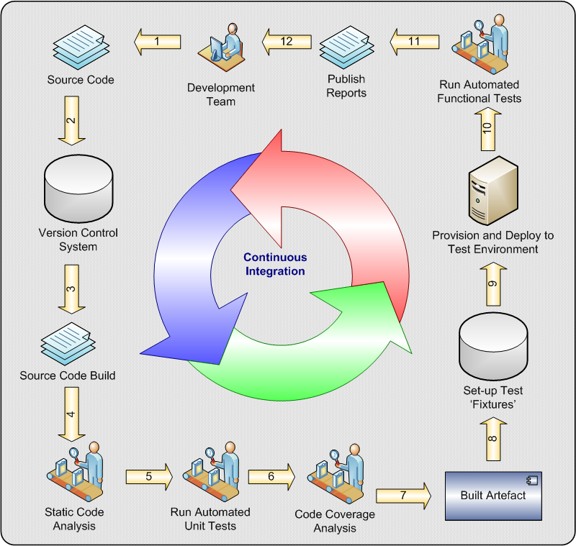

Slide 4
Jenkins - Setup
Jenkins Installation
Install Git Plugin
Create the Job
Connection to GitHub
Build
Post Build
Reports
Note: The Build, Post Build and Reports are being done based on the work that we are doing.

Slide 5
Installation
On Windows
download the http://mirrors.jenkins-ci.org/windows/latest
uncompressed the .zip file
Installing and execute the setup file
Once installed a service called “Jenkins” is created
Or Download the Jenkins war and execute it with the command:
java –jar Jenkins.war
note: Install it as administrator

Slide 6
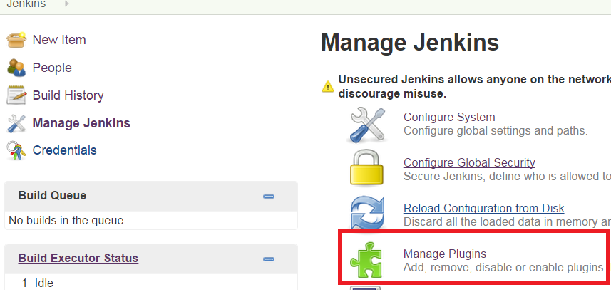
Install Git Plugin
Manage Jenkins-> Manage Plugins

Slide 7
Install Git Plugin
Click Available tab
Search for the plugin called Git
Check the plugin and install it
Once installed it should be displayed in the Installed tab.
When behind a proxy this tab will be empty, so it is need to configure the proxy in the Jenkins

Slide 8
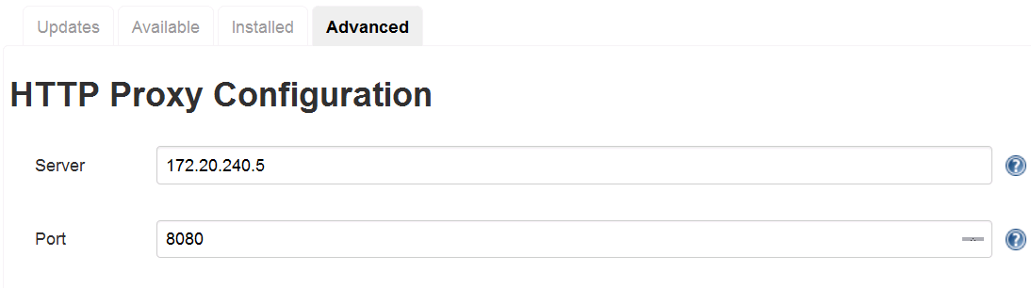
Install Git Plugin - proxy
Click Advanced tab
Enter the information for the proxy

Slide 9
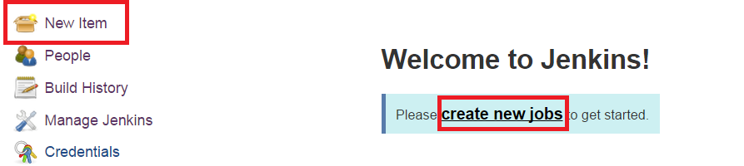
Create a Simple Job
Click New Item or Create New Jobs

Slide 10
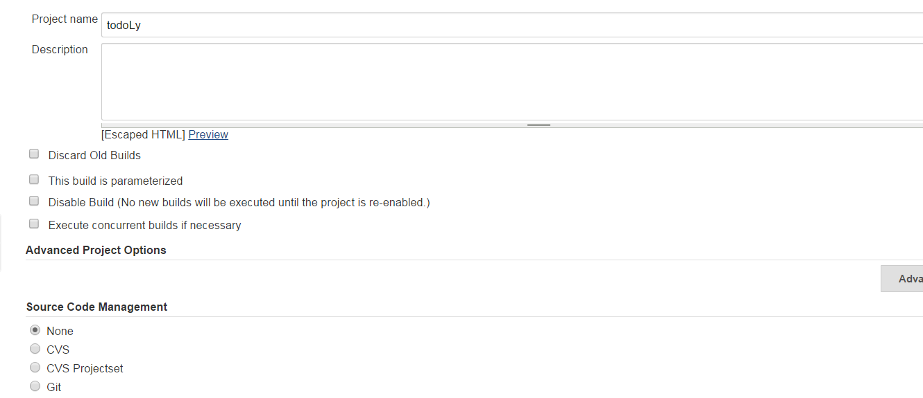
Create a Simple Job cont.
Enter a name for the Job
Select Freestyle job and Click Ok button

Slide 11
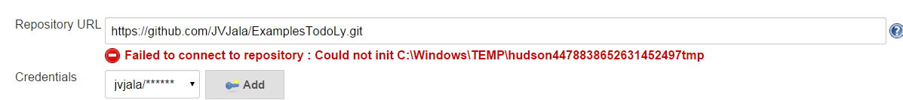
Create a Simple Job cont.
Select Git
Enter the Git repository : https://github.com/JVJala/ExamplesTodoLy.git
Enter the Credentials to access the repository
Probably you will get an error notifying that it could not be initiated, this indicates that the Jenkins couldn’t find git.exe

Slide 12
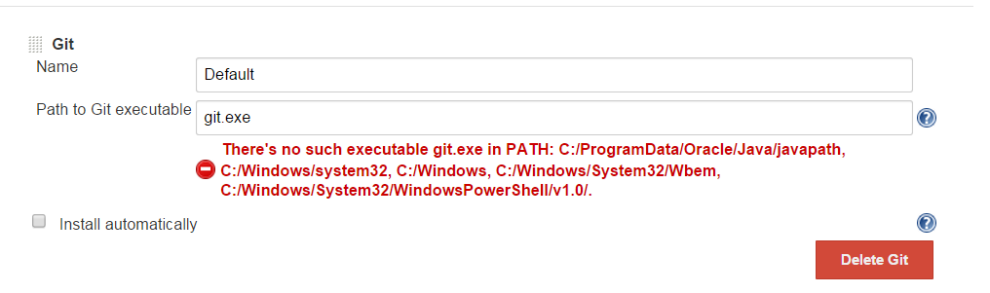
Create a Simple Job cont.
if Git is already installed it is need to specify where it is located
if not installed with a simple installation could fix it, if not it is need to specify where it is specified
Manage Jenkins->Configure System-> Git

Slide 13
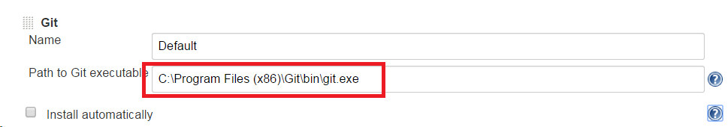
Create a Simple Job cont.
After configured the Manage Jenkins->Configure System-> Git
Configured the Job

Slide 14
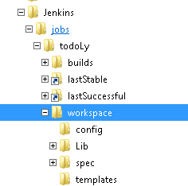
Workspace – By Default
To make this easier we are going to specify a different path

Slide 15
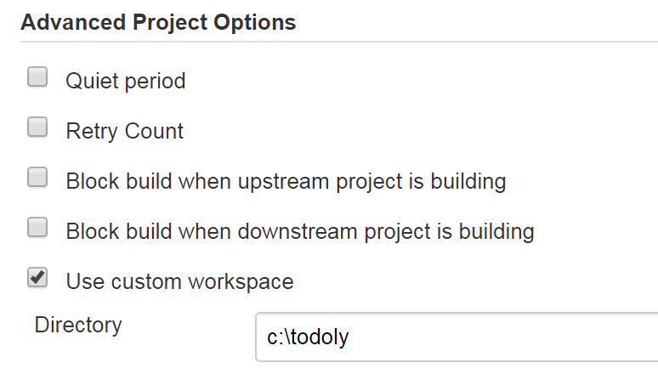
Create a Simple Job cont.
Configuring the workspace

Slide 16
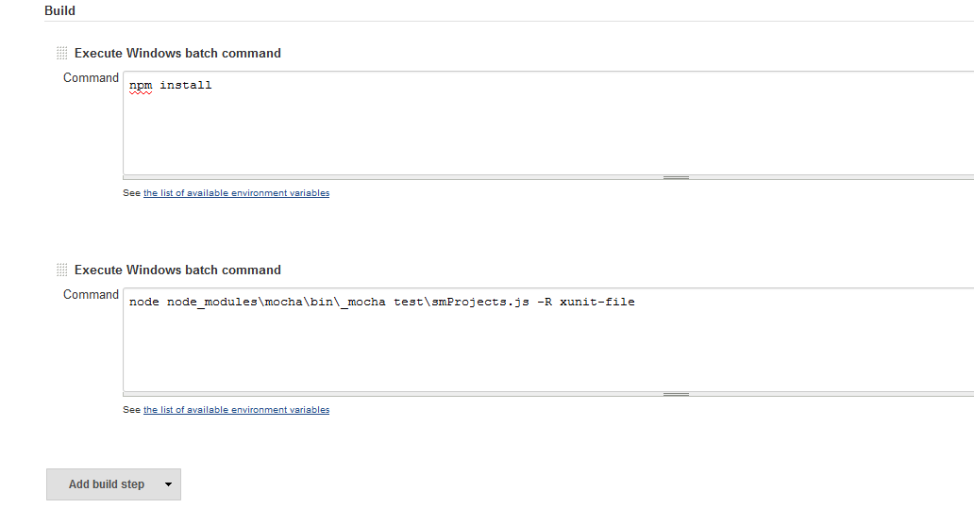
Create a Simple Job cont.
Specifies the Build steps

Slide 17
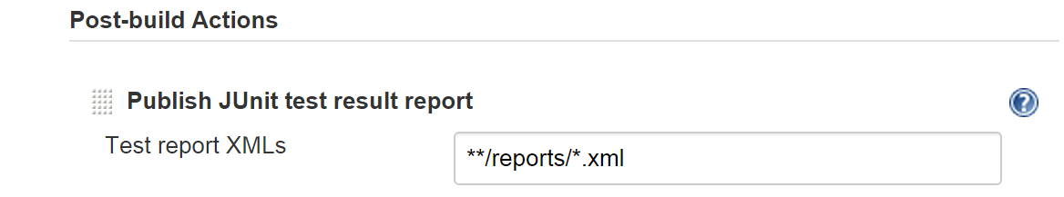
Create a Simple Job cont.
Publishing the report

Slide 18
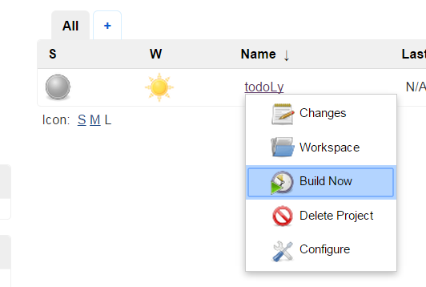
Create a Simple Job Cont.
Save all the configuration
Execute it

Slide 19

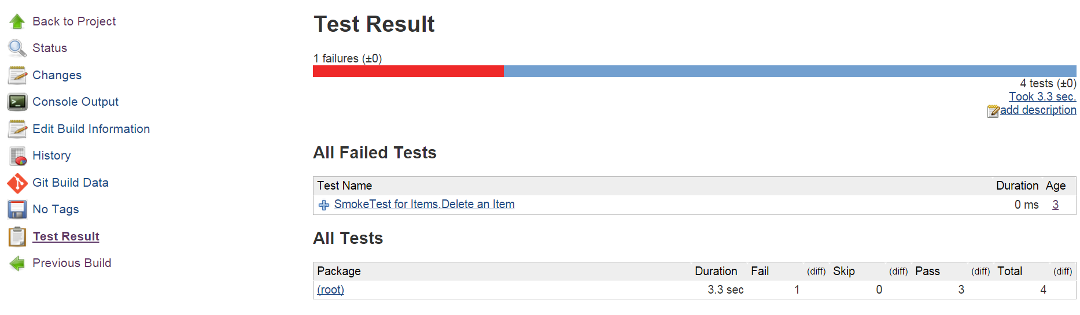
Reviewing Results
Click on the link that represents the execution
Click on Test Results link

Slide 20
Create the following jobs
Smoke Test
Acceptance Test
Functional - BDT

Slide 21
Pipelines
Pipelines makes reference to the execution of different jobs for a determined flow for instance:
Build-> Install-> Smoke Test-> Acceptance Test-> BDT
Build-> Install-> Smoke Test -> Performance Test
And, the Delivery Pipeline Plugin helps on the visualization of pipelines created

Slide 22
Pipelines
Follow the next steps to build a pipeline with the corresponding rendering:
Create two jobs
Smoke Test
Acceptance Test
Configure the Smoke Test job to start the Acceptance Test job
Install the Delivery Pipeline Plugin
Go to the Jenkins Dashboard
Create the Delivery Pipeline View

Slide 23
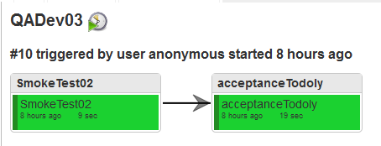
5. Open the Pipeline created in the step 4.
And something to the picture would be displayed

Slide 24
Task
Configure the SmokeTest to be triggered whenever there is a change in the code
Configure the SmokeTest to be triggered in a determined scheduled

