Slide 1

Software Testing Fundamentals
Thomas Dawkins | Senior Product Manager
Erik Downing | Senior Software Development Engineer in Test (SDET)

Slide 2
Take the Exam
98-379 – Software Testing Fundamentals
Certiport
http://www.certiport.com
Prometric
http://www.prometric.com

Slide 3

Meet Thomas Dawkins | ‏@thomasdawkins
Senior Product Manager – LeX, Microsoft DPE
Over 30 years in the IT Industry
15 years @ Microsoft – Microsoft Services, ForeFront, TwC, STB & DPE
Support, Developer, Consultant, IT Admin, IT Management, Product and Program Management, Communications & Marketing
MCSE and MCT focused on SQL Server

Slide 4

Meet Erik Downing| @sammamishman
Senior Software Development Engineer in Test, Microsoft
13 years at Microsoft
Software development lifecycle, Automation, SQL Server, Performance and Load testing
Test lead over a diverse set of applications including Legal, Human Resources, Learning, Compensation and Benefits

Slide 5

Join the MVA Community!
Microsoft Virtual Academy
Free online learning tailored for IT Pros and Developers
Over 1M registered users
Up-to-date, relevant training on variety of Microsoft product
http://www.microsoftvirtualacademy.com

Slide 6
Setting Expectations
Target Audience
Individuals who are looking to transition their career into an IT position
New college/university graduates who want to demonstrated their capability in Software Testing
Suggested Prerequisites
It is recommended that exam candidates be familiar with the concepts of and have hands-on experience with the technologies described here, either by taking relevant training courses or by working with tutorials and samples available on MSDN. Although minimal hands-on experience with the technologies is recommended, job experience is not assumed for these exams.
Exam Prep
This course, along with the prescribe reference materials, are designed to help you in preparation for taking the MTA exam 98-379. Register today @ prometric.com.

Slide 7
Course Topics
Software Testing Fundamentals
01 | Testing Fundamentals 1.1 Software Testing 1.2 Software and Hardware Components 1.3 Fundamentals of Programming 1.4 Application Lifecycle Management | 04 | Managing Software Testing Projects 4.1 Testing Milestones 4.2 The Agile Process 4.3 Working with Distributed Teams 4.4
02 | Testing Methodologies 2.1 Testing Techniques 2.2 Testing Levels 2.3 Testing Types | 05 | Working with Bugs 5.1 Detecting Software Defects 5.2 Logging Bugs 5.3 Managing Bugs
03 | Creating Software Tests 3.1 User Centric Tests 3.2 Software Testability 3.3 Creating Test Plan Components 3.4 Feature Testing 3.5 Appropriately Scoped Test Cases | 06 | Automating Software Test 6.1 Test Automation 6.2 Test Automation Strategies 6.3 Writing Automation Tests 6.4 Managing Test Scripts

Slide 8
01 | Testing Fundamentals
Thomas Dawkins | Senior Product Manager
Erik Downing | Senior Software Development Engineer in Test (SDET)

Slide 9
Testing Fundamentals - Module Overview
1.1 Software Testing
1.2 Software and Hardware Components
1.3 The Fundamentals of Programming
1.4 Application Lifecycle Management (ALM)

Slide 10

1.1 Software Testing
1.2 Software & Hardware
Components

Slide 11
Section Overview
In this section, we will review the following:
Measuring software quality and testing benefits.
Distinguishing operating systems, network, data, and hardware and software and their interaction and dependencies.

Slide 12
Guiding Questions
What is the purpose of testing during the software development process?
How can software quality be measured?
What is the role of an operating system (OS) in a computer system?

Slide 13
Understanding Software Testing
Testing is the process of examining an application to ensure it fulfills the requirements for which it was designed and meets quality expectations.
Testing measures the quality of an application or project.
Developers should take the view that your project does have bugs or defects that have not yet been discovered.
Testing helps find and correct those defects.
A bug is an error in coding or logic that causes a program to malfunction or to produce incorrect results.

Slide 14
Importance of Software Testing
Reduces the cost of developing the program.
Common estimates indicate that a problem that goes undetected and unfixed until a program is actually in operation can be 40-100 times more expensive to resolve than resolving the problem early in the development cycle.
Ensures that your application behaves exactly as intended.
Reduces the total cost of ownership for end users.
Develops customer loyalty and word-of-mouth market share.

Slide 15
Testing benefits for End Users
Early testing results in software with better usability and reliability, as well as a lower cost of ownership.
Bugs caught during testing do not require users to spend time identifying bugs.
Bugs caught before a project is delivered do not cost the user any downtime while fixes are created and updates are installed.
Software that behaves as expected requires less training and user support.
Software that is well-tested results in increased user satisfaction.

Slide 16
Measuring Software Quality
There are many different type of metrics (standards of measurement) for software quality. Common metrics include:
Performance metrics, such as the time in takes to complete a process or the amount of space required by the application.
Reliability metrics, such as the total number of bugs, or “defect density,” which is the number bugs divided by the number of lines of code.
“You cannot manage what you cannot measure” –Lord Kelvin (1824-1907)

Slide 17
Understanding Computer Systems
Hardware refers to all of the physical elements of a computer system. Examples include keyboard, mouse, hard disk drives, CPU, etc.
Software is the data and instructions that operate on a computer.
An operating system (OS) is the software that controls the allocation and usage of hardware resources such as memory, central processing unit (CPU) time, disk space, and peripheral devices. The operating system is the foundation software on which applications depend.
A device driver permits a computer system to communicate with a device. Many devices will not work properly—if at all—without the correct device drivers installed in the system.
A network is a group of computers and associated devices that are connected by communications facilities.

Slide 18
Section Questions
What is the purpose of testing during the software development process?
How can software quality be measured?
What is the role of an operating system (OS) in a computer system?

Slide 19

Great MSPress Books
How We Test Software at Microsoft
http://www.microsoft.com/learning/en-us/book.aspx?ID=11240&locale=en-us
Alan Page, Ken Johnston, RJ Rollison

Slide 20
1.3 Fundamental of Programming
1.4 Application Lifecycle
Management

Slide 21
Section Overview
In this section, we will review the following:
Data types, distinguishing programming languages such as compiled or interpreted, and analyzing simple algorithms.
Application lifecycle management. Topics include: agile, waterfall, product and project lifecycles.

Slide 22
Guiding Questions
What happens when an interpreted application is built and executed?
What are some commonly-used data types?
How is agile development different than a waterfall model?

Slide 23
Compiled vs. Interpreted languages
Compiled languages, such as C++, are converted to machine language (or “native code”) that is run directly by the operating system.
Interpreted languages, including C#, Visual Basic, and F#, are compiled to an intermediate language. When the application is executed, a runtime (or “just-in-time”) compiler translates this intermediate code into native code.
Interpreted code is generally “managed”—the runtime environment that executes the code manages many low-level tasks, such as memory management and security.
Interpreted applications are generally “managed”—the runtime environment that executes the code manages many low-level tasks, such as memory management and security.

Slide 24
Data Types
Data types specify how data (e.g., variables) are stored in memory, and what values can be stored in that data set.
For example, the data type specifies whether a number is an integer (“whole number”) or includes floating point data (“decimal” or fractional).
The data type also delineates what can be done with the data, including what methods or functions can be called.
For example, String data types typically include methods for returning a substring.

Slide 25
Software Development Methodologies
There are many different models for managing development projects, each with advantages and disadvantages.
Often, they fall into two major categories:
Sequential development, in which a development team proceeds through a set of phases in order. In general, the team does not move to a new phase until the preceding phase is complete.
Iterative development, in which a team cycles through a set of phases for a portion of the project, then moves on to another portion and repeats; this continues—often at a rapid pace—until the entire project is completed.
Every methodology has advantages and disadvantages.
The approach a team uses plays a big role in determining how the software will be tested.

Slide 26
The Waterfall Model
An example of sequential development is the Waterfall model, named because it flow through a set of phases like water cascading down a waterfall. Characteristics include:
The team starts with a detailed (and perhaps lengthy) design process, identifying the requirements of a program and designing a system to meet those requirements.
After the design is complete, the team begins implementing code, testing each model (or unit) as it goes.
Next, the team integrates the individual modules and tests the overall system.
Finally, the project is deployed and moved into a maintenance phase.
The waterfall approach favors spending a lot of time on design and planning; coding often does not begin until all of the design details are resolved.

Slide 27
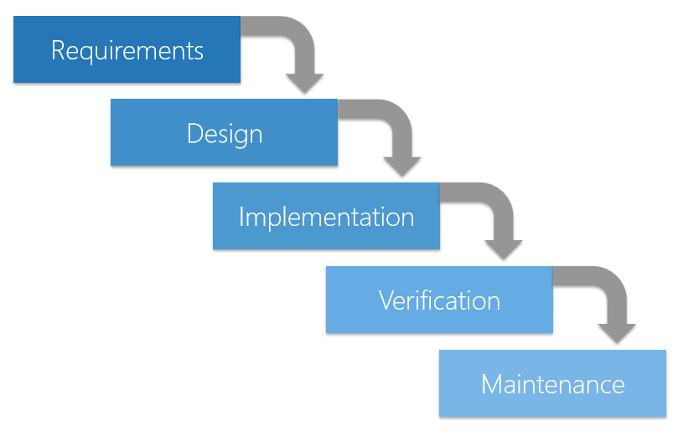
Waterfall Model

Slide 28
The Agile Model
In agile development, software is developed in incremental, rapid cycles. This results in small, incremental releases, with each release building on previous functionality.
Each release is thoroughly tested, which ensures that all issues are addressed in the next iteration.
Agile emphasizes the ability to respond to change, rather than extensive planning. While planning is still important, the plan is subject to change as the project develops.
In general, projects are delivered “early and often,” giving the customer/user the opportunity to provide feedback that can influence the next iteration.

Slide 29
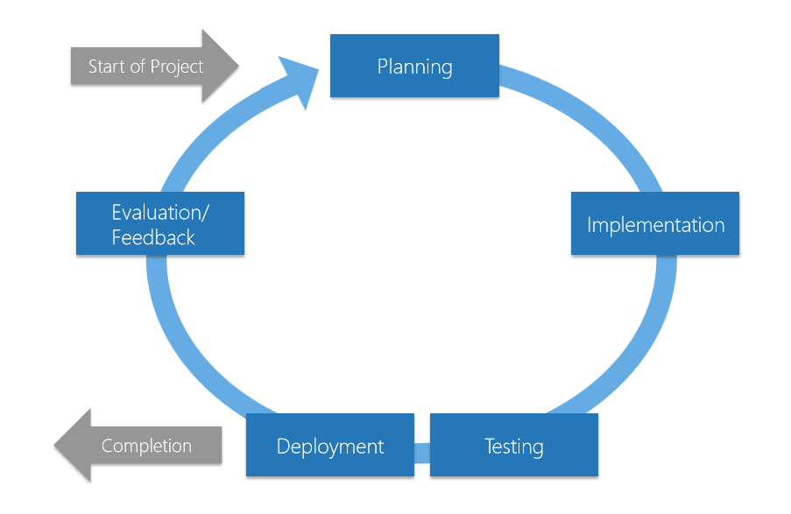
Agile Model

Slide 30
Section Questions
What happens when an interpreted application is built and executed?
What are some commonly-used data types?
How is agile development different than a waterfall model?

Slide 31
Additional Resources
MSDN Software Testing Resources
Testing for Continuous Delivery with Visual Studio 201 | http://msdn.microsoft.com/en- us/library/jj159345.aspx
Test Early and Often | http://msdn.microsoft.com/en- us/library/ee330950.aspx
Testing Overview | http://msdn.microsoft.com/en- us/library/aa292191.aspx
Data Types (C# Programming Guide) | http://msdn.microsoft.com/en- us/library/ms173104.aspx
Compiled vs. Interpreted Applications | http://msdn.microsoft.com/en- us/library/aa240840.aspx
Managed Execution Process | http://msdn.microsoft.com/en- us/library/k5532s8a.aspx
Testing Methodologies | http://msdn.microsoft.com/en- us/library/ff649520.aspx
Lab: Walkthrough for Analyzing Managed Code for Defects | http://msdn.microsoft.com/en-us/library/ms182066.aspx

Slide 32
Know your stuff? Get Certified!
Microsoft Certified Solutions Developer (MCSD) for Application Lifecycle Management
http://www.microsoft.com/learning/en-us/mcsd-application-lifecycle-management.aspx
Microsoft Learning Partners—Learn from the Pros!
http://aka.ms/CPLS
Find a Class: http://aka.ms/ClassLocator

