Slide 1
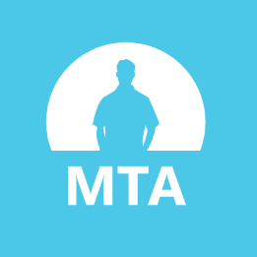
Software Testing Fundamentals
Thomas Dawkins | Senior Product Manager
Erik Downing | Senior Software Development Engineer in Test (SDET)

Slide 2
Take the Exam
98-379 – Software Testing Fundamentals
Certiport
http://www.certiport.com
Prometric
http://www.prometric.com

Slide 3
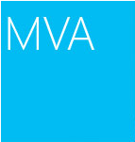
Join the MVA Community!
Microsoft Virtual Academy
Free online learning tailored for IT Pros and Developers
Over 1M registered users
Up-to-date, relevant training on variety of Microsoft product
http://www.microsoftvirtualacademy.com

Slide 4
Course Topics
Software Testing Fundamentals
01 | Testing Fundamentals 1.1 Software Testing 1.2 Software and Hardware Components 1.3 Fundamentals of Programming 1.4 Application Lifecycle Management | 04 | Managing Software Testing Projects 4.1 Testing Milestones 4.2 The Agile Process 4.3 Working with Distributed Teams 4.4
02 | Testing Methodologies 2.1 Testing Techniques 2.2 Testing Levels 2.3 Testing Types | 05 | Working with Bugs 5.1 Detecting Software Defects 5.2 Logging Bugs 5.3 Managing Bugs
03 | Creating Software Tests 3.1 User Centric Tests 3.2 Software Testability 3.3 Creating Test Plan Components 3.4 Feature Testing 3.5 Appropriately Scoped Test Cases | 06 | Automating Software Test 6.1 Test Automation 6.2 Test Automation Strategies 6.3 Writing Automation Tests 6.4 Managing Test Scripts

Slide 5
03 | Creating Software Tests
Thomas Dawkins | Senior Product Manager
Erik Downing | Senior Software Development Engineer in Test (SDET)

Slide 6
Module Overview
User Centric Testing
Software Testability
Creating Test Plan Components
Feature Testing
Appropriately Scoping Test Cases

Slide 7
03 | Creating Software Tests
3.1 User Centric Testing
3.2 Software Testability

Slide 8
Section Overview
In this section, we will review the following:
Business need and issues, customer requirements, and scenarios
Test-driven development
Testing hook

Slide 9
Guiding Questions
What is an example of a user requirements document?
What is an advantage or benefit of test-driven development?
What type of testing is central to test-driven development?

Slide 10
User Requirements
A user requirements document or diagram defines what the users need from the system or application.
They are discussed and articulated early in the design process to ensure that the software meets the needs of its intended users.
User requirements do not attempt to explain internal design or how the system works.
They are great tools for discussions with users/customers, and in agile development they help re-focus development at the start of a new iteration.
There are many ways to document user requirements, including use case diagrams and user stories.

Slide 11
Use Case Diagrams
Use case diagrams describe who uses the system, and what they use it for.
A use case represents a goal of a user and the procedure they perform to achieve the goal.

Slide 12
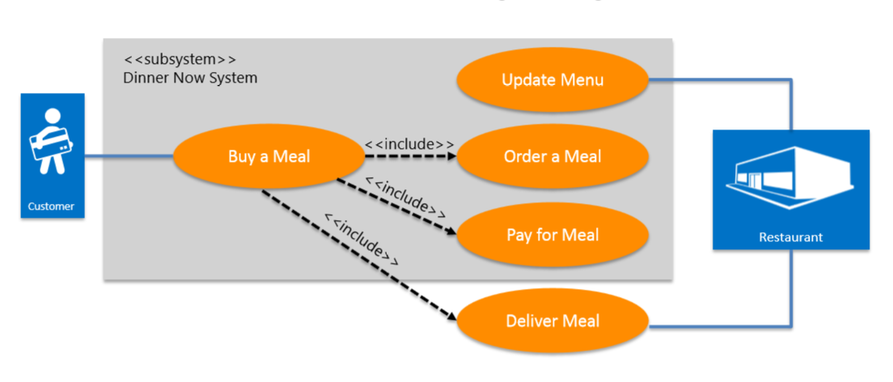
Use Case Diagram Example
Imagine a software system for selling meals online. It must allow customers to buy a meal, and must allow the restaurant to update the menu and deliver the meal. A diagram might look like this:

Slide 13
User Stories
A user story communicates functionality that is of value to the end user of the product or system.
Each user story should state one activity a user wants to complete with the software and describe it from the user's perspective.
A user story can be managed in Microsoft® Visual Studio®, and is typically expressed in a sentence or short paragraph.
Putting user stories in Visual Studio has many advantages, including the ability to link stories to test cases and tasks assigned to developers on the team.

Slide 14
User Story Examples
“As a customer, I can view the current menu.”
“As a customer, I can place an order.”
“As a customer, I can pay for a meal.”
“As a restaurant, I can add an item to the current menu.”
“As a restaurant, I can deliver a meal.”

Slide 15
Test-driven Development
Test-driven development is a technique that uses unit tests to guide the design of software.
It requires that you develop test cases before you develop code. Developers then develop functionality to pass the existing test cases.
Test-driven development has many benefits, including:
Development can begin with an unclear set of requirements.
It promotes code that is “loosely coupled”—each unit is self-sufficient because it is developed independent of other units.
Test cases act as documentation.
Heavy use of automated test reduces testing time and allows for quick regression testing.

Slide 16
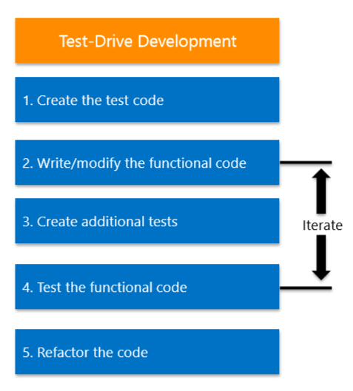
Test-driven Development Process

Slide 17
Testing Hooks
A testing hook is a feature that allows internal functionality to be tested independent of the rest of the software.
For example, a test hook might allow a developer to test the functionality of paying for a meal without having to navigate through the menu and add a meal to a shopping cart.
Hooks may or may not be removed before releasing or deploying the application.

Slide 18
More Testing Hook Examples
A sequence of keystrokes that triggers a dialog box of information about the system.
A simplified user interface that allows streamlined access to functionality without the “user friendliness” that end users will require.
Command-line arguments that initialize state data automatically, sparing the tester from having to input data manually.

Slide 19
Section Questions
What is an example of a user requirements document?
What is an advantage or benefit of test-driven development?
What type of testing is central to test-driven development?

Slide 20
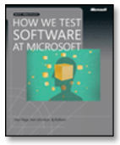
Great MSPress Books
How We Test Software at Microsoft
http://www.microsoft.com/learning/en-us/book.aspx?ID=11240&locale=en-us
Alan Page, Ken Johnston, RJ Rollison

Slide 21
03 | Creating Software Tests
3.3 Creating Test Plan
Components

Slide 22
Section Overview
In this section, we will review the following:
Test schedule
Scope
Methodology
Scenarios
Tools

Slide 23
Guiding Questions
What does ALM stand for?
What software is the centerpiece of ALM in Microsoft® Visual Studio®?
What is code coverage?

Slide 24
Application Lifecycle Management
Application Lifecycle Management (ALM) refers to the administration of the entire scope of work necessary to build an application, from initial planning through deployment and maintenance.
Microsoft Visual Studio includes a comprehensive and tightly integrated suite of ALM tools; the core of this toolset is Microsoft Visual Studio Team Foundation Server (TFS).
TFS provides version control, a build system, and tools and metrics for managing and organizing projects.

Slide 25
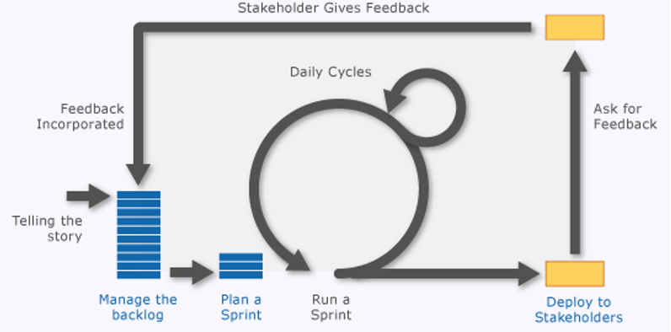
ALM Continued

Slide 26
ALM Tools in Visual Studio
PowerPoint Storyboarding: You can quickly illustrate a user story, requirement, or experience by using PowerPoint Storyboarding.
Product backlog: The product backlog page shows a single view of the current backlog of work that can be dynamically re-ordered and grouped.
Sprint backlog and team capacity: The sprint backlog page reflects in real time the data you input that includes work items assigned to the iteration path, and specifying dates, individual work capacity, and work interruptions both for the team and individuals.
Task board: As a daily practice, the team can view and update the task board to reflect the status of work items visually.
Request Feedback and Microsoft Feedback Client: The Request Feedback and Microsoft Feedback Client tools enable teams to engage stakeholders to provide frequent and continuous feedback.

Slide 27
Testing Strategy and Scope
As early as possible, developers need to discuss and establish a testing strategy for the project.
Often, the strategy is determined—or at least influenced by—the development methodology in use, such as waterfall or agile development.
Based on this strategy, teams develop one or more test plans.
Each test plan has its own scope:
The entire project may have a test plan.
In agile development, each sprint should have a test plan. It may or may not be similar to other sprint test plans.
For other development models, tests are often based on features rather than sprints/iterations.

Slide 28
Code Coverage
A testing strategy may include a specific goal for code coverage.
Code coverage is a metric that describes how much of the project’s code is being tested. It is usually expressed as a percentage.
Often, a development team strives for 80% of the code to be covered by test cases. This objective is decided as part of the test strategy.
In Visual Studio, code coverage can be calculated two ways:
Block coverage: a block is a piece of code with exactly one entry and exit point. If program control flows through that block during tested, it is counted as covered. This is the default coverage format.
Line coverage: If the test run exercised all the code blocks in any line of code, it is counted as one line. Where a line contains some code blocks that were exercised and some that were not, that is counted as a partial line

Slide 29
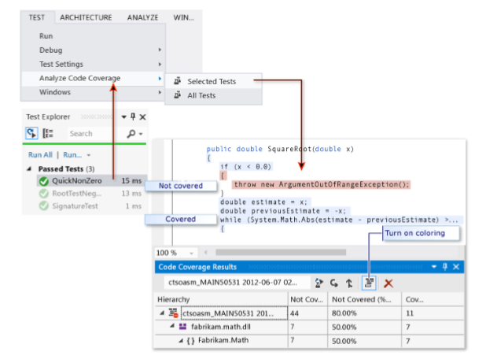
Code Coverage in Visual Studio

Slide 30
Section Questions
What does ALM stand for?
What software is the centerpiece of ALM in Microsoft® Visual Studio®?
What is code coverage?

Slide 31
03 | Creating Software Tests
3.3 Feature Testing

Slide 32
Section Overview
In this section, we will review the following:
Distinguishing the functionality in the appropriate feature test.

Slide 33
Guiding Questions
What is a feature test?
Who should be the focus of a usability test?
What name is used to describe an automated test of the user interface?

Slide 34
Software Features
A feature, from a development perspective, is a capability available to the user.
The features of a project are determined largely by the user stories created during the initial planning process.
Often, each independent user story is a description of a feature in the final product. If a user story states that a customer should be able to pay for an order with a credit card, then accepting credit card payments becomes a feature of the product.
Features may share overlapping functionality in the code. For example, the same project may also accept other forms of payment.
Likewise, some features may be accessible in different ways. Think about the different ways the user can underline text in Microsoft Word, for example.

Slide 35
Feature Testing
While well-designed unit and integration tests may provide excellent code coverage and help ensure the units work meet the internal specifications of the developers, it is important that the functionality of each feature is tested.
Each feature in an application should be tested independently.
A test that focuses on the functionality of an individual feature in the software, independent of other features, is called a feature test.
In many cases, black box testing is used to testing functionality.
The big-picture goal of feature testing is to ensure the features implemented in the software meet or fit the user requirements.

Slide 36
Exploratory Testing
Sometimes called ad hoc testing, exploratory testing encourages the tester to use the features of the software in a variety of ways.
Often, effective exploratory testers use software in ways the development team might not have anticipated. This can reveal unexpected bugs.
Despite the name, quality exploratory tests are more than just running a program and trying things out—the tester should have a plan and specific testing criteria. If those criteria are not met, the test fails.

Slide 37
Usability Testing
Usability testing involves the study of how end-users interact with the software.
This provides valuable feedback related to ease-of-use and customer satisfaction.
Although usability tests are not necessarily a part of feature testing, examining how users operate a specific feature can give insight into potential flaws.
By definition, usability tests by end-users are black box tests.

Slide 38
User Interface (UI) Testing
Any test of the operation and functionality of the user interface itself is considered a UI test.
Since the user interface is usually integral to the implementation of a feature, UI testing is critical.
Automated tests of the user interface are referred to as coded UI tests.
Visual Studio allows the developer to create a coded UI test by recording actions while the application is running.

Slide 39
Section Questions
What is a feature test?
Who should be the focus of a usability test?
What name is used to describe an automated test of the user interface?

Slide 40
03 | Creating Software Tests
3.5 Appropriately Scoped Test Cases

Slide 41
Section Overview
In this section, we will review the following:
Appropriately scoped test cases
Topics included:
Boundary conditions
Level of detail
Validity

Slide 42
Guiding Questions
What is a boundary test?
What is a “happy path” test?
What type of test generally requires detailed steps?

Slide 43
Test Case Design Considerations
In many situations, the possible permutations of an application’s data—and the possible paths through the code—are very large.
Consider an application that asks the user to input a few numbers. Theoretically, there are an infinite number of possible inputs!
Therefore, developers and testers have to accept that complete testing may be impossible, or at least impractical.
Test case design is about selecting test cases that have a high probability of catching most defects.

Slide 44
Happy Path Test Cases
In test-driven development, including agile models, tests are written before a unit is coded. Often, the first tests created are for standard, expected data.
For example, a developer creating a website login interface might start by creating some tests using valid username/password combinations— tests that are expected to pass.
Some testers & developers refer to this as a happy path test case.
While happy path tests are a valid starting point, additional tests are clearly necessary.
For example, what happens when an invalid username is entered?

Slide 45
Zero and Null Test Cases
In the case of numeric data, the unit should be tested for correct handling of zero values.
Likewise, create tests to verify how null values are handled.
In the case of strings, it may be advisable to test with an empty string (“”).

Slide 46
Boundary Test Cases
Boundary tests focus on how the software behaves when data are at or near their minimum or maximum levels. These boundary cases are also called edge cases.
For example, if a method makes calculations based on a month entered by the user (1 for January, 2 for February, etc.), what happens if the month is 13? Other possible boundary cases for this scenario would be 12 (the highest valid value), zero, and negative numbers.
In general, if values near boundaries are handled correctly, it is often the case that it should behave correctly in most other cases as well.

Slide 47
Manual Test Cases
Because manual test cases may be executed by different testers at different times, it is important that the include enough detail to ensure consistency.
Manual test cases are broken down into discrete steps, each with a description of the action and the expected result.
Visual Studio allows you to attach a file with additional details or a screen shot to assist the tester.

Slide 48
Manual Test Case Example
The user login example might have a test case with these steps:
“Click the sign-in link in the top right corner.”
“Enter your user name into the prompt.”
“Type your password into the password prompt.”
“Click the ‘Sign In’ button.”

Slide 49
Exploratory Testing
Development teams sometimes supplement detailed testing with a more exploratory approach, allowing testers more freedom.
In these test cases, directions may be much more general and feature-focused:
“Sign in to the website.”

Slide 50
User Interface (UI) Testing
Any test of the operation and functionality of the user interface itself is considered a UI test.
Since the user interface is usually integral to the implementation of a feature, UI testing is critical.
Automated tests of the user interface are referred to as coded UI tests.
Visual Studio allows the developer to create a coded UI test by recording actions while the application is running.

Slide 51
Section Questions
What is a boundary test?
What is a “happy path” test?
What type of test generally requires detailed steps?

Slide 52
Additional Resources for this Module
MSDN Software Testing Resources
Modeling User Requirements | http://msdn.microsoft.com/en- us/library/vstudio/dd409376.aspx
User Story (Agile) | http://msdn.microsoft.com/en- us/library/dd380634.aspx
Testing Methodologies | http://msdn.microsoft.com/en- us/library/ff649520.aspx
Testing in the Software Lifecycle | http://msdn.microsoft.com/en-us/library/jj159342.aspx
Creating, Editing and Maintaining a Coded UI Test | http://msdn.microsoft.com/en-us/library/ff977233.aspx
Creating and Running Unit Tests for Managed Code | http://msdn.microsoft.com/en- us/library/ms182532.aspx
Manual System Tests | http://msdn.microsoft.com/library/jj15933 4.aspx
Test Automation Code Review Guidelines | http://msdn.microsoft.com/en- us/library/ff519670.aspx

Slide 53
Know your stuff? Get Certified!
Microsoft Certified Solutions Developer (MCSD) for Application Lifecycle Management
http://www.microsoft.com/learning/en-us/mcsd-application-lifecycle-management.aspx
Microsoft Learning Partners—Learn from the Pros!
http://aka.ms/CPLS
Find a Class: http://aka.ms/ClassLocator

