Slide 1

Software Testing Fundamentals
Thomas Dawkins | Senior Product Manager
Erik Downing | Senior Software Development Engineer in Test (SDET)

Slide 2
Take the Exam
98-379 – Software Testing Fundamentals
Certiport
http://www.certiport.com
Prometric
http://www.prometric.com

Slide 3

Join the MVA Community!
Microsoft Virtual Academy
Free online learning tailored for IT Pros and Developers
Over 1M registered users
Up-to-date, relevant training on variety of Microsoft product
http://www.microsoftvirtualacademy.com

Slide 4
Course Topics
Software Testing Fundamentals
01 | Testing Fundamentals 1.1 Software Testing 1.2 Software and Hardware Components 1.3 Fundamentals of Programming 1.4 Application Lifecycle Management | 04 | Managing Software Testing Projects 4.1 Testing Milestones 4.2 The Agile Process 4.3 Working with Distributed Teams 4.4 Test Reports
02 | Testing Methodologies 2.1 Testing Techniques 2.2 Testing Levels 2.3 Testing Types | 05 | Working with Bugs 5.1 Detecting Software Defects 5.2 Logging Bugs 5.3 Managing Bugs
03 | Creating Software Tests 3.1 User Centric Tests 3.2 Software Testability 3.3 Creating Test Plan Components 3.4 Feature Testing 3.5 Appropriately Scoped Test Cases | 06 | Automating Software Test 6.1 Test Automation 6.2 Test Automation Strategies 6.3 Writing Automation Tests 6.4 Managing Test Scripts

Slide 5
04 | Managing Software Testing Projects
Thomas Dawkins | Senior Product Manager
Erik Downing | Senior Software Development Engineer in Test (SDET)

Slide 6
Module Overview
Test Milestones
The Agile Process
Working with Distributed Teams
Test Reports

Slide 7
04 | Managing Software Testing Projects
4.1 Test Milestones

Slide 8
Section Overview
In this section, we will review the following:
Describe testing milestones
Process fundamentals
Topics included:
exit criteria
sign off

Slide 9
Guiding Questions
What is the difference between exit criteria and entry criteria?
What term refers to the collection of activities that are completed during a project?
What is it called when a person or team formally endorses the progress on the project?

Slide 10
Process Guidance
Process refers to the activities that are used to complete a project.
In Microsoft® Visual Studio® and Microsoft Team Foundation Server, the process guidance documents the process to be followed by team members who work on a software project.
It provides a web-based portal that acts as a repository for information related to the project.

Slide 11
Phases
The terminology used to describe phases of the development project will vary depending on the model being used.
For example, agile models refer to iterations as sprints, whereas stage or version is more likely to be used by waterfall developers.
In general, a phase includes the following:
Activities, including the user stories and tasks that make up the phase.
Entry criteria
Exit criteria

Slide 12
Milestones
At regular intervals, a development team may take time to assess progress and quality. Often, these milestones occur at the end of one or more phases.
There are generally two types of milestones:
Internal milestones are focused on the process and provide concrete objectives for the team as it proceeds through the process.
External milestones are focused on the customer or, perhaps, areas of the organization outside of the development team, such as a marketing department.
Milestones may be tied to specific calendar-date deadlines rather than progress on the project.

Slide 13
Entry Criteria
Entry criteria are the conditions that must be present before a phase can begin successfully. In other words, what needs to be done before the phase can start?
Again, this will vary depending on the model.
In waterfall development, coding and unit testing entry criteria may include:
A complete analysis of requirements and written specifications.
A completed design document.
The team cannot begin writing tests and code until those components are completed and “signed off.”

Slide 14
Signing Off
To sign off on something signifies approval or endorsement.
In software development, several different roles may have sign off responsibilities:
The customer may need to sign off on the user requirements, or on a release candidate.
Testing managers may sign off on a test plan or test suite.
A project manager may sign off on a version or sprint.

Slide 15
Exit Criteria
Part of the sign off process, or replacing the idea of sign offs in some management approaches, is the idea of exit criteria.
Exit criteria are conditions that a product or service must meet before a particular milestone is complete.
Exit criteria may include conditions such as code coverage, defect density, various sign offs, or completed features.
When all exit criteria are completed, the phase is considered complete.

Slide 16
Section Questions
What is the difference between exit criteria and entry criteria?
What term refers to the collection of activities that are completed during a project?
What is it called when a person or team formally endorses the progress on the project?

Slide 17

Great MSPress Books
How We Test Software at Microsoft
http://www.microsoft.com/learning/en-us/book.aspx?ID=11240&locale=en-us
Alan Page, Ken Johnston, RJ Rollison

Slide 18
04 | Managing Software Testing Projects
4.2 The Agile Process

Slide 19
Section Overview
In this section, we will review the following:
The Agile Process
Scrum
Kanban
Sprint Management

Slide 20
Guiding Questions
What are two examples of agile derivatives or implementations?
What are phases called in agile development?
What scheduling technique minimizes bottlenecks by focusing on just-in-time implementation?

Slide 21
Agile Development
Agile development is a collection of values, principles, and practices that incorporates iterative development, test-driven development, and immediate feedback.
It is iterative because it values a short development phases and a quick product releases (or at least feedback) before repeating the process.
Contrast this with a waterfall approach, in which there is one planning phase, one development phase, etc.
Agile may be thought of as an umbrella of principles and beliefs; there are several development and management methodologies that implement agile fundamentals.

Slide 22
Feedback in Agile Development
In agile models, the customer is viewed as part of the team, rather than an outside entity.
Customers are heavily involved in planning, and their feedback is integral to the evolution of the software.
While traditional models focus on internal development, with customers or end-users seeing the product only near the end of the development process, agile relies on constant feedback from the customer.
For this reason, agile requires less planning at the start of a project. Instead, agile developers plan one phase of development at a time.

Slide 23
Documentation in Agile Development
Traditional development models place a high value on code documentation.
Since code may change quickly and frequently in agile development, less emphasis is placed on documentation.
Instead, agile models see tests as important documentation.
Unit tests are critical to understanding how methods work, and must be updated as the project evolves.

Slide 24
Scrum
Scrum is an agile derivative (or implementation) that focuses on how a development team is managed.
In scrum, programming teams are flexible and self-organized; developers are encouraged to communicate frequently and share in the management of the project.
Like other agile approaches, scrum values quick, iterating development phases, which are called sprints.
Scrum teams accept that customer requirements can and do change frequently, so quick sprints allow the team to respond effectively to evolving specifications.

Slide 25
Sprints
A sprint is the basic phase of development, and the development team will complete multiple sprints over the duration of a large project.
As the name implies, a sprint is a short period of time. Scrum developers limit the length of a sprint based on time rather than exit criteria—often a sprint will last less than a month.
Once a sprint is complete, the team gets feedback from the customer and plans the next sprint, which will add new features (or change existing features, if necessary).

Slide 26
Extreme Programming
Extreme programming is an agile programming or engineering methodology that emphasizes test-driven development and utilizes pairs of programmers.
In a programming pair, one developer will focus on writing code to meet the test case requirements, while the second will review the code and ensure that they are using best practices.
Extreme programming is often used in conjunction with scrum, though the two sometimes differ in terminology. For example, extreme programming refers to sprints as iterations

Slide 27
Sprint/Iteration Management
Sprints are preceded by a planning meeting, in which the team (including customers) determine what tasks will be completed.
Often, a sprint is focused on implementing one or more user stories.
Stories are broken down into tasks, and developers focus on completing those tasks within the allotted time.
At the end of the sprint, the team conducts a retrospective meeting to evaluate their performance, then they begin planning the next sprint.

Slide 28
During a Sprint
Microsoft® Visual Studio® 2012 provides a variety of tools for tracking and managing the progress of a sprint.
Team Foundation Server (TFS) will keep track of the backlog, or list of tasks yet to be completed.
Reports provide information about progress on each user story (based on the completeness of its tasks) and will keep statistics on code coverage and test results.
Based on this data, TFS can calculate the team’s velocity, or number of stories that can be completed before the end of the sprint.

Slide 29
Kanban Management
Kanban is a scheduling model that enables on just-in-time delivery by managing the workflow pipeline to avoid overloading the development team.
It was originally developed at Toyota® to minimize bottlenecks on the assembly line.
In development, it minimizes bottlenecks and downtime caused when one team gets too far ahead or behind.
It emphasizes just-in-time development, where features are added only when they are needed.
Visual Studio 2012 includes a tool called the Kanban board to help managers adjust programming efforts to minimize bottlenecks.

Slide 30
Section Questions
What are two examples of agile derivatives or implementations?
What are phases called in agile development?
What scheduling technique minimizes bottlenecks by focusing on just-in-time implementation?

Slide 31
04 | Managing Software Testing Projects
4.3 Working with
Distributed Teams

Slide 32
Section Overview
In this section, we will review the following:
Communication
Risk Management
Schedule Management
Delivery Process

Slide 33
Guiding Questions
What is a distributed team?
Why do companies use distributed teams?
What is a challenge distributed teams face?

Slide 34
Importance of Communication
Communication is a central component of a successful development project. Agile development models often rely on daily meetings. Additionally, even informal conversations among team members, such as discussions over lunch or in hallways and break rooms, contribute significantly to a project.
While telephone calls and web conferencing can include remote team members in organized meetings, a distributed team lacks many of the informal opportunities to discuss the project.
The main reason distributed teams face greater risks and lower productivity is the difficulties of distributed communications

Slide 35
Distributed vs. Co-Located Teams
A distributed team is a group in which some or all of the team members are not working in the same location.
Though some distributed teams include individuals from all over the world (sometimes called a globally distributed team), team members may be a relatively short distance away.
In general, distributed teams rely on technology for communication, such as telephone calls or video conferencing.

Slide 36
Risks with Distributed Teams
A 2008 survey found that distributed agile teams had a success rate 23% lower than co-located teams.
A different study found that development teams that emphasize face-to-face communication experience increased productivity and, consequently, reduced delivery times

Slide 37
Communication Tools
Technology makes it easier than ever to communicate over even vast distances.
Many teams use video or web conferencing software, such as Skype™, to include distributed members in meetings. Being able to see each other helps with communications (since nonverbal cues are important) and also build rapport among the group.
Microsoft® SharePoint® Workspace can be an effective way to share files quickly and easily.
Teams may also use a wiki knowledge base for an easy-to-maintain repository of information.

Slide 38
Advantages of Distributed Teams
Companies use distributed teams for a variety of reasons, including:
Taking advantage of a deeper pool of talent. Sometimes, teams may not be able to find the teams members they need locally.
Reducing costs. Hiring team members from other locations may be less expensive. Likewise, allowing local members to work from home (“telecommuting”) can reduce costs.
Reaching new markets. Companies wishing to develop a product for a distant market may benefit from having team members in that market, or near the customer

Slide 39
Visual Studio in Distributed Development
Microsoft® Visual Studio® and Team Foundation Server (TFS) provide tools that can minimize communications issues for distributed teams.
Process guidance will create a portal that houses documentation for the project, easily accessible (and editable) by both local and remote team members.
Files can be attached to work items, allowing members to share diagrams, images, and other documents.
Notifications and alerts can be sent to teams and individuals.

Slide 40
Section Questions
What is a distributed team?
Why do companies use distributed teams?
What is a challenge distributed teams face?

Slide 41
04 | Managing Software Testing Projects
4.4 Test Reports

Slide 42
Section Overview
In this section, we will review the following:
Define appropriate status and project report components.
Define reporting cadence to meet project milestones.
Identify appropriate recipients for various report types.

Slide 43
Guiding Questions
What is a burndown report?
How can data from previous sprints be useful for planning an upcoming sprint?
What metric describes the degree to which source code has changed?

Slide 44
Reports and Dashboards
Throughout development, members of the team need to keep track of their own progress, as well as the progress of the entire team.
Because the rapid pace of agile development demands flexibility and awareness, agile reporting is particularly important.
Microsoft® Visual Studio® and Microsoft Team Foundation (MTF) provide a variety of flexible reporting options.
The term report generally refers to a presentation of data based on a specific search or specified criteria. Traditionally, reports were printed—though they can be viewed on-screen, by email, or on a website.
A dashboard is a dynamic overview of the project (or a facet of the project) using easy-to-read visuals and charts.

Slide 45
Useful Metrics
Burndown: the trend of completed and remaining work over a specified time period; helps estimate time to completion or amount of work that can be finish within a specified timeframe.
Velocity: a measure of the work accomplished per unit of time. For example, the amount of work completed per iteration.
Bug Progress: the number of active and resolved bugs over time; useful for seeing the team’s progress toward resolving bugs.
Work Assignment: the amount of work (in hours or tasks) assigned to each team member.

Slide 46
Useful Metrics Continued
Test Plan Progress: a burndown chart of the test results over a specified period of time.
Code Churn: a measure of how many lines of code the team added, deleted, or modified; shows the degree to which source code files are changing over time.

Slide 47
Sprint Planning Reports
Prior to a sprint, the team will examine the backlog of tasks and user stories to determine priorities and milestones.
Burndown data from previous sprints helps set manageable deadlines and milestones.
Backlog and story reports identify tasks or problems needing attention and help establish priorities.
Work assignment reports assist the team in assigning roles and balancing the workload.

Slide 48
Reports During a Sprint
Burndown (and burn rate) are important to the team during a sprint.
It shows the overall progress toward the milestone and helps estimate whether or not the team is on pace to meet its goals.
Individual members can use My Dashboard in Team Foundation Server to view the following:
All assigned tasks
Assigned bugs and test cases
Upcoming events (meetings, deadlines)
An overview of recent progress

Slide 49
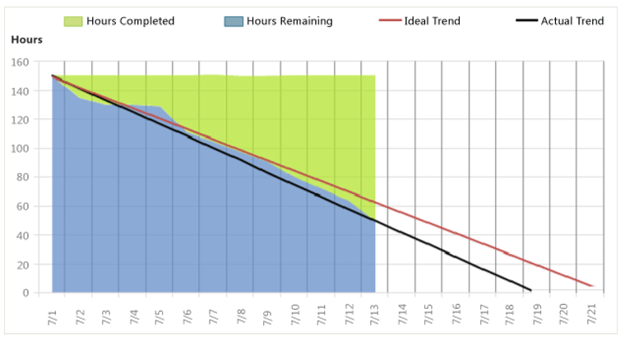
A Healthy Burndown Report

Slide 50
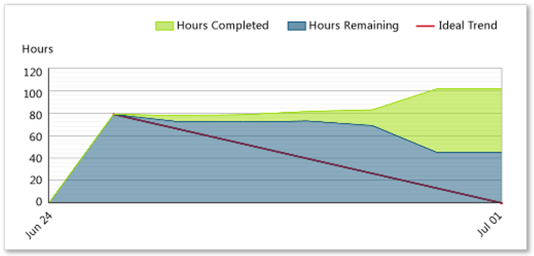
An Unhealthy Burndown Report

Slide 51
Retrospective Report
After a sprint, the team will review data to see if any processes need to change prior to starting the next sprint.
Team members may look at progress trends for each member or pair and test-plan progress to see team productivity.
Then the process will repeat; teams will look at burndown and task progress to establish goals for the next sprint.

Slide 52
Section Questions
What is a burndown report?
How can data from previous sprints be useful for planning an upcoming sprint?
What metric describes the degree to which source code has changed?

Slide 53
Additional Resources for this Module
MSDN Software Testing Resources
Process Guidance & Process Templates for TFS | http://msdn.microsoft.com/en- us/library/hh533801.aspx
Planning and Tracking Project | http://msdn.microsoft.com/en- us/library/dd286619.aspx
Work Items and Workflow (Agile) | http://msdn.microsoft.com/en- us/library/dd997897.asp
Agile Principles and Values | http://msdn.microsoft.com/en- us/library/dd997578.aspx
Testing Methodologies | http://msdn.microsoft.com/en- us/library/ff649520.aspx
Scrum | http://msdn.microsoft.com/en- us/library/dd997796%28v=VS.100%29.aspx
Open Distributed Agile Development | http://download.microsoft.com/download/ 4/4/a/44a2cebd-63fb-4379-898d- 9cf24822c6cc/distributed_agile_developme nt_at_microsoft_patterns_and_practices.pd
Collaborating within a Team Using Team Project Resources | http://msdn.microsoft.com/en- us/library/ms242904(v=vs.100).aspx
Distributed Scrum | http://msdn.microsoft.com/en- us/library/jj620910.aspx
Burndown and Burn Rate Report (Agile) | http://msdn.microsoft.com/en- us/library/dd380678.asp
Excel Reports (Agile) | http://msdn.microsoft.com/en- us/library/vstudio/dd997876.aspx
My Dashboard (Agile) | http://msdn.microsoft.com/en- us/library/dd420561.aspx

Slide 54
Know your stuff? Get Certified!
Microsoft Certified Solutions Developer (MCSD) for Application Lifecycle Management
http://www.microsoft.com/learning/en-us/mcsd-application-lifecycle-management.aspx
Microsoft Learning Partners—Learn from the Pros!
http://aka.ms/CPLS
Find a Class: http://aka.ms/ClassLocator

