Slide 1

Software Testing Fundamentals
Thomas Dawkins | Senior Product Manager
Erik Downing | Senior Software Development Engineer in Test (SDET)

Slide 2
Take the Exam
98-379 – Software Testing Fundamentals
Certiport
http://www.certiport.com
Prometric
http://www.prometric.com

Slide 3

Join the MVA Community!
Microsoft Virtual Academy
Free online learning tailored for IT Pros and Developers
Over 1M registered users
Up-to-date, relevant training on variety of Microsoft product
http://www.microsoftvirtualacademy.com

Slide 4
Course Topics
Software Testing Fundamentals
01 | Testing Fundamentals 1.1 Software Testing 1.2 Software and Hardware Components 1.3 Fundamentals of Programming 1.4 Application Lifecycle Management | 04 | Managing Software Testing Projects 4.1 Testing Milestones 4.2 The Agile Process 4.3 Working with Distributed Teams 4.4 Test Reports
02 | Testing Methodologies 2.1 Testing Techniques 2.2 Testing Levels 2.3 Testing Types | 05 | Working with Bugs 5.1 Detecting Software Defects 5.2 Logging Bugs 5.3 Managing Bugs
03 | Creating Software Tests 3.1 User Centric Tests 3.2 Software Testability 3.3 Creating Test Plan Components 3.4 Feature Testing 3.5 Appropriately Scoped Test Cases | 06 | Automating Software Test 6.1 Test Automation 6.2 Test Automation Strategies 6.3 Writing Automation Tests 6.4 Managing Test Scripts

Slide 5
05 | Working with Bugs
Thomas Dawkins | Senior Product Manager
Erik Downing | Senior Software Development Engineer Tester (SDET)

Slide 6
Module Overview
How to Detect Software Defects
Logging Bugs
Managing Bugs

Slide 7
05 | Working with Bugs
5.1 Detecting Software
Defects

Slide 8
Section Overview
In this section, we will review the following:
Executing test cases
Running automation scripts

Slide 9
Guiding Questions
What must be configured in Microsoft® Test Foundation Server (TFS) to run tests and collect data remotely?
What must to be set up on each remote machine used to run the tests?
What tool in Visual Studio enables the developer to execute tests and analyze the results in test plans?

Slide 10
Manual vs. Automated Testing
In manual testing, the tester plays the role of a user and checks to see if there is any unexpected or undesirable behavior.
Automated tests use testing software to control and track one or more automatically executed tests.
Some testers refer to the programming used to run a script as a test script or and automation script.
Automation scripts that use and test the user interface are called coded UI tests.

Slide 11
Automated Testing with Visual Studio and MTM
Visual Studio enables testers and developers to run local and remote tests.
However, in order to organize tests into test plans—and in turn, execute test plans and analyze the results, you can use Microsoft Test Manager (MTM).
MTM interfaces with Microsoft Team Foundation Server to manage tests for a team project.

Slide 12
Managing Distributed Testing
Distributed testing is the use of multiple computers (configured as a lab environment) to execute tests and collect data.
The lab can consist of either physical or virtual machines.
A virtual machine is a “computer within a computer,” implemented in software. It emulates a complete hardware system in a self-contained, isolated software environment.
Additionally, different machines within the lab can run different environments (different versions of the Windows operating system, different configurations, etc.)
Distributed testing requires a machine with a test controller and lab machines with test agents.

Slide 13
Software for Distributed Testing
Test Controller: a background process that manages a set of machines with the test agent software installed.
Test Agent: a background process that receives, runs, and reports on tests and collects data on a single computer. The test agent communicates with test controller, usually located on another computer.

Slide 14
Running Tests from Visual Studio
Visual Studio provides different ways to run tests. You can choose the way that best suits your current needs:
From Test Explorer (Test Explorer easily lets you run and monitor the status of all the automated tests in your solution).
From the load test editor (load tests and web performance tests).
From source code files (run tests while editing a file that contains your code under test).
From test code files (run tests while editing the file that contains your test cases).

Slide 15
Running Tests from Microsoft Test Manager
Many methods of running your automated tests are available in MTM, depending on how you want to run tests and view the results.
If you run your automated tests by using a test plan, you can view your testing progress and easily rerun your tests as required.

Slide 16
Section Questions
What must be configured in Microsoft® Test Foundation Server (TFS) to run tests and collect data remotely?
What must to be set up on each remote machine used to run the tests?
What tool in Visual Studio enables the developer to execute tests and analyze the results in test plans?

Slide 17

Great MSPress Books
How We Test Software at Microsoft
http://www.microsoft.com/learning/en-us/book.aspx?ID=11240&locale=en-us
Alan Page, Ken Johnston, RJ Rollison

Slide 18
05 | Working with Bugs
5.2 Logging Bugs

Slide 19
Section Overview
In this section, we will review the following:
Priority
Severity
Dependency
Repro Steps

Slide 20
Guiding Questions
What term refers to the impact a bug has on the overall project?
Explain the difference between priority and stack rank.
What technology records diagnostic data to help troubleshoot bugs that are difficult to reproduce?

Slide 21
Tracking Bugs
From a programmer/development perspective, a bug is an error in coding or logic that causes a program to malfunction or to produce incorrect results.
When using Microsoft’s® Application Lifecycle Management (ALM) software, such as Team Foundation Server (TFS), to ensure high- quality software, a bug is an issue that needs to be logged, tracked, and resolved.
With that in mind, a bug is a “work item,” just like any other task in the development process. In this case, it is a work item that records a potential source of dissatisfaction with the product

Slide 22
Defining a Bug
When a bug or defect is found, a work item is created to communicate to the team that there is a potential problem, and to document the nature of that potential problem.
Like any other work item, a bug is managed by Team Foundation Server and is generally assigned to a team member.
If the bug is defined using Microsoft Test Manager, information about the related test case, user story, and other information will automatically be linked to the bug.
It is important to record several pieces of information when logging a new, or previously unknown, bug.

Slide 23
Bug Priority
Priority is a subjective rating of the bug as it relates to the business.
You can specify the following values:
Product cannot ship without the successful resolution of the bug, and it should be addressed as soon as possible.
Product cannot ship without the successful resolution of the bug, but it does not need to be addressed immediately.
Resolution of the bug is optional based on resources, time, and risk.

Slide 24
Bug Severity
Severity is a subjective rating of the impact of the bug on the project.
You can specify the following values:
Critical
High
Medium
Low

Slide 25
Bug Stack Rank
Stack rank is a subjective rating of the bug compared to other bugs. A bug that is assigned a lower number should be fixed before a bug that is assigned higher number.
There is no prescribed scale for stack rank. You can think of it as a “sort order” for the overall list of bugs. If the team is going to prioritize which bugs to focus on, they might rank all unresolved bugs by stack rank.
A bug that is going to be addressed early will have a low number, such as 1 or 2. A bug that can wait until later in the development process can be assigned a higher number, perhaps 30 or 100.
The stack rank is often decided by evaluating the Priority and Severity of the bug.

Slide 26
Reproducing (Repro) Steps
Repro steps are the steps other testers or developers can execute to reproduce the bug or unexpected behavior.
Detailed repro steps are crucial for team members who may not have seen the bug first-hand. This is especially true if the bug is discovered via manual or exploratory testing.
Good repro steps are explicit, explaining exactly what actions to take, including mouse clicks and keyboard presses, to observe the defective behavior.
You may consider including screenshots, which can be included as attachments in the work item system.

Slide 27
Diagnostic Trace Data
Developers can collect specific diagnostic trace information when they run tests to help isolate bugs that are difficult to reproduce.
IntelliTrace: a feature for debugging a managed application at specific points in time. It captures and records what the application does while it is running. When an error occurs, you can view the state of the application at any time from the start to the point of the error.
This information enables them to use IntelliTrace to trace through what really occurred in the application to cause the bug.
When a test step fails and a bug is filed, an IntelliTrace file is automatically linked to the bug and is available together with the test results.
The IntelliTrace file can then be used by another individual who can replicate the local test session on their computer without having to reproduce the bug directly.

Slide 28
Section Questions
What term refers to the impact a bug has on the overall project?
Explain the difference between priority and stack rank.
What technology records diagnostic data to help troubleshoot bugs that are difficult to reproduce?

Slide 29
05 | Working with Bugs
5.3 Managing Bugs

Slide 30
Section Overview
In this section, we will review the following:
Triage
Resolution
Closing
Monitoring
Bug Summary Reports

Slide 31
Guiding Questions
What does it mean to triage a list of bugs?
What is the last step before closing a bug?
What is a reason for activating a resolved bug?

Slide 32
What is a Triage?
The concept of triage comes from the medical community; it is the process of prioritizing the order in which patients will be treated based on the severity of their illness or injury.
In software development, triage is the process of reviewing new or reopened bugs and assigning a priority or stack rank for working on each.
On some projects, there may be a specified triage team that handles triage; on other projects, testers or perhaps the entire team may perform triage.

Slide 33
Triaging a Bug
Triage meetings should be held at set intervals after the development work and testing have started on the project.
Before triage starts, devise a set of criteria to determine which bugs should be fixed and in what priority. The criteria will typically identify the severity of bugs, bugs that are associated with features of significant value, or other project risks.
Early in the project, you will likely decide to fix most of the bugs that you triage. However, as the project proceeds, the triage criteria (or bar) may be raised to reduce the number of bugs that are fixed.
Raising the triage criteria bar and allowing reported bugs to remain unfixed is a trade-off. It is a trade-off that says that fixing the bug is less important than meeting the project scope, budget, and schedule

Slide 34
Verifying a Bug Fix
After a bug is fixed, it should be assigned to a tester to verify that the problem is solved before the bug work item is closed.
To verify a fix, the tester should attempt to reproduce bug, look for additional unexpected behavior, and, if necessary, reactivate the bug.
When verifying a bug resolution, you may find that the bug was not completely fixed or you may disagree with the resolution. In this case, you discuss the bug with the person who resolved it, come to an agreement, and possibly reactivate the bug.

Slide 35
Bug States
A team can track the progress of a bug by setting its State. The possible values for state will vary based on the development methodology, but most models use similar concepts.
Active state means that the bug is being investigated and/or fixed. New bugs are generally set to Active when added.
Resolved indicates that a bug has been fixed.
Closed means that someone has verified that the resolved bug is fixed.
When the State of a bug is changed, the team member selects a reason

Slide 36
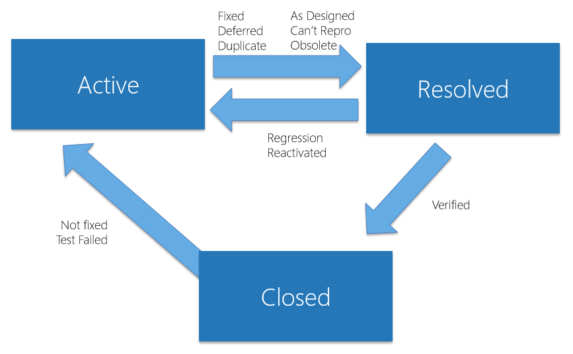
Bug States

Slide 37
Reasons for Resolving a Bug
Fixed: After you fix the problem that the bug identifies, run unit tests to confirm that the problem is fixed, and check in the changed code.
Deferred: When the bug will not be fixed in the current iteration.
Duplicate: When another active bug reports the same problem.
As Designed: When the bug describes an expected condition or behavior of the system.
Cannot Reproduce: When team members cannot reproduce the behavior that the bug reports.
Obsolete: When the bug no longer applies to the product. For example, a bug is obsolete if it describes a problem in a feature area that no longer exists in the product.

Slide 38
Reasons for Reactivating a Resolved Bug
Not Fixed: When the resolution is unacceptable or if the fix was incorrect.
Test Failed: When a test demonstrates that the bug still exists.

Slide 39
Reasons for Reactivating a Closed Bug
Regression: When the bug reappears in later builds of the code.
Reactivated: When the bug was closed in error or for some other reason.

Slide 40
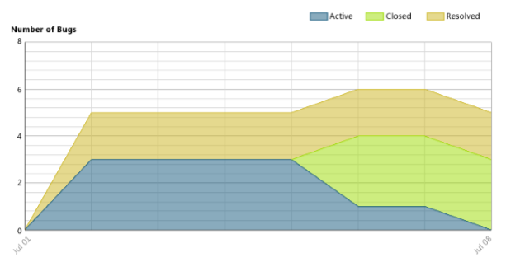
Bug Status Report
After the team has started to find and fix bugs, you can track the team's progress toward resolving and closing bugs by viewing the Bug Status report. This report shows the cumulative bug count based on the bug state, priority, and severity.

Slide 41
Bug Summary Report Data
Data shown on bug summaries includes:
Number of bugs
Active bugs by priority or severity
Active bugs by assignment (indicating how many active bugs have been assigned to each team member)
Resolved bugs by assignment (indicating the count of bugs that each team member has resolved)

Slide 42
Section Questions
What does it mean to triage a list of bugs?
What is the last step before closing a bug?
What is a reason for activating a resolved bug?

Slide 43
Additional Resources for this Module
MSDN Software Testing Resources
Essential Guide for Running Automated Tests from a Test Plan | http://msdn.microsoft.com/en-us/library/ff472576.aspx
Installing and Configuring Test Agents and Test Controllers | http://msdn.microsoft.com/en- us/library/vstudio/dd648127.aspx
Running Tests in Microsoft Test Manager | http://msdn.microsoft.com/en- us/library/dd286680.aspx
Test Early and Often | http://msdn.microsoft.com/en- us/library/vstudio/ee330950.aspx
Bugs (Agile) | http://msdn.microsoft.com/en- us/library/dd380645(v=vs.110).aspx
Triage Workbook | http://msdn.microsoft.com/en- us/library/dd380707(v=vs.100).aspx
Submitting Bugs | http://msdn.microsoft.com/en- us/library/dd286746.aspx
Bug Status Report | http://msdn.microsoft.com/en- us/library/dd380736.aspx

Slide 44
Know your stuff? Get Certified!
Microsoft Certified Solutions Developer (MCSD) for Application Lifecycle Management
http://www.microsoft.com/learning/en-us/mcsd-application-lifecycle-management.aspx
Microsoft Learning Partners—Learn from the Pros!
http://aka.ms/CPLS
Find a Class: http://aka.ms/ClassLocator

