Slide 1

ICEG
Open Standards
June 26th, 2024
Eric Auquière (Paradigm), Rink Kruk (NGI)

Slide 2
Agenda
Status Data Standardization
Budget 2024-2025

Slide 3
Data standardization – status
belgif/thematic: ICEG: Thematic Working Groups (github.com)
https://github.com/belgif/thematic/tree/master/models
Finished:
Mobility: IMKL standard (Cables and Pipes):
validation webinar with the stakeholders on 2024-05-14
positive advice from ICEG Review Committee on 2024-05-23
documentation here
ratification is requested by ICEG

Slide 4
Data standardization – status
belgif/thematic: ICEG: Thematic Working Groups (github.com)
https://github.com/belgif/thematic/tree/master/models
On hold (waiting for signing of the renewed collaboration agreement)
Hydrants: some additional semantic issues need to be addressed by the firefighters and the water companies
Additional budget requested: 20 MD (18170 €)
Approval for budget utilization is requested from ICEG (as soon as the collaboration agreement is signed)

Slide 5
Data standardization – status
belgif/thematic: ICEG: Thematic Working Groups (github.com)
https://github.com/belgif/thematic/tree/master/models
Persons
On hold (waiting for signing of the renewed collaboration agreement)
Request to start a new standardization trajectory:
Budget requested: 71.1K €
Approval for budget utilization is requested from ICEG (as soon as the collaboration agreement is signed)

Slide 6
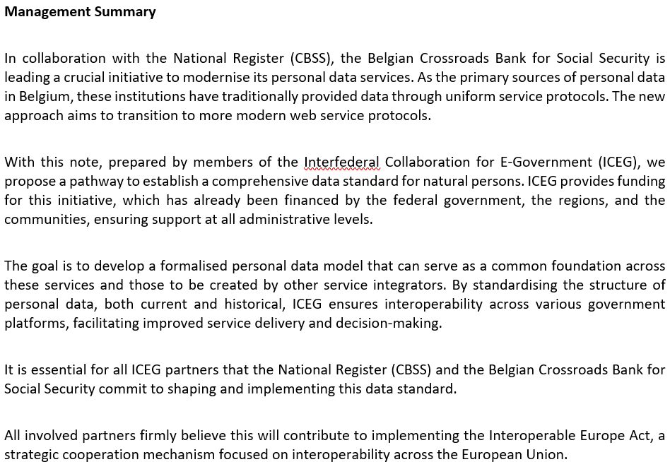
Data standardization – status
On hold (waiting for signing of the renewed collaboration agreement)
Persons: one-pager
request to send a message to the National Register and KSZ/BCSS to request their support for this exercise

Slide 7
Data standardization – status
belgif/thematic: ICEG: Thematic Working Groups (github.com)
https://github.com/belgif/thematic/tree/master/models
On hold (waiting for signing of the renewed collaboration agreement)
Translations of the OSLO standards

Slide 8
Agenda
Status Data Standardization
Budget 2024-2025

Slide 9
Budget 2024-2025
The following table gives an overview of the responses received
Signing of the collaboration agreement is blocked at BOSA-side since March 2024
Foreseen utilization of this budget
Hydrants 18170 €
Person 71.1 K€
Translation OSLO standards 150 K€
Contributing Organisation | Approved budget 2024 (€) | Cost allocationKey (%)
BOSA FOD Beleid & Ondersteuning | 80.000 | 27,59
Digitaal Vlaanderen | 80.000 | 27,59
Service Public de Wallonie (SPW) | 50.000 | 17,24
Paradigm (for the Brussels Region) | 20.000 | 6,90
ETNIC (for the Fédération Wallonie-Bruxelles) | 50.000 | 17,24
German speaking community | 10.000 | 3,45
Total | 290.000 | 100,00

