Slide 1

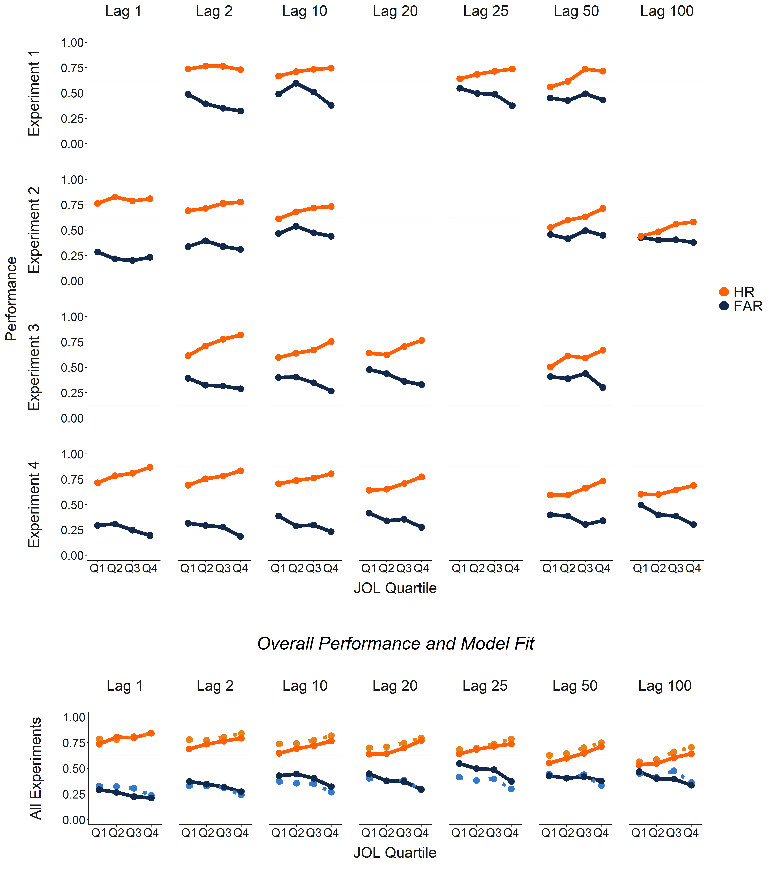
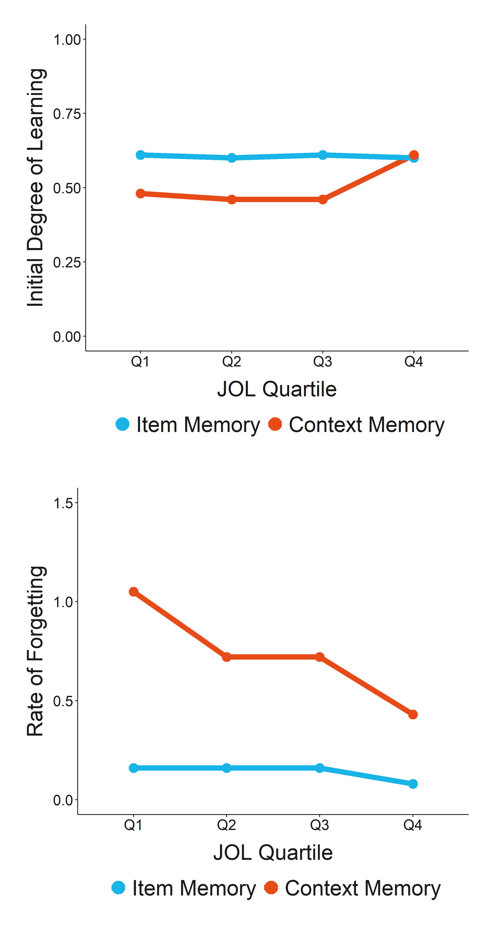
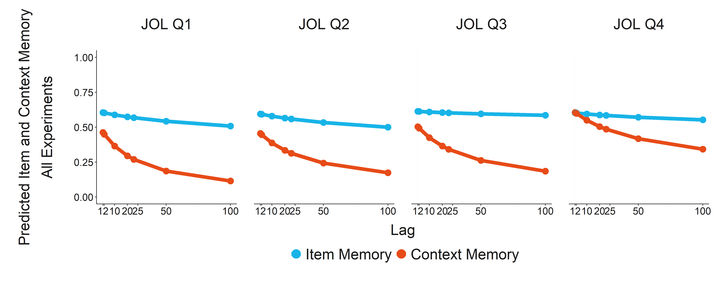
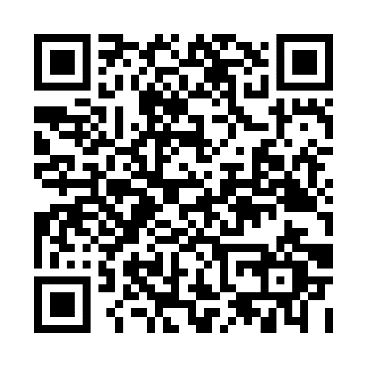

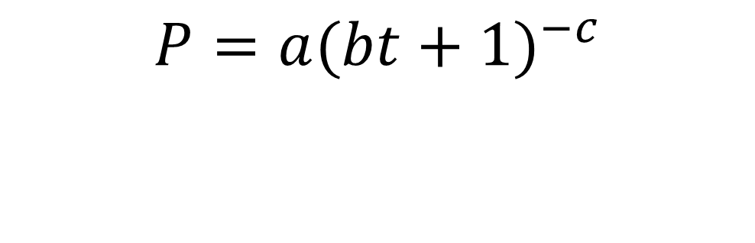
Judgments of Learning Reflect the Encoding of Contexts, Not Items:
Evidence from a Test of Recognition Exclusion
Belgin Ünal and Aaron S. Benjamin, University of Illinois Urbana-Champaign
Abstract Number: 2189
Introduction
Hit and False Alarm Rates
Median Parameter Estimates
Two sources of evidence are assumed to be shared by judgments of past recognition and judgments of future performance: item memory and context memory.
We tested memory and metamemory using a continuous exclusion procedure which allowed us to disentangle the contributions of item and context memory to JOLs.
Higher JOLs are predictive of a higher degree of initial learning and a lower rate of forgetting for context memory but are not related to either parameter for item memory.
JOLs reflect the memory strength for the individual memory episode rather than for the semantic information associated with that episode.
JOLs predicted the degree of learning for context memory but not for item memory.
Independent contributions model (Jacoby, 1991)
JOLs predicted the
rate of forgetting for context memory but not for item memory.
$$C=HR − {FAR}_{TBX}$$
$$I= \frac{{FAR}_{TBX}}{(1−C)}$$
C = Context Memory
I = Item Memory
HR = Hit Rate
FAR = False Alarm Rate
TBX = to-be-excluded items
Power law forgetting function (Wickelgren, 1974)
P = parameter of interest
a = initial degree of learning
B = scaling parameter
t = time (here, measured in lags)
c = rate of forgetting
Conclusions
$$P={a(bt+1)}^{−c}$$
Continuous Exclusion Procedure
STORY
JOL Question:
“Please estimate the probability that you will remember this word later.”
JOL?
Estimated Item and Context Memory
ITEM
JOL?
?STORY?
References
EDGE
Jacoby, L. L. (1991). A process dissociation framework: Separating automatic from Intentional uses of memory. Journal of memory and language, 30, 513–541.
Wickelgren, W. A. (1974). Single-trace fragility theory of memory dynamics. Memory & Cognition, 2, 775–780.
Exclusion Question:
“Have you seen this word in this color? ”
JOL?
?EDGE?
Belgin Ünal bunal2@illinois.edu

