Slide 1
Space efficient volumes

Slide 2
Extent space efficient (ESE) volumes
Track space efficient (TSE) volumes

Slide 3
Track space efficient (TSE) volumes
SATA drives will not support TSE
“Repository”
    physical storage provider for TSE
    It has Physical & logical sizes
    One repository per one ext pool
    The repository is striped across all ranks
Track space efficient (TSE) volumes are supported only as FlashCopy target volumes.

Slide 4
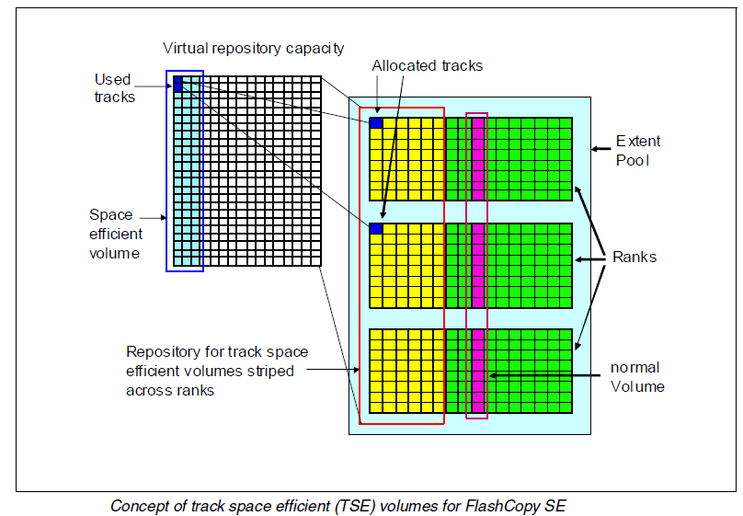

Slide 5
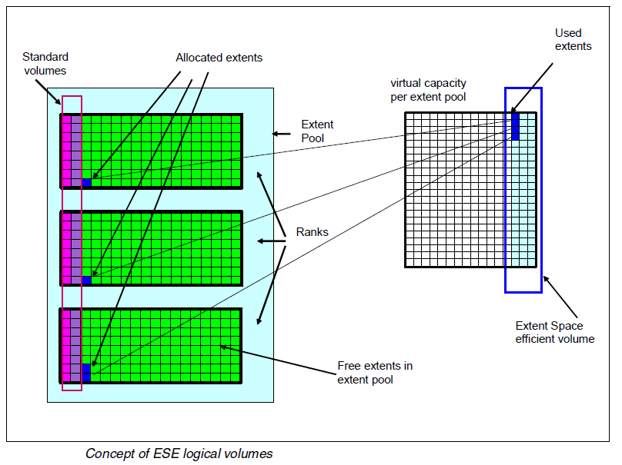

Slide 6
EAMs for DS8000
Rotate volumes
Storage Pool Striping (Rotate extents)
For latest versions SPS is default .
Allocation method for older LMC versions than 6.6.0.xx is Rotate volumes

Slide 7
