Slide 1
Group 01 – Presentation -1
Sai Krishna Chillara
Shipra Jain
Brittney Elhard
Woobae Kim
Greeshma Sree Katam
Tianyi Wang

Slide 2
Agenda
Selection Sort
Merge
Sort
Max PQ Sort

Slide 3
Selection Sort
Sorting Algorithm
It iterates through the array and finds the smallest number in the array and swaps it with the first element if it is smaller than the first element.
Next, it goes on to the second element and so on until all elements are sorted.
It performs well on a small list.
It does not require a lot of space for sorting.

Slide 4
Selection Sort
Let’s understand it through an example
2
8
5
3
9
4
1

Slide 5
Selection Sort
Let’s consider the Array Below
2
8
5
3
9
4
1

Slide 6
There are two partitions in a selection sort.
SORTED PARTITION
UNSORTED PARTITION
During each iteration we’ll select the smallest item from the Unsorted partition to the Sorted partition.
Sorted
Current minimum
Current Item

Slide 7
We always set the current minimum to the first number in the unsorted partition.
In this case it is 2 , we progress the length of the array looking for a smaller number
2
8
5
3
9
4
1
2
8
5
3
9
4
1
2
8
5
3
9
4
1
2
8
5
3
9
4
1
2
8
5
3
9
4
1
2
8
5
3
9
4
1
2
8
5
3
9
4
1
2
8
5
3
9
4
1
1
8
5
3
9
4
2

Slide 8
Moving on we set 8 as our current minimum and scan the reminder of the array for a smaller number updating the current minimum as we progress
1
8
5
3
9
4
2
1
8
5
3
9
4
2
1
8
5
3
9
4
2
1
8
5
3
9
4
2
1
8
5
3
9
4
2
1
8
5
3
9
4
2
1
8
5
3
9
4
2
1
8
5
3
9
4
2
1
8
5
3
9
4
2

Slide 9
At the end we find 2 and swap it with 8 and move it into our sorted partition
1
8
5
3
9
4
2
1
2
5
3
9
4
8

Slide 10
Continuing our iterations
1
2
5
3
9
4
8
1
2
5
3
9
4
8
1
2
5
3
9
4
8
1
2
5
3
9
4
8
1
2
5
3
9
4
8
1
2
5
3
9
4
8
1
2
5
3
9
4
8
1
2
3
5
9
4
8

Slide 11
1
2
3
5
9
4
8
1
2
3
5
9
4
8
1
2
3
5
9
4
8
1
2
3
5
9
4
8
1
2
3
5
9
4
8
1
2
3
5
9
4
8
1
2
3
4
9
5
8
1
2
3
4
9
5
8
1
2
3
4
9
5
8
1
2
3
4
9
5
8
1
2
3
4
9
5
8
1
2
3
4
9
5
8

Slide 12
With each iteration we select the smallest item that hasn’t yet been sorted.
1
2
3
4
5
9
8
1
2
3
4
5
9
8
1
2
3
4
5
9
8
1
2
3
4
5
9
8
1
2
3
4
5
9
8
1
2
3
4
5
8
9
1
2
3
4
5
8
9
1
2
3
4
5
8
9

Slide 13
Merge Sort
Divide and Conquer algorithm
Two-Step Process
Recursive
Merge
6/5/22

Slide 14
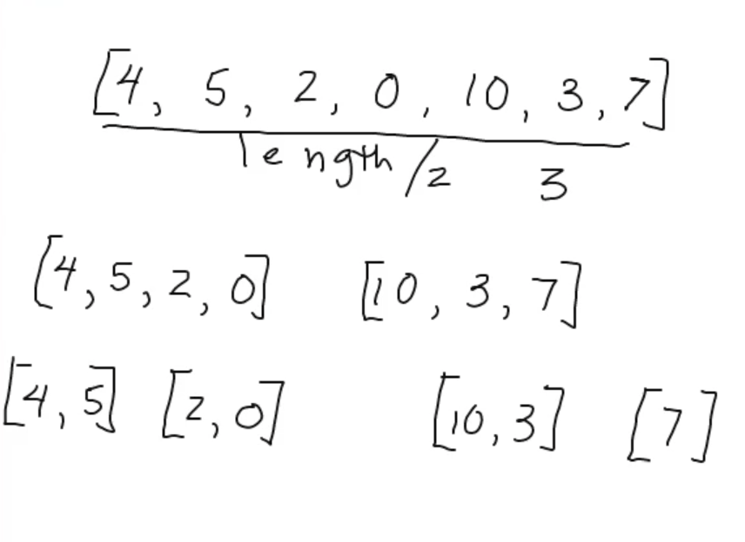
Recursive

Slide 15
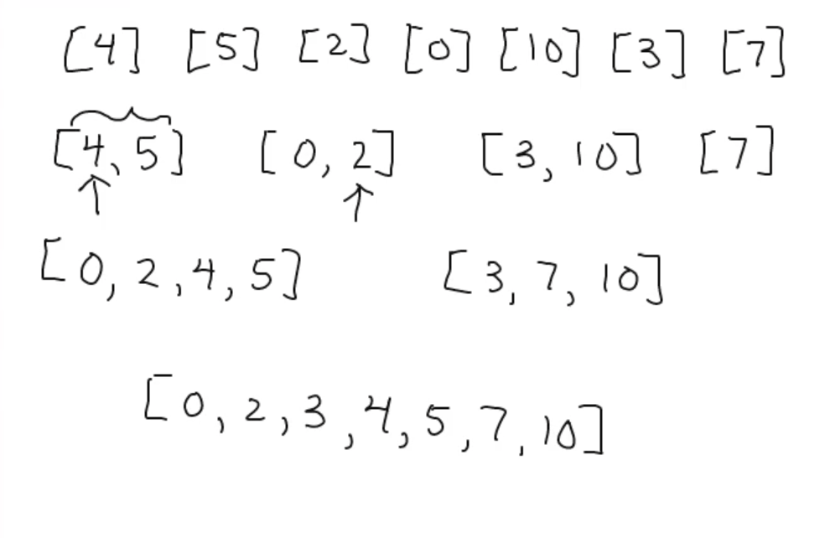
Merge

Slide 16
Merge Sort
Consider another array
9
10
13
3
8
7
2
6
11

Slide 17
Merge Sort can be considered a divide and conquer function.
Divide: The array is split at the midpoint, and each half array continues to split at the midpoint until there are no more halves to divide.
Conquer: the arrays are sorted and merged in the correct order, from lowest to highest values.
10
9
13
8
3
7
2
6
11
MIDPOINT

Slide 18
Divide:
10
9
13
8
3
7
2
6
11
10
9
13
8
3
7
2
6
11
10
9
13
8
3
7
2
6
11
10
9

Slide 19
Sort
10
9
13
8
3
7
2
6
11
10
9
13
8
3
7
2
6
11
10
9
13
8
3
7
2
6
11
10
9
9
10
3
8
2
7

Slide 20
Sort
10
9
13
8
3
7
2
6
11
10
9
13
8
3
7
2
6
11
9
10
13
3
8
2
7

Slide 21
Conquer
10
9
13
8
3
7
2
6
11
3
8
9
10
13
2
6
7
11
2
3
6
7
8
9
10
11
13

Slide 22
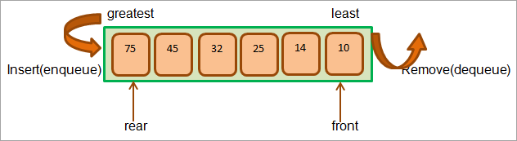
PQ(Priority Queue)
A Priority Queue data structure is a special queue in which the elements are present not as per FIFO order but according to the natural elements or any custom comparator used during queue creation.

Slide 23
Constructors
PriorityQueue()
PriorityQueue(Collection c)
PriorityQueue(int initialCapacity)
PriorityQueue(int initialCapacity, Comparator comparator)
PriorityQueue(PriorityQueue c)
PriorityQueue(SortedSet c)

Slide 24
Methods
Adding Items
Accessing Items
Removing Items

Slide 25
Max Priority Queue
In a max priority queue, elements are inserted in the order in which they arrive the queue and the maximum value is always removed first from the queue.
9 | 4 | 2 | 6
9 | 6 | 4 | 2

Slide 26
MaxPQ Representations
Using an Unordered Array (Dynamic Array)
Using an Unordered Array (Dynamic Array) with the index of the maximum value
Using an Array (Dynamic Array) in Decreasing Order
Using an Array (Dynamic Array) in Increasing Order
Using Linked List in Increasing Order
Using Unordered Linked List with reference to node with the maximum value

Slide 27
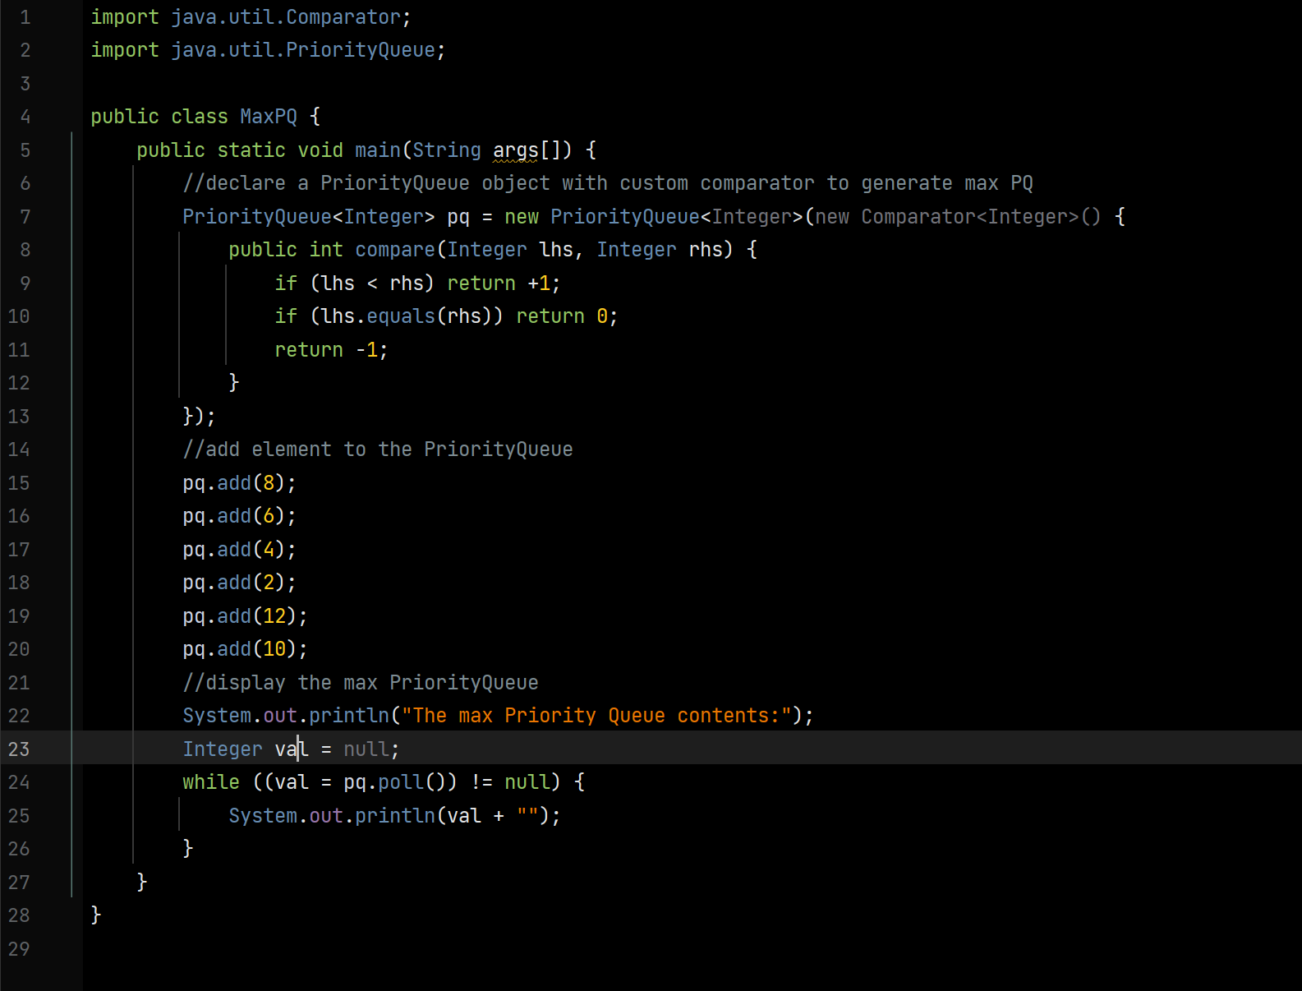
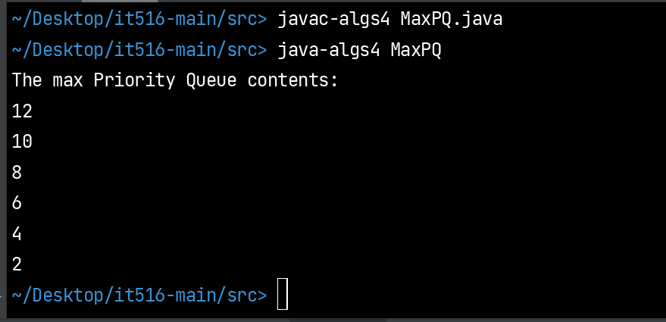
Code
The max priority queue has the elements in descending order. The head of the Max priority queue will return the greatest element in the queue.
Output:

