Slide 1
ACT: Electronic Transformer v2.0
for Maxwell 2021R1
January 2021
Notes:
1

Slide 2
Copyright and Trademark Information
Copyright and Trademark Information
© 2020 ANSYS, Inc. All rights reserved. Unauthorized use, distribution or duplication is prohibited.
ANSYS, ANSYS Workbench, Ansoft, AUTODYN, EKM, Engineering Knowledge Manager, CFX, FLUENT, HFSS, AIM and any and all ANSYS, Inc. brand, product, service and feature names, logos and slogans are registered trademarks or trademarks of ANSYS, Inc. or its subsidiaries in the United States or other countries. ICEM CFD is a trademark used by ANSYS, Inc. under license. CFX is a trademark of Sony Corporation in Japan. All other brand, product, service and feature names or trademarks are the property of their respective owners.
Disclaimer Notice
THIS ANSYS SOFTWARE PRODUCT AND PROGRAM DOCUMENTATION INCLUDE TRADE SECRETS AND ARE CONFIDENTIAL AND PROPRIETARY PRODUCTS OF ANSYS, INC., ITS SUBSIDIARIES, OR LICENSORS. The software products and documentation are furnished by ANSYS, Inc., its subsidiaries, or affiliates under a software license agreement that contains provisions concerning non-disclosure, copying, length and nature of use, compliance with exporting laws, warranties, disclaimers, limitations of liability, and remedies, and other provisions. The software products and documentation may be used, disclosed, transferred, or copied only in accordance with the terms and conditions of that software license agreement.
Contains proprietary and confidential information of ANSYS, Inc. and its subsidiaries and affiliates.

Slide 3
Electronic Transformer Overview
What does the “Electronic Transformer ACT” do?
It automatically sets up a ready-to-solve Maxwell 3D Eddy Current design for magnetic components. Permeability is linear and frequency dependent. Steinmetz core loss coefficients are frequency dependent. A frequency dependent state-space model can be created for Simplorer (and Pspice using Network Data Explorer).
What devices can be modeled?
It is intended for electronic ferrite core transformers and inductors
How easy is it to use?
ACT consists of three input steps which can be setup in 5-10 minutes
Are any manufacturer libraries included?
Philips and Ferroxcube libraires with 15 core shapes are included in this release

Slide 4
Electronic Transformer Release 2021R1: What’s new?
Number of transformer windings (sides) is unlimited. Now you can create as many sides as you have layers such as: Primary, Secondary, Tertiary, etc
Winding sides can be connected in arbitrary series or parallel combinations
Thermal properties for windings are included for further two-way coupling with thermal tools like Icepak and Fluent
Auto skin layers: if thickness of the conductor is less than 3 values of skin depth then ACT will automatically generate additional layers for mesher to capture eddy effects
Calculates leakage inductance between all windings (sides) and automatically creates a report
Excitation strategy is expanded. Now you can have a voltage (or current) winding instead of only current sources
Load resistance for secondary windings can be input for loaded conditions
Creates field overlays: Mag(J), Ohmic-Loss for windings and Mag(B), Coreloss density for the core
By default, simulates a half-model for faster simulation time
Note: Due to added functionality .tab files from the older versions are not supported

Slide 5
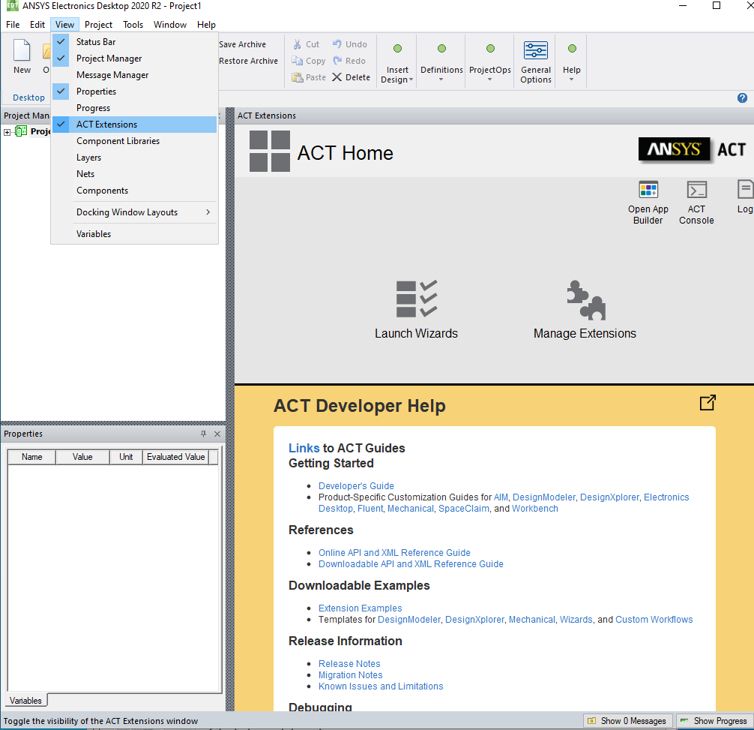
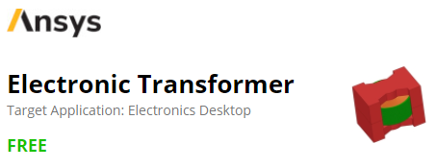
Install the Extension
Open Electronics Desktop and activate the ACT through
View -> ACT Extensions
You can download latest release of Electronic Transformer ACT from GitHub or from Ansys App Store
Once you have downloaded the app go to Manage Extensions and click on the “+” sign to install extensions, select the wbex file downloaded from the ANSYS ACT Application Store.

Slide 6
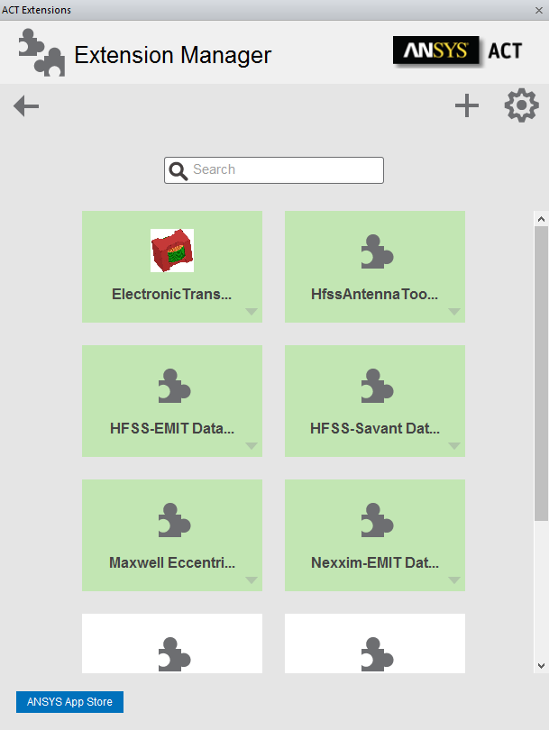
Install the Extension
After installing, you will see the Electronic Transformer ACT extension shown
Import extension appears in the Extension Manager with a white background, which means it has been installed but not yet loaded. To load the extension, you can just simply click on it. If the extension is loaded successfully, the icon’s background should be green.
Now you can leave the Extension Manager panel and run the ACT from the Launch Wizard panel

Slide 7
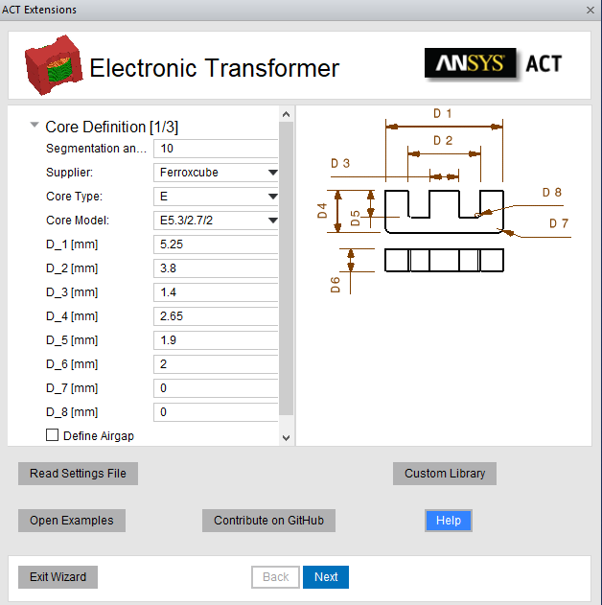
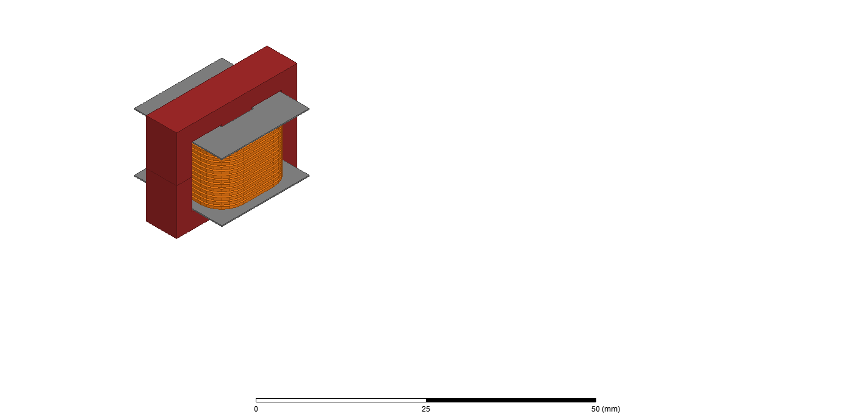
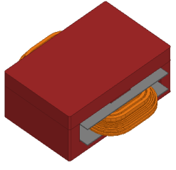
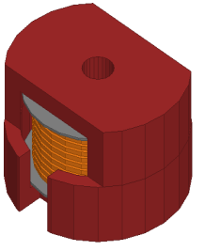
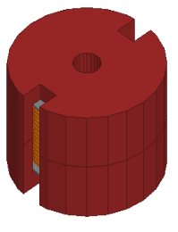
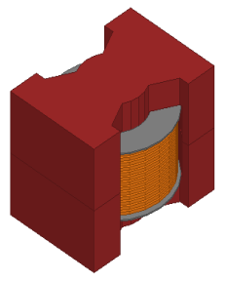
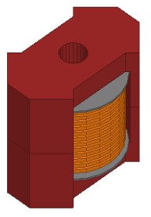
Input panel 1 of 3: Core Definition
There are two options to set-up a transformer model:
Create a totally new design
Read input data from a previously recorded .json text file
For new design, set Segmentation angle and Supplier, Core Type, Core Model
Accept the default dimensions or manually modify
The are (15) available core shapes from Philips/Ferroxcube

Slide 8
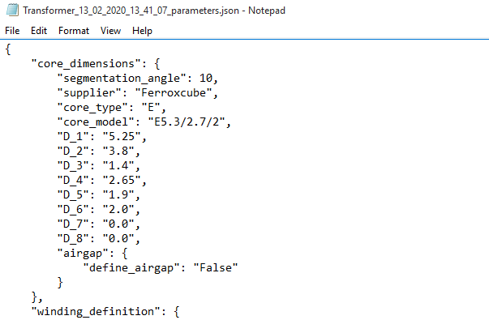
Recorded input file – used to recreate model in future
An input text file (.json) is automatically recorded and saved in the Maxwell default project folder each time when analysis is set up
For a previously recorded design, the input file can be re-run by selecting “Read Settings File” on the core definition input step (note that the Core Model box will remain unchanged)
This input file can also be manually modified in text editor to make changes in parameters before re-running
Click “Open Examples” to run demo input files
Note: Due to added functionality .tab files from the older versions are not supported

Slide 9
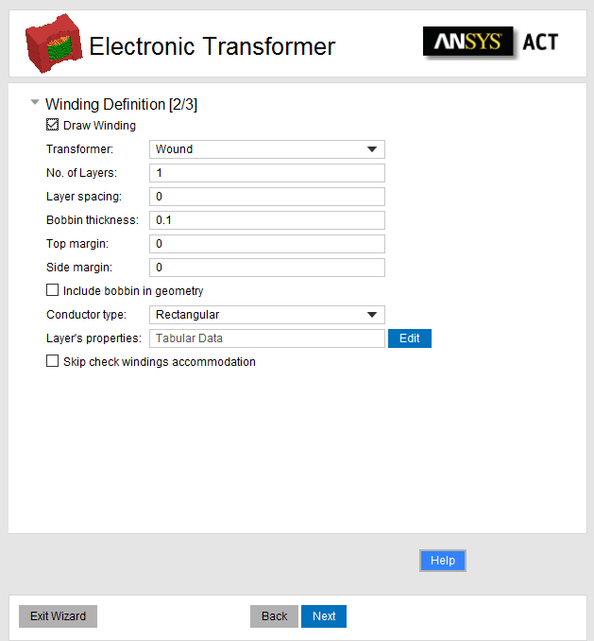
Input panel 2 of 3: Winding Definition
Transformer type: Wound/Planar
Number of Layers, Layer Spacing, Bobbin/Board Thickness, Top/Bottom Margin size, Side Margin size
Layer Type: Top Down or Concentric
Include bobbin (or not)
Conductor Type: Rectangular or Circular (only for wound)
Layer properties:
For rectangular: Conductor Width, Conductor Height, Number of Turns, Insulation thickness
For circular: Conductor Diameter, Number of segments, Number of Turns, Insulation Thickness
Skip check windings (validates that windings will fit into the core)

Slide 10
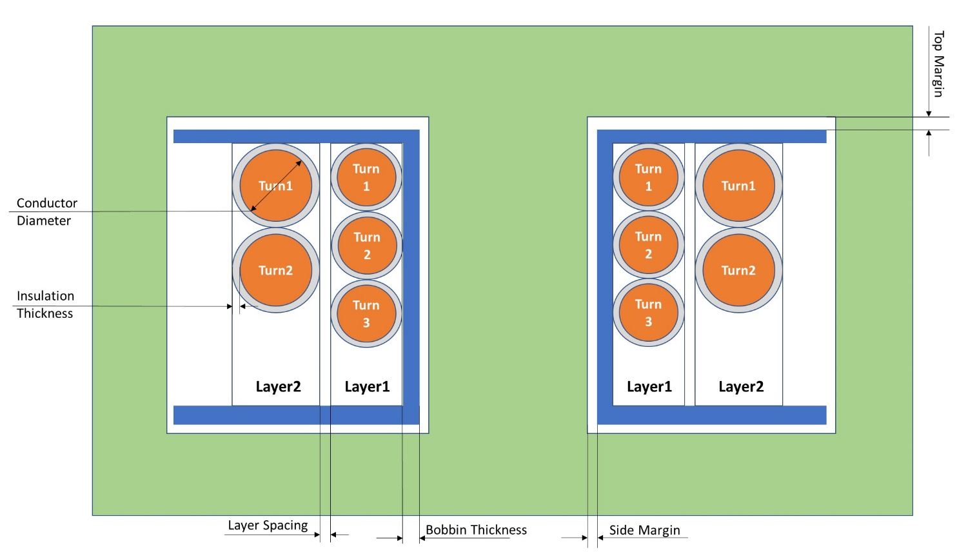
Wound Transformer

Slide 11
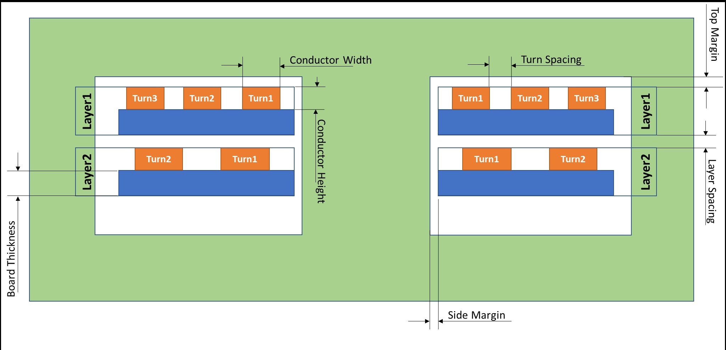
Planar Transformer

Slide 12
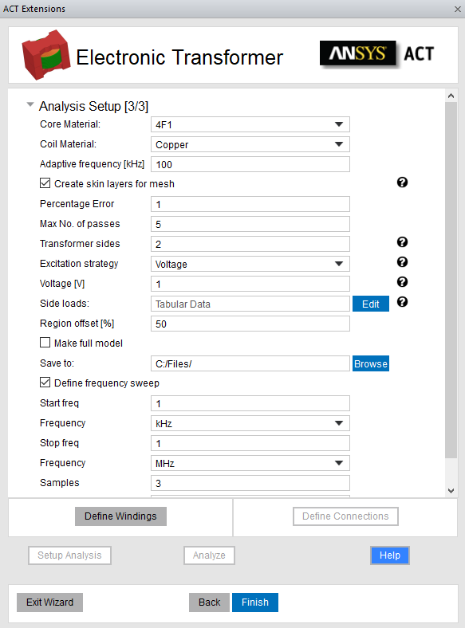
Input panel 3 of 3: Analysis Setup [step 1]
Define Core Material and Coil Material
Adaptive Frequency [kHz] for meshing (enable skin layers for mesh, if desired)
Note: if thickness of the conductor is less than 3 values of skin depth then ACT will automatically generate additional layers for mesher to capture eddy effects
% error and max number of adaptive passes
Define number of transformer sides: 2 (for 1 Primary and 1 Secondary)
Select Excitation strategy for Primary side (Voltage or Current source with magnitude)

Slide 13
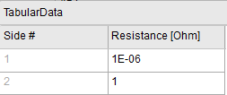
Input panel 3 of 3: Analysis Setup [step 2]
Side loads sets the load resistance for each secondary (table)
Set value of Regions offset
Check Make Full Model to generate full model (default is a half model)
Select Path where to Save the project
Define frequency sweep (if desired) for start, stop and number samples
Click Define Windings to assign each layer to the appropriate Winding (Side: 1,2,3…)

Slide 14
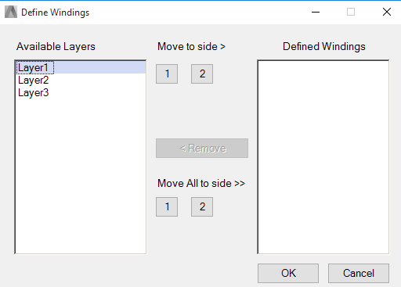
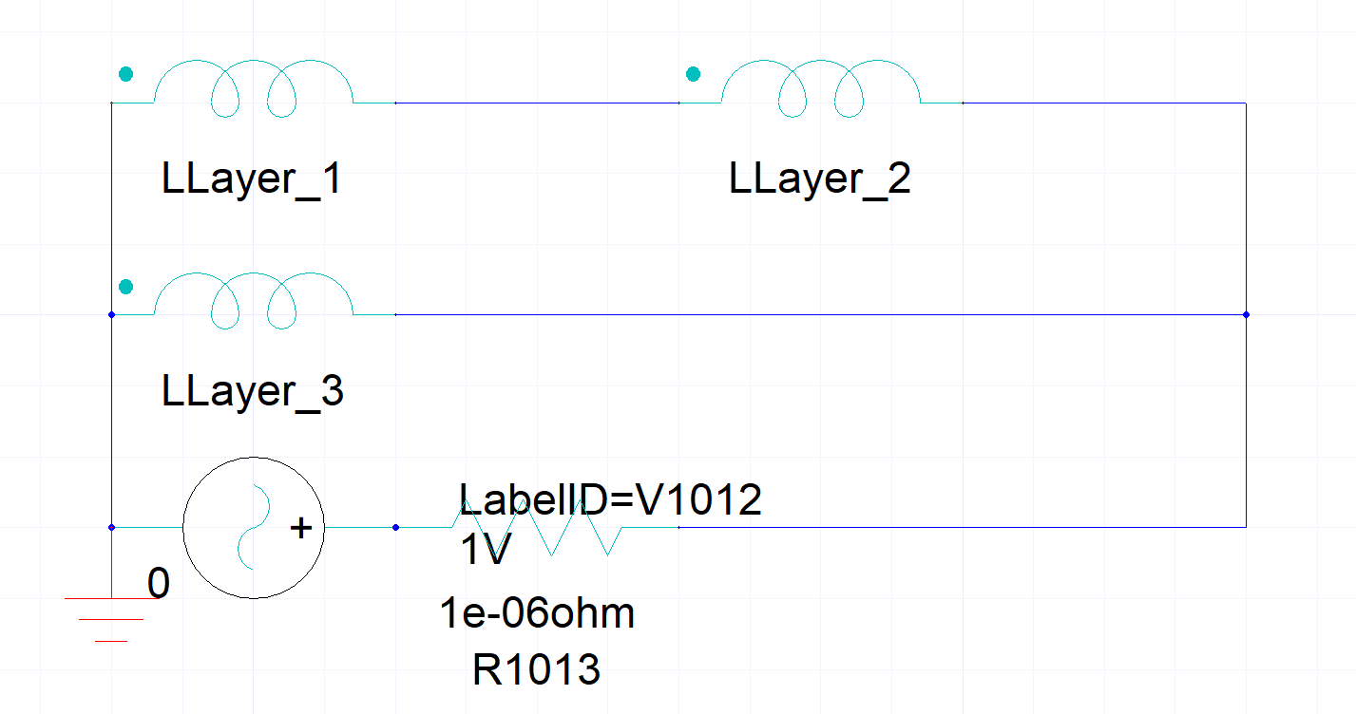
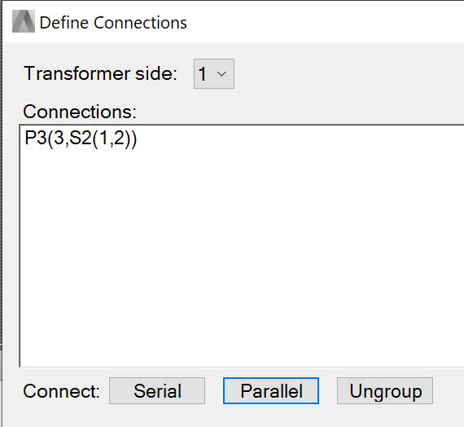
Input panel 3 of 3: Analysis Setup [step 3]
Move each layer to the appropriate side
Click Define Connections to set connections within each side: Parallel or Serial
In the Maxwell Circuit below, you can see Layers 1 and 2 are connected in Series and then connected in Parallel to Layer 3
Return to Analysis Setup [3/3 panel]
Setup Analysis to create design and stop
OR Analyze to setup and solve design
Finish and Exit Wizard to close ETK

Slide 15
Adding a New Core Material
In order to add a new core material, users can follow below steps:
Open ACT and click Custom Library button. It will open folder where you can modify material_properties.json file to add new materials
Add new material respecting JSON syntax. For each material you need to add Conductivity, Steinmetz coefficients (Cm, X, Y), density and permeability versus frequency

Slide 16
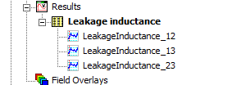
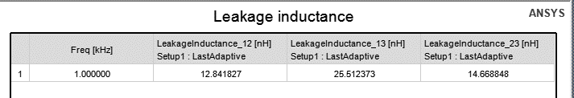
Maxwell Results – Leakage Inductance
ACT will automatically generate Leakage Inductance report for you. It will calculate values between all sides.
For example, for 3 sides (primary, secondary, tertiary) you will get a report frequency vs all Leakage values:

Slide 17
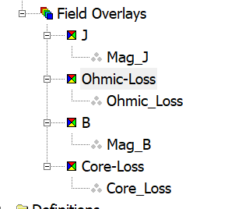
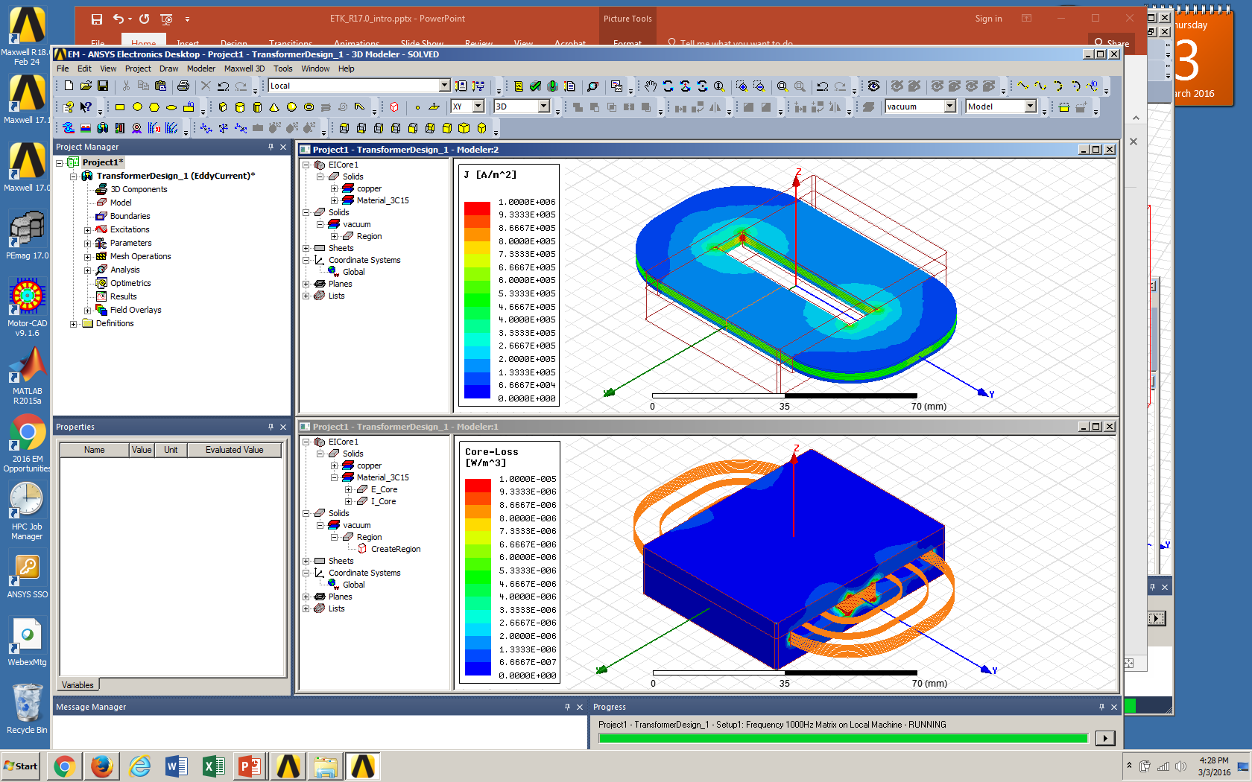
Maxwell Results - Plots
ACT will automatically create plots
MagJ, Ohmic Losses for Windings
MagB, Core Losses for the Core

Slide 18
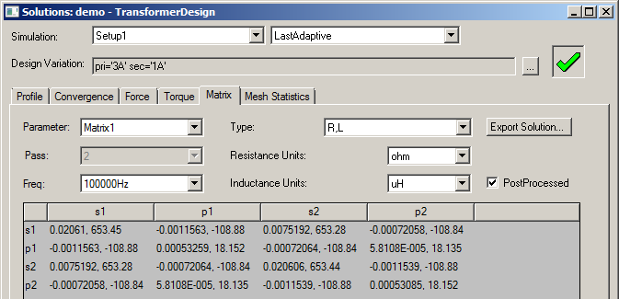
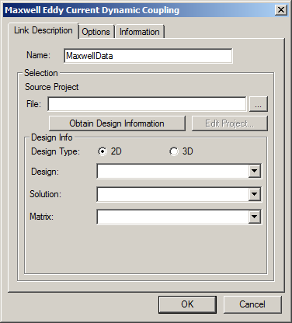
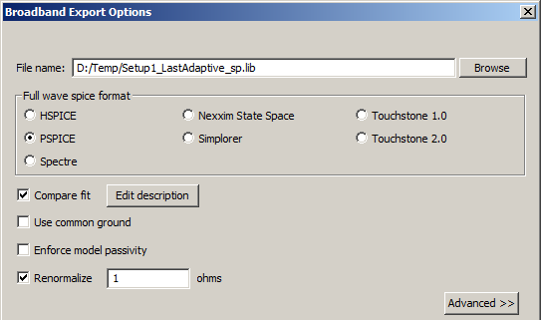
Maxwell Results – Matrix and Netlist
Impedance Matrix results at solved frequencies
Frequency dependent State Space model can be imported into Simplorer for circuit simulation using “Dynamic Eddy Current” link
Frequency dependent netlist model can also be exported to PSpice using Network Data Explorer
Right-click on Analysis / Setup1
In the NDE window, click on Export Broadband
Choose PSPICE (Renormalize to 1 ohm)
Maxwell to Simplorer
Maxwell to PSpice

Slide 19
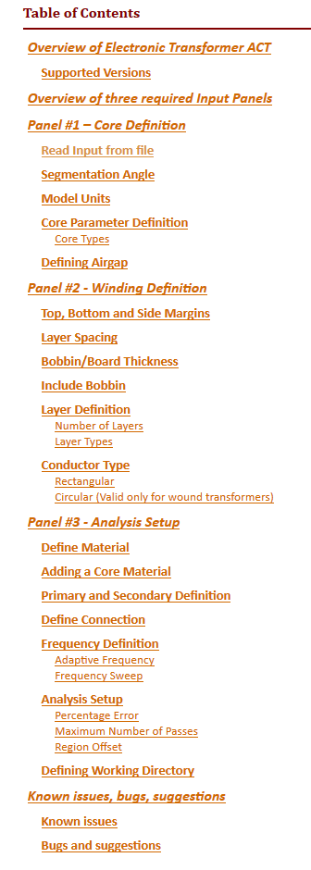
Help
Help contains information about settings for each step
Access with “Help” button on any ACT panel
It is suggested to read help before starting to work with ACT since this presentation is giving only a short overview of ACT

Slide 20
Issues and Contributions
We are glad to see contributors to this project. If you want to add transformer shapes, new materials or any other enhancement please join us on GitHub
Report any issue or provide feedback related to this app please
Open an issue on GitHub
Or contact:
maksim.beliaev@ansys.com
mark.christini@ansys.com
Copyright and Trademark Information
© 2020 ANSYS, Inc. All rights reserved. Unauthorized use, distribution or duplication is prohibited.

