Slide 1
ACT: Electronic Transformer 2021R1
Notes:
1

Slide 2
Copyright and Trademark Information
Copyright and Trademark Information
© 2018 ANSYS, Inc. All rights reserved. Unauthorized use, distribution or duplication is prohibited.
ANSYS, ANSYS Workbench, Ansoft, AUTODYN, EKM, Engineering Knowledge Manager, CFX, FLUENT, HFSS, AIM and any and all ANSYS, Inc. brand, product, service and feature names, logos and slogans are registered trademarks or trademarks of ANSYS, Inc. or its subsidiaries in the United States or other countries. ICEM CFD is a trademark used by ANSYS, Inc. under license. CFX is a trademark of Sony Corporation in Japan. All other brand, product, service and feature names or trademarks are the property of their respective owners.
Disclaimer Notice
THIS ANSYS SOFTWARE PRODUCT AND PROGRAM DOCUMENTATION INCLUDE TRADE SECRETS AND ARE CONFIDENTIAL AND PROPRIETARY PRODUCTS OF ANSYS, INC., ITS SUBSIDIARIES, OR LICENSORS. The software products and documentation are furnished by ANSYS, Inc., its subsidiaries, or affiliates under a software license agreement that contains provisions concerning non-disclosure, copying, length and nature of use, compliance with exporting laws, warranties, disclaimers, limitations of liability, and remedies, and other provisions. The software products and documentation may be used, disclosed, transferred, or copied only in accordance with the terms and conditions of that software license agreement.
Contains proprietary and confidential information of ANSYS, Inc. and its subsidiaries and affiliates.

Slide 3
Electronic Transformer Overview
What does the “Electronic Transformer ACT” do?
It automatically sets up a ready-to-solve Maxwell 3D Eddy Current design for planar magnetic components. Permeability is linear and frequency dependent. Steinmetz core loss coefficients are frequency dependent. A frequency dependent state-space model can be created for Simplorer (and Pspice) using Network Data Explorer.
What devices can it model?
It is intended for electronic ferrite core transformers and inductors in the 100kHz range (but NOT for oil-filled transformers in the 50-60Hz range).
How easy is it to use?
→ ACT consists of three input steps which can be setup in 10-15 minutes
Are any manufacturer libraries included?
Philips and Ferroxcube with 15 core shapes are included in the initial release.
How is the “Electronic Transformer ACT” different from PExprt?
The “Electronic Transformer ACT” is a script using only Maxwell 3D (PExprt uses both 2D and 3D). It provides only an FEA based solution (PExprt creates both analytical and FEA based) using pre-defined design inputs (PExprt totally creates designs). Litz and twisted wire cannot be considered in the ETK. Capacitance is not considered in the ETK unless a separate electrostatic design is created manually.

Slide 4
Electronic Transformer: What’s new?
Release 2021R1
Enabling thermal properties for Windings for further two-way coupling with thermal tools like Icepak and Fluent
Auto skin layers: if thickness of the conductor is less than 3 values of skin depth then ACT will automatically generate additional layers for mesher to capture eddy effects
Number of transformer windings (sides) is unlimited (now you can create as many sides as you have layers such as: Primary, Secondary, Tertiary, etc)
Create reports for leakage inductance. Auto report is setup to calculate Leakage between all windings (sides)
Excitation strategy is expanded. Now you can have a Voltage (or Current) winding instead of current sources
Create field overlays: Mag(J), Ohmic-Loss for windings and Mag(B), Core-Loss for the core
By default generates half of the model to reduce simulation time
Note: Due to added functionality .tab files from the older versions are not supported

Slide 5
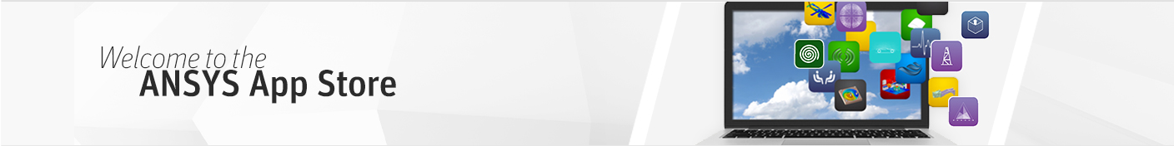
ACT App Store
https://catalog.ansys.com/
Great place to get started
A library of helpful applications available to any ANSYS customer
New apps added regularly
Applications made available in either binary format (.wbex file) or binary plus scripted format (Python and XML files)
Scripted extensions are great examples
Documentation and training materials available on the ANSYS Customer Portal: https://support.ansys.com/AnsysCustomerPortal/en_us/Downloads/ACT+Resources

Slide 6
Information
Please pay attention to paragraph 9 of the CLICKWRAP SOFTWARE LICENSE AGREEMENT FOR ACS EXTENSIONS regarding TECHNICAL ENHANCEMENTS AND CUSTOMER SUPPORT (TECS): “TECS is not included with the Program(s)”
Report any issue or provide feedback related to this app please contact:
maksim.beliaev@ansys.com
mark.christini@ansys.com

Slide 7
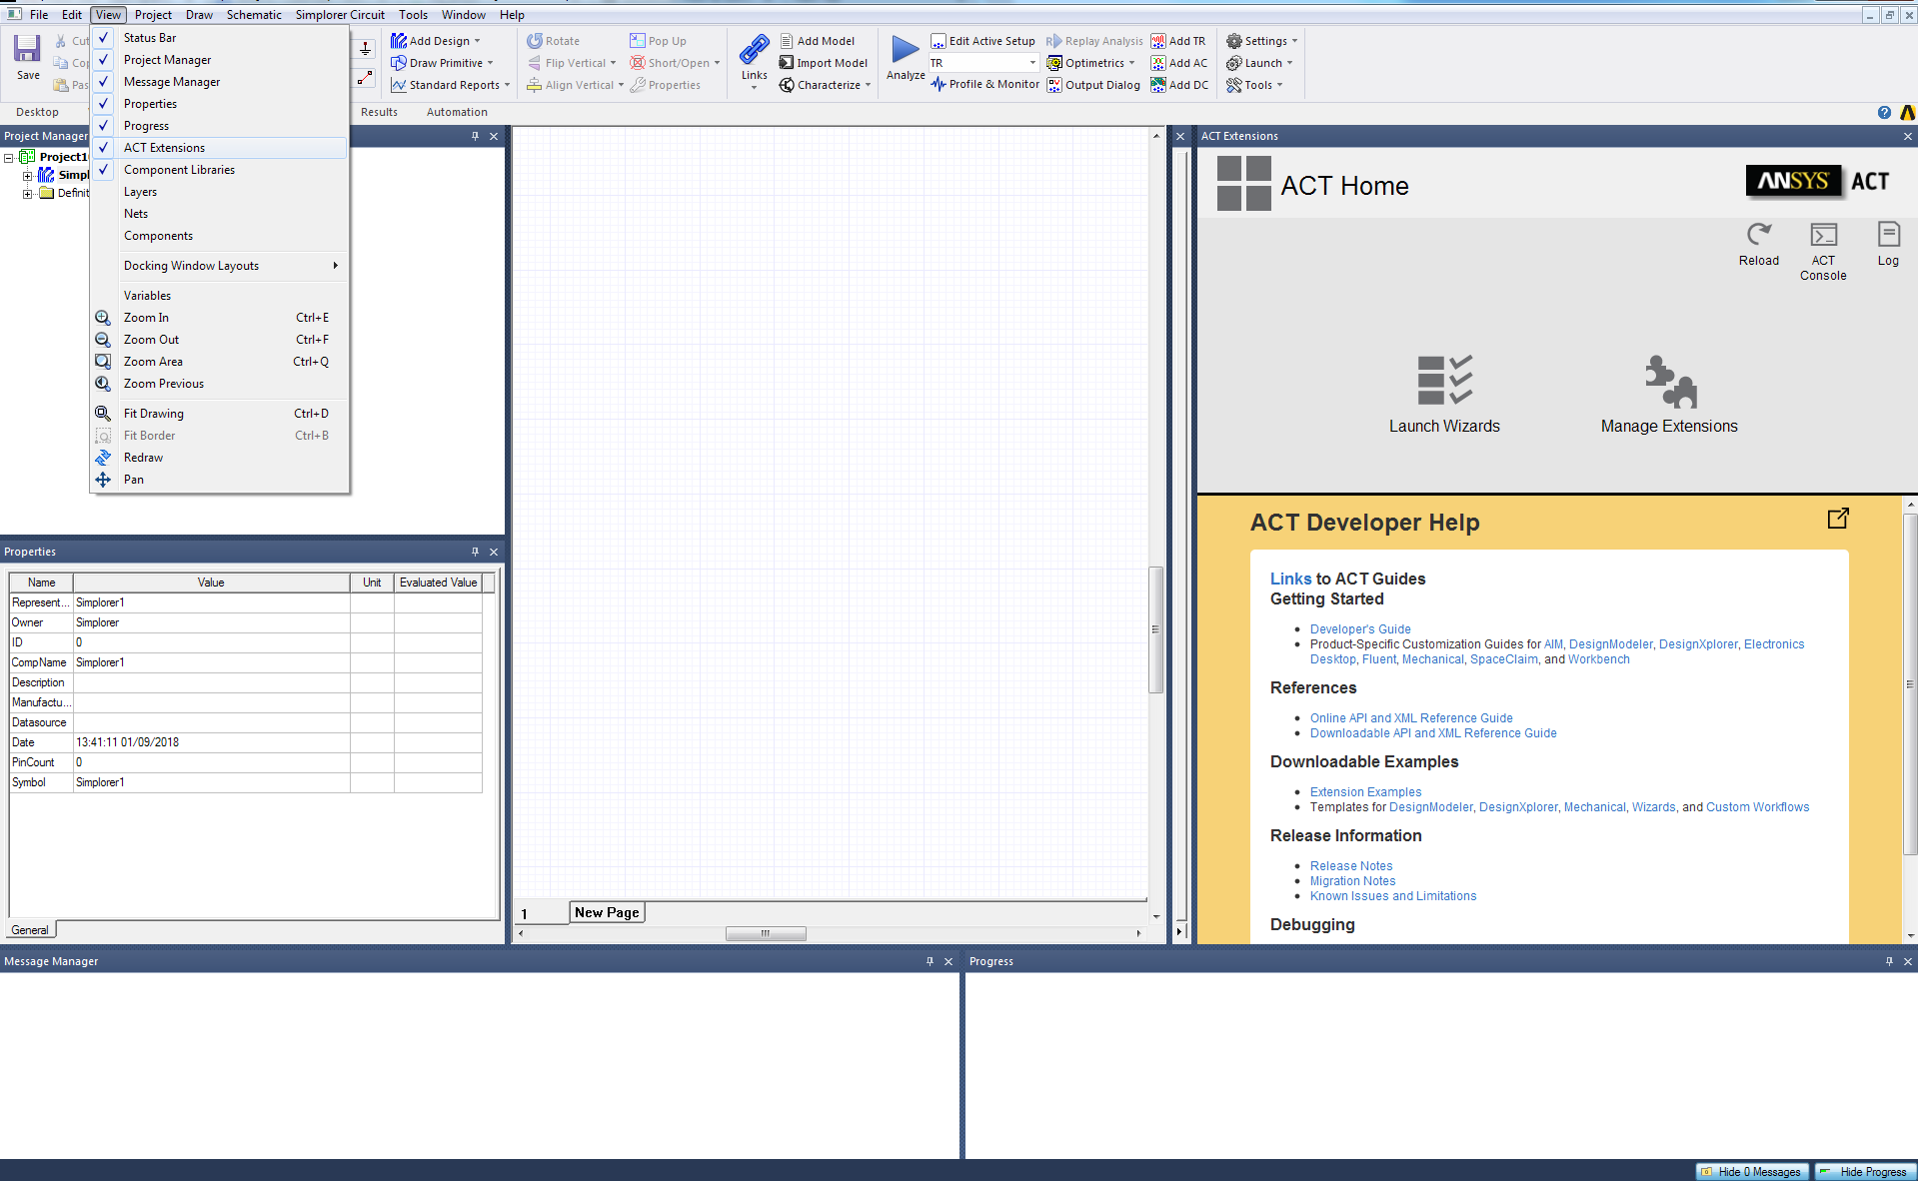
Install the Extension
To install extension:
Open Electronics Desktop and activate the ACT through
View -> ACT Extensions View → ACT Extensions
Then you be able to access the ACT Start Page as shown in the right figure.
Click on Manage Extensions, click on the “+” sign to install extensions, select the wbex file downloaded from the ANSYS ACT Application Store.

Slide 8
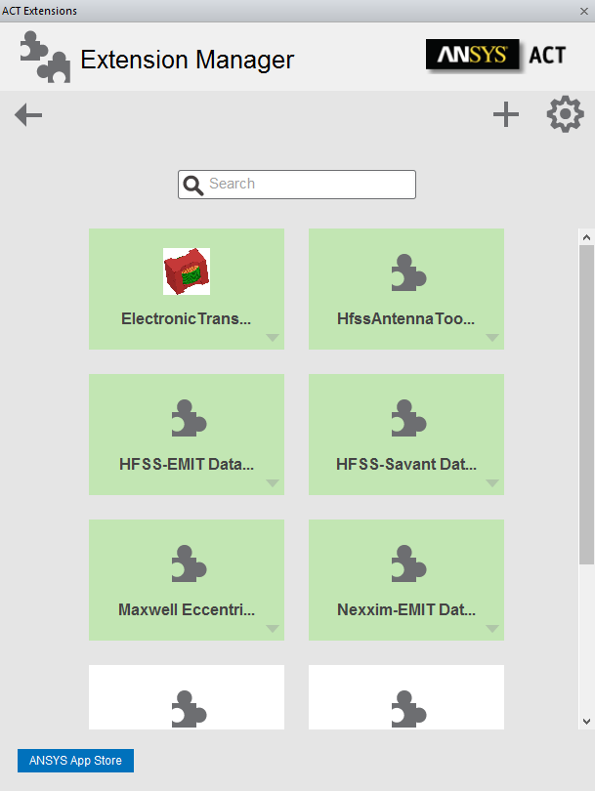
Install the Extension
After installing the extension, you will see the extension.
Import extension appears in the Extension Manager with a white background, which means it has been installed but not yet loaded. To load the extension, you can just simply click on it. If the extension is loaded successfully, the icon’s background should be green.
Now you can run ACT from Launch Wizard panel

Slide 9
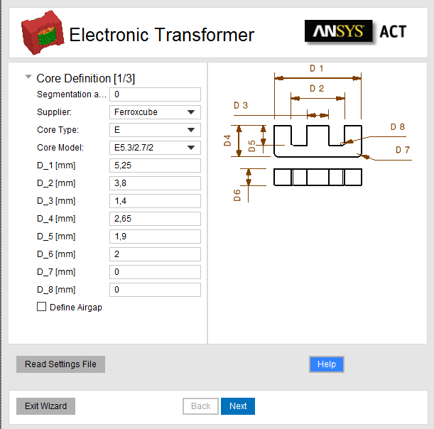
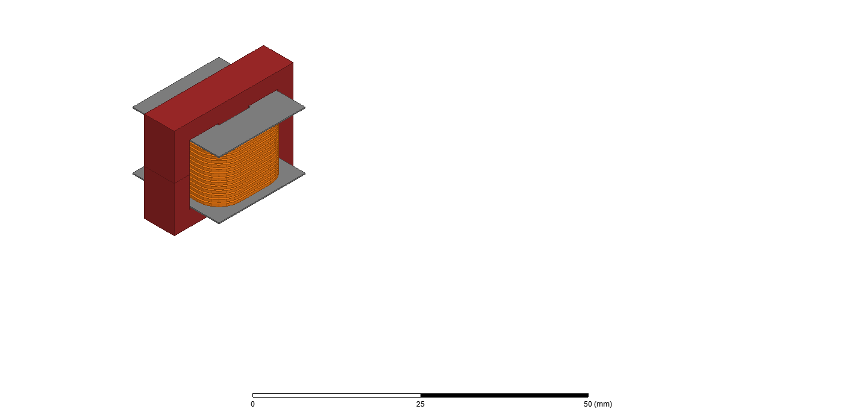
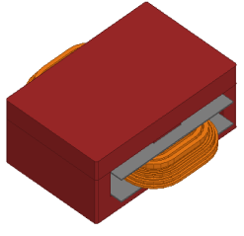
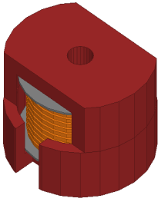
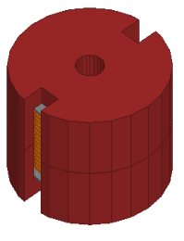
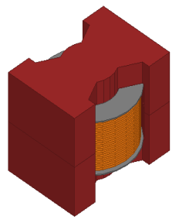
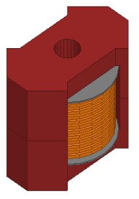
Input panel 1 of 3: Core Definition
Two options to set-up a transformer model:
Read input data from a previously recorded .tab text file
Create a totally new design
Select Supplier, Core Type, Core Model
15 available core shapes from Philips/Ferroxcube
Choose default dimensions or manually modify

Slide 10
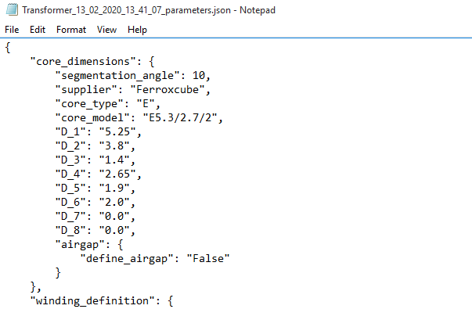
Recorded input file – used to recreate model in future
File is automatically recorded and saved in the Maxwell default project folder each time when analysis is setup
Input file can be re-run by selecting “Read Settings File” on the core definition input step (note Core Model box will remain unchanged)
File can also be manually modified in text editor to make changes in parameters before re-running
In example folder you can find demo files
Note: Due to added functionality .tab files from the older versions are not supported

Slide 11
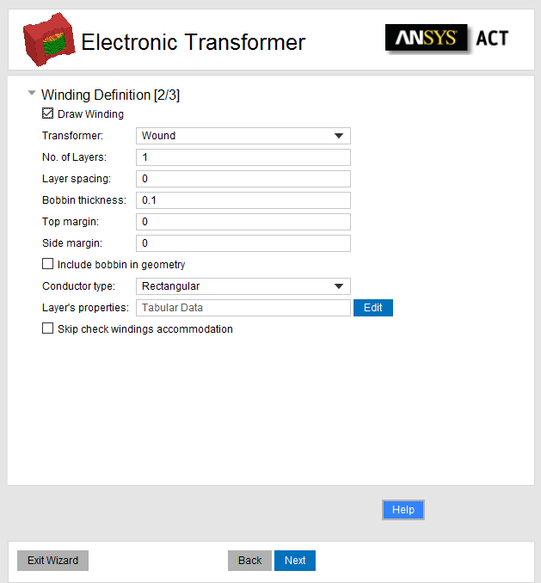
Input panel 2 of 3: Winding Definition
Transformer type: Wound/Planar
Number of Layers, Layer Spacing, Bobbin/Board Thickness, Top/Bottom Margin size, Side Margin size
Layer Type: Top Down or Concentric
Conductor Type: Rectangular or Circular (only for wound)
For each layer: Conductor Width, Conductor Height, Number of Turns, and Insulation Thickness/Turn Spacing

Slide 12
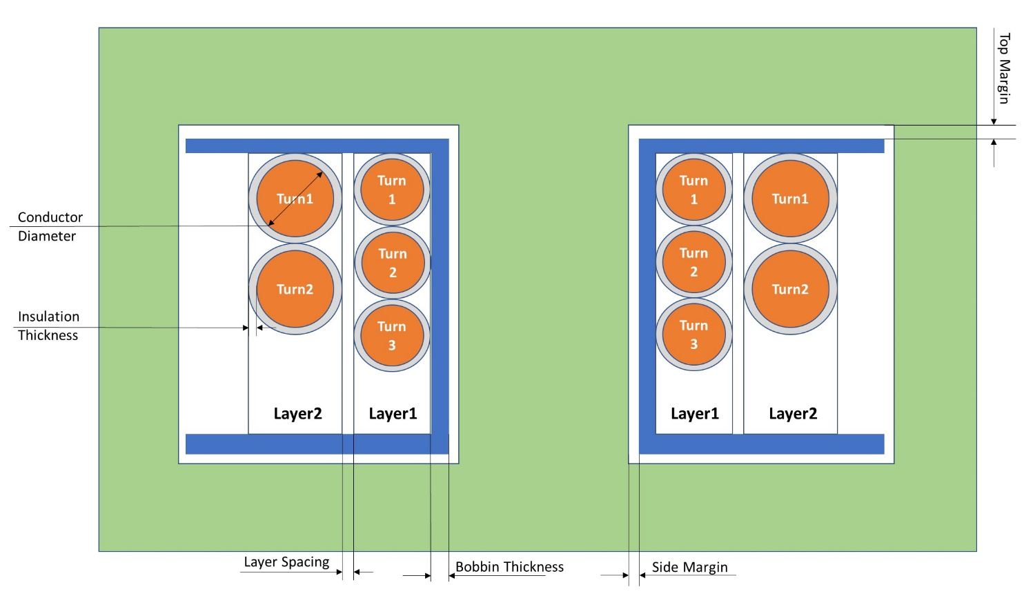
Wound Transformer

Slide 13
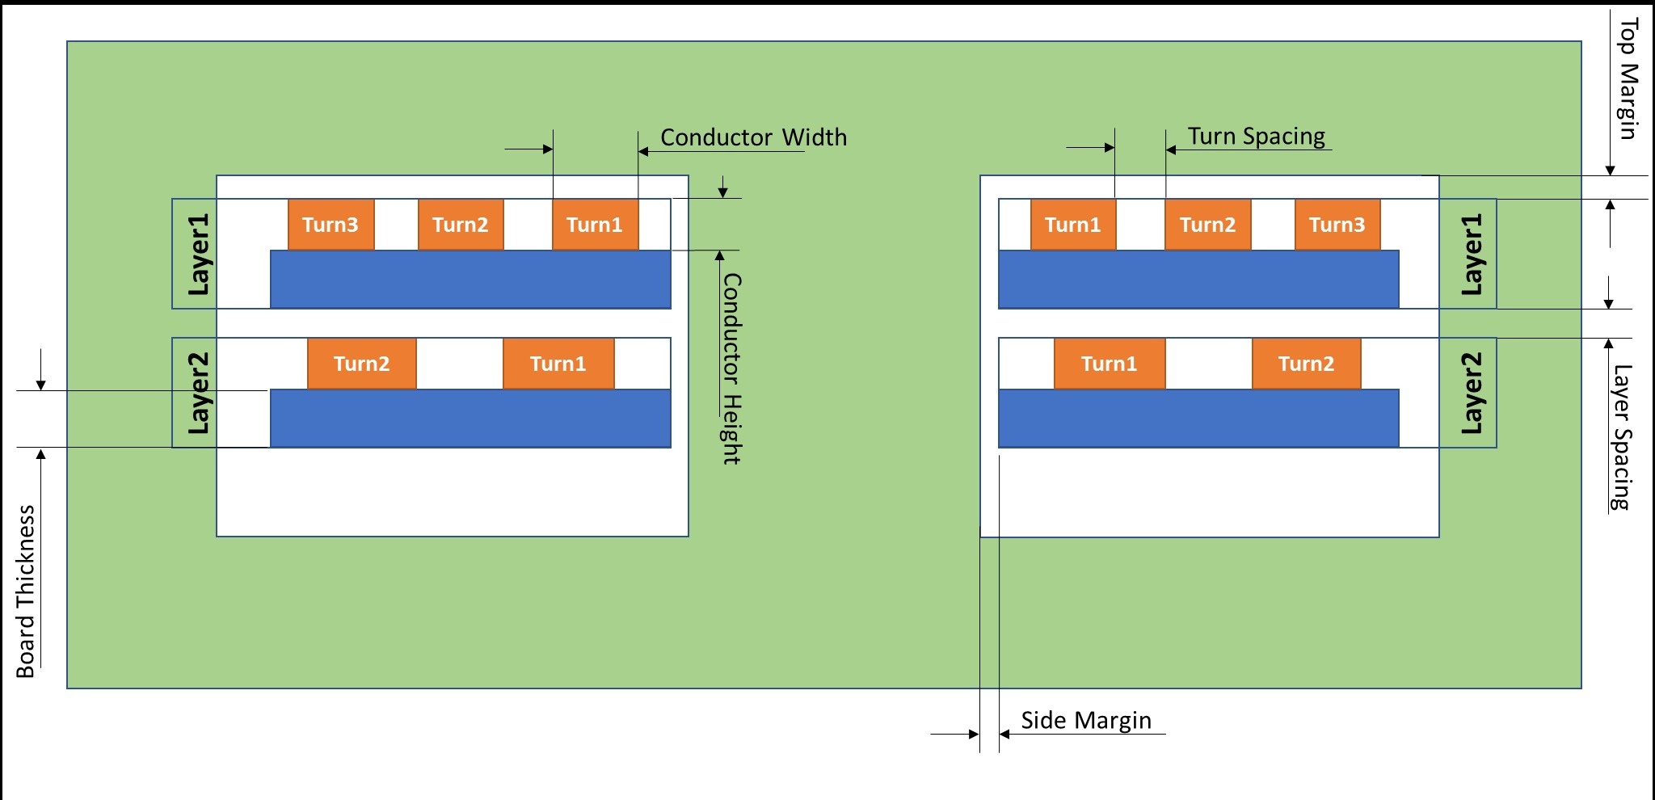
Planar Transformer

Slide 14
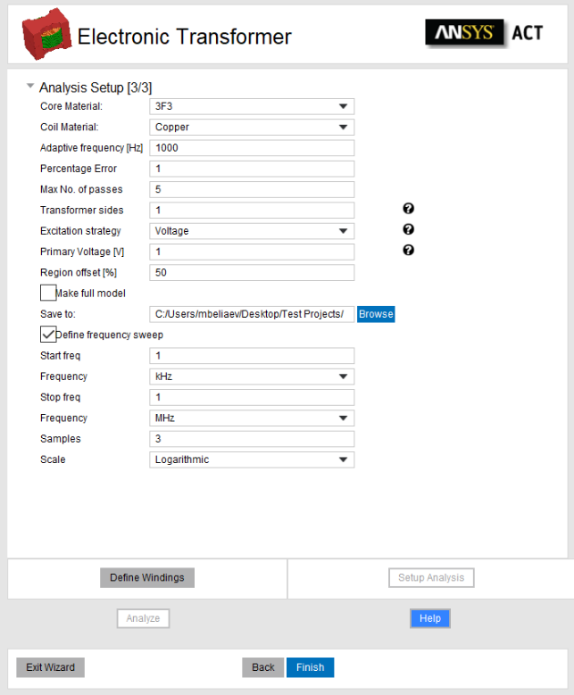
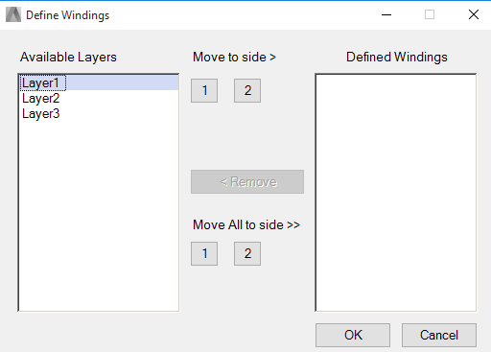
Input panel 3 of 3: Analysis Setup [Part 1]
Define Core Material and Coil Material
Define Primary and Secondary Windings
Define number of transformer sides (eg 2 for Primary, Secondary)
Select Excitations strategy for Primary side (Voltage or Current source) and set value of resistance for 2, 3, etc sides which would be defined as voltage winding
Click Define Windings to assign each layer to the Winding

Slide 15
Input panel 3 of 3: Analysis Setup [Part 2]
Define adaptive frequency, frequency sweep, % error and max number of passes
Set value of regions offset
Select Path where to Save the project
Check Make Full Model to generate full model (default is half of the model)
Setup Analysis to create design OR Analyze to setup and solve design
Note: if thickness of the conductor is less than 3 values of skin depth then ACT will automatically generate additional layers for mesher to capture eddy effects

Slide 16
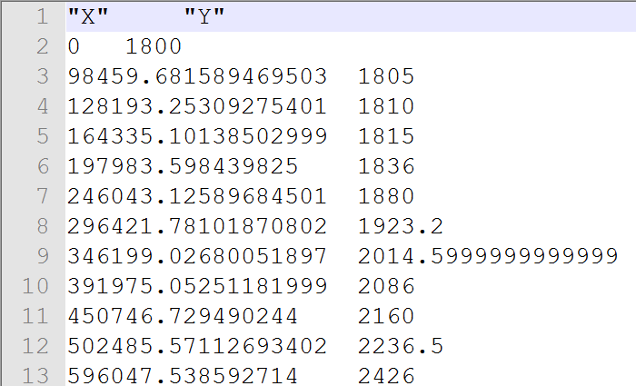
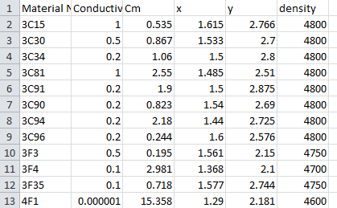
Adding a New Core Material
In order to add a new core material, users can follow below steps
Make test run of the ACT to create geometry, this will create file folder Materials and file matdata.tab in personalLib folder defined in Electronics Desktop
Create a tab file for frequency versus permeability for the required core. Sheet Scan option available in Maxwell can help for creation of the tab fil.
Name the tab file same as the name of the material to be added
Place the tab file in that folder …\PersonalLib\Materials
Open “matdata.tab” file in Excel
Add a row for the material to be added and specify name and other material properties
Save the file with same name.
Once this is done, the material should be available for selection for next run of the ACT
frequency versus permeability
matdata.tab

Slide 17
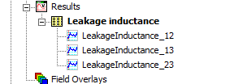
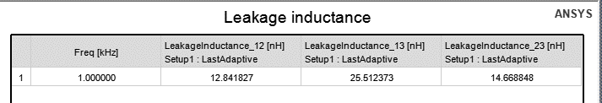
Maxwell Results – Leakage Inductance
ACT will automatically generate Leakage Inductance report for you. It will calculate values between all sides.
For example for 3 sides (primary, secondary, tertiary) you will get a report frequency vs all Leakage values:

Slide 18
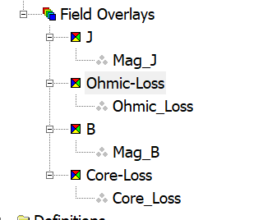
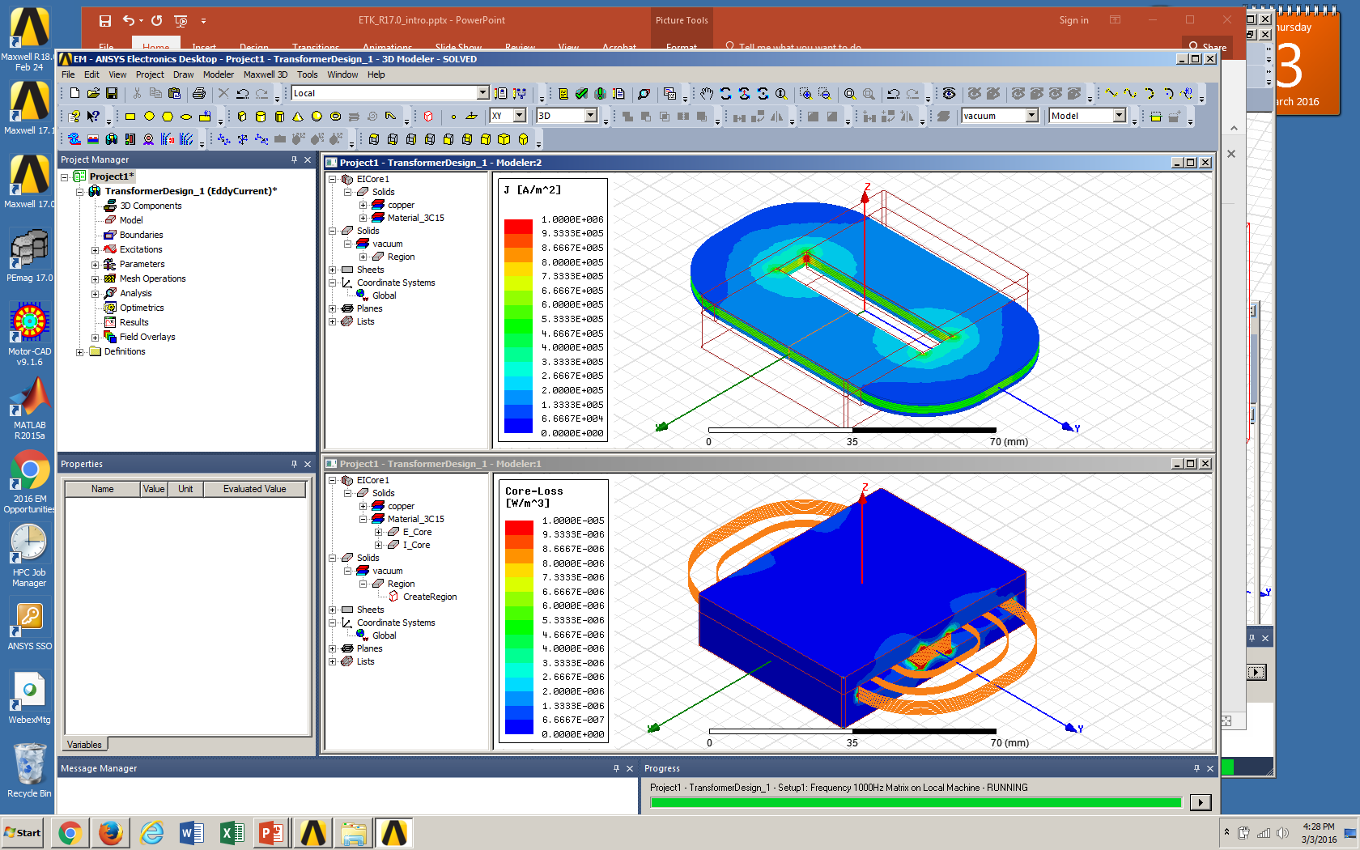
Maxwell Results - Plots
ACT will automatically create plots
MagJ, Ohmic Losses for Windings
MagB, Core Losses for the Core

Slide 19
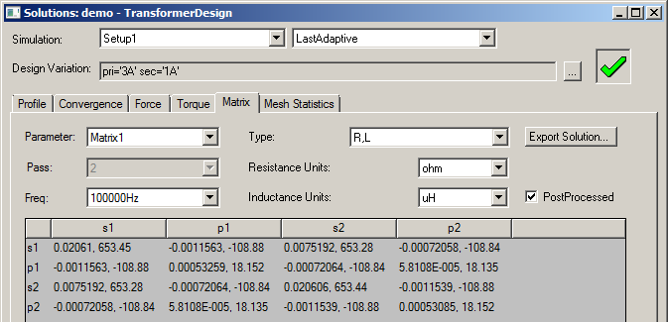
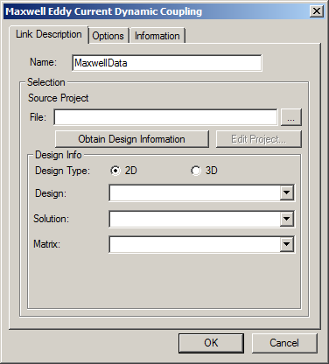
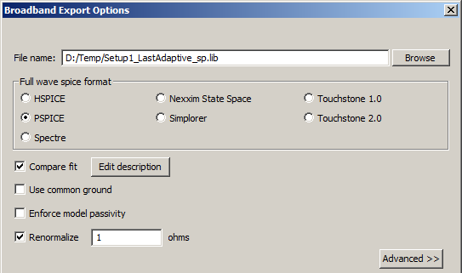
Maxwell Results – Matrix and Netlist
Impedance Matrix results at solved frequencies
Maxwell to Simplorer
Frequency dependent State Space model can be imported into Simplorer for circuit simulation using “Dynamic Eddy Current” link
Frequency dependent netlist model can also be exported to PSpice using Network Data Explorer
Right-click on Analysis / Setup1
In the NDE window, click on Export Broadband
Choose PSPICE (Renormalize to 1 ohm)
Maxwell to PSpice

Slide 20
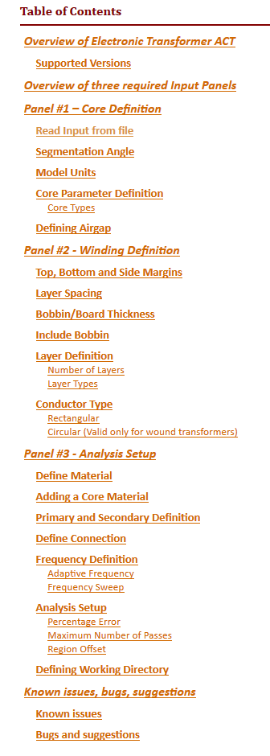
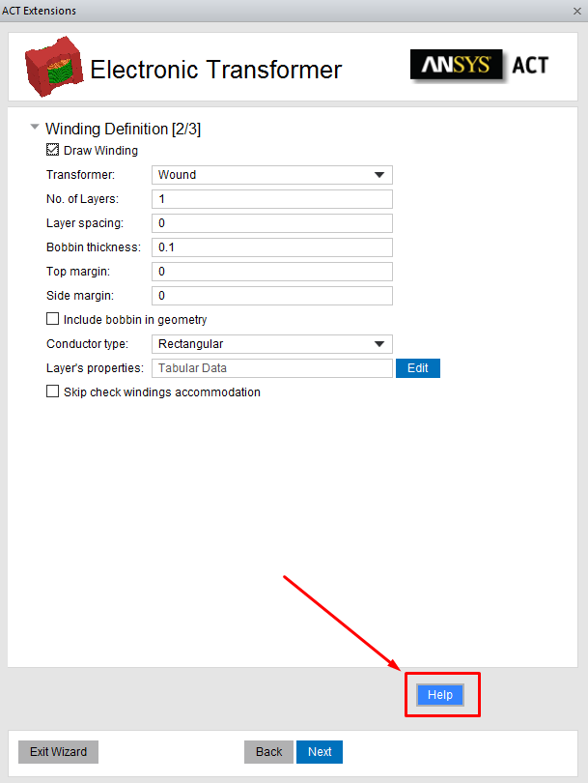
Help
Help contained exhaustive information about settings on each step. It is recommended to read help before starting to work with ACT since this presentation is giving only a short overview of ACT
Accessed with “Help” button on any ACT panel

Slide 21


Thank you
Maksim Beliaev maksim.beliaev@ansys.com
Mark Christini mark.christini@ansys.com
Copyright and Trademark Information
© 2018 ANSYS, Inc. All rights reserved. Unauthorized use, distribution or duplication is prohibited.

