Slide 1
Introduction of data & Research question & Research field
2025/01/05
yixuan

Slide 2
Data introduction
Data Type
Household financial data
Data Description
The Household Survey is a comprehensive statistical study that:
Sample size: Approximately 10,000 households Japanese nationwide selected
Survey scope: Monthly collection of household income, expenditure to different categories.
Other information: single and family householders are separated; part of income are published.
１、https://www.stat.go.jp/data/kakei/index3.html
２、https://www.e-stat.go.jp/stat-search/files?page=1&layout=datalist&toukei=00200561&tst[…]30001&tclass2=000000330004&tclass3=000000330005&tclass4val=0

Slide 3
Sample data description
Each family contains 3.2 people
Big cities contains 70% to 80% percentile national wide (big city means population size over 50,000)
For example, in 10,000 families, around 4000 (40%) families are from Tokyo and Osaka
The average householder age : 50 years old

Slide 4
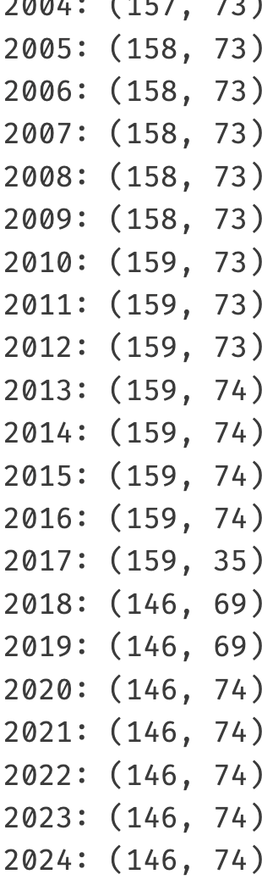
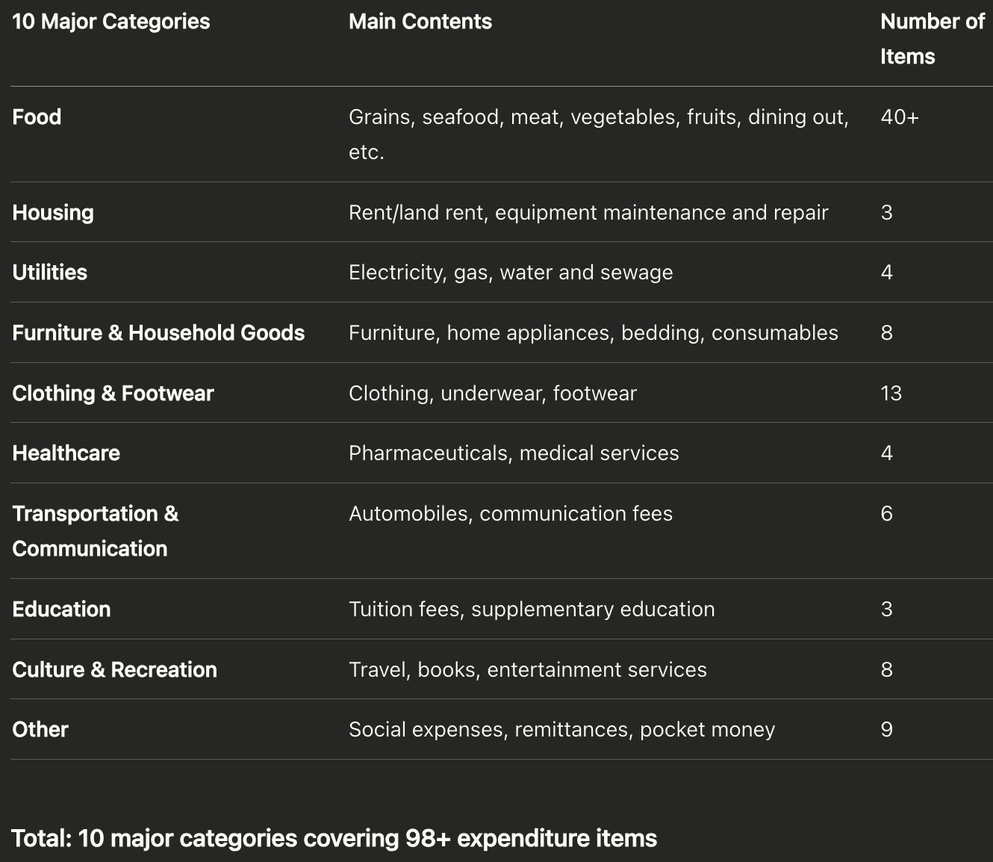
Categories been statisticed continuously:

Slide 5
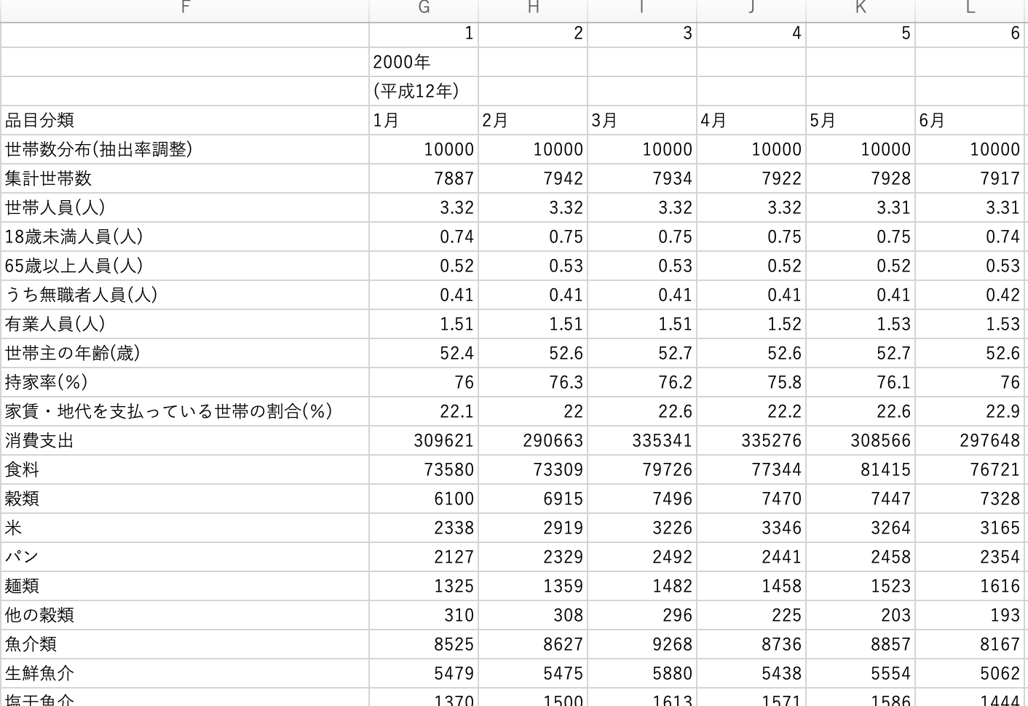
What the data looks like
Month
The statistical information of the sample:
Population size per family;
Population <18;
Population > 65;
Jobless rate;
Percentage of holding a house…
Main category expenditure
Total expenditure;
Food expenditure;
Rice;
Breads;
Noodles;
Fishes…

Slide 6
About the cooperation
Project Overview
Topic: Japanese Household Expenditure Pattern Analysis
Status: Early exploratory stage
Data: National Household Survey (10,000 households, 10 expenditure categories, 98+ items)
Collaboration Goals
Exchange methodological insights with European researchers
Develop joint publication strategies
Strengthen international research network for future funding applications
Working Format
Bi-monthly online meetings (Zoom/Teams)
Collaborative writing and analysis

Slide 7
Team members:
Research Team
1. Dr. Yohei Shida (Corresponding Author)
Assasian Professor, Tsukuba University
Former Takayasu Lab PhD (graduated 2023)
Expertise: Social physics, human mobility
Google scholar: https://scholar.google.com/citations?user=Ef3wukEAAAAJ&hl=en
2. Dr. Hajime Koike
Associate Professor, Kyoto University
Former Takayasu Lab PhD (graduated mid-2024)
Expertise: Non-linear theory, mathematical modeling
ResearchGate: https://www.researchgate.net/profile/Hajime-Koike
3. Yixuan (PhD Candidate)
Tokyo University of Science, Takayasu Lab
Expertise: Urban transportation, statistical physics applications

Slide 8
Initial Research Direction
Analyze structural changes in household expenditure patterns over time
Identify correlations and anomalies between spending categories
Apply time series analysis and statistical physics methods
。。。。

Slide 9
Purpose
Cosality and correlation
Question
Prediction (FLSPI)
AI-based social politics, demographic problem

