Slide 1
Entrepreneurship and Business Development
By Gazu G.(MBA)
Bule hora University
College of Business and Economics
Department of Management

Slide 2

Chapter Three
Business Formation

Slide 3
Introduction
A business formation deals with the formalization and actual implementation of business ideas in to practice.
In today’s economic development/transformation, small businesses are:
  creating new jobs even as large businesses continue eliminating jobs
  more flexible than large ones in the products and services they offer.

Slide 4
Forms of Business (A Short Explanation)
Proprietorship
  Form of business with single owner who has unlimited liability, controls all decisions, and receives all profits.
Partnership:
  Two or more individuals having unlimited liability who have pooled resources to own a business
Corporation
  Separate legal entity that is run by stockholders having limited liability

Slide 5
These three basic legal forms are compared with regard to
CONT…
ownership
liability
start-up costs
continuity
transferability of interest
capital requirements
management control
distribution of profits
attractiveness for raising capital.

Slide 6
The Concept of Small Business Development
Specifying size and standard to define small business is necessarily arbitrary/subjective, because people adopt different standards for different purposes.
Based on socio-economic conditions, countries define small business differently.
But all may use size and economic criteria as a base to define small business

Slide 7
Small businesses defined based on criteria of:
Definition of MSEs
Size refers to the scale of operation and it include:
  number of employees
  volume and value of sales turnover
  asset size, and volume of deposits
  total capital investment
  volume/value of production,
  a combination of the stated factors
  2. Economic
  Market Share,
  Independence, and
  Personalized Management.
  Geographical Area of Operation
  Technology

Slide 8
Role/Importance of MSEs in Developing Countries
  Large Employment Opportunities
  Economical Use of Capital
  Removing Regional Imbalance
  Equitable Distribution of Wealth and Decentralization of Economic Power
  Shape unregulated Growth of Large
  Dispersal over Wide
  Higher Standard of Living
  Mobilization of Locals Resources/Symbols of National Identity
  Innovative and Productive /Simple Technology
  Less Dependence on Foreign Capital/ Export Promotion

Slide 9
Classification of Micro and Small Enterprises
In Case of Manufacturing Enterprise (Manufacturing, Construction and Mining):
  A Micro Enterprise is one in which the investment in plant and machinery (total asset) does not exceed Birr 100, 000 (one hundred thousand); and operates with 5 people including the owner.
  Small Enterprises is one in which the investment in plant and machinery (a paid up capital of total asset) of Birr 100, 000 (one hundred thousand) and not more than Birr 1.5 million; and operates with 6-30 persons.

Slide 10
CONT…
In Case of Service Enterprise (Retailing, Transport, Hotel and Tourism, ICT and Maintenance):
  A micro enterprise is one with the values of total asset is not exceeding Birr 50,000 (fifty thousands); and operates with 5 persons including the owner of the enterprise.
  Small Enterprises is one in which the total asset value or a paid up capital of Birr 100, 000 (one hundred thousand) and not more than Birr 1.5 million; and operates with 6-30 persons.

Slide 11
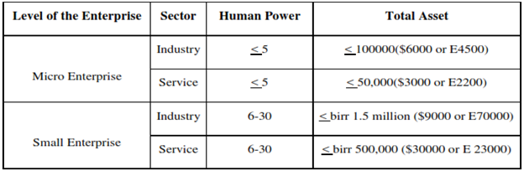
CONT….
More clearly, the improved definition of MSE is presented in the table below.

Slide 12
Priority Sectors and Sub-Sectors for MSEs Engagement In Ethiopia
1. Manufacturing sector
Textile & Garments
Leather & leather Products
Food & Beverage
Metal works & Engineering
Wood works & ornaments
Agro-processing
2. Construction
Sub-contracting
Building materials
Traditional mining
Cobble stone
Infrastructure sub contract
Prestigious goods

Slide 13
CONT…
3. Trade
Whole sale
Retailer
Raw materials supply
4. service
Transport service
Café and Restaurants
Store service
Tourism service
Canning/packing
Management service
Municipality service
Product design
Maintenance etc.

Slide 14
CONT…
5. Urban Agriculture
Modern livestock raring
Bee production
Poultry
Modern forest development
Vegetables and fruits
Modern irrigation
Animal food processing

Slide 15
Levels of MSEs in Ethiopia
Start-up:- It is a level where an enterprise begins production and service under legal framework or legal entity.
Growth Level:- when an enterprise become competent in price, quality and supply and profitable using the support provided.
Maturity Level:- when an enterprise able to be profitable and invest further by fulfilling the definition given to the sector and using the support provided.
Growth- Medium Level:- when it enabled to be competent in price, quality and supply using the support given to the level.

Slide 16
Setting up Small Scale Business
Steps for Setting up the Entrepreneurial Venture
setting up of a small new enterprise is a very challenging as well as a rewarding task.
The entrepreneurial process of launching a new venture can be divided into three key stages of:
  Discovery, Evaluation and Implementation.
These can be further sub-divided into seven steps as shown below:

Slide 17
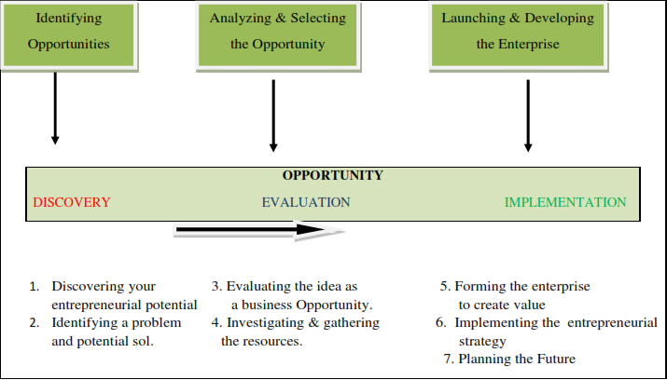
CONT….

Slide 18
1. Discovery
is to identify opportunities that may form the basis of an entrepreneurial venture.
It requires creative thinking to indentify issues that can benefit from an entrepreneurial vision.
Step 1 Discovering your entrepreneurial potential
  is to know more about your personal resources and attributes through some self evaluation
Step 2 Identifying a problem and potential solution
  a new venture has to solve a problem and meet a genuine need.

Slide 19
2. Evaluation
selected an idea worthy of further detailed investigation.
Step 3 Evaluating the idea as a business opportunity
  find out information about the market need.
  Investigate the feasibility of the proposed solution (technically, economically, socially, and legally).
Step 4 Investigating and gathering the resources
  How will the product/service get to market?
  How will it make money? What resources are required?

Slide 20
3. Exploitation
identified an opportunity is required to launch it.
to make the final preparations and launch it into the market.
Step 5 Forming the enterprise to create value
  set up a business entity and protect any intellectual property.
  launch the venture in a way that minimizes risk and maximizes returns.
Step 6 Implementing the entrepreneurial strategy
  activate the marketing, operating, and financial plans.
Step 7 Planning the future
  look ahead and visualize where you want to go.

Slide 21
Entrepreneurship vs. Environment
As the economies are getting internationally integrated, for an analysis of the environment of entrepreneurship you would be required to develop an understanding of macroeconomic and industry/sector specific factors.
The macro environment of an entrepreneur consists of the political, technological, social, legal and economic environments.
The purpose of industry analysis is to determine what makes an industry attractive- this is usually indicated either by above normal profits or high growth rates.
For such analysis one should:

Slide 22
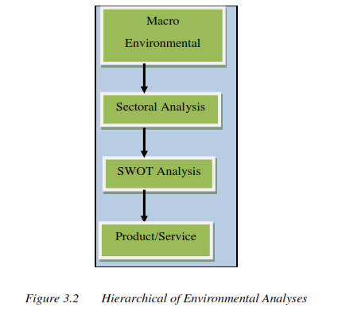
CONT….
  study the history of the industry, the future trends, new products developed in the industry, forecasts made by the government or the industry.
  study the existing or potential competition, threat of substitutes and entry barriers.

Slide 23
Small Business Failure and Success Factors
1. Small Business Failure Factors
MSEs failure attributing by many factors: External factors and Personal (internal) factors
    A. External factors
    Business cycles
    Fluctuating
    Interest rate
    Interrupted supplies
    Labor market
    Inflation
    Government regulations
    Unstable financial markets

Slide 24
CONT…
B. Personal (internal) factors
  Inexperience
  Arrogance
  Mismanagement
      Over investment on fixed assets
      Poor financial and inventory control
      Poor business philosophy
      Lack of planning

Slide 25
CONT…
2. Small Business Success Factors
  Conducive Environment
      Political Climate
      The Economic Environment
      Technology
      Socio-Cultural Environment
  Adequate Credit Assistance
  Markets and Marketing Support

Slide 26
Main Supporting Packages for MSEs Development in Ethiopia
When entrepreneurs are deciding to involve and develop MSEs in Ethiopia, they are more likely entitled with some supporting packages.
  awareness creation about the sector
  provision of legal services, to form legal business enterprises
  providing Technical and business management training
  financial support based on personal saving, 20/80 (the beneficiaries are save 20% and the MFIs provide Loan 80% of the projects)
  facilitate working premises
  industry extinction services and
  BDS provision; bookkeeping and audit services.

Slide 27
Problems of Small Scale Business in Ethiopia
Small scale industries have not been able to contribute substantially as needed to the economic development particularly because of:
    financial,
    production
    marketing problems
    Know how

Slide 28
Chapter Four
Product/Service Development

Slide 29
INTRODUCTION
In Entrepreneur’s business, product/service development is the term used to describe:
    the complete process of bringing a new product or service in the market
    it's an ongoing practice in which the entire business is looking for opportunities as new products provide growth promise to businesses that allow them to strengthen their market position.

Slide 30
Con….
The new product development process involves:
        The idea generation
        Product design and detail engineering
        Market research and marketing analysis.
Factors makes new product development a critical activity in most businesses are:
        Intense global competition
        Short product and technology lifecycles
        Unpredictable consumer buying patterns
        Possible market stagnation

Slide 31
The Concept of Product/Service
Organization's success is dependent on customer satisfaction and delight and achieved through:
    the development of product and service, which have all attributes required by the customer.
A success product or services do not only have an attractive package design but should be also able to provide robust performance.
Thus, product design must be:
    practical enough for production
    powerful enough to provide a competitive advantage.

Slide 32
Product/Service Development Process
Once the opportunity is selected and a business model has been designed
        the next step is to develop a commercial version of the opportunity.
One of the essential characteristics of a successful business is
        exemplified by its ability to continuously and rapidly develop new or improved versions of existing products that deliver values more than customers expect.

Slide 33
Con….
Product development is the process through which companies:
      react to market signals
      respond to changes in customer demand
      adopt new technologies
      foray into new areas
      ensure continuous growth
      core process in achieving strategic objectives
      renewal of the company business model
      deterring competition from displacing the company from its market position.

Slide 34
Con….
Product/service development process is part of the overall new-venture creation process.
Even though there are many models that advocate what the product/service generation process should look like, for this purpose we shall adopt four distinct stages.
      Idea Generation
      Incubation
      Implementation
      Diffusion

Slide 35
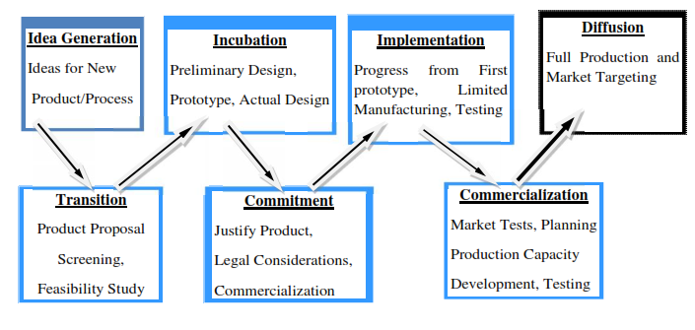
Con….

Slide 36
Con….
1. New Idea Generation
    It is search for ideas.
    Sources of ideas
      Consumers, existing products and services, distribution channels, the federal government and research and development.
2. Idea Screening
    To lessen the number of ideas to few vital/valuable ideas.
    Written down and reviewed each week by an idea committee into three groups.
      Promising Ideas, Marginal Ideas and Rejects

Slide 37
Con….
3. Concept Development and Testing
Attractive ideas must be refined into fast able product concepts since people do not purchase ideas but they buy concepts.
Any product idea can be turned into several product concepts. The questions asked probably include:-
      Who will use the product?
      What benefits should the product provide?
      When will people consume the produced
Concept Testing: calls for testing product concepts with an appropriate group of target consumers/customers, and then getting the consumers’ reactions.
At this stage, the concepts can be in words or picture description.

Slide 38
Con….
4. Marketing Strategy Development
The marketing strategy plan consists of three parts:
      Market size, structure, behavior
      Planned price, distribution strategy, and marketing budget of the 1st year
      Long run sales and profit goals, marketing mix strategy.
5. Business Analysis
  It is evaluating the proposal’s business attractiveness.
  Management needs to prepare sales, cost and profit projections to determine whether they satisfy the company's objective or not.

Slide 39
Con….
6. Product Development
If product concept passes the business test, it moves to R&D or engineering to be developed one or more physical version of the product concept.
Its goal is to find a prototype that the consumers/customers see as embodying the key attribute described in the product concept statement,
7. Market Testing
After management is satisfied with the products’ functional and psychological performance the product is ready to be dressed up with the brand name.

Slide 40
Con….
8. Commercialization
When (Timing): In commercializing, market entry timing is critical.
If the company hears about a competitor nearing the end of its development work, it will face three choices.
  First Entry.
  Late Entry Strategy- which has three advantages include:
      The competition will have borne the cost of educating the market;
      The competing product may reveal fault that the late entrant can avoid; and
      The company can learn the size of the market.

Slide 41
Intellectual Property Protection
Intellectual property is a legal definition of:
      ideas
      Inventions
      artistic works
      other commercially viable products
Intellectual property Includes:
      patents
      trademarks
      copyrights
      trade secrets represents

Slide 42
1. Patents
Invents a new thing or improves an existing invention.
A patent is the exclusive right of the inventor to enjoy the benefits resulting' from the possession of the patent.
Forms of patent :
    Utility Patent: protects any new invention or functional improvements on existing inventions.
    Design Patent: protects the appearance of an object and covers new, original, ornamental, and unobvious designs for articles of manufacture.

Slide 43
What Can Be Patented Then?
Processes
  Methods of production, research, testing, analysis, technologies with new applications.
Machines
  Products, instruments, physical objects.
Manufactures
  Combinations of physical matter not naturally found.
Composition of matter
  Chemical compounds, medicines, etc.

Slide 44
2. Trademarks
A trademark may be:
  a word, symbol, design, or some combination of such,
  it could be a slogan or even a particular sound
It identifies the source or sponsorship of certain goods or services.

Slide 45
3. Copyrights
Copyright is a right given to prevent others from printing, copying, or publishing any original works of authorship.
Copyrights provide exclusive rights to creative individuals for the protection of literary or artistic productions.
It protects original works of:
  authorship including literary, dramatic, musical.
  artistic works, such as poetry, novels, movies, songs, computer software, and architecture.

Slide 46
The Intellectual Property System in Ethiopia
Ethiopia became a party to the convention establishing the world Intellectual Property Organization (WIPO) in February 1998
some time the Country had joined the Nairobi Treaty on the Protection of the Olympic Symbol in 1981.
It is a member of the Treaty establishing the Common Market for Eastern and Southern Africa (COMESA) which was formed in 1994, the Partnership Agreement between members of the African, Caribbean and Pacific (ACP) Group of States and the European Union (EU).

Slide 47
Con….
The Ethiopian Government established the Ethiopian Intellectual Property Office in the year 2003.
The existing laws and directives in Ethiopia in the field of Intellectual Property (IP) are:
      The Patent Proclamation and the Implementing Regulation
      The Copyright and Related Rights Proclamation
      The Trademark Registration Directive.

Slide 48
Patent proclamation
According to the proclamation in order to be granted a patent, an invention must fulfill three conditions-
    it must be new
    It should be capable of industrial application
    It must be "non-obvious”
The duration of a patent is 15 years which may be extended for a further period of five years if proof is furnished that the invention is properly worked in Ethiopia.

Slide 49
Con….
The proclamation excludes the following from patentability:-
  Inventions contrary to public order or morality
  Plant or animal varieties or essentially biological processes for the production of plants or animals
  Schemes, rules or methods for playing games or performing commercial and industrial activities and computer programs
  Discoveries, scientific theories and mathematical methods
  Methods for treatment of the human or animal body by surgery or therapy as well as diagnostic methods practiced on the human or animal body.

Slide 50
Trademark Directive
Is issued in the country in 1986 with the following objectives in that it helps:-
To centrally deposit trademarks which are used by local and foreign enterprises to distinguish their goods or services;
To distinguish the products or services of one enterprise from those of other enterprises and prevent consumers from being victims of unfair trade practices;
To provide information on trademark ownership and right of use when disputes arise between parties;
To provide required information on trademarks to government and individuals;
Protection is granted after publication of cautionary notice;

Slide 51
Proclamation Copyright
Is issued in 2004 and The Proclamation gives protection to:
    Works of authors who are nationals of or have their habitual residence in Ethiopia;
    Works first published in Ethiopia; or works first published in another country and published within thirty days in Ethiopia;
    Audio-visual works whose producer has his headquarter or habitual residence in Ethiopia; and
    Works of architecture erected in Ethiopia and other artistic works incorporated in a building or other structure located in Ethiopia.

Slide 52
THANK YOU !!

