Slide 1
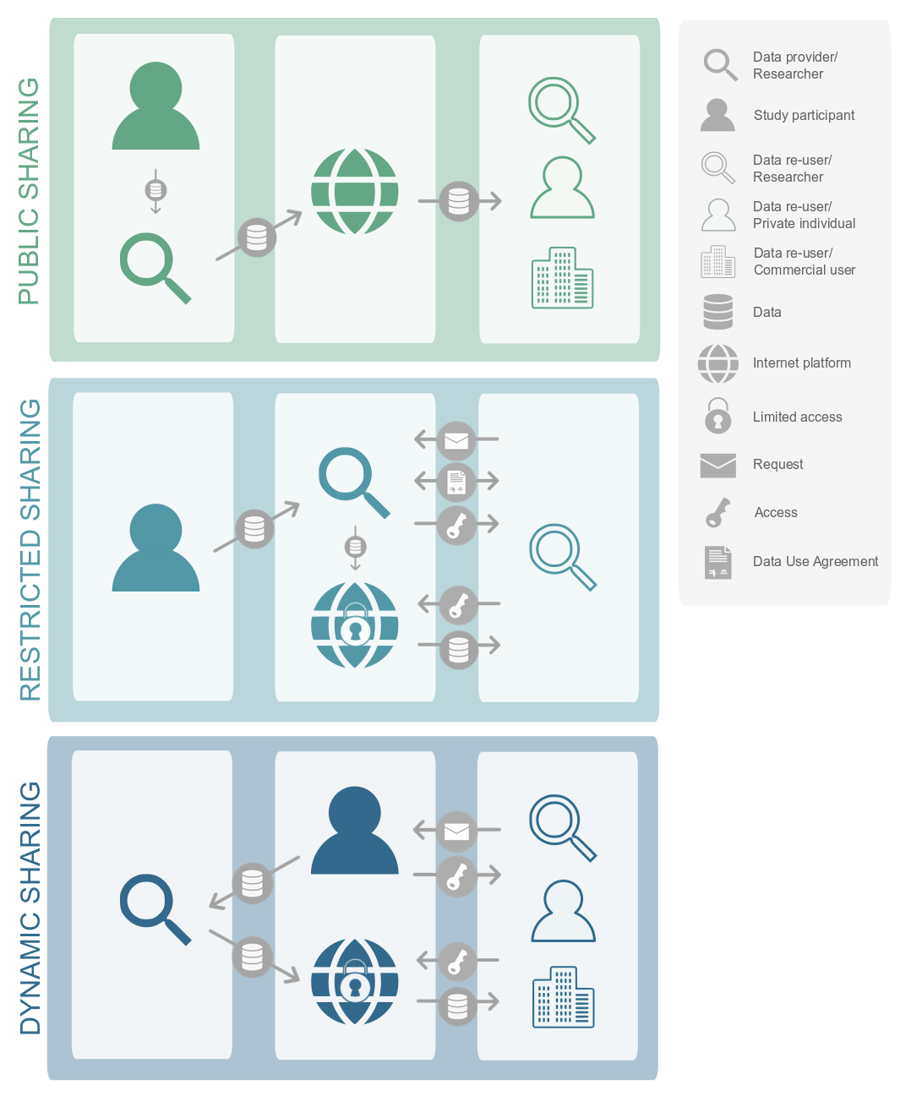
PUBLIC SHARING
Open data platforms
RESTRICTED SHARING
Peer-to-peer data sharing
DYNAMIC SHARING
Participant-centred platforms

