Slide 1
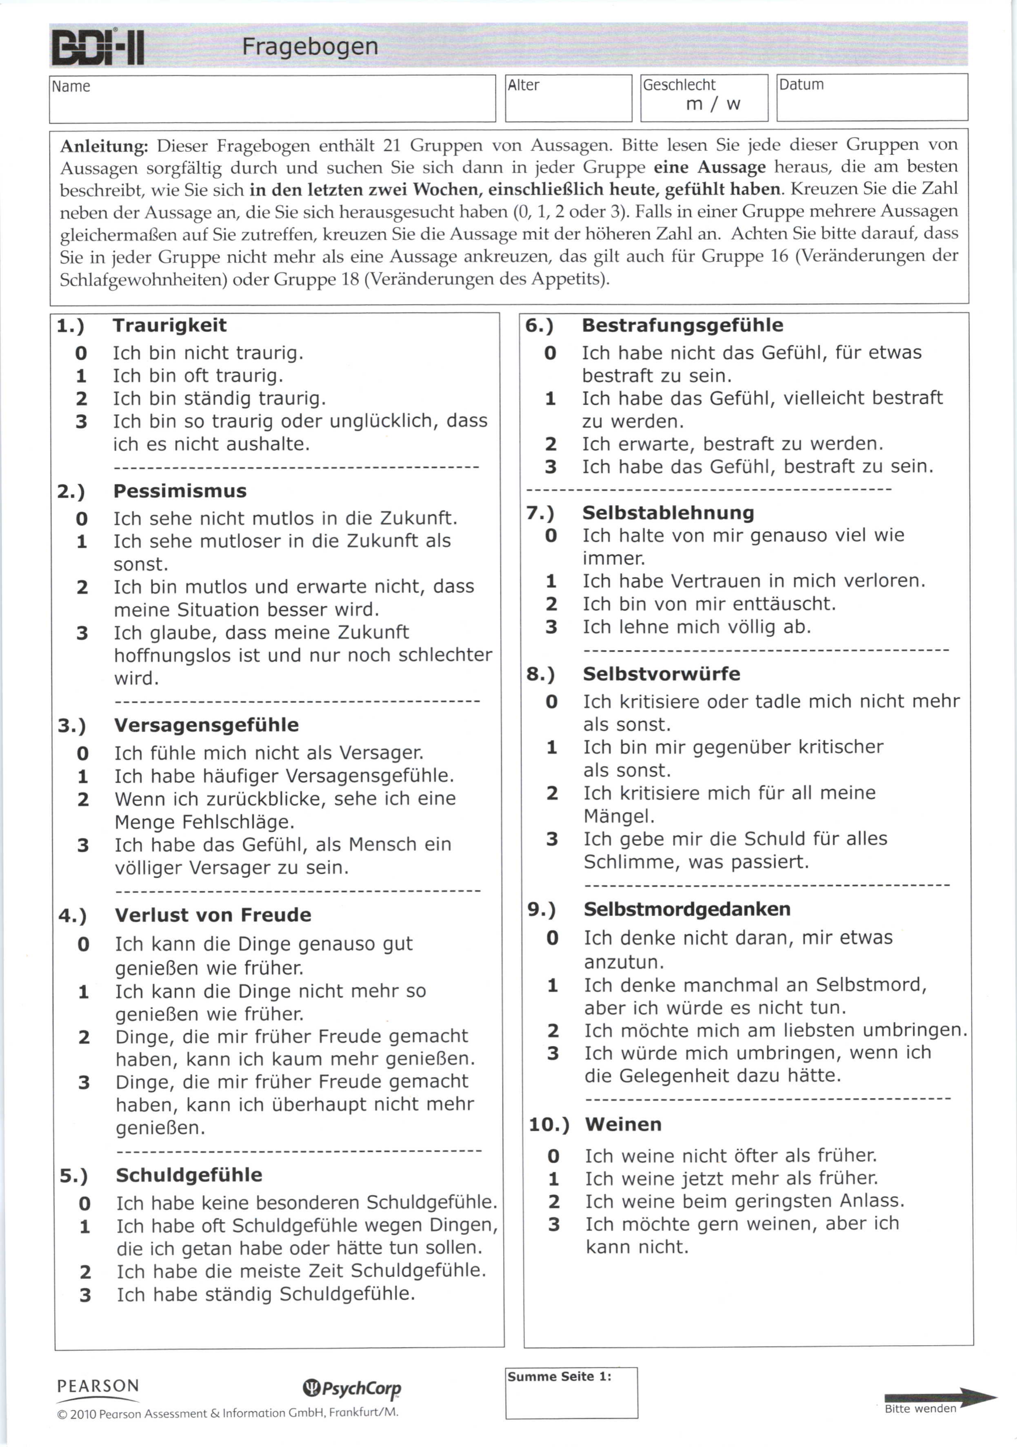


Pre-BDI
0 - 8 keine Depression
9 - 13 minimale Depression
14 - 19 leichte Depression
20 - 28 mittelschwere Depression
29 - 63 schwere Depression
n = 12
Post-BDI
$⇒$ Pre-Post BDI Score Reduktion

