Slide 1
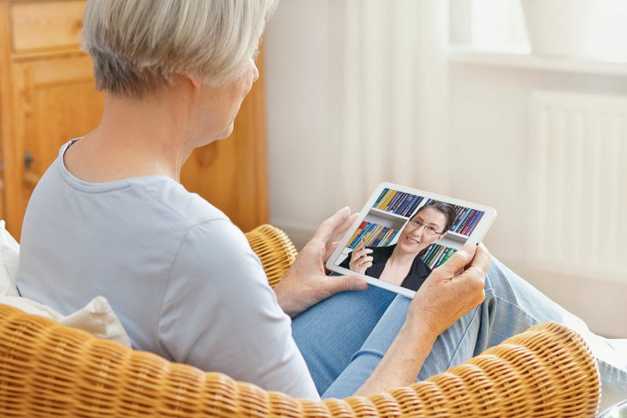

Online Psychotherapie
Face-To-Face Psychotherapie

