Slide 1
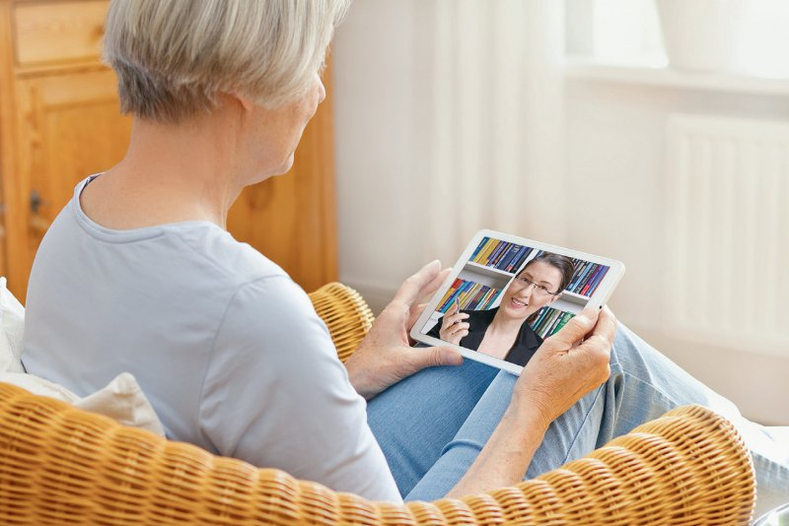

Online Psychotherapie
Face-to-face Psychotherapie

