Slide 1
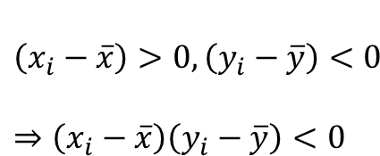
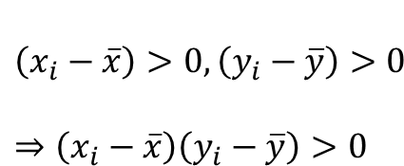
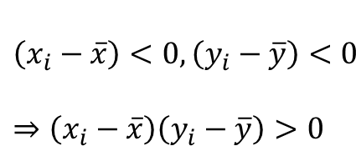
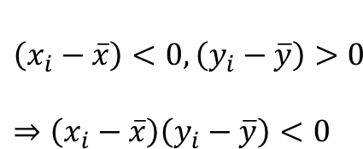

$$\left(x_{i}−\overline{x}\right)<0,\left(y_{i}−\overline{y}\right)>0$$
$$⇒\left(x_{i}−\overline{x}\right)\left(y_{i}−\overline{y}\right)<0$$
$$\left(x_{i}−\overline{x}\right)>0,\left(y_{i}−\overline{y}\right)>0$$
$$⇒\left(x_{i}−\overline{x}\right)\left(y_{i}−\overline{y}\right)>0$$
$$(\overline{x}, \overline{y})$$
$$\left(x_{i}−\overline{x}\right)<0,\left(y_{i}−\overline{y}\right)<0$$
$$⇒\left(x_{i}−\overline{x}\right)\left(y_{i}−\overline{y}\right)>0$$
$$\left(x_{i}−\overline{x}\right)>0,\left(y_{i}−\overline{y}\right)<0$$
$$⇒\left(x_{i}−\overline{x}\right)\left(y_{i}−\overline{y}\right)<0$$

