Slide 1
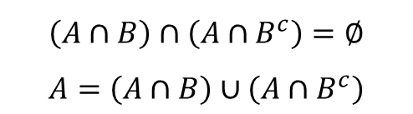







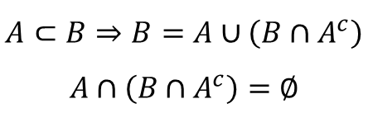





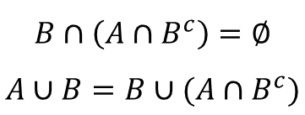





A B C
$$A⊂B⇒B=A∪\left(B∩A^{c}\right)$$
$$A∩\left(B∩A^{c}\right)=∅$$
$$\left(A∩B\right)∩\left(A∩B^{c}\right)=∅$$
$$A=\left(A∩B\right)∪\left(A∩B^{c}\right)$$
$$B∩\left(A∩B^{c}\right)=∅$$
$$A∪B=B∪(A∩B^{c})$$
$$A^{c}$$
$$B$$
$$A$$
$$A$$
$$∩$$
$$B$$
$$A$$
$$∩$$
$$B$$
$$A$$
$$A$$
$$B$$
$$B$$
$$B∩A^{c}$$
$$A∩B^{c}$$
$$A∩B^{c}$$
$$Ω$$
$$B^{c}$$
$$Ω$$
$$B^{c}$$
$$Ω$$

