Slide 1
bash + Functions & Modules
Genome 559: Introduction to Statistical and Computational Genomics
Brian Beliveau

Slide 2
One Minute Responses
Some of the git and GitHub text was tiny on my mac screen so I was unable to follow what you were saying.
Can we get some information on what the format of the final will be? Will it be entirely coding? Will it be open book? Timed? I'd love to get some clarity so I can begin to review.
- Online, open materials
- Mon, Dec 14, 8:30 am - 10:20 am
- 50% first half of course, 50% second half
- Questions from first half of course will cover both theory and coding
- Questions from second half will be on coding
- 20% of course grade

Slide 3
Command line basics and bash

Slide 4
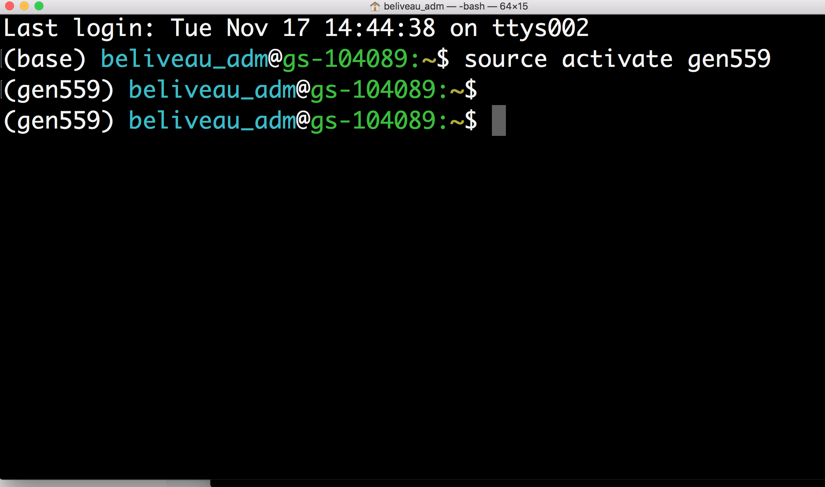
Using the command line

Slide 5

The Bash shell
Bash shell = Bourne Again Shell … a pun (not important)
Default shell (i.e. command line interface) for Unix, Linux, Mac OS X (prior to 10.15 Catalina)
Can be made default shell on OS X 10.15+ by running chsh -s /bin/bash in Terminal
Available on Windows via Linux subsystem (https://docs.microsoft.com/en-us/windows/wsl/about)
Your portal to scientific computing / bioinformatics

Slide 6
Command line basics: the filesystem
All Unix-based file systems (Unix, Linux, OS X) start at “/” aka “root”.
The cd “change directory” command moves your location in the filesystem to the specified path
Useful shortcuts:
$ cd ~ move to your home directory
$ cd / move to root of filesystem
$ cd .. move one directory backwards
The full file path from root to the current directory is called the absolute path
You can use the pwd “print working directory” command to get the absolute path to your current location

Slide 7
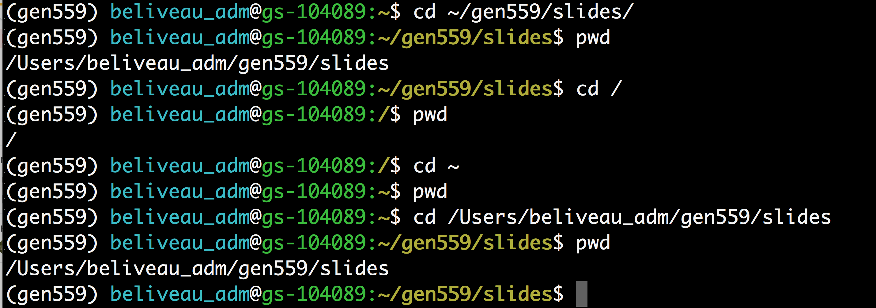
Command line basics: the filesystem

Slide 8
Command line basics: files and directories
You can see the contents of your current directory with the ls “list” command
You can make a new directory with the mkdir “make directory” command
You can make a new, empty file with the touch command (this also updates access/modification date of existing file)
You can “print” text to the terminal using the echo command
You can view the first or last N lines of a file (default=10) using the head or tail commands, respectively
You can print the entire contents of a file to the terminal using the cat “concatenate” command

Slide 9
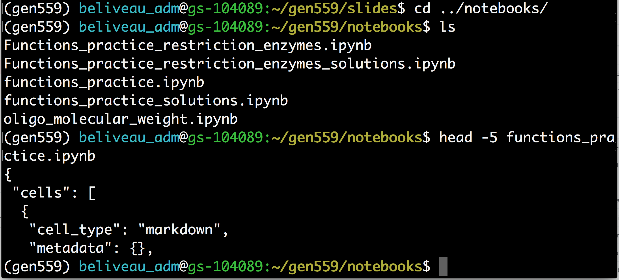
Command line basics: files and directories

Slide 10
Command line basics: stdin and stdout
By default, the bash shell takes user input from the command line and prints any output to the terminal
These input/output streams are named stdin “standard in” and stdout “standard out”, respectively
You can redirect the input/output streams using the < or > characters, respectively
Redirecting stdin is not common for beginners
Redirecting stdout is common and very useful
E.g. $ echo “hello world” > new.txt creates the file “new.txt” containing the string “hello world” (or overwrites the contents of an existing file called new.txt with hello world”)

Slide 11
Python scripts vs. Jupyter notebooks
Both .py scripts and .ipynb notebooks have strengths and weakness
.py scripts shine for saving “execution code” for re-use, use by others (e.g. Modules)
.ipynb notebooks shine for saving/sharing “analysis code”
There often is not a single “correct” choice
FWIW I learned to code in IDEs, will almost always default to writing code there. You may do same with notebooks
A general guide: .py scripts to generate data, .ipynb notebooks to analyze data

Slide 12
Functions and Modules

Slide 13
A quick review
Functions have their own namespace
Local variables inside the function are invisible outside
Arguments can be of any type!
Number and strings
Lists and dictionaries
Return values can be of any type!
Number and strings
Lists (as a way to return multiple values)
Pass-by-reference vs. pass-by-value
Default arguments
def CalcSumProd(a_list):
...
return [sum, prod]
def printMulti(text, n=3):
...

Slide 14
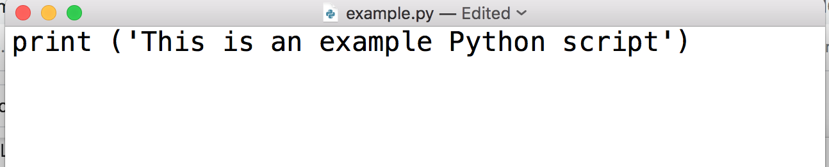
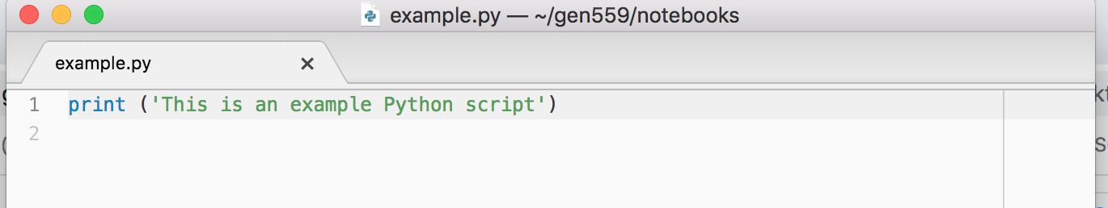
Command line basics: Python
$ python myscript.py will execute the code contained in the file myscript.py
.py scripts should be plain text and can be created using a text editor or IDE (integrated development environment)
TextEdit
Atom
(IDE)

Slide 15
Modules
Example a makeDict() fuction:
This is in fact a very useful function which you may want to use in many programs!
So are other functions you might write.
def makeDict(fileName):
myFile = open(fileName, "r")
myDict = {}
for line in myFile:
fields = line.strip().split("\t")
myDict[fields[0]] = float(fields[1])
myFile.close()
return myDict

Slide 16
Modules
A module is a file that contains a collection of related functions.
You have already used built-in modules:
e.g.: random
Python has numerous standard modules
Python Standard Library: (http://docs.python.org/library/)
It is easy to create and use your own modules:
JUST PUT YOUR FUNCTIONS IN A SEPARATE FILE!

Slide 17
Importing Modules
To use a module, you first have to import it into your namespace
To import the entire module: import module_name
my_prog.py
utils.py
import utils
import sys
Dict1 = utils.makeDict(sys.argv[1])
Dict2 = utils.makeDict(sys.argv[2])
Mtrx = utils.makeMatrix(“blsm.txt”)
…
# This function makes a dictionary
def makeDict(fileName):
myFile = open(fileName, "r")
myDict = {}
for line in myFile:
fields = line.strip().split("\t")
myDict[fields[0]] = float(fields[1])
myFile.close()
return myDict
# This function reads a 2D matrix
def makeMatrix(fileName):
< ... >

Slide 18
The dot notation
Why did we use utils.makeDict() instead of just makeDict()?
Dot notation allows the Python interpreter to organize and divide the namespace

