Slide 1
Argparse and IO
Genome 559: Introduction to Statistical and Computational Genomics
Brian Beliveau

Slide 2
One Minute Responses
The example in class for implementation of re.finditer that uses the self aspect of m, is very confusing. Does re.finditer() always need to be used in context of a class object that is defined with .self variables?
>>> my_str = "WTF is a regexp?! It's short for regular expression."
>>> [m.start() for m in re.finditer('re', my_str)]
[9, 33, 44]
>>> for match in re.finditer(‘re’, my_str):
print(match.start())
[9, 33, 44]
>>> for match in re.finditer(‘re’, my_str):
print(match.group())
[‘re’, ‘re’, ‘re’]

Slide 3
What we’ve learned so far
Basic data types (strings, lists, tuples, dictionaries, sets, ndarrays, dataframes)
Ways to operate on said data (loops, Booleans, conditionals, comparisons, recursions)
Ways to build repurposable/generalizable code for operating on data (arguments, functions, classes)
What are we still missing??

Slide 4
Outline
argparse
main() functions & shebang lines
Subprocess

Slide 5
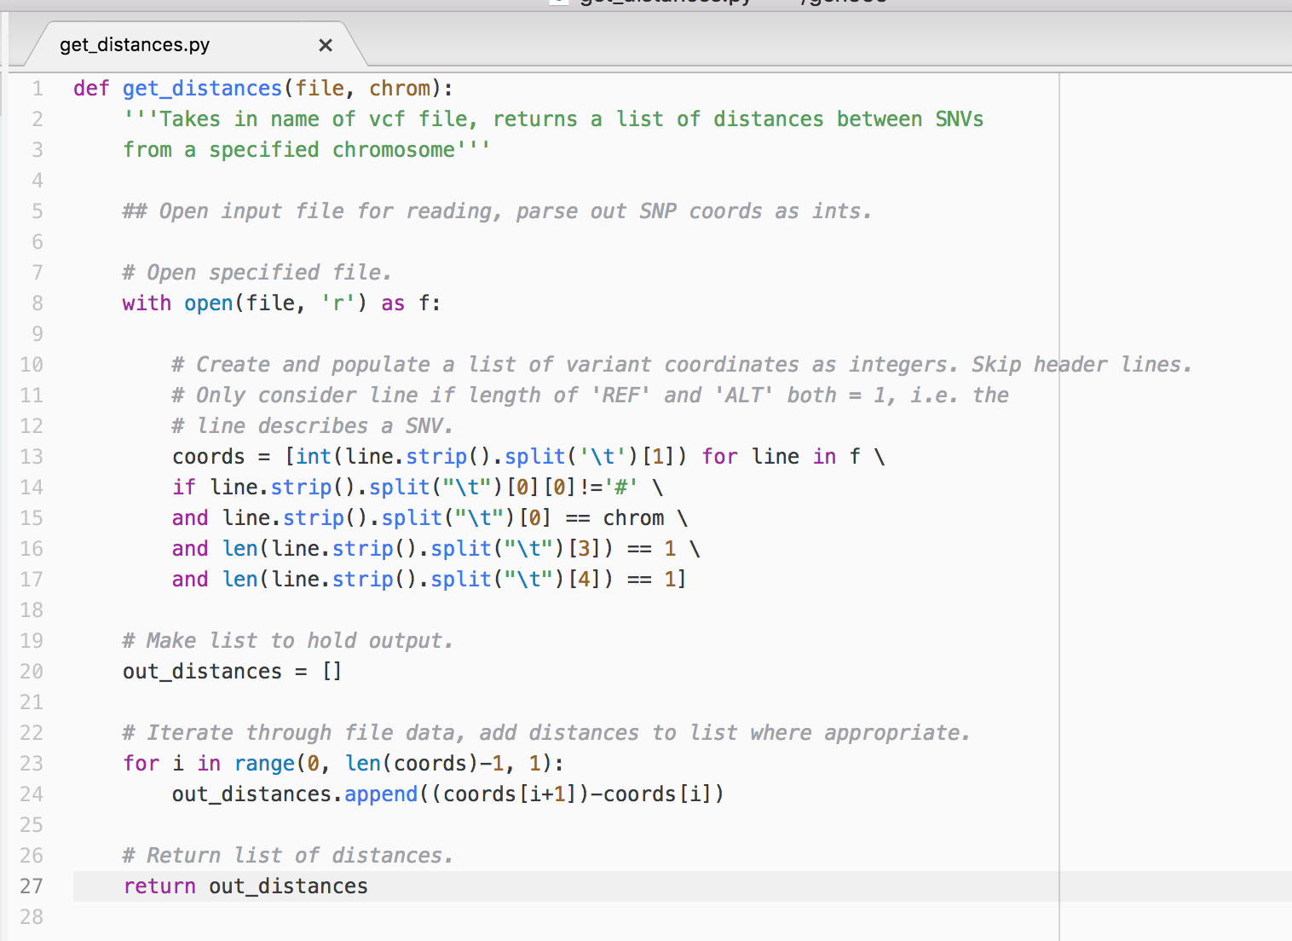
Recall the solution to last Wednesday’s practice problem – part 1
Function: 27 lines (with comments, etc.)
Generalized for all VCF files in same format

Slide 6
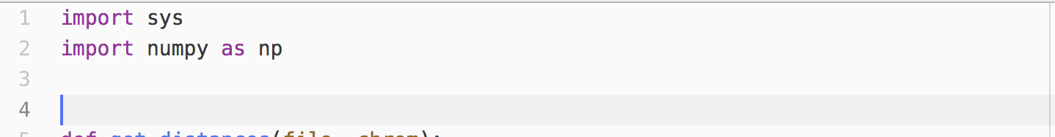
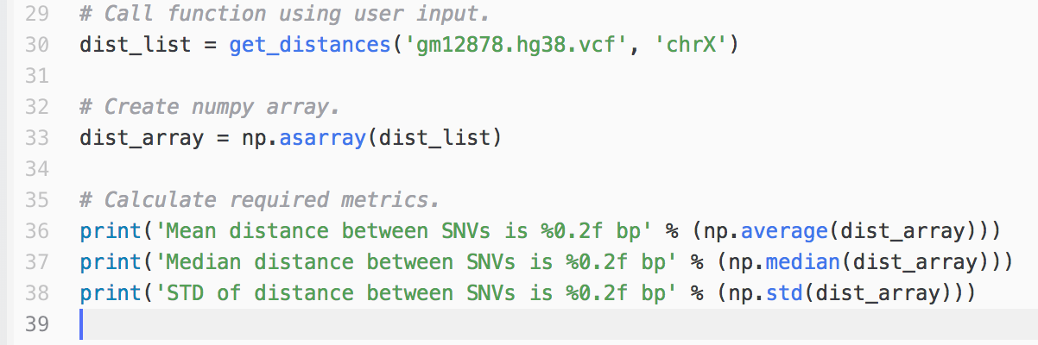
Recall the solution to last Wednesday’s practice problem – part 2
Everything else: 12 lines (with comments, etc.)
Only import statements generalized
To reproduce, must remember specific function inputs
Notebook-specific data structures ‘dist_list’ & ‘dist_array’
How do we generalize these tasks??

Slide 7
Generalization wish list
Specify intelligent arguments that are easy to keep track of and can be passed on the command line
Automatically import user data with correct types
Have default variable names for common tasks (eg input_file) and default values like in functions
Be able to define required and mutually exclusive arguments
Have built in help / documentation / error handling

Slide 8

Wishes do come true
>>> import argparse

Slide 9
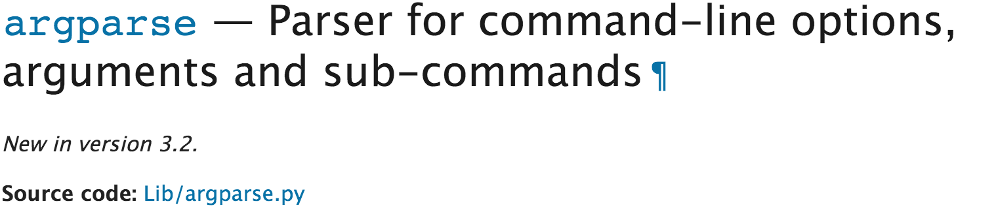
Argparse is my favorite module
The argparse module makes it easy to write user-friendly command-line interfaces. The program defines what arguments it requires, and argparse will figure out how to parse those out of sys.argv. The argparse module also automatically generates help and usage messages and issues errors when users give the program invalid arguments.
https://docs.python.org/3/library/argparse.html

Slide 10
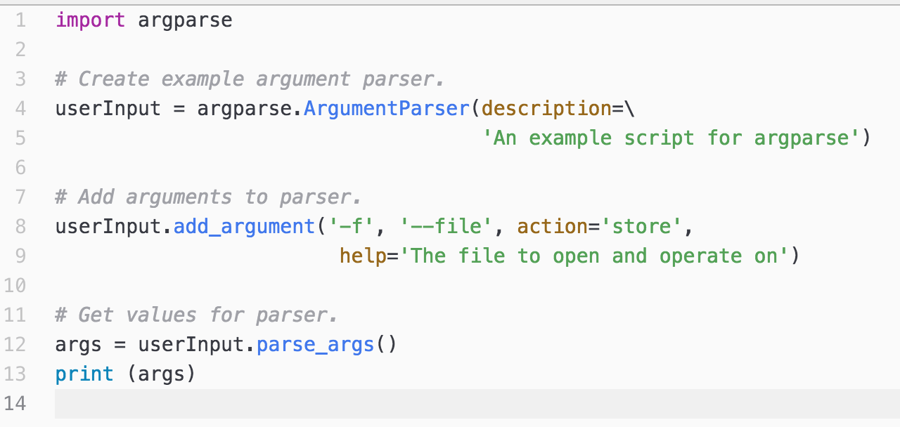
Let’s build a basic ArgumentParser
$ python my_args.py -f 3_probes.bed
Namespace(file='3_probes.bed')

Slide 11
Breaking down the ArgumentParser
Line 4 creates the ‘ArgumentParser’ object
The description (optional) creates an overall usage message for the script displayed when –h / --help is flagged
python my_args.py -h
usage: my_args.py [-h] [-f FILE]
An example script for argparse
optional arguments:
-h, --help show this help message and exit
-f FILE, --file FILE The file to open and operate on

Slide 12
Breaking down the ArgumentParser
Line 8 adds an argument to the ‘ArgumentParser’ object
‘-f’ is the flag for this argument
‘--file’ is the name for this argument
action tells argparse what to do with the value (store it)
help defines the text displayed when –h / --help is flagged

Slide 13
The add_argument() method
name or flags - Either a name or a list of option strings, e.g. foo or -f, --foo.
action - The basic type of action to be taken when this argument is encountered at the command line.
nargs - The number of command-line arguments that should be consumed.
const - A constant value required by some action and nargs selections.
default - The value produced if the argument is absent from the command line.
type - The type to which the command-line argument should be converted.
choices - A container of the allowable values for the argument.
required - Whether or not the command-line option may be omitted (optionals only).
help - A brief description of what the argument does.
metavar - A name for the argument in usage messages.
dest - The name of the attribute to be added to the object returned by parse_args().
https://docs.python.org/3/library/argparse.html#name-or-flags

Slide 14
Names, flags, and positional args
Optional, required, and mutually exclusive arguments can be given flags (eg ‘-f’) and names (eg ‘--flile')
>>>userInput.add_argument(‘-f’, ‘--file’)
Positional arguments are defined without dashes
>>>userInput.add_argument(‘seq1’)
>>>userInput.add_argument(‘seq2’)
In the above example, argprase will assume sys.argv[1] = seq1 and sys.argv[2] = seq2 in the absence of a flag/name being invoked

Slide 15
Action
store: Just stores the args value; default
store_true and store_false: Store the specified Boolean value. Creates a default value of the opposite state.
append: Stores a list and appends each arg to list
count: Counts the number of times a keyword argument occurs
Others…

Slide 16
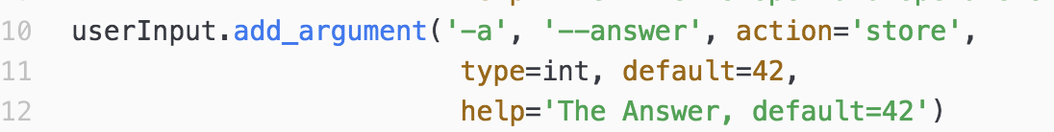
Types & default values
Remember, the most common errors in Python* are type errors
Use argparse to set the type of your incoming variable on the spot
You can also use argparse to set useful default values
*arguably

Slide 17
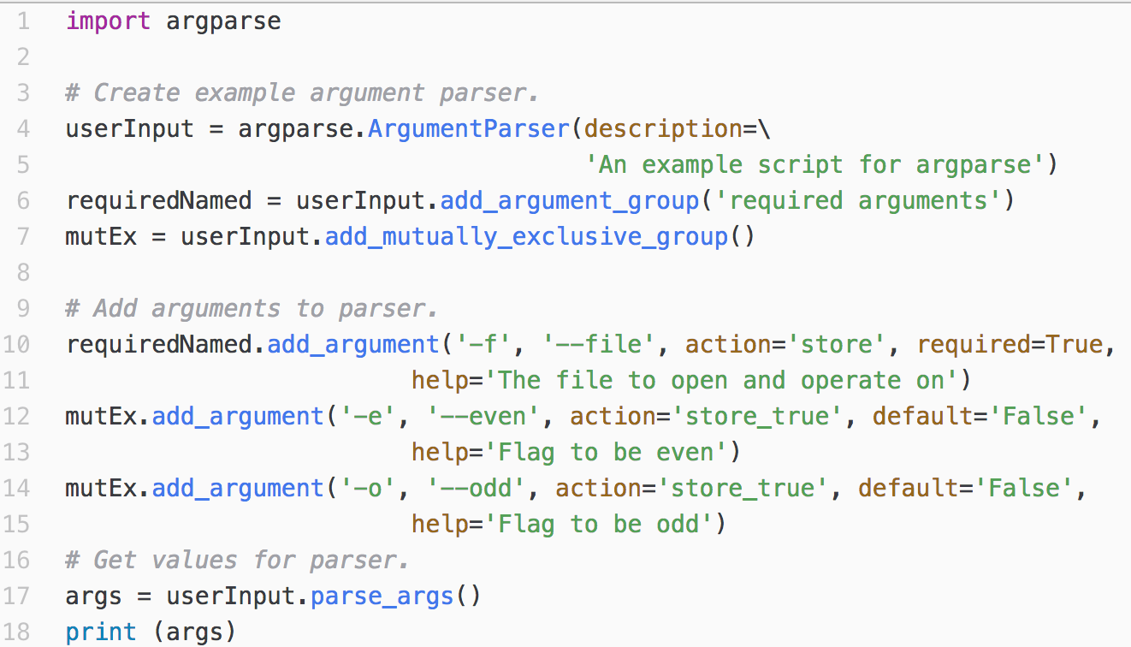
Argument groups
$ python my_args.py
usage: my_args.py [-h] -f FILE [-e | -o]
my_args.py: error: the following arguments are required: -f/--file
$ python my_args.py -f 3_probes.bed -e
Namespace(even=True, file='3_probes.bed', odd='False')
$ python my_args.py -f 3_probes.bed -o
Namespace(even='False', file='3_probes.bed', odd=True)
$ python my_args.py -f 3_probes.bed -e -o
usage: my_args.py [-h] -f FILE [-e | -o]
my_args.py: error: argument -o/--odd: not allowed with argument -e/--even

Slide 18
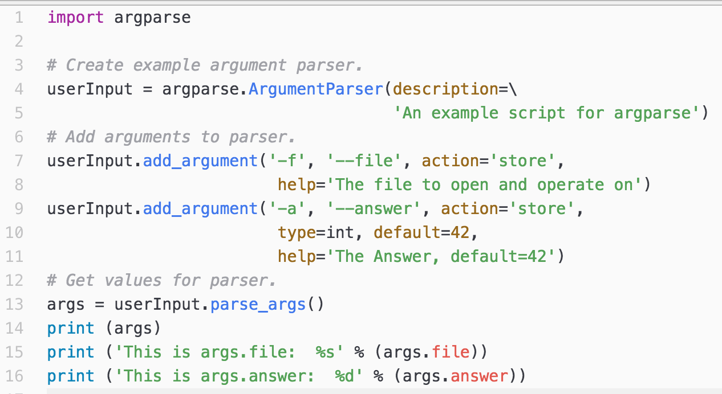
Use the parse_args() method to access the argparse input
$ python my_args.py -f 3_probes.bed
Namespace(answer=42, file='3_probes.bed')
This is args.file: 3_probes.bed
This is args.answer: 42

Slide 19
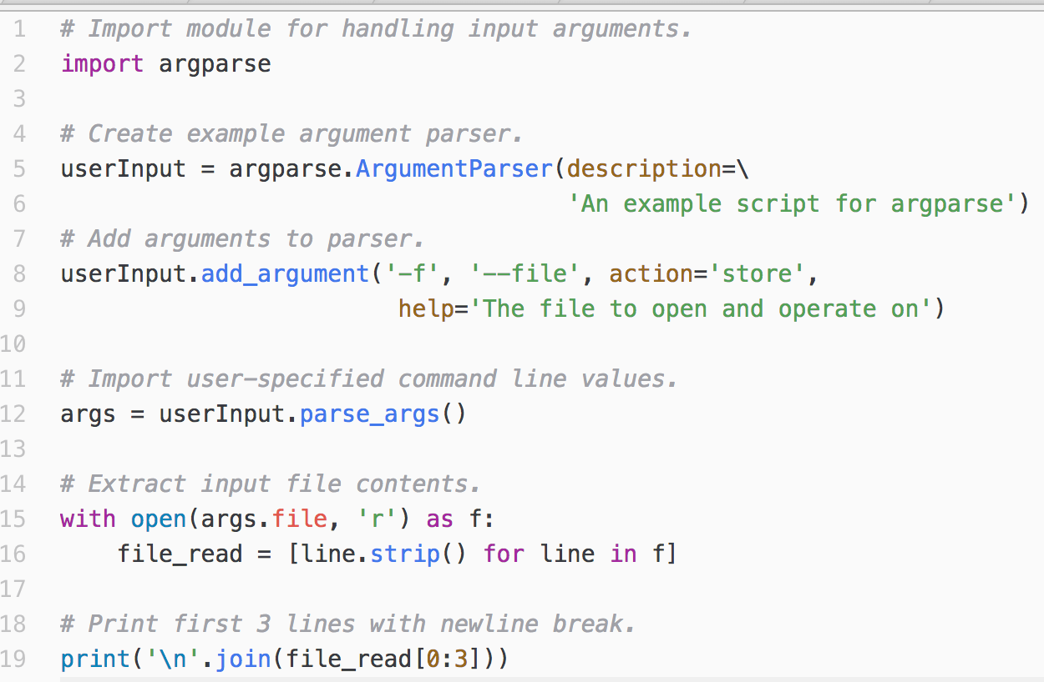
argparse + list comprehensions + context management: file import like a boss
$ python file_parse_ex.py -f 3_probes.bed
chr7 148845262 148845298 CCCCATCCTTATTCCCTTTAAGAACGTTCTGATGGGC 42.85
chr7 148845406 148845445 ATAAGTCAGAGCTTTACAGAGGTGTCACCTAACAAAACGC 42.27
chr7 148845449 148845489 AATGACTAAGAATCATTCCAAGTGTCACCATCAAGACCACC 42.24

Slide 20
Argparse summary
Argparse provides much of the same functionality as ‘def function (kwargs):’ but for user-inputted data
Use argparse to control defaults and variable types and to set required / mutually exclusive arguments coming in
Argparse gives you a framework to re-use the same logic and variable names from script to script
Every script I write starts with copying blocks of import statements, argparse arguments, and functions. I write very little from scratch.

Slide 21
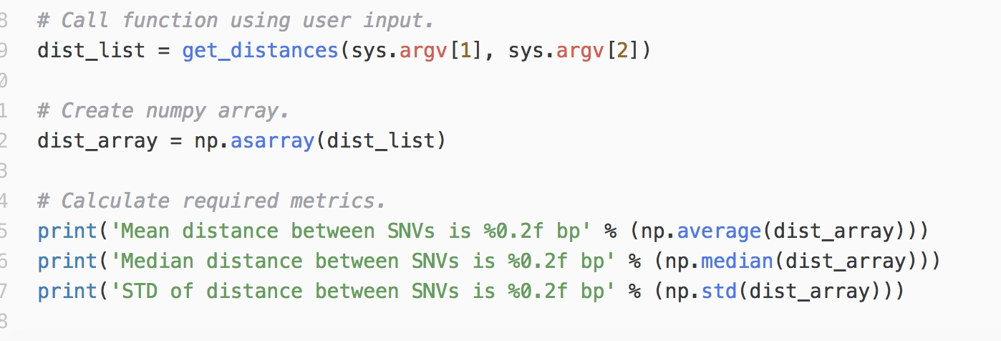
main() functions
Here is a command-line version of our snp-stats code.
sys.argv[1] and sys.argv[2] pass the file and chrom.
get_distances(file, chrom) also in script (not shown)

Slide 22
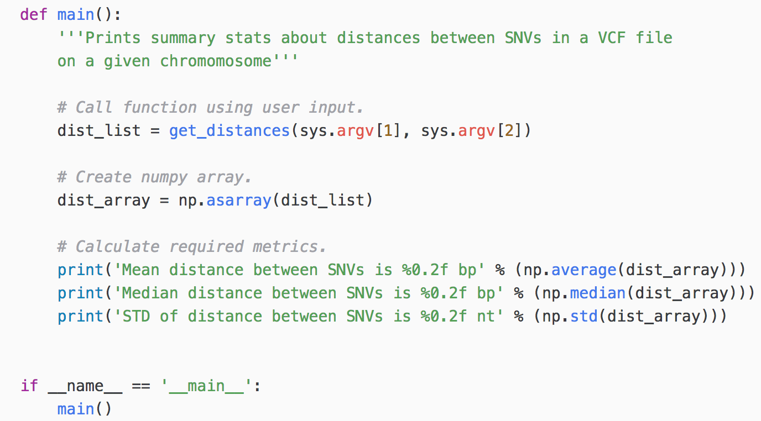
In the wild, this might look different
All of the code not in get_distances(file, chrom) is now wrapped in a function called “main()” … why??

Slide 23
What is going on??
If a script is run directly on the command line (eg ‘python snp-stats.py hg38.hybrid.vcf chr1’, __name__ = ‘__main__’
If a script is imported as a module (eg ‘import snp-stats’), __name__ = the name of the script, eg ‘snp-stats’)

Slide 24
main() functions: use-cases
Allows importing as a module to access functions within script without executing whole script
Same applies for interactive Python using the interpreter (>>>)
Does not alter how the script runs when called directly via the terminal
Imo of somewhat marginal utility for early-stage programming, but becomes more or less expected as you progress. Good to get in the habit early.

Slide 25
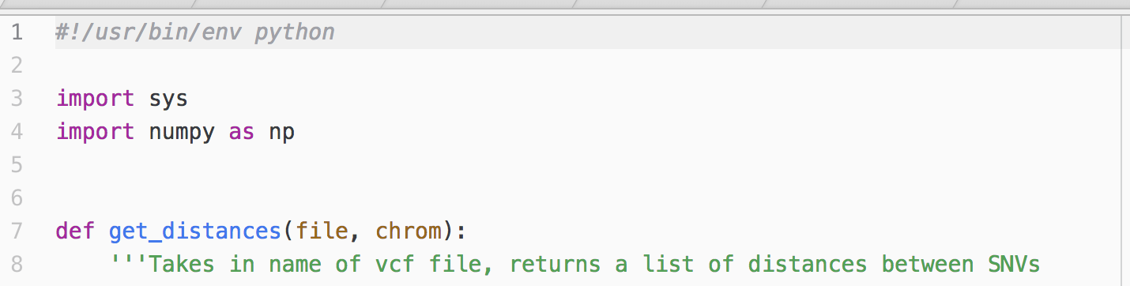
Shebang lines
Allows direct execution of script (using ./scriptname.py) without explicitly calling Python
Tells the terminal to use Python, where Python is
Imo of marginal utility, but easy to add and you’ll see frequently
$ python snp-stats.py gm12878.hg38.vcf chr1
Mean distance between SNVs is 909.57 bp
Median distance between SNVs is 373.00 bp
STD of distance between SNVs is 34528.73 nt
$ ./snp-stats.py gm12878.hg38.vcf chr1
Mean distance between SNVs is 909.57 bp
Median distance between SNVs is 373.00 bp
STD of distance between SNVs is 34528.73 nt

Slide 26
Subprocess
Lets you interface directly with terminal
Use this to make wrappers that call external utilities/programs
You can’t do everything in Python, but can (more or less) do everything with Python!
**Potential security risk**
>>> import subprocess
>>> subprocess.run(["head", "-2", "seqs.fa"])
>chr7:148845262-148845298
CCCCATCCTTATTCCCTTTAAGAACGTTCTGATGGGC
CompletedProcess(args=['head', ‘-2', 'seqs.fa'], returncode=0)
>>> exit()
$ head -2 seqs.fa
>chr7:148845262-148845298
CCCCATCCTTATTCCCTTTAAGAACGTTCTGATGGGC

