Slide 1
NumPy Arrays
Genome 559: Introduction to Statistical and Computational Genomics
Brian Beliveau

Slide 2
One Minute Responses
I really like the new breakout room format. One thing I am still unclear about is the difference between functions and methods, and how to write a function vs writing a method. Today(!)

Slide 3
Installing NumPy 1
$ conda install numpy
Collecting package metadata (repodata.json): done
Solving environment: done
## Package Plan ##
environment location: /anaconda2/envs/gen559
added / updated specs:
- numpy
The following packages will be downloaded:
package | build
---------------------------|-----------------
libblas-3.8.0 | 15_openblas 10 KB conda-forge
libcblas-3.8.0 | 15_openblas 10 KB conda-forge
libgfortran-4.0.0 | 2 716 KB conda-forge
liblapack-3.8.0 | 15_openblas 10 KB conda-forge
libopenblas-0.3.8 | h3d69b6c_0 8.4 MB conda-forge
llvm-openmp-9.0.1 | h28b9765_2 265 KB conda-forge
numpy-1.18.1 | py37hde6bac1_0 5.0 MB conda-forge
------------------------------------------------------------
Total: 14.4 MB

Slide 4
Installing NumPy 2
The following NEW packages will be INSTALLED:
libblas conda-forge/osx-64::libblas-3.8.0-15_openblas
libcblas conda-forge/osx-64::libcblas-3.8.0-15_openblas
libgfortran conda-forge/osx-64::libgfortran-4.0.0-2
liblapack conda-forge/osx-64::liblapack-3.8.0-15_openblas
libopenblas conda-forge/osx-64::libopenblas-0.3.8-h3d69b6c_0
llvm-openmp conda-forge/osx-64::llvm-openmp-9.0.1-h28b9765_2
numpy conda-forge/osx-64::numpy-1.18.1-py37hde6bac1_0
Proceed ([y]/n)? Y
Downloading and Extracting Packages
libgfortran-4.0.0 | 716 KB | ############################################################################### | 100%
libblas-3.8.0 | 10 KB | ############################################################################### | 100%
numpy-1.18.1 | 5.0 MB | ############################################################################### | 100%
liblapack-3.8.0 | 10 KB | ############################################################################### | 100%
llvm-openmp-9.0.1 | 265 KB | ############################################################################### | 100%
libcblas-3.8.0 | 10 KB | ############################################################################### | 100%
libopenblas-0.3.8 | 8.4 MB | ############################################################################### | 100%
Preparing transaction: done
Verifying transaction: done
Executing transaction: done

Slide 5
NumPy overview
Module for N-dimensional matrices, matrix math using Arrays
Slicing, indexing similar to strings and lists
Dependency of many other modules e.g. SciPy (advanced math, stats) and scikit-learn (machine learning)
>>> import numpy as np
>>> b = np.zeros((3,3))
>>> print b
[[0. 0. 0.]
[0. 0. 0.]
[0. 0. 0.]]
>>> b[0][1] = 0.25
>>> b[1][2] = 0.5
>>> print (b)
[[0. 0.25 0. ]
[0. 0. 0.5 ]
[0. 0. 0. ]]

Slide 6
NumPy and Object Oriented Programming
class numpy.ndarray(shape, dtype=float, buffer=None, offset=0, strides=None, order=None)
An array object represents a multidimensional, homogeneous array of fixed-size items.
An associated data-type object describes the format of each element in the array (its byte-order, how many bytes it occupies in memory, whether it is an integer, a floating point number, or something else, etc.)
https://docs.scipy.org/doc/numpy/reference/generated/numpy.ndarray.html#numpy.ndarray
NumPy introduces the ndarray class

Slide 7
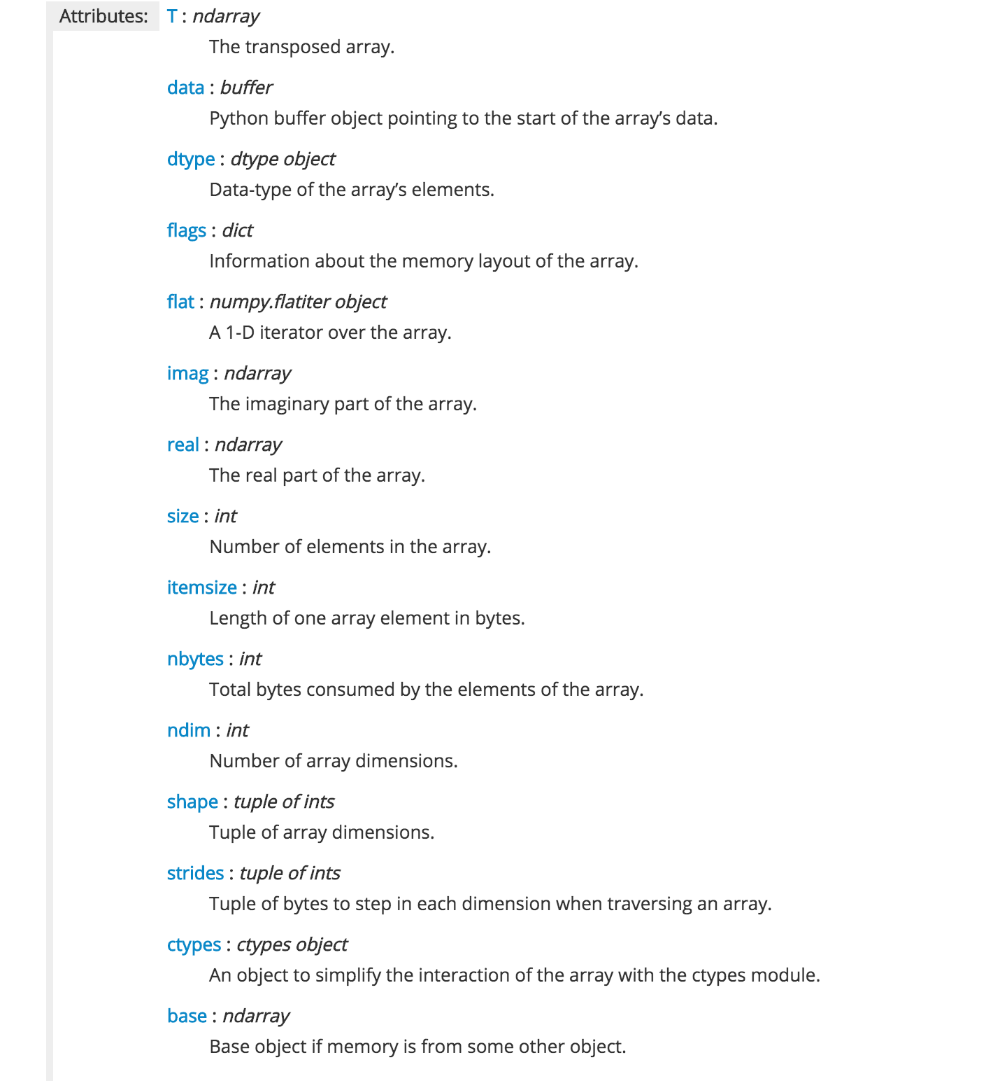
NumPy and Object Oriented Programming
ndarray attributes (eg month, year)

Slide 8
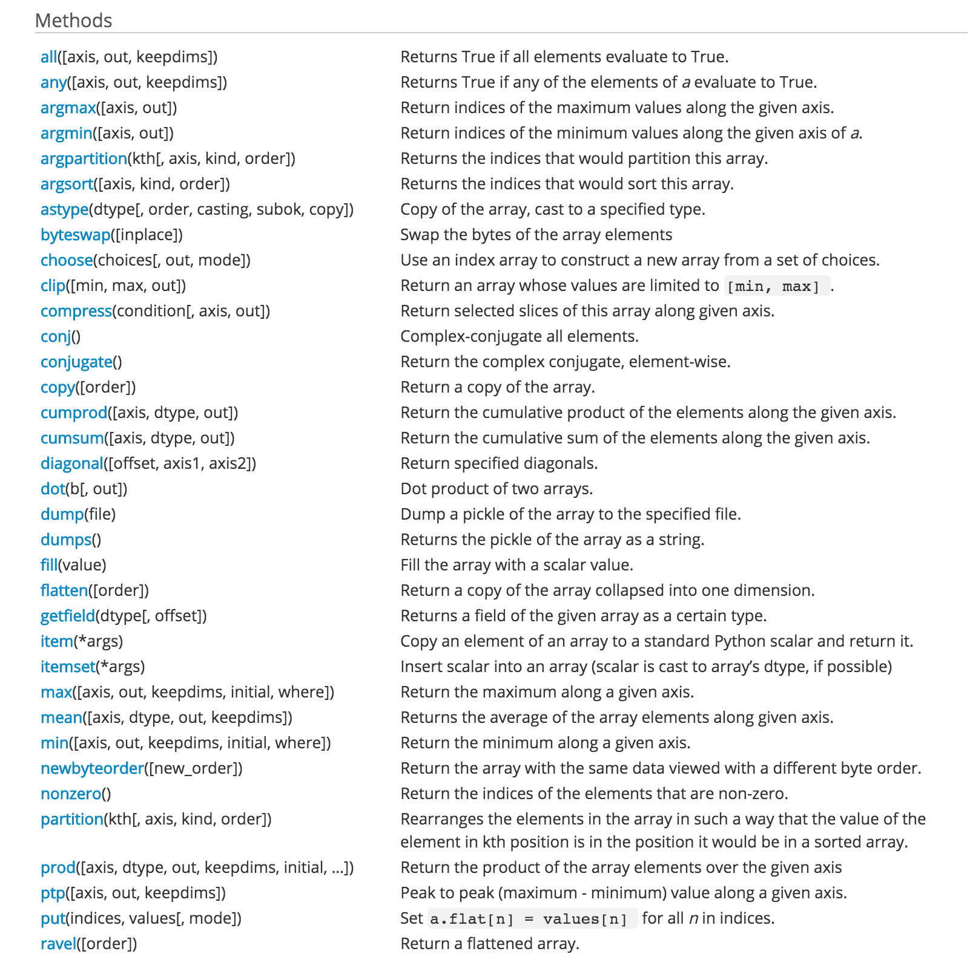
NumPy and Object Oriented Programming
ndarray methods (eg printUK(), addMonths() )

Slide 9
A word on Data types
NumPy supports a much greater variety of numerical types than Python does. This section shows which are available, and how to modify an array’s data-type.
https://numpy.org/devdocs/user/basics.types.html
np.bool_
np.byte
np.ubyte
np.short
np.ushort
np.intc
np.uintc
np.int_
np.uint
np.longlong
np.ulonglong
np.half / np.float16
np.single
np.double
np.longdouble
np.csingle
np.cdouble
np.clongdouble
np.int8
np.int16
np.int32
np.int64
np.uint8
np.uint16
np.uint32
np.uint64
np.intp
np.uintp
np.float32
np.float64 / np.float_
np.complex64
np.complex128 / np.complex_
Type errors are easy to run into! Keep track of what you are working with!

Slide 10
Creating ndarrays from lists
Moving from list -> ndarray and ndarray -> list is very easy
>>> a = [round(np.random.random(), 3) for x in range(6)]
>>> print(a)
[0.026, 0.121, 0.266, 0.131, 0.448, 0.127]
>>> b = np.asarray(a)
>>> print (b)
[0.026 0.121 0.266 0.131 0.448 0.127]
>>> b.dtype
dtype('float64')
>>> c = b.tolist()
>>> print (c)
[0.026, 0.121, 0.266, 0.131, 0.448, 0.127]

Slide 11
Creating ndarrays using built-ins
np.array: define array contents explicitly
np.zeros: create an array of all zeros
np.empty: creates a “garbage” array from current memory state (marginally faster than zeros method … very niche)
>>> a = np.array([[1,2,3], [1,5,6]])
>>> print (a)
[[1 2 3]
[1 5 6]]
>>> b = np.zeros((2,3))
>>> print (b)
[[0. 0. 0.]
[0. 0. 0.]]
>>> c = np.empty((2,3))
>>> print (c)
[[4.9e-324 9.9e-324 1.5e-323]
[4.9e-324 2.5e-323 3.0e-323]]

Slide 12
Why use NumPy ndarrays?
Efficient, scalable storage of numerical data
Many handy built-in methods for simple calculations
Allows for vectorized operations over dataset
>>> a = [1,2,3,4,5,6]
>>> b = np.asarray(a)
>>> print (a * 6)
[1, 2, 3, 4, 5, 6, 1, 2, 3, 4, 5, 6, 1, 2, 3, 4, 5, 6, 1, 2, 3, 4, 5, 6, 1, 2, 3, 4, 5, 6, 1, 2, 3, 4, 5, 6]
>>> print (b * 6)
[ 6 12 18 24 30 36]
>>> print (a**6)
Traceback (most recent call last):
File "<stdin>", line 1, in <module>
TypeError: unsupported operand type(s) for ** or pow(): 'list' and 'int'
>>> print (b**6)
[ 1 64 729 4096 15625 46656]

Slide 13
Example: summary statistics
>>> a = [np.random.random() for x in range(100)]
>>> b = np.asarray(a)
>>> print (np.sum(b))
51.70946543275186
>>> print (np.average(b))
0.5170946543275187
>>> print (np.median(b))
0.5322799770555982
>>> print (np.std(b))
0.29574768998009365
>>>

Slide 14
NumPy and shape
>>> # make a 1-d array
>>> a = np.zeros(24,)
>>> print (a)
[0. 0. 0. 0. 0. 0. 0. 0. 0. 0. 0. 0. 0. 0. 0. 0. 0. 0. 0. 0. 0. 0. 0. 0.]
>>> # convert to 2-d array with reshape
>>> b = a.reshape(3, 8)
>>> print (b)
[[0. 0. 0. 0. 0. 0. 0. 0.]
[0. 0. 0. 0. 0. 0. 0. 0.]
[0. 0. 0. 0. 0. 0. 0. 0.]]
>>> # convert to 3-d array with reshape
>>> c = b.reshape(2,3,4)
>>> print (c)
[[[0. 0. 0. 0.]
[0. 0. 0. 0.]
[0. 0. 0. 0.]]
[[0. 0. 0. 0.]
[0. 0. 0. 0.]
[0. 0. 0. 0.]]]
>>> # flatten to 1-d again with ravel
>>> d = np.ravel(c)
>>> print (d)
[0. 0. 0. 0. 0. 0. 0. 0. 0. 0. 0. 0. 0. 0. 0. 0. 0. 0. 0. 0. 0. 0. 0. 0.]

Slide 15
Closing thoughts: type and shape
>>> # make a 1-d array
>>> a = np.zeros((2,3))
>>> b = np.zeros((3,2))
>>> c = a * b
Traceback (most recent call last):
File "<stdin>", line 1, in <module>
ValueError: operands could not be broadcast together with shapes (2,3) (3,2)
Shape matters a lot in linear algebra/matrix math
NumPy built-ins can help you keep track of of things as you go

Slide 16
Closing thoughts: type and shape
>>> a = [np.random.random() for x in range (10)]
>>> a.append("test")
>>> b = np.asarray(a)
>>> print (b*2)
Traceback (most recent call last):
File "<stdin>", line 1, in <module>
numpy.core._exceptions.UFuncTypeError: ufunc 'multiply' did not contain a loop with signature matching types (dtype('<U32'), dtype('<U32')) -> dtype('<U32’)
>>> a = [np.random.random() for x in range (10)]
>>> a.append(float('NaN'))
>>> b = np.asarray(a)
>>> print (b*2)
[0.1496992 0.31518099 1.6406983 1.98913062 0.89381854 1.42633881
0.6704446 0.17432865 0.66039822 1.82731407 nan]
Mixed types can spell disaster in ndarrays!
‘NaN’ / ‘not a number’ can help, but not a perfect bandaid

Slide 17
Interactive problem
Write a program snp-stats.py to calculate mean, median, standard deviation for distances between SNVs in gm12878.hg38.vcf on a given chromosome
The file also contains indels of >1 nt, we want to avoid these too
And as always, we want to avoid the header lines
Lines 44–46 + example of indel in gm12878.hg38.vcf
$ sed -n '44,46p' gm12878.hg38.vcf
#CHROM POS ID REF ALT QUAL FILTER INFO FORMAT NA12878
chr1 727477 . G A 0 PASS SOURCE=PG GT 1|1
chr1 727717 . G C 0 PASS SOURCE=PG GT 1|1
chr1 1010481 . ATTAT A 0 PASS SOURCE=PG GT 1|1
$ python snp-stats.py hg38.hybrid.vcf chr1
Mean distance between SNVs is 909.57 bp
Median distance between SNVs is 373.00 bp
STD of distance between SNVs is 34528.73 bp
←Expected outcome

Slide 18
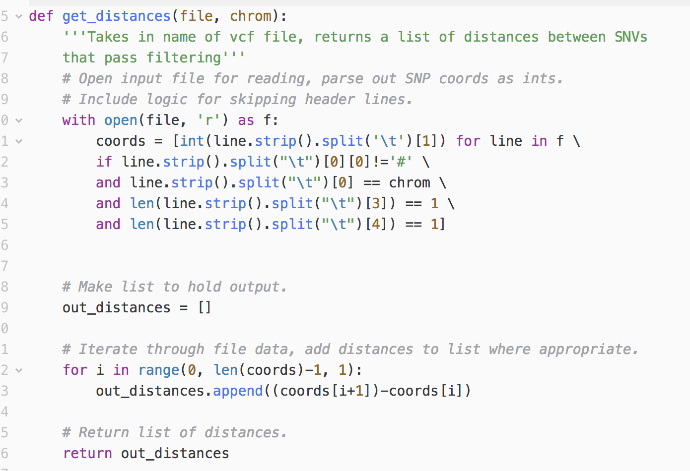
Interactive problem – solution

Slide 19
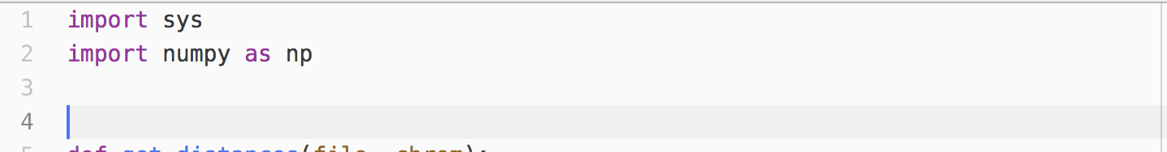
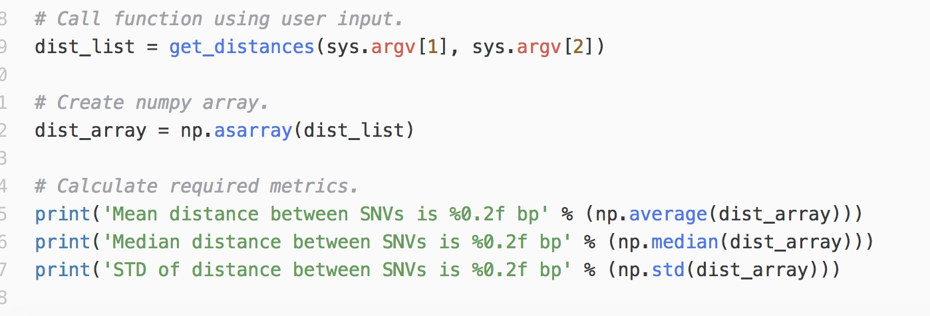
Interactive problem – solution

Slide 20
Interactive problem – solution
import sys
import numpy as np
def get_distances(file, chrom):
'''Takes in name of vcf file, returns a list of distances between SNVs
that pass filtering'''
# Open input file for reading, parse out SNP coords as ints.
# Include logic for skipping header lines.
with open(file, 'r') as f:
coords = [int(line.strip().split('\t')[1]) for line in f \
if line.strip().split("\t")[0][0]!='#' \
and line.strip().split("\t")[0] == chrom \
and len(line.strip().split("\t")[3]) == 1 \
and len(line.strip().split("\t")[4]) == 1]
# Make list to hold output.
out_distances = []
# Iterate through file data, add distances to list where appropriate.
for i in range(0, len(coords)-1, 1):
out_distances.append((coords[i+1])-coords[i])
# Return list of distances.
return out_distances
# Call function using user input.
dist_list = get_distances(sys.argv[1], sys.argv[2])
# Create numpy array.
dist_array = np.asarray(dist_list)
# Calculate required metrics.
print('Mean distance between SNVs is %0.2f bp' % (np.average(dist_array)))
print('Median distance between SNVs is %0.2f bp' % (np.median(dist_array)))
print('STD of distance between SNVs is %0.2f bp' % (np.std(dist_array)))

Slide 21
Practice problem #1
Use NumPy to write and print 3 x 4 matrix of zeros
Roll and round a random number generator 12 times to make a list of 12 0/1 values, print list
Print an update your original matrix using the following coordinate transformations:
list[0] = matrix[0][0]
list[4] = matrix[1][0]
etc
$ python zero_update.py
[[0. 0. 0. 0.]
[0. 0. 0. 0.]
[0. 0. 0. 0.]]
[1, 1, 0, 1, 1, 1, 1, 1, 1, 1, 1, 1]
[[1. 1. 0. 1.]
[1. 1. 1. 1.]
[1. 1. 1. 1.]]
←Expected outcome

Slide 22
Practice problem # 1 – solution
import numpy as np
a = np.zeros((3,4))
b = [round(np.random.random()) for x in range (12)]
print (a)
print (b)
for i in range(0, 3, 1):
for j in range(0,4,1):
ind = 4*i + j
a[i][j] = b[ind]
print (a)

