Slide 1

pandas
Genome 559: Introduction to Statistical and Computational Genomics
Brian Beliveau

Slide 2
One Minute Responses
Thank you for going over how to work with the terminal again for lecture today, that was definitely needed and help me to unravel some of the earlier material.
Everything is clear to me, and no unanswered questions

Slide 3
Installing pandas 1 (~5 mins)
$ conda install pandas
Collecting package metadata (repodata.json): done
Solving environment: done
## Package Plan ##
environment location: /anaconda2/envs/gen559
added / updated specs:
- pandas
The following packages will be downloaded:
package | build
---------------------------|-----------------
ca-certificates-2020.12.5 | h033912b_0 138 KB conda-forge
certifi-2020.12.5 | py37hf985489_0 143 KB conda-forge
------------------------------------------------------------
Total: 281 KB
The following packages will be UPDATED:
ca-certificates 2020.6.20-hecda079_0 --> 2020.12.5-h033912b_0
certifi 2020.6.20-py37h2987424_2 --> 2020.12.5-py37hf985489_0
pandas 1.0.4-py37h94625e5_0 --> 1.0.5-py37h94625e5_0
Proceed ([y]/n)?

Slide 4
Installing pandas 2 (~5 secs)
Proceed ([y]/n)? y
Downloading and Extracting Packages
ca-certificates-2020 | 138 KB | ################################################################################################################## | 100%
certifi-2020.12.5 | 143 KB | ################################################################################################################## | 100%
Preparing transaction: done
Verifying transaction: done
Executing transaction: done

Slide 5
Reminder: NumPy and Object Oriented Programming
class numpy.ndarray(shape, dtype=float, buffer=None, offset=0, strides=None, order=None)
An array object represents a multidimensional, homogeneous array of fixed-size items.
An associated data-type object describes the format of each element in the array (its byte-order, how many bytes it occupies in memory, whether it is an integer, a floating point number, or something else, etc.)
https://docs.scipy.org/doc/numpy/reference/generated/numpy.ndarray.html#numpy.ndarray
NumPy introduces the ndarray class

Slide 6
Reminder: NumPy type and shape
>>> a = [np.random.random() for x in range (10)]
>>> a.append("test")
>>> b = np.asarray(a)
>>> print (b*2)
Traceback (most recent call last):
File "<stdin>", line 1, in <module>
numpy.core._exceptions.UFuncTypeError: ufunc 'multiply' did not contain a loop with signature matching types (dtype('<U32'), dtype('<U32')) -> dtype('<U32’)
>>> a = [np.random.random() for x in range (10)]
>>> a.append(float('NaN'))
>>> b = np.asarray(a)
>>> print (b*2)
[0.1496992 0.31518099 1.6406983 1.98913062 0.89381854 1.42633881
0.6704446 0.17432865 0.66039822 1.82731407 nan]
Mixed types can spell disaster in ndarrays!
‘NaN’ / ‘not a number’ can help, but not a perfect bandaid

Slide 7
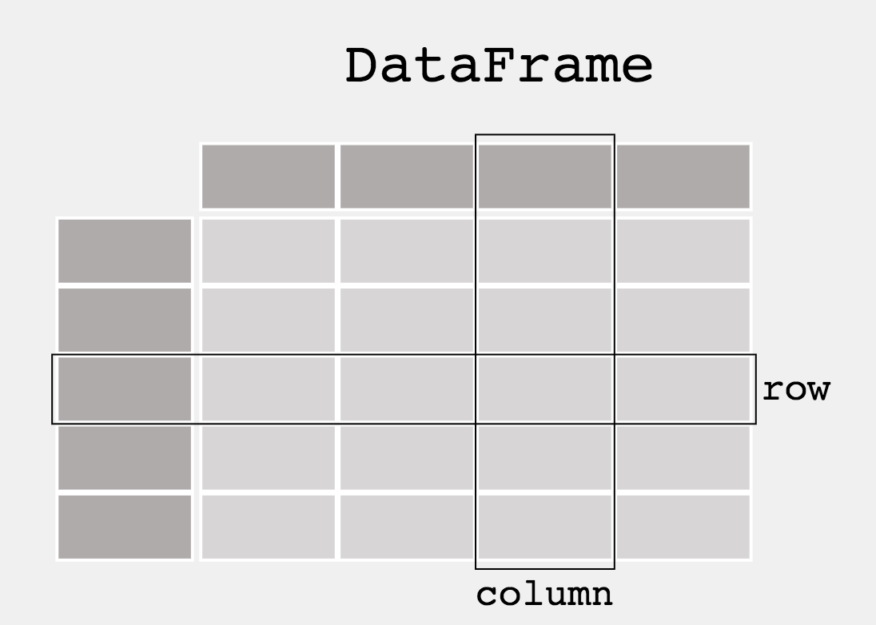
pandas: the go-to tool for data science (in Python)
https://pandas.pydata.org/pandas-docs/stable/getting_started/index.html
When working with tabular data, such as data stored in spreadsheets or databases, pandas is the right tool for you. pandas will help you to explore, clean and process your data. In pandas, a data table is called a DataFrame.

Slide 8
NumPy vs pandas
NumPy
much faster, much more memory efficient for mathematical operations
supports N-dimensional data
can only handle homogenous data
can only reference by index
pandas
comparatively slower, not built for certain approaches like for/while loop iteration (built-in methods provide alternatives)
supports 1- (Series) and 2- (DataFrame) dimensional data
can handle heterogenous (i.e. mixed type) data
can reference by index or row/column label

Slide 9
pandas Series
Conceptually similar to lists, ndarrays
You probably won’t use very often
Conversion methods to/from lists and ndarrays exist
>>> import numpy as np
>>> import pandas as pd
>>> a = [x**3 for x in range(5)]
>>> print(a)
[0, 1, 8, 27, 64]
>>> b = pd.Series(a)
>>> print(b)
0 0
1 1
2 8
3 27
4 64
dtype: int64
>>> c = b.to_numpy()
>>> print(c)
[ 0 1 8 27 64]

Slide 10
pandas DataFrames 101
2D object for tabular data
Can initiate from existing data structures (lists, dictionaries, ndarrays, pd.Series, other DataFames)
>>> import pandas as pd
>>> a = [x for x in range(5)]
>>> b = [x**2 for x in range(5)]
>>> c = [x**3 for x in range(5)]
>>> df = pd.DataFrame(list(zip(a,b,c)))
>>> print(df)
0 1 2
0 0 0 0
1 1 1 1
2 2 4 8
3 3 9 27
4 4 16 64

Slide 11
df labels
DataFrames have column labels specified by columns=[]
DataFrames have row labels that specified by index=[]
>>> print(df)
0 1 2
0 0 0 0
1 1 1 1
2 2 4 8
3 3 9 27
4 4 16 64
>>> df.columns = ['integers', 'squares', 'cubes']
>>> df.index = ['zero', 'one', 'two', 'three', 'four']
>>> print(df)
integers squares cubes
zero 0 0 0
one 1 1 1
two 2 4 8
three 3 9 27
four 4 16 64

Slide 12
Adding columns to a df
Add a column to a DataFrame with df.insert()
>>> df.insert(3, '^4', [0, 1, 16, 81, 256])
>>> print(df)
integers squares cubes ^4
zero 0 0 0 0
one 1 1 1 1
two 2 4 8 16
three 3 9 27 81
four 4 16 64 256

Slide 13
Adding rows to a df
Add a row(s) to a DataFrame with df.loc[]
Adds values at a specified index (creates if not there)
There are other methods (append, concat) as well that are less efficient in most cases. Best to avoid adding rows if you can
>>> df.loc['five'] = [5, 25, 125, 625]
>>> print(df)
integers squares cubes ^4
zero 0 0 0 0
one 1 1 1 1
two 2 4 8 16
three 3 9 27 81
four 4 16 64 256
five 5 25 125 625

Slide 14
df.filter()
Subset the data with df.filter()
Can specify columns to keep by name with “items”
>>> df2 = df.filter(items=["integers"])
>>> print(df2)
integers
zero 0
one 1
two 2
three 3
four 4
five 5

Slide 15
df.filter()
Subset the data with df.filter()
Can use “like” to specify columns (axis=0) or rows (axis=1) to keep that contain a given string
>>> df3 = df.filter(like='one', axis=0)
>>> print(df3)
integers squares cubes ^4
one 1 1 1 1
>>> df4 = df.filter(like='cubes', axis=1)
>>> print(df4)
cubes
zero 0
one 1
two 8
three 27
four 64
five 125

Slide 16
df.query()
Subset the data with df.query() using conditional operations
>>> df5 = df.query("squares>4")
>>> print(df5)
integers squares cubes ^4
three 3 9 27 81
four 4 16 64 256
five 5 25 125 625
>>> df6 = df.query("cubes==125")
>>> print(df6)
integers squares cubes ^4
five 5 25 125 625
>>> df7 = df.query("squares>4" and "cubes>27")
>>> print(df7)
integers squares cubes ^4
four 4 16 64 256
five 5 25 125 625

Slide 17
Creating DataFrames from files
Load data into a df from a file using read_csv()
Use “sep” to specifiy deliminter, e.g. ‘\t’ for tab
Can specify column names with names[]
Specify ‘header=0’ if you have a header row
(gen559) beliveau_adm@gs-104089:~$ head -2 test.txt
0 0
1 1
(gen559) beliveau_adm@gs-104089:~$ python
>>> import pandas as pd
>>> df = pd.read_csv("test.txt", sep='\t', names=["digit", "square"])
>>> print(df)
digit square
0 0 0
1 1 1
2 2 4
3 3 9
4 4 16

